Slide 1
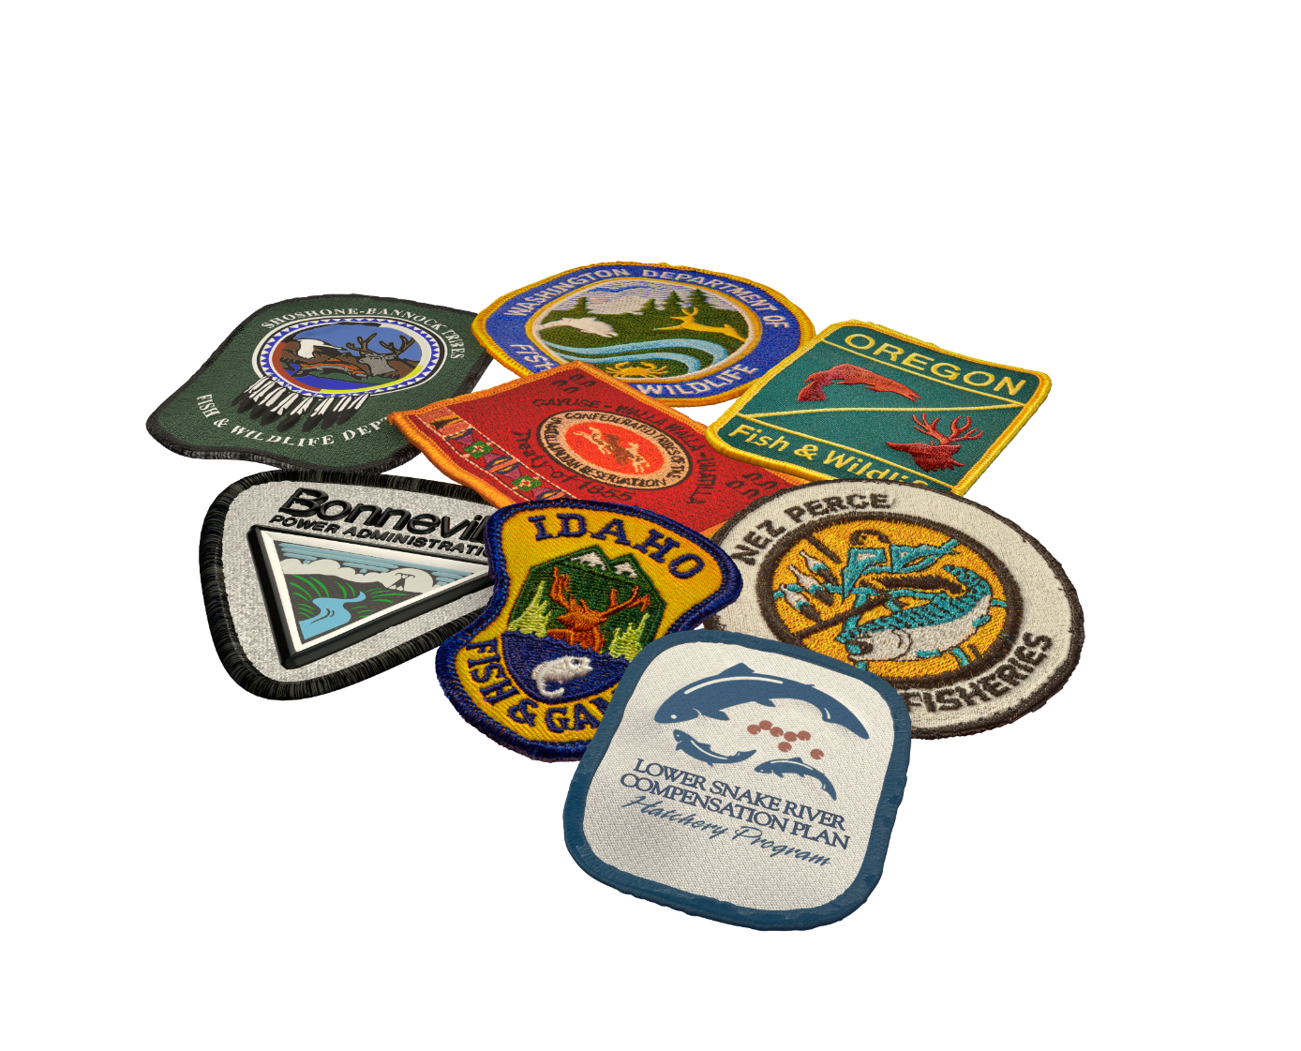
Fish for the Future
Station of the Year

Slide 2
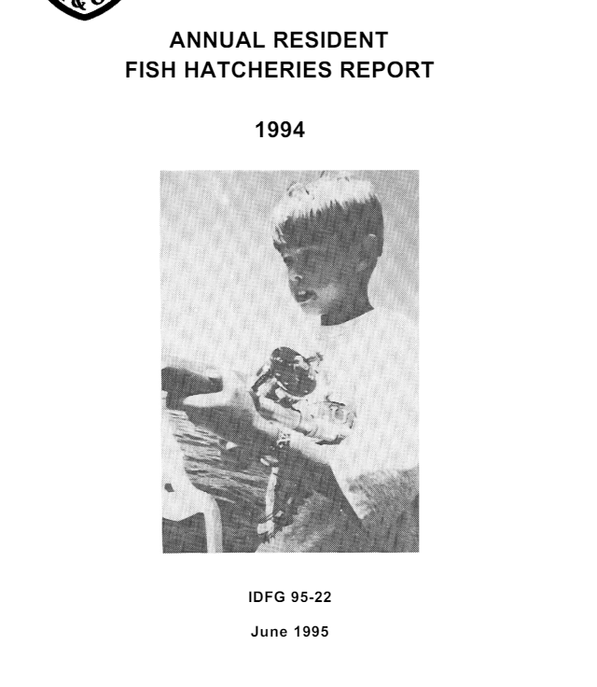
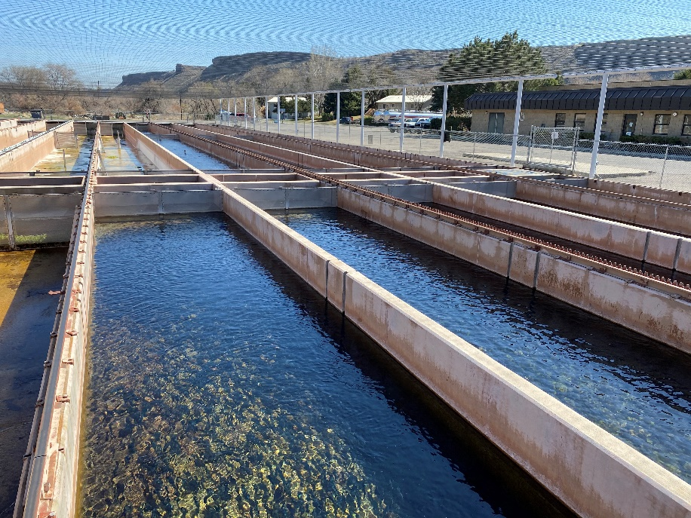
Steve Kammeyer
30 years for LSRCP!

Slide 3
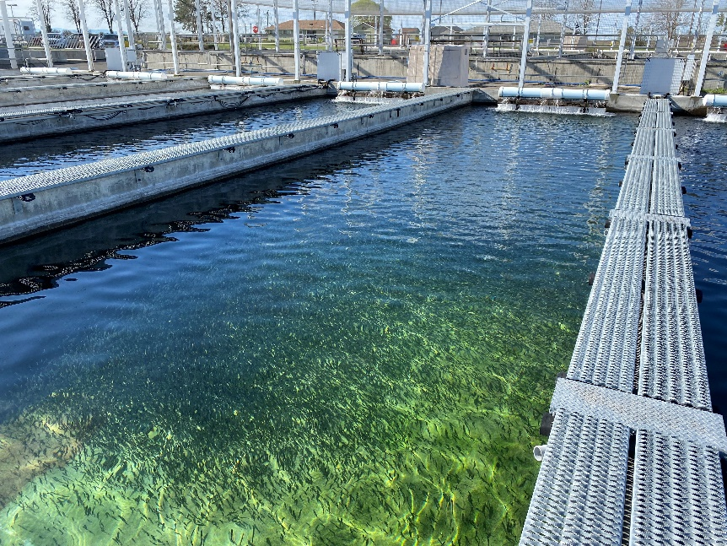
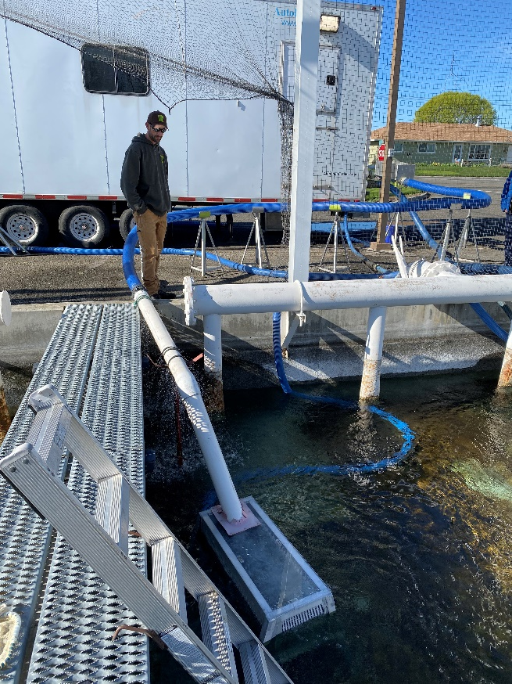
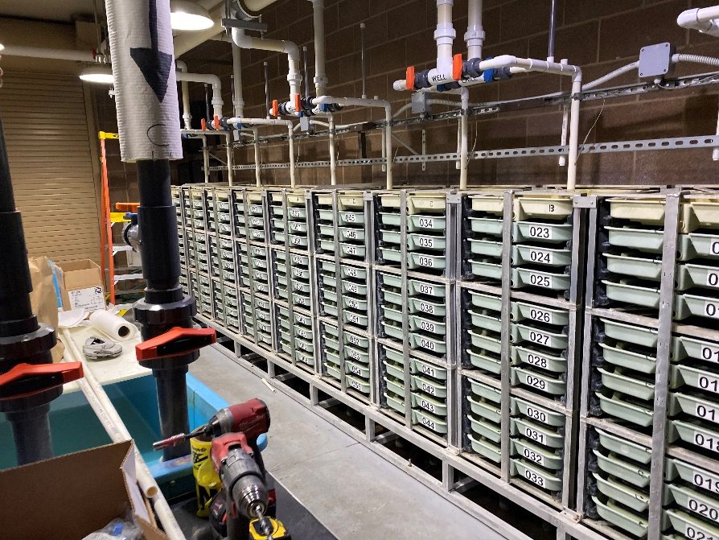
Irrigon Fish Hatchery

Slide 4
Irrigon Fish Hatchery
Building out incubation space for the Fall Chinook sub-yearling conversion
Rearing 200,000 sub-yearling spring Chinook for the Yankee Fork program for release May 21st
Cutting edge feeding, VFD, chiller heat exchangers, and alarm systems
Continued work on steelhead strategies

Slide 5
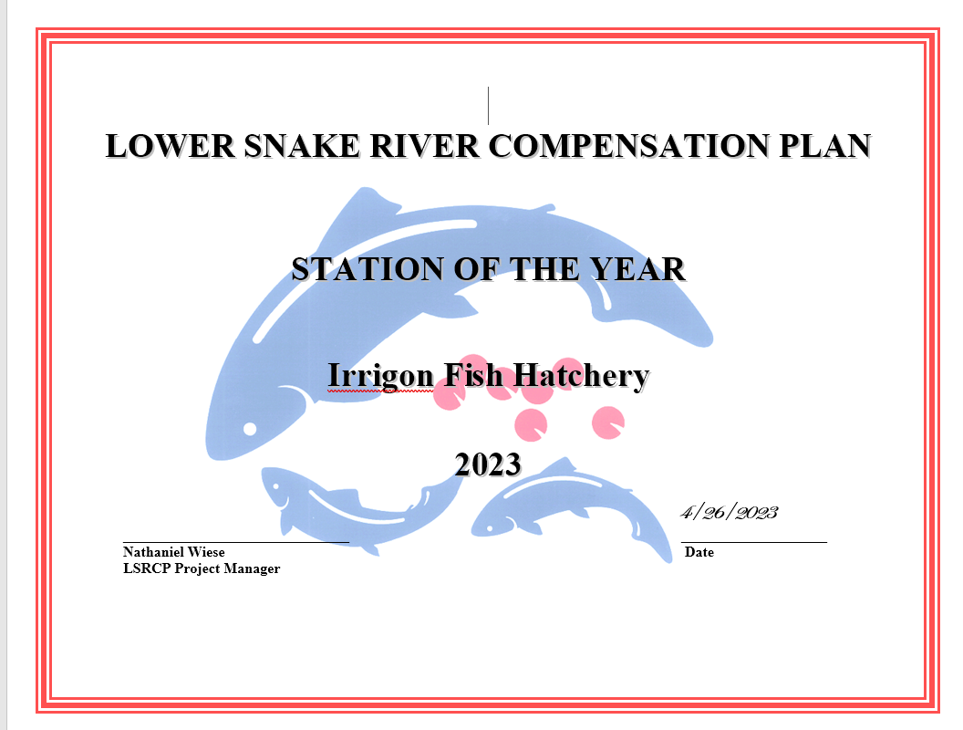

Slide 6
GREAT JOB!

