Slide 1
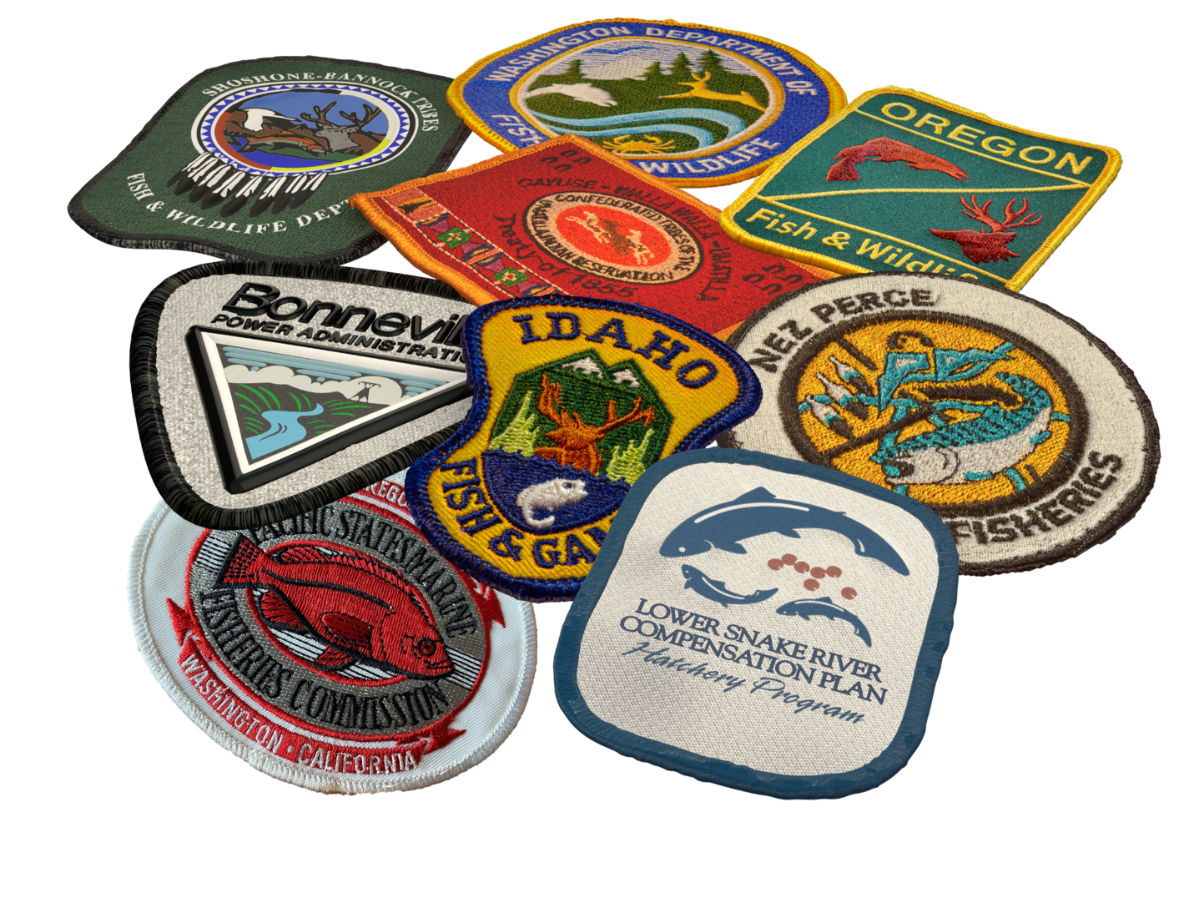
LSRCP Outreach
Fish for the Life!
Nathan Wiese LSRCP

Slide 2
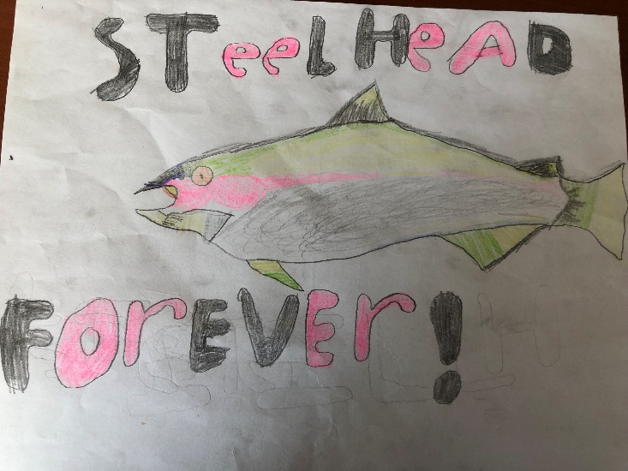
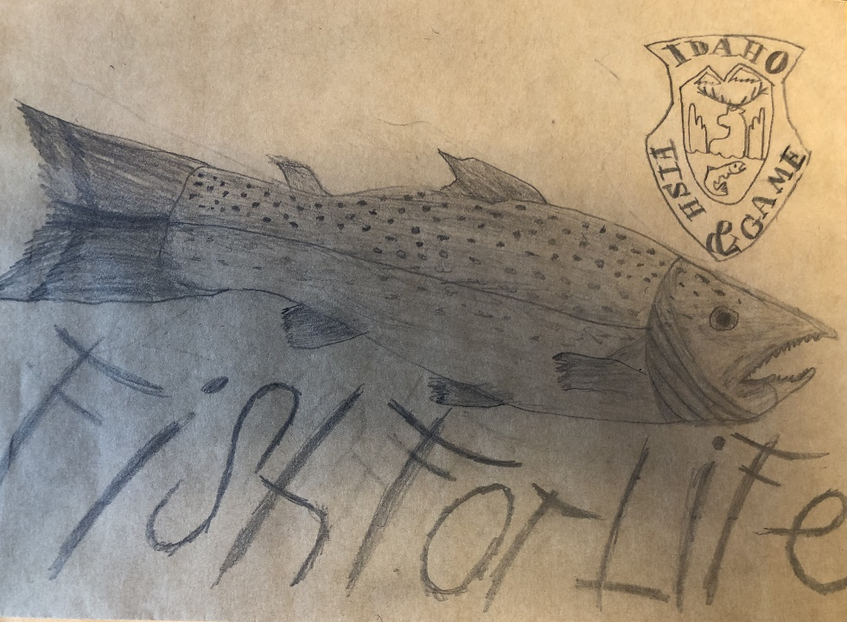
LSRCP Vision
Fish for Life!

Slide 3
LSRCP 2023 – Exceptional Outreach
Daniela Ruiz – Sawtooth Outreach and Signs
Jule Keller – LSRCP Brochures
Angela Feldmann/Nancy Jasper – Artwork Greg Burak - UAS
Devyn Hallamore – Treasure Valley Urban Conservation Partnership
Dan Craver – LSRCP Map
Thank you to everyone that engages our Fish for Life stakeholders!

Slide 4
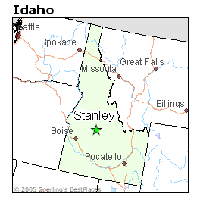
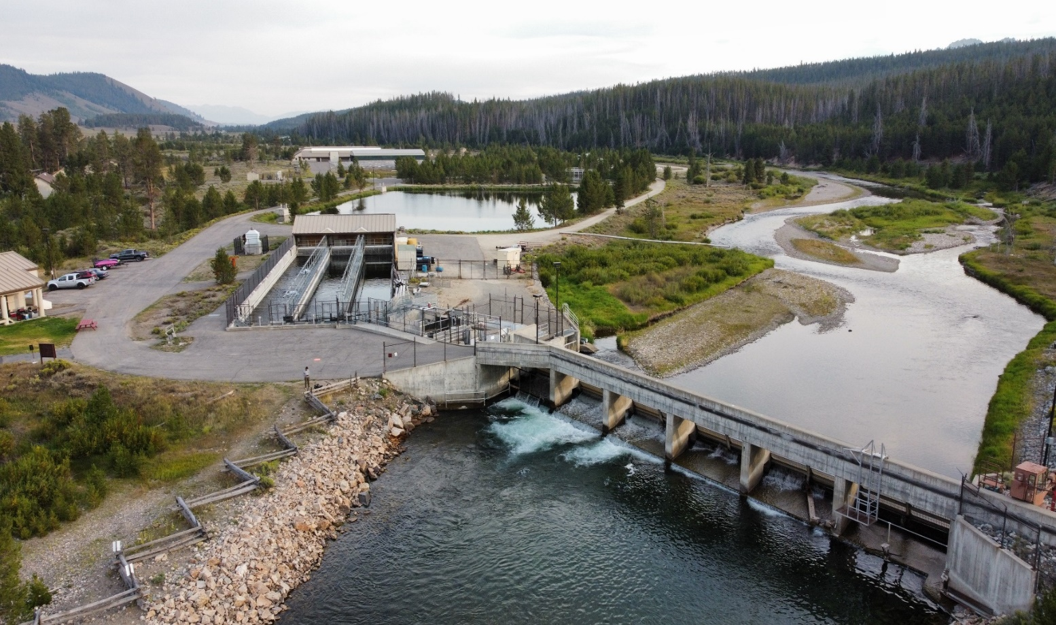
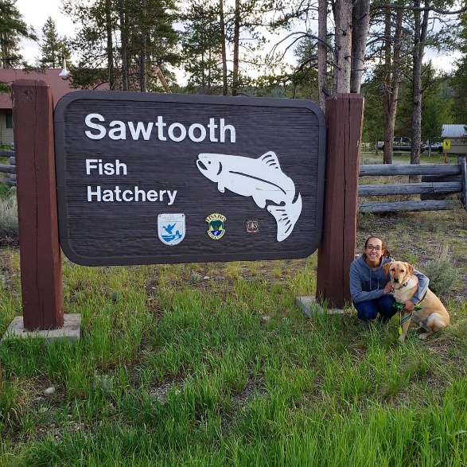
Sawtooth
Located in Stanley, Idaho
Chinook Salmon Hatchery with a weir, fish ladder, trap, spawning, and rearing on station.
5,000-7,000 visitors annually from May-October
Notes:
2500 people signed the visitor log in 2023.

Slide 5
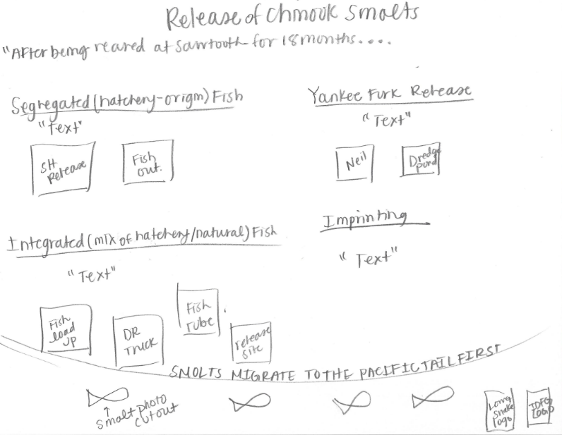
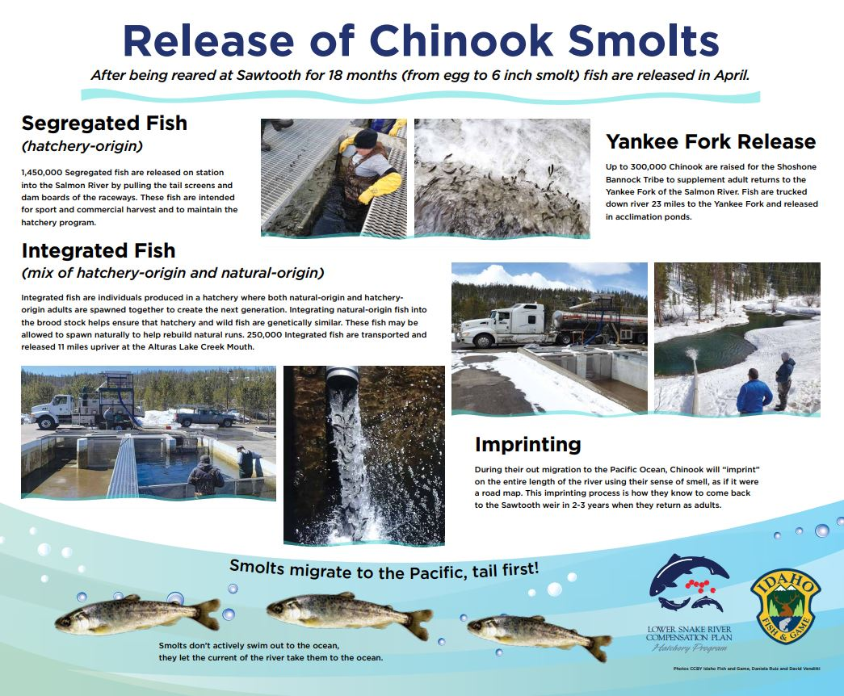
Sawtooth
Biggest thank you to Nancy Jasper
Graphic Designer with the IDFG Communications Bureau

Slide 6
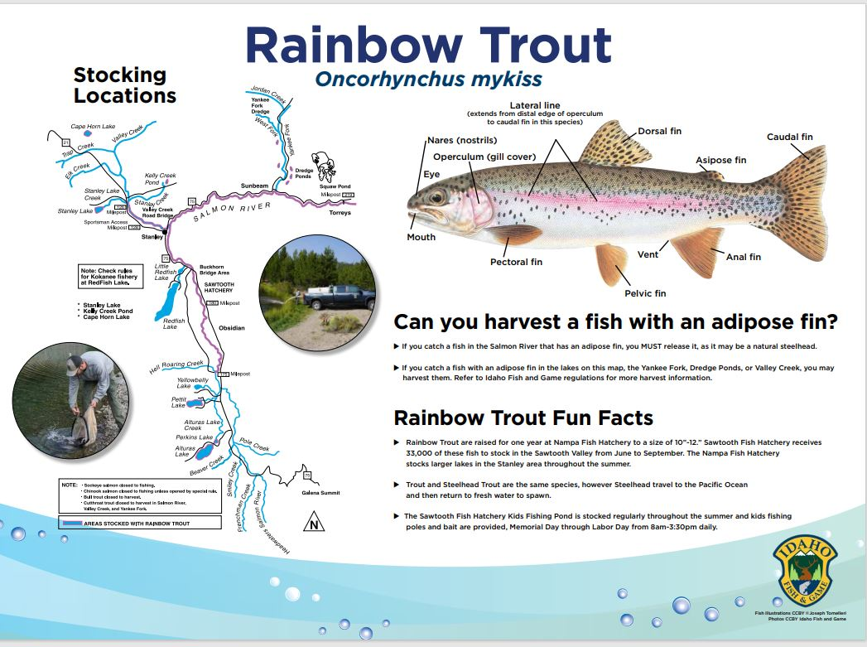
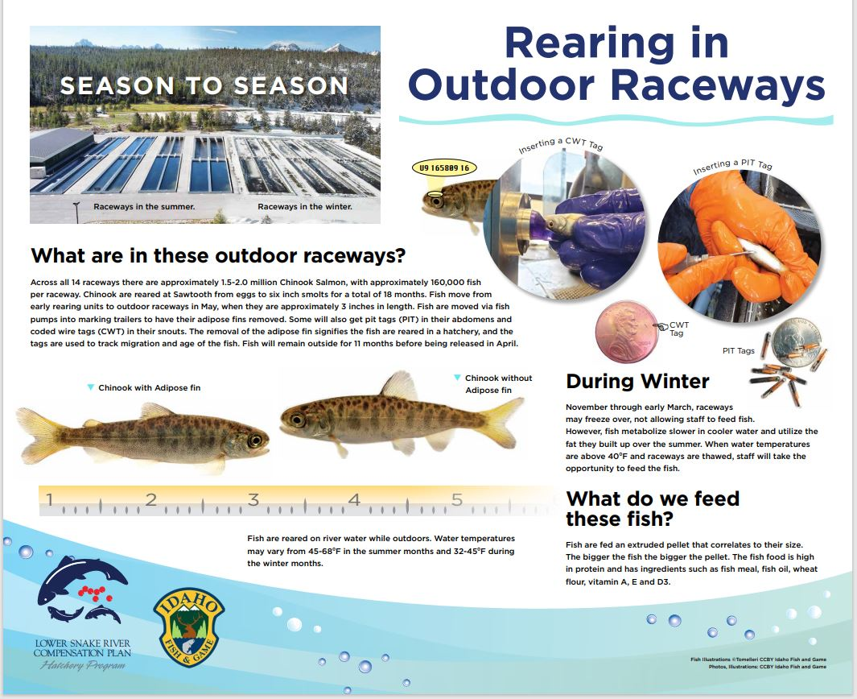
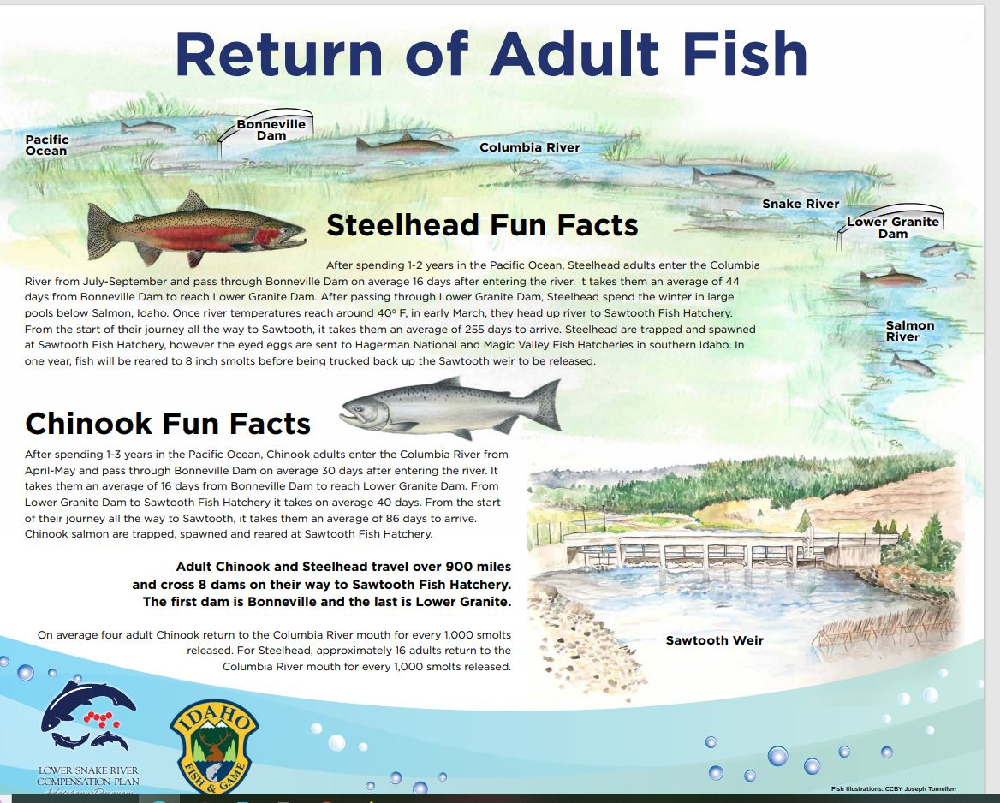
Sawtooth
New signs provide a visual for visitors.

Slide 7
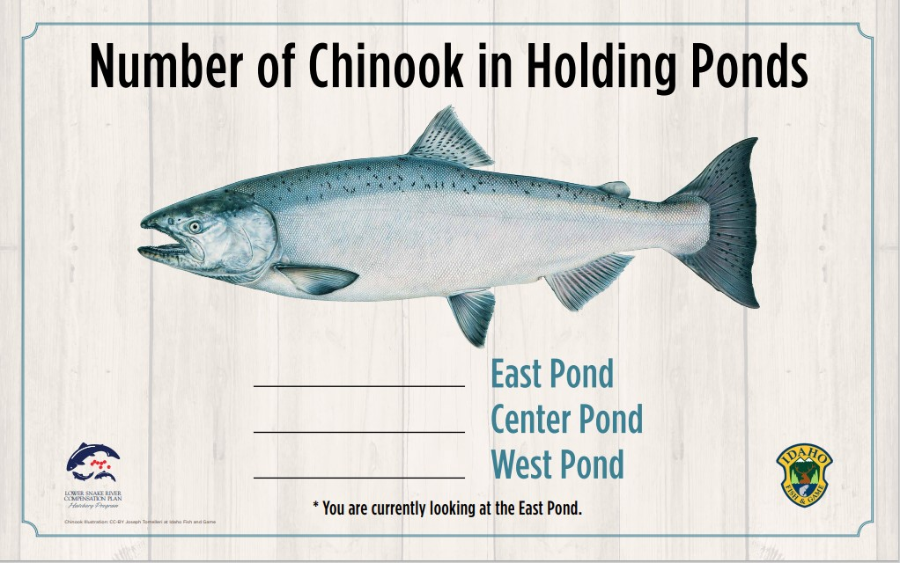
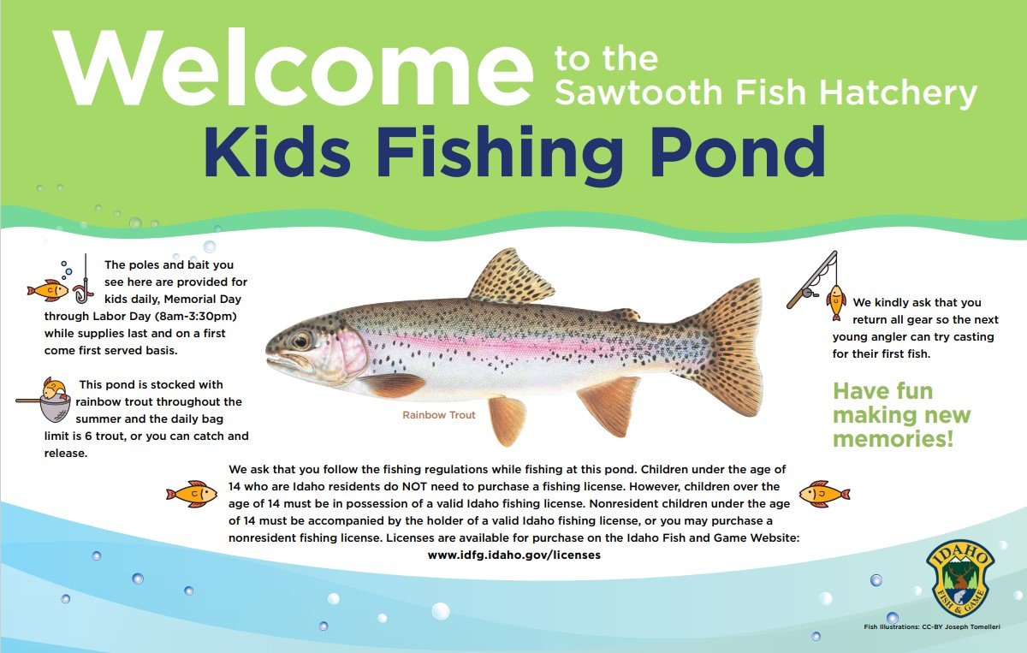
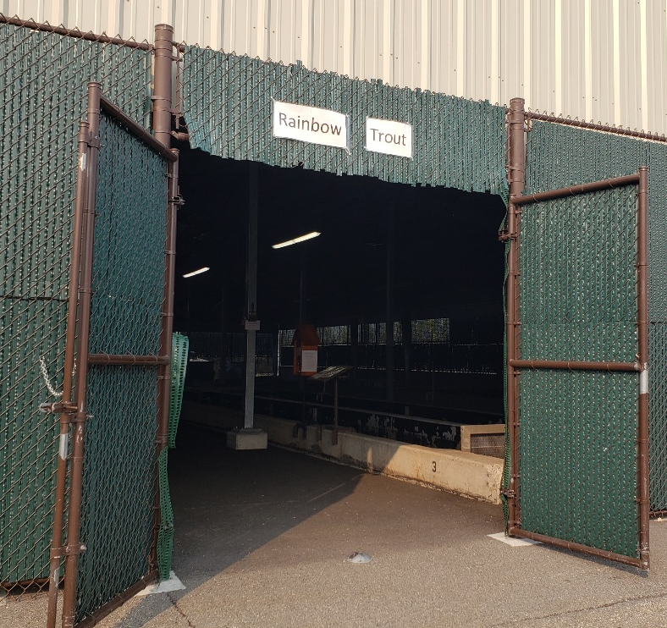
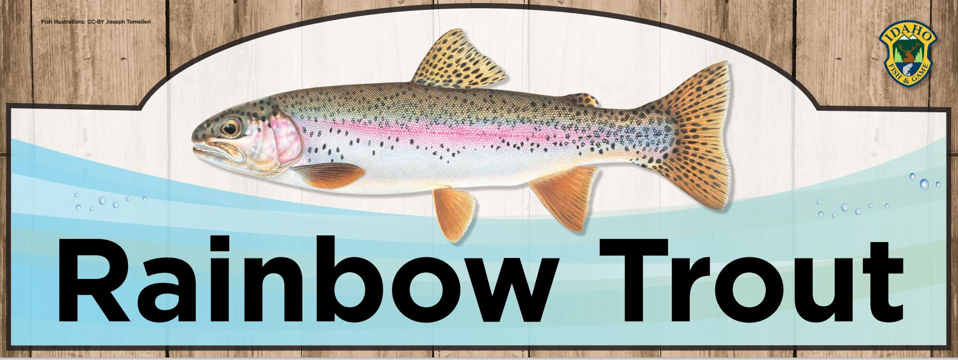
Sawtooth
Upgrade from laminated paper

Slide 8
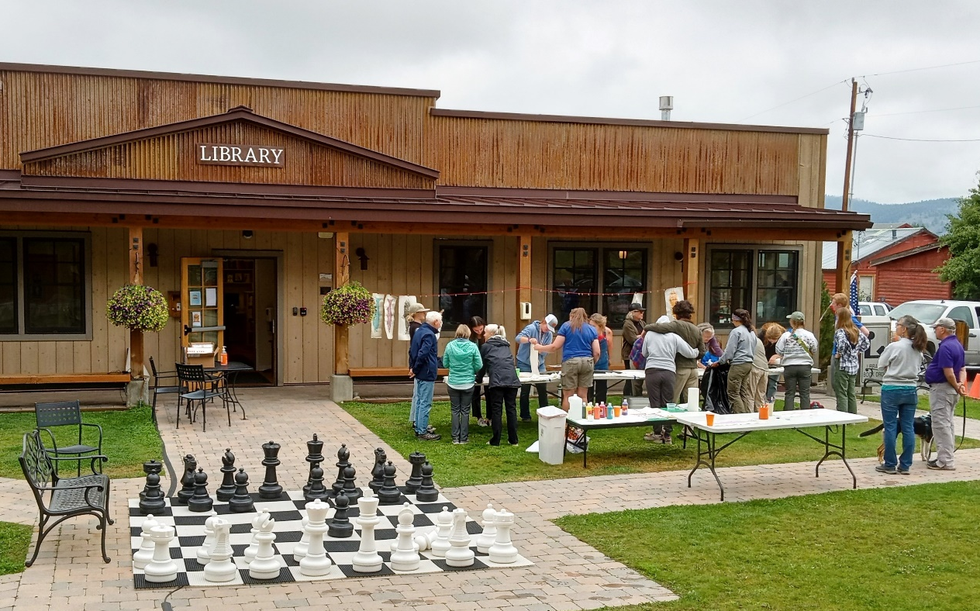
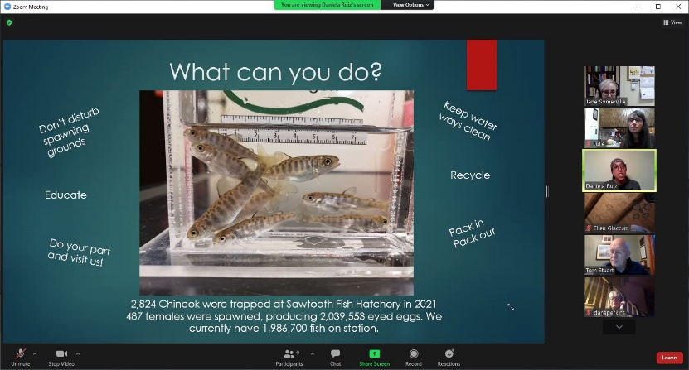
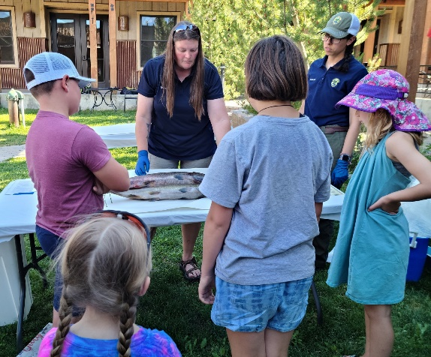
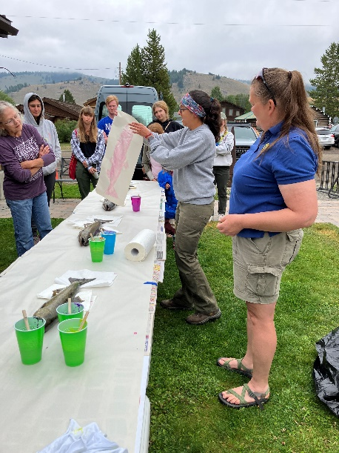
Sawtooth
Outreach at the Stanley Community Library
2021 Zoom presentation
2022 Fish dissection
2023 Fish prints

Slide 9
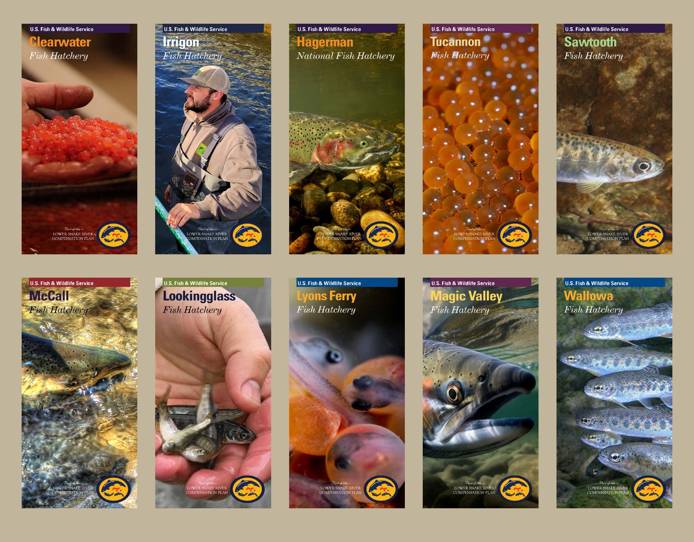
LSRCP Brochures
Notes:
-500 per station
-Order more through Tanya when you need them
-Goal of updated photos within 5 years – so start taking additional pics
- Outreach signs are coming

Slide 10
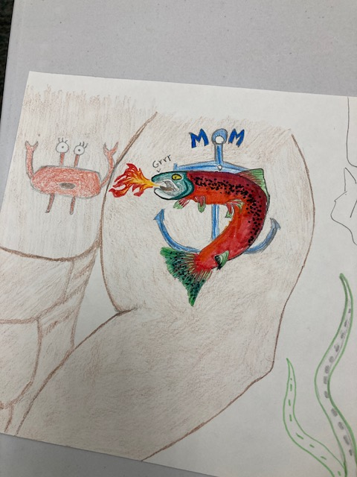
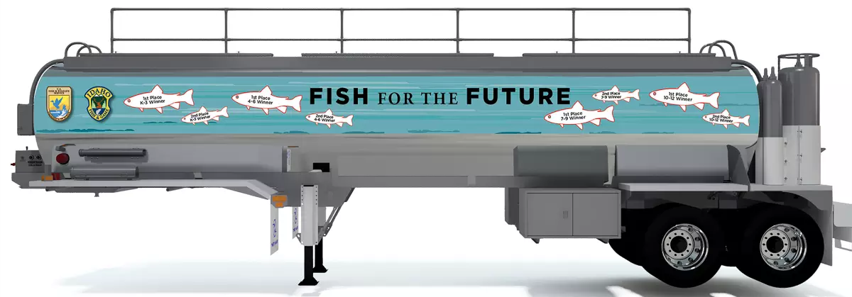
LSRCP Artwork Events
Who doesn’t want to show off their art skillz in the name of FISH????
  Knowledge is Power
    Step one: Get the word out
    Step two: Make art accessible
    Step three: Combine art with anatomy to create a meaningful conservation message
Notes:
Get the word out- Reached out to Hatchery in the Classroom teachers and art teachers in the Clearwater and L/C valley; Used social media to promote the contest and create events
Make Art Accessible- Dworshak held open studios where kids could come to the hatchery to work on their art all supplies were provided.
Conservation Message: Many teachers combined a hatchery tour with a classroom art project and a fish dissection. Open studio Art dates held at the hatchery included a hatchery tour and an external anatomy lesson.

Slide 11
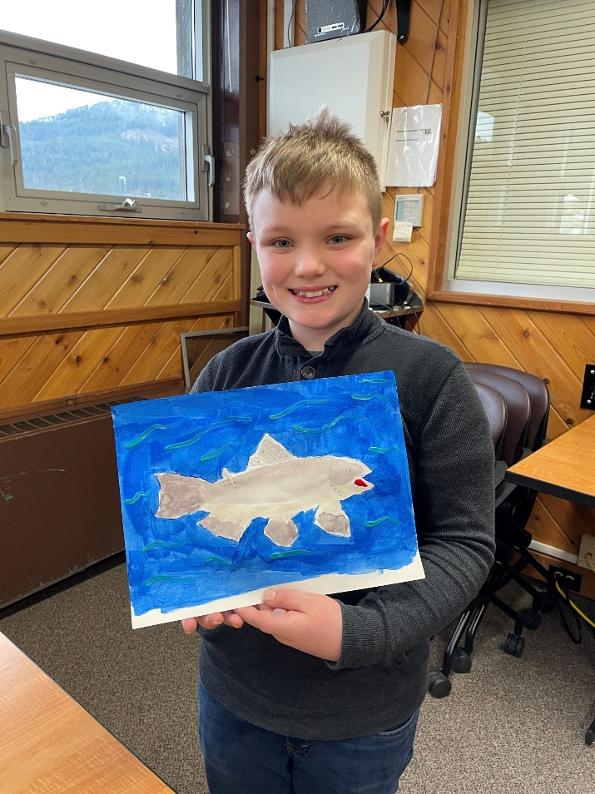
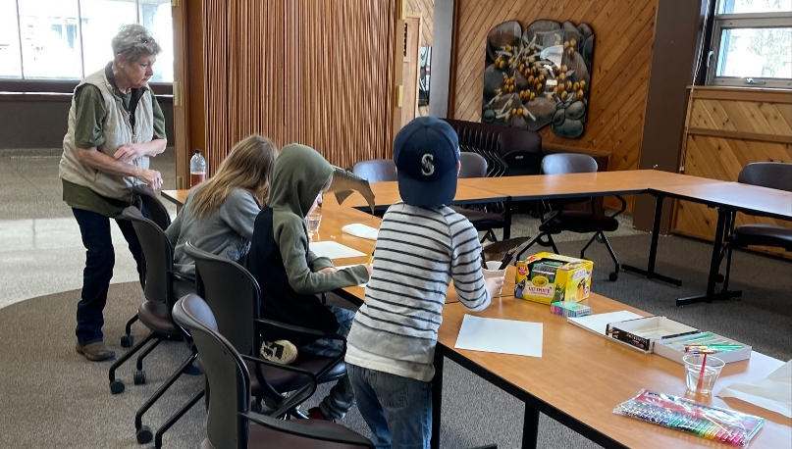
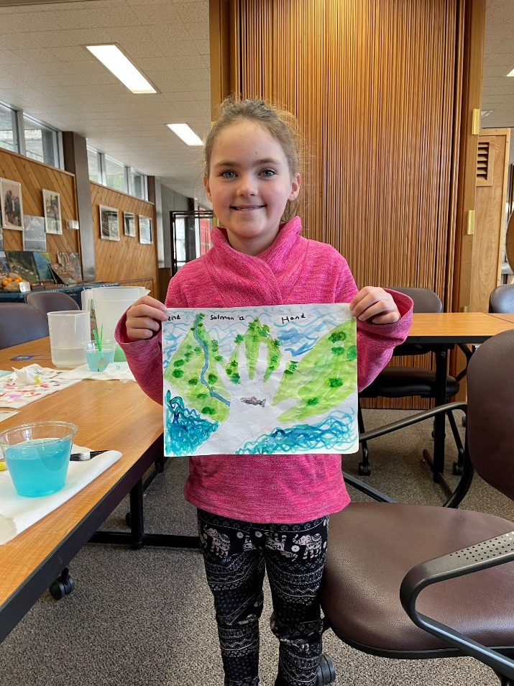
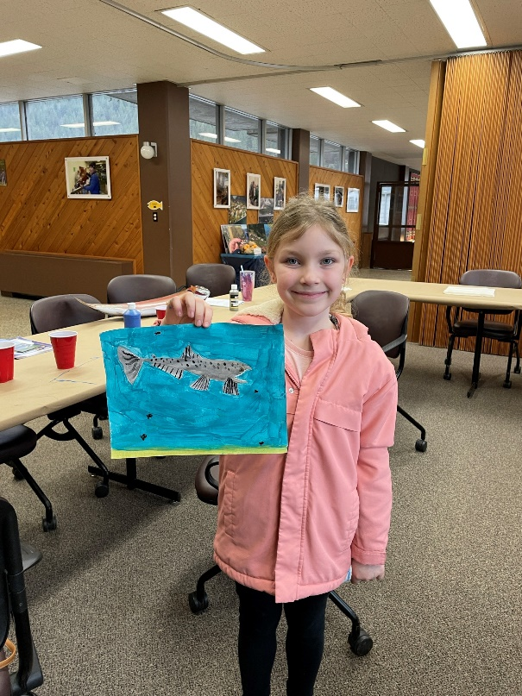
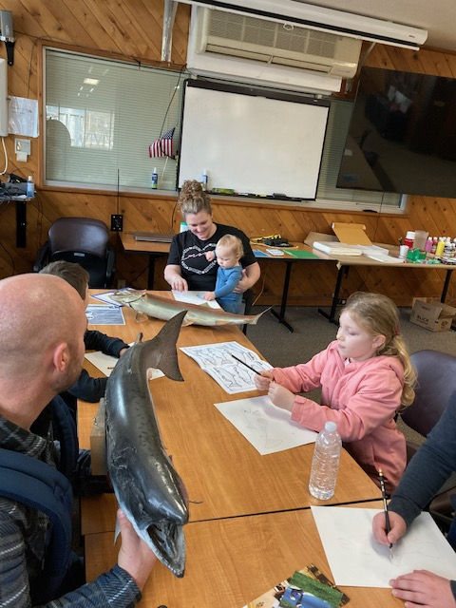
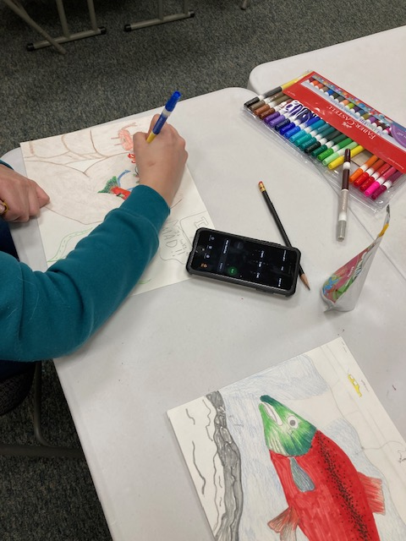
LSRCP Artwork Events
Calling All Artists: Open Studio Art Dates
Notes:
Held three events. Two at DNFH one at the UI county extension office. Provided the art supplies and props to help with anatomy. Toured the hatchery.

Slide 12

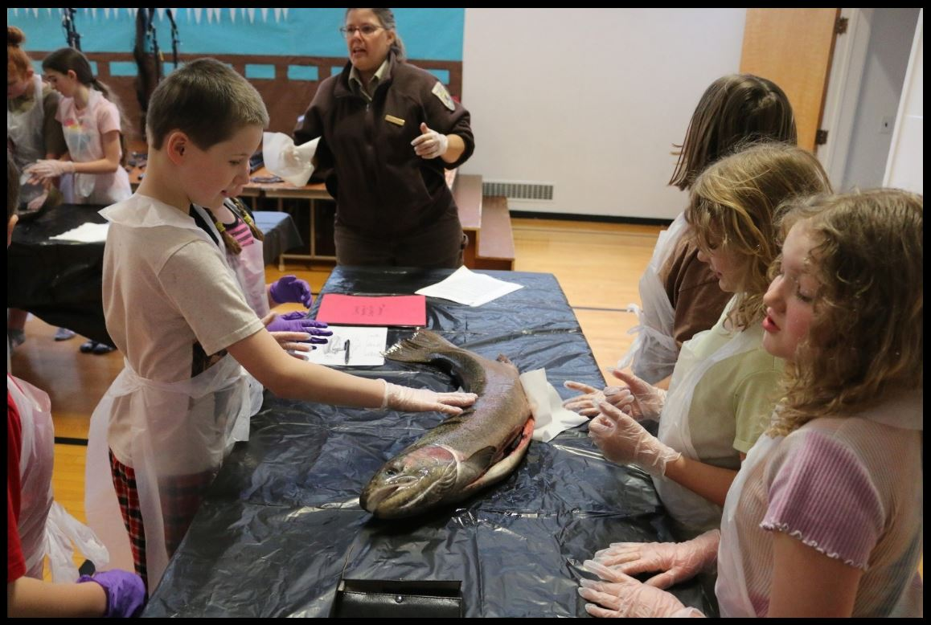
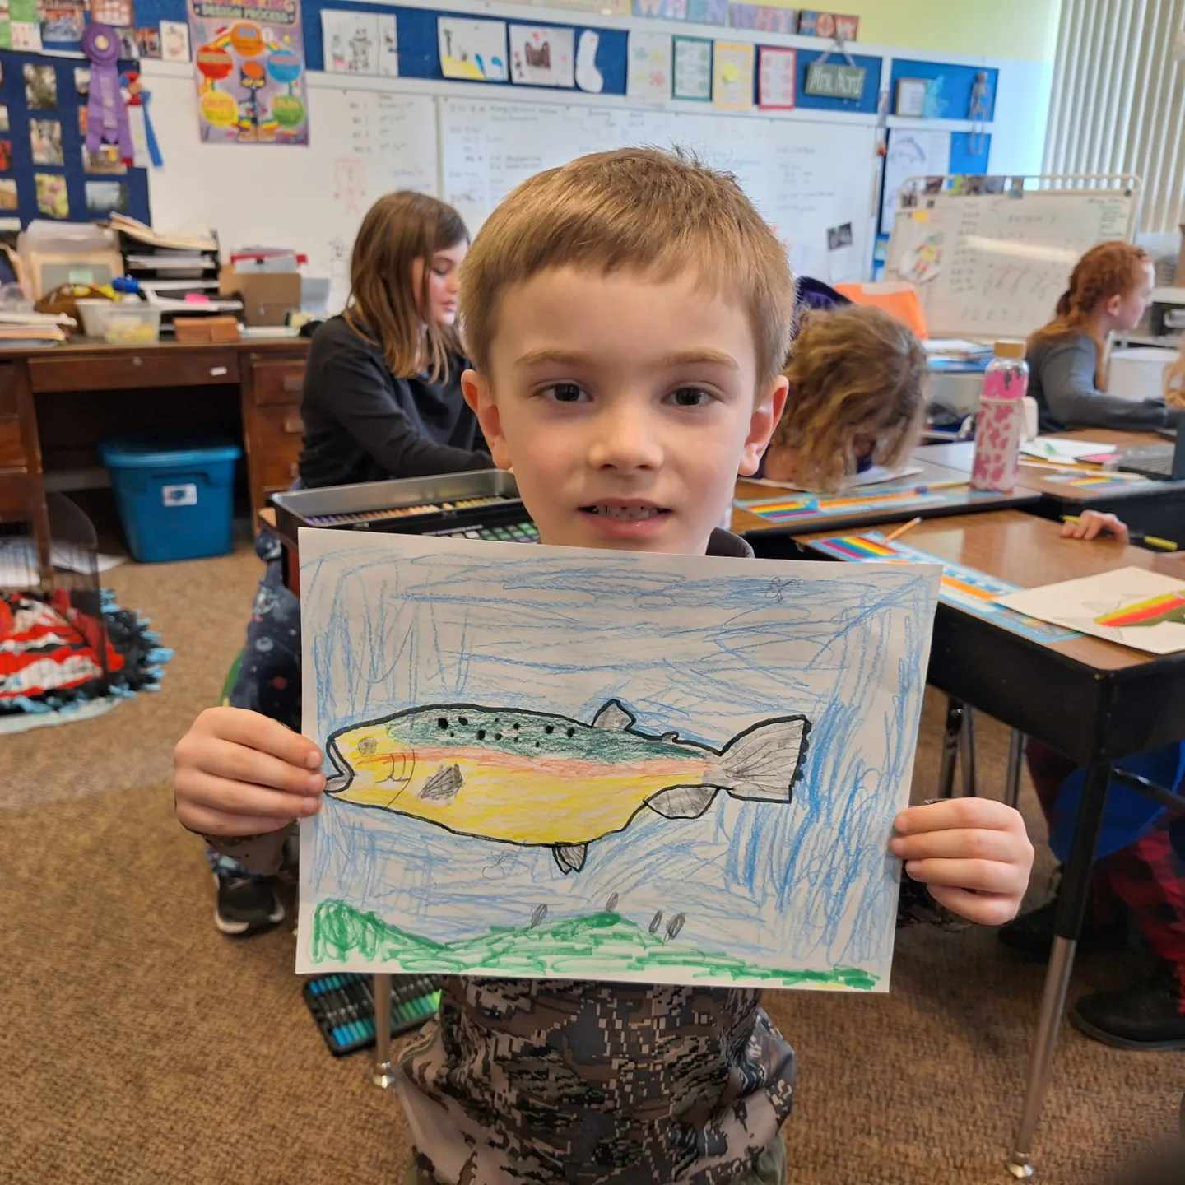
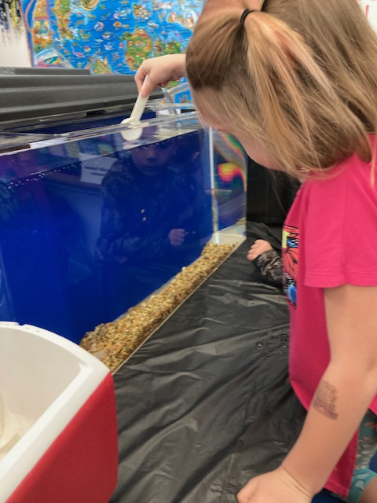
LSRCP Artwork Events
Taking it to the Classroom
And bringing home a message
Notes:
Many schools added the LSRCP art contest to their Steelhead in the Classroom curriculum

Slide 13
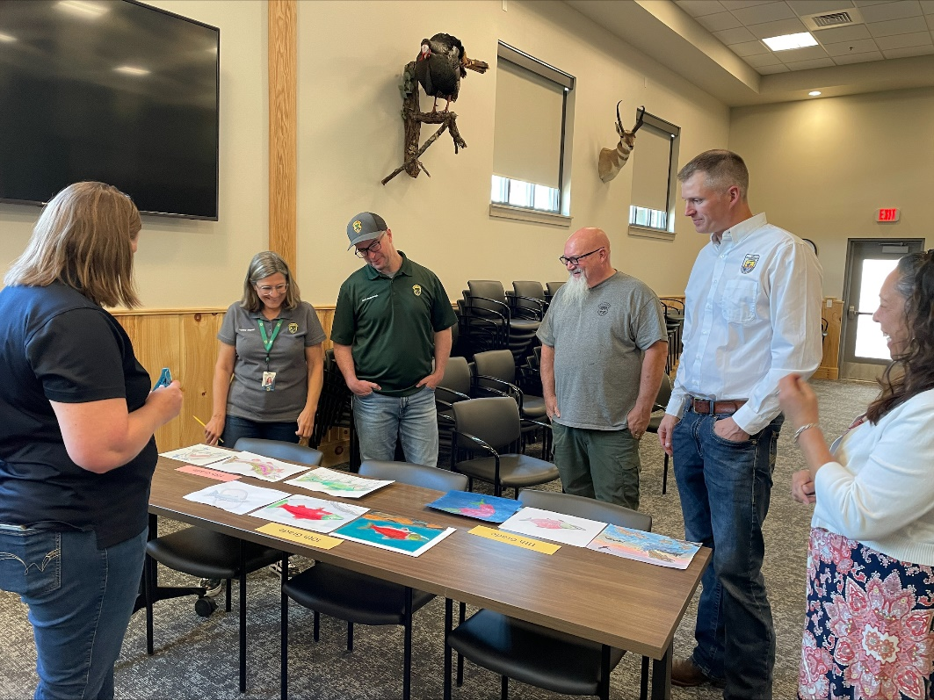
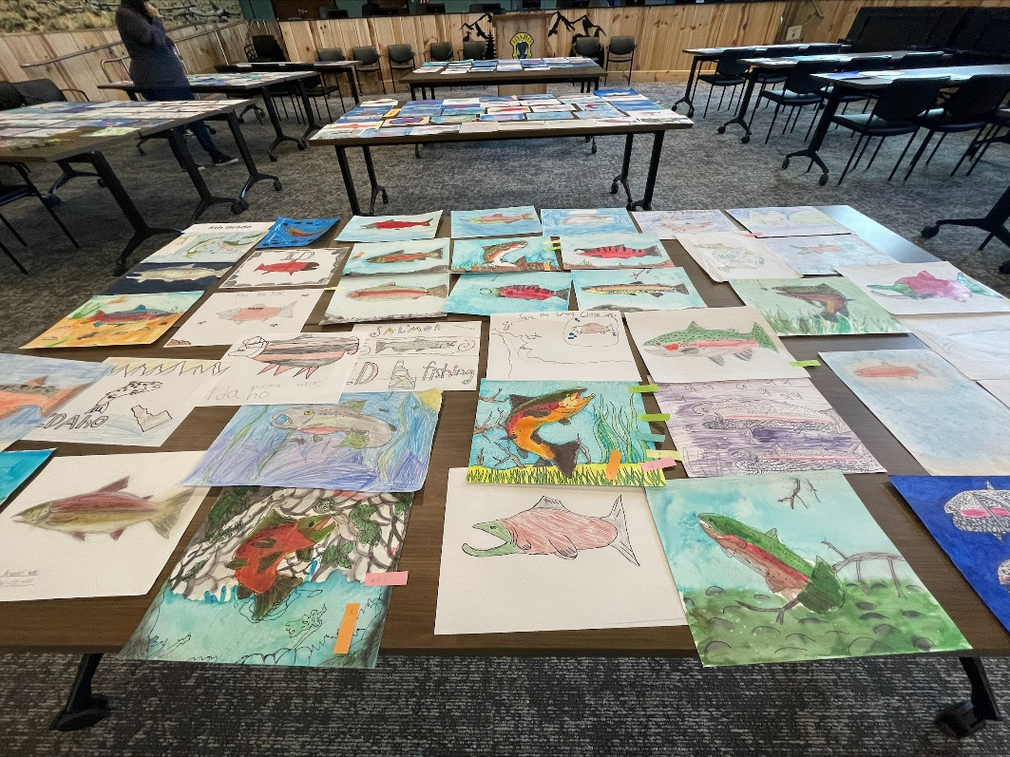
LSRCP Artwork Events
Collaboration for the Win
Notes:
Pulling off this event was a group effort from the initial idea to the final judging (and soon the first wrapped truck!!!) This was a group effort!!

Slide 14
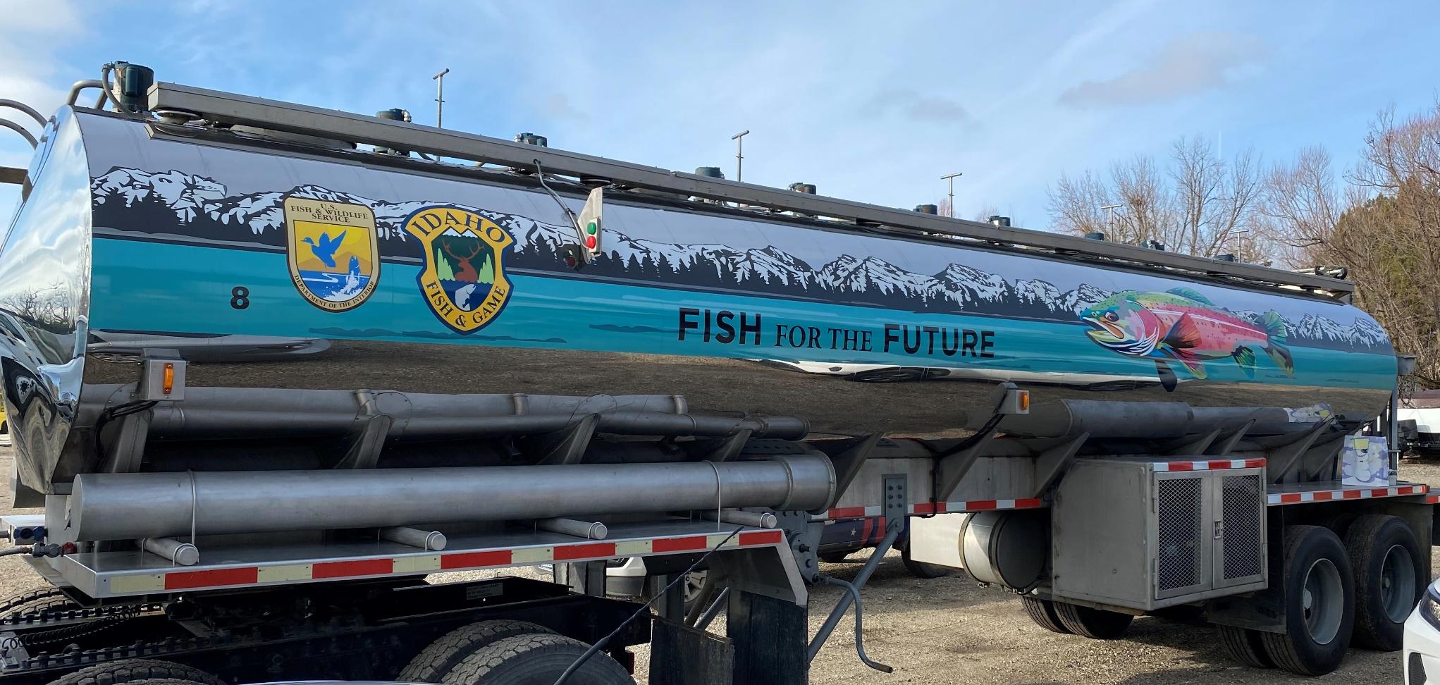
Artwork Canvas

Slide 15
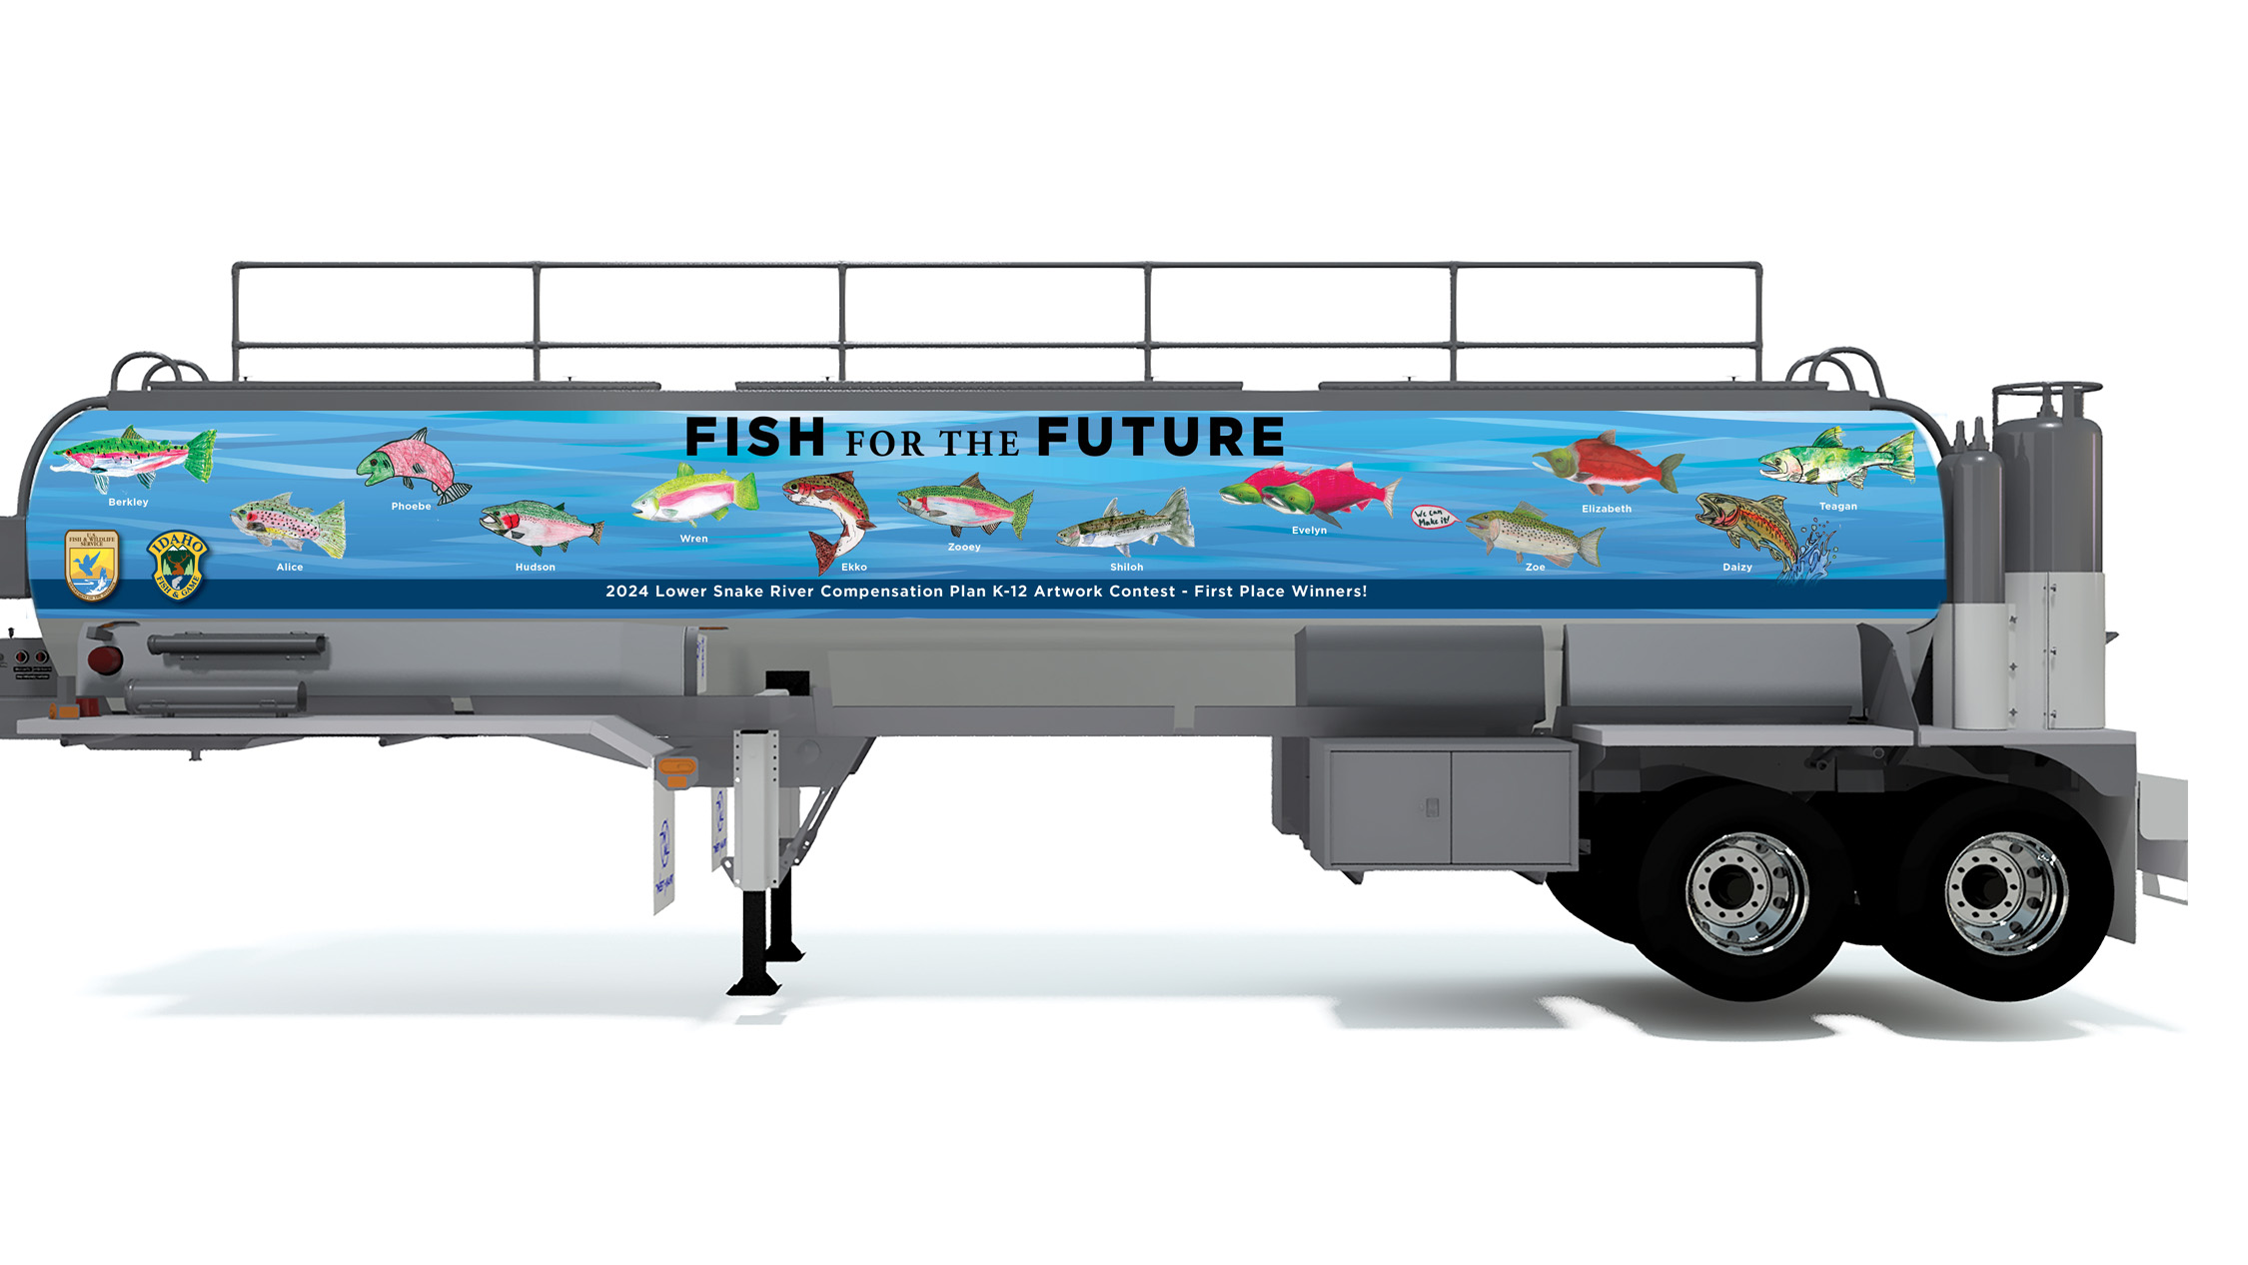
Artwork Design

Slide 16
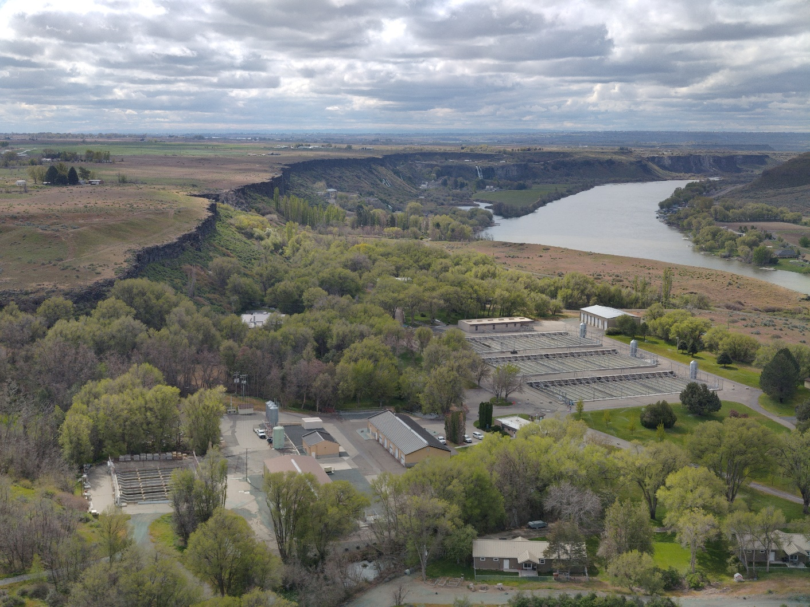
UAS Surveys
Coming soon
20MB pics
For outreach and project scoping
Greg Burak
Hagerman National Fish Hatchery – May 2024

Slide 17
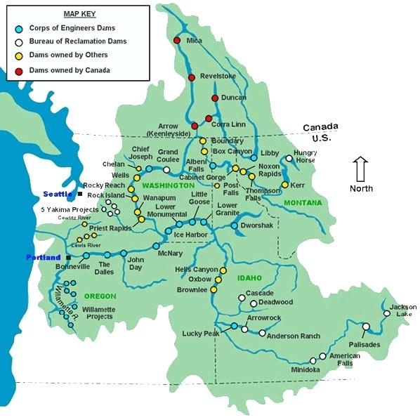
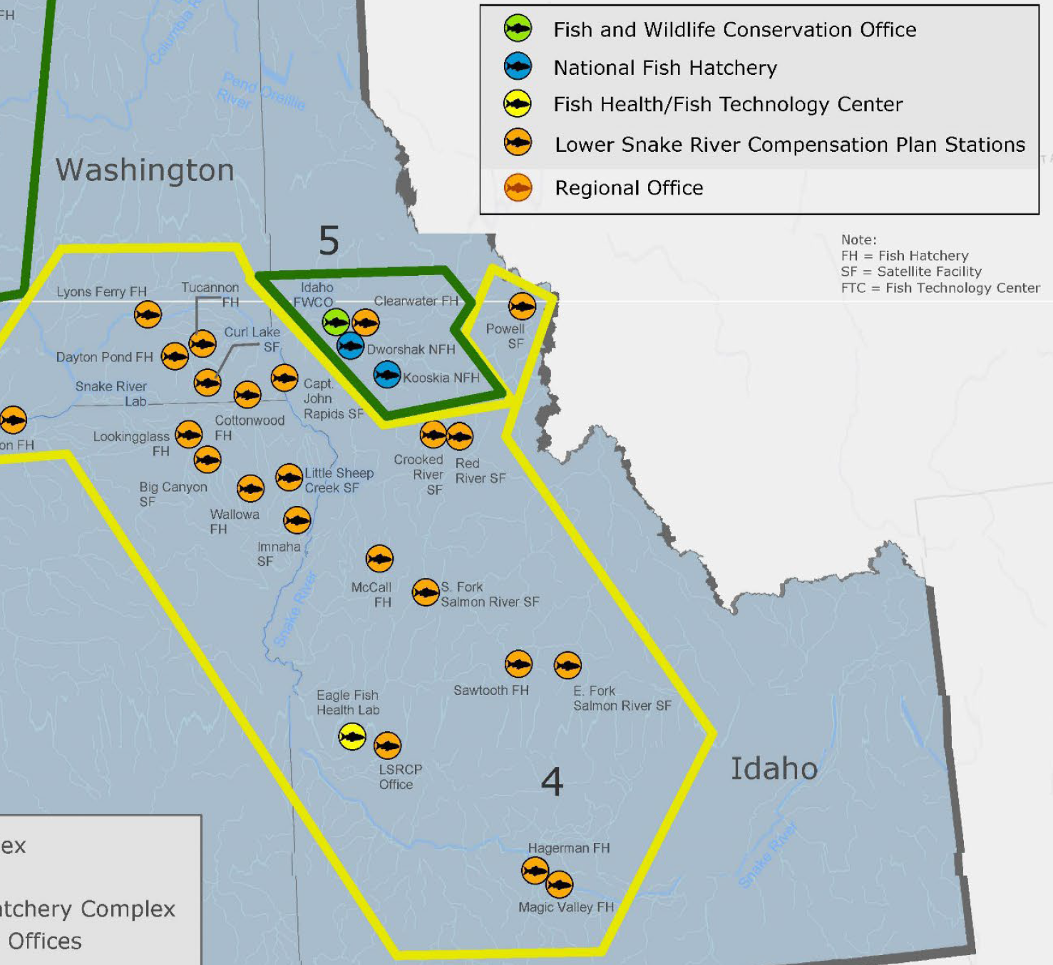
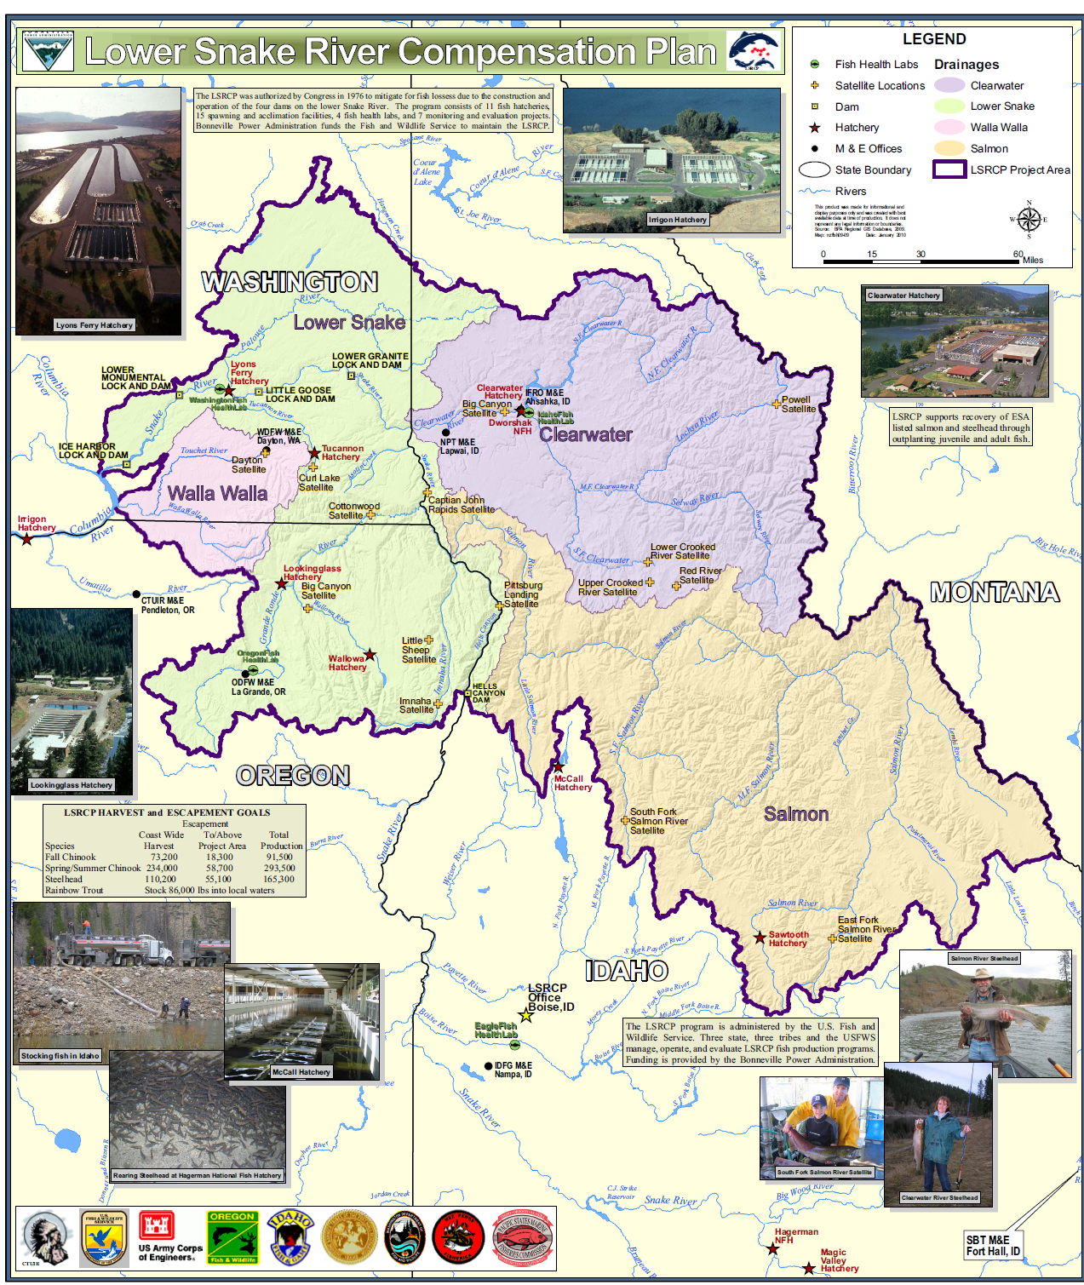
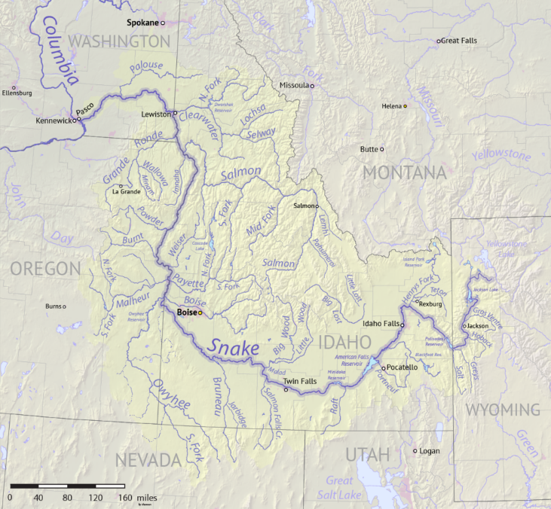
LSRCP Map Update

Slide 18
LSRCP Map Update
Include best of from existing maps
Create shareable trusted data layers
Provide maps and data for many purposes
  Printable poster-size wall map(s)
  Images for presentations and websites
  Data for online maps, mobile purposes, analysis, reporting
Collaboration

Slide 19
LSRCP Map Update
Theme | Features | Stewards
Facilities | Hatcheries and Dams | USFWS / ___
Hydrography | Rivers and Streams | USGS / NHD
Monitoring | PIT Arrays | ___
Operations | Release Sites | ___

Slide 20
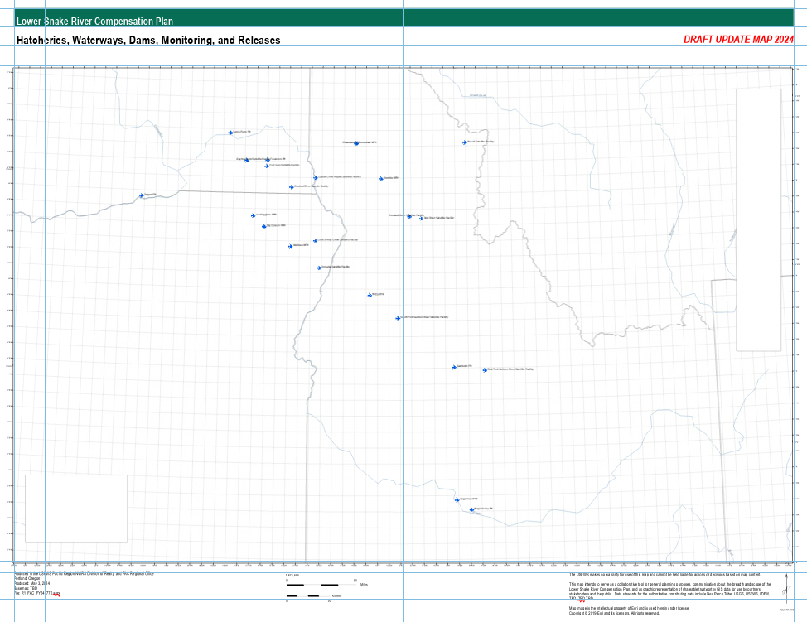
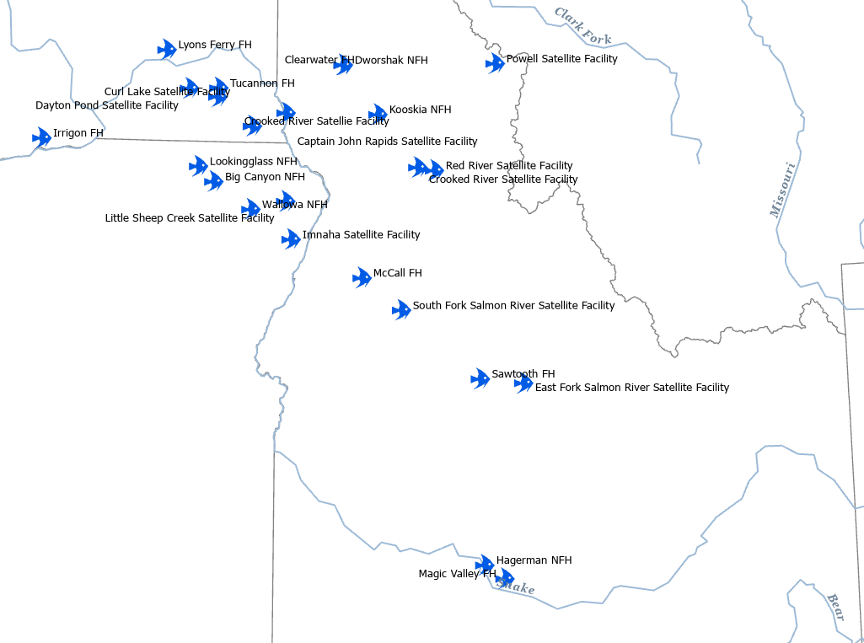
DRAFT

Slide 21
Treasure Valley Urban Conservation Partnership
(October 2021) Deer Flat NWR Urban Refuge Investment Plan
  Initial TVUCP Vision: Natural spaces at the refuge and across the valley are accessible and welcoming to all and provide diverse Treasure Valley residents with equitable opportunities to learn and engage with nature.
(April 2024) TVUCP Mission, Vision, Roles Workshop
  Mission: Strengthening the connection between organizations and community through collaboration and conservation.
  Vision: The Treasure Valley is a place where all people and nature thrive.

Slide 22
Treasure Valley Urban Conservation Partnership
2021
(FWS) Deer Flat National Wildlife Refuge
(FWS) Lower Snake River Compensation Plan
(FWS) Idaho Fish and Wildlife Office
Friends of Deer Flat NWR

Slide 23
Treasure Valley Urban Conservation Partnership
2022
(FWS) Deer Flat National Wildlife Refuge
(FWS) Lower Snake River Compensation Plan
(FWS) Idaho Fish and Wildlife Office
Friends of Deer Flat NWR
Caldwell School District
Nampa School District
(Federal Programs)
Central Elementary
Family Community Resource Center
Canyon County Parks, Cultural and Natural Resources
Community Members

Slide 24
Treasure Valley Urban Conservation Partnership
2023
(FWS) Deer Flat National Wildlife Refuge
(FWS) Lower Snake River Compensation Plan
(FWS) Idaho Fish and Wildlife Office
Friends of Deer Flat NWR
Caldwell School District
Nampa School District
(Federal Programs)
Central Elementary
Family Community Resource Center
Canyon County Parks, Cultural and Natural Resources
Community Members
Advocates Against Family Violence
Bogus Basin
COMPASS
Hispanic Cultural Center of Idaho
Idaho Business for the Outdoors
Idaho Dept. of Environmental Quality
Idaho Dept. of Parks & Recreation
I’m Hooked, Inc.
Natural Resources Conservation Service
The Nature Conservancy
Treasure Valley Canopy Network
Wild Hearts Idaho

Slide 25
Treasure Valley Urban Conservation Partnership
2024
(FWS) Deer Flat National Wildlife Refuge
(FWS) Lower Snake River Compensation Plan
(FWS) Idaho Fish and Wildlife Office
Friends of Deer Flat NWR
Caldwell School District
Nampa School District
(Federal Programs)
Central Elementary
Family Community Resource Center
Canyon County Parks, Cultural and Natural Resources
Community Members
Advocates Against Family Violence
Bogus Basin
COMPASS
Hispanic Cultural Center of Idaho
Idaho Business for the Outdoors
Idaho Dept. of Environmental Quality
Idaho Dept. of Parks & Recreation
I’m Hooked, Inc.
Natural Resources Conservation Service
The Nature Conservancy
Treasure Valley Canopy Network
Wild Hearts Idaho
Deer Flat NWR Volunteer Program
(FWS) Pacific Region Migratory Birds & Habitat Program
Golden Eagle Audubon Society
University of Idaho Extension

Slide 26

You are
Fish for the Life!

