Slide 1


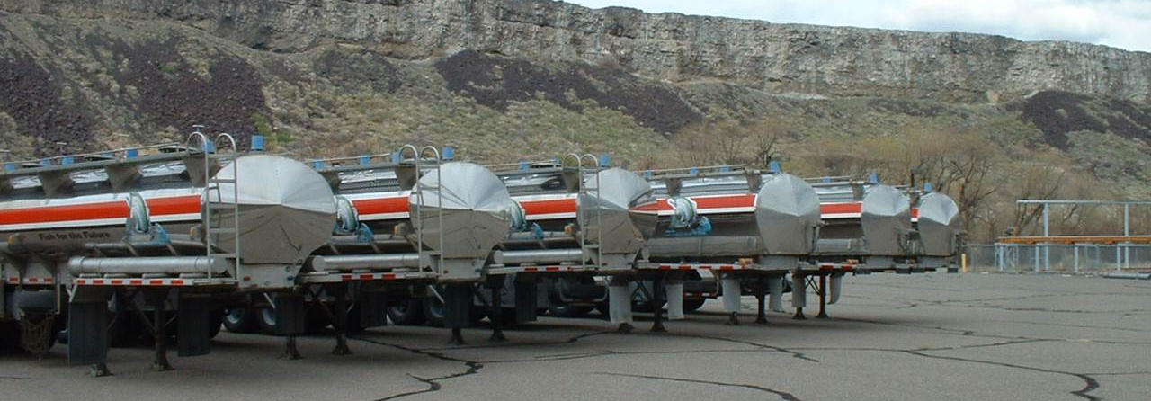
LSRCP
FISH TRANSPORT SAFETY
John McKernan
IDFG Truck Shop Mechanic

Slide 2
Agenda
Pre-Trip Inspection
Post-Trip Inspection
Maintenance Logs
Driving Safety

Slide 3
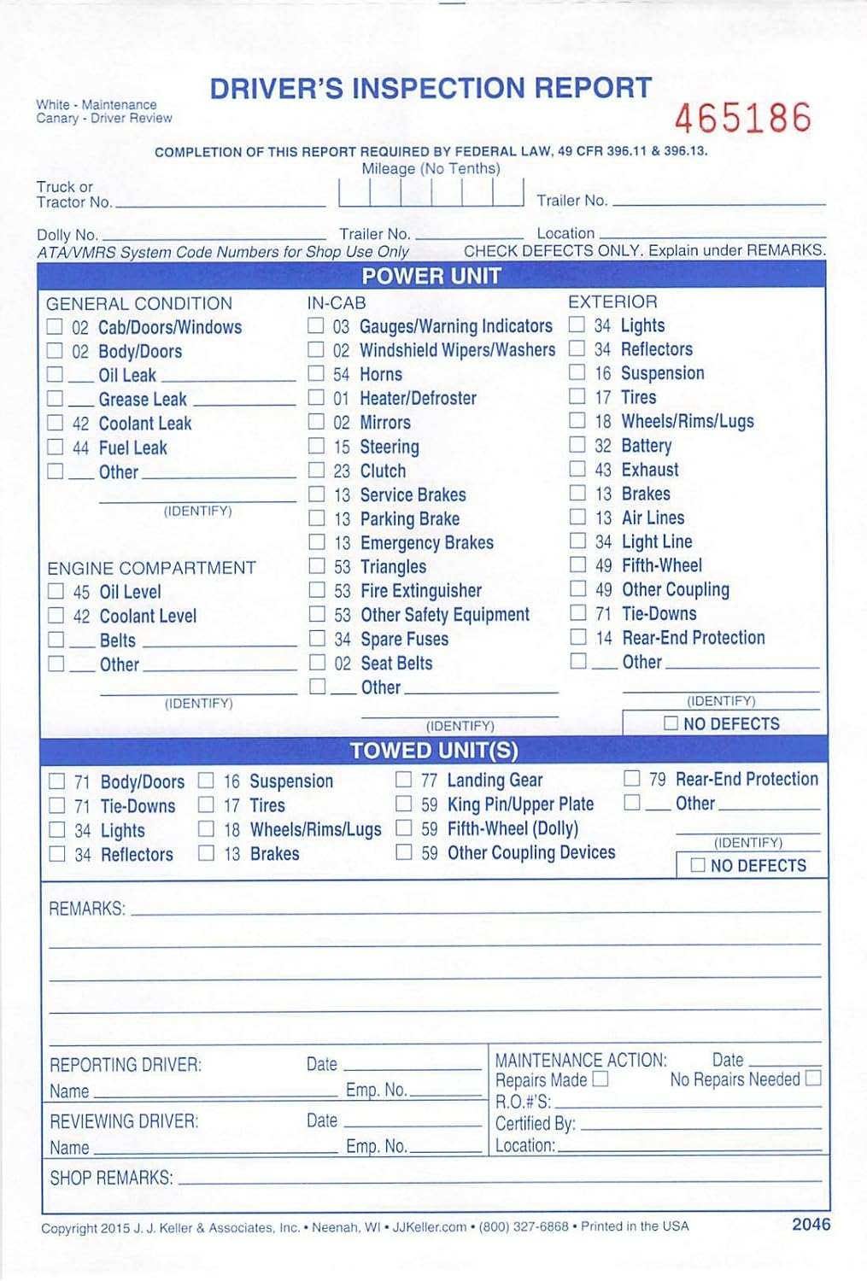
Pre-Trip Inspection
Pre-trip inspections are required by DOT
Should be documented for safety and maintenance records
Examples include a printed form, book or there are even apps

Slide 4
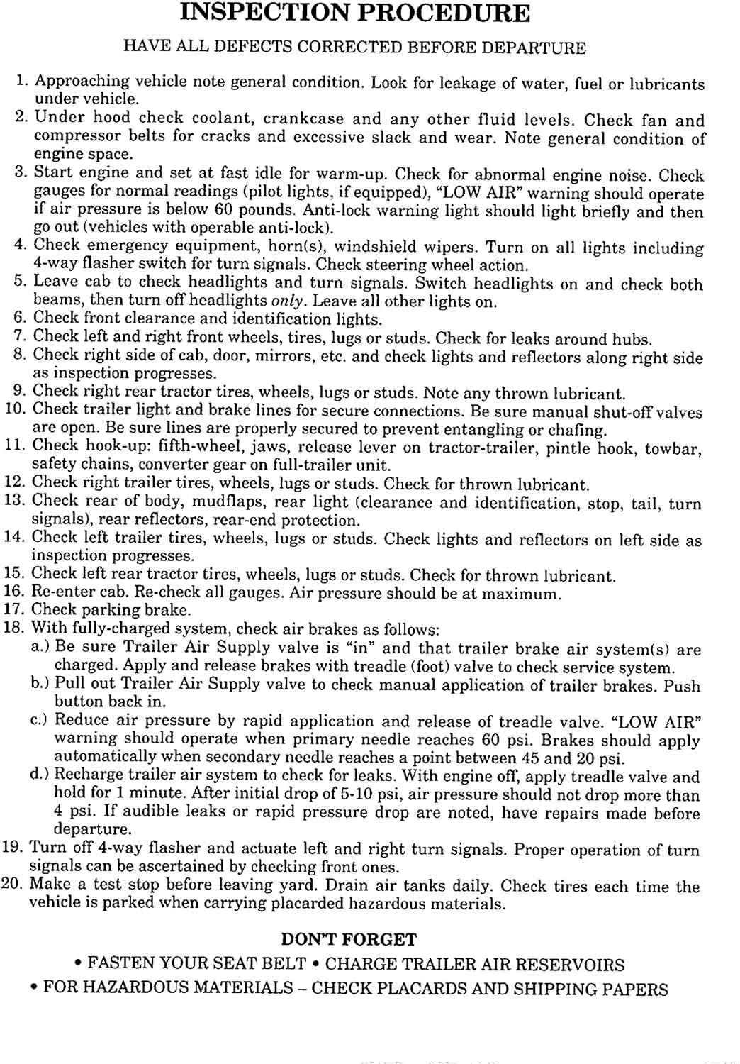

Slide 5
Post-Trip Inspection
Same form can be used for post-trip inspection
Fish hatcheries operate on tight timelines
Post trip inspections can identify issues quickly before the next trip
Helps the Truck Shop Mechanic to be aware of issues

Slide 6
Maintenance Logs
Walk Arounds Very Important
Safety First
Important to keep maintenance logs on every vehicle
Helps to track routine maintenance is getting completed
Improves communication between hatchery staff and truck shop

Slide 7
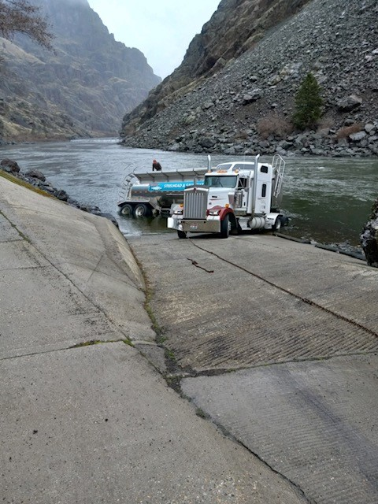
Transport Safety
Set all the Brakes and use Wheel Chocks
Be Careful moving around on top of the trailers
Three Points of Contact

Slide 8
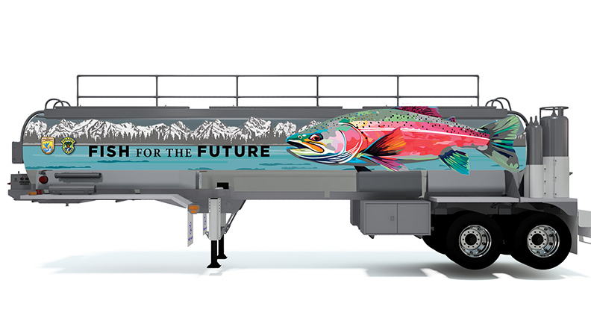
Public Image
Please Slow Down
Stay in your lane
Remember you are driving a rolling billboard

Slide 9
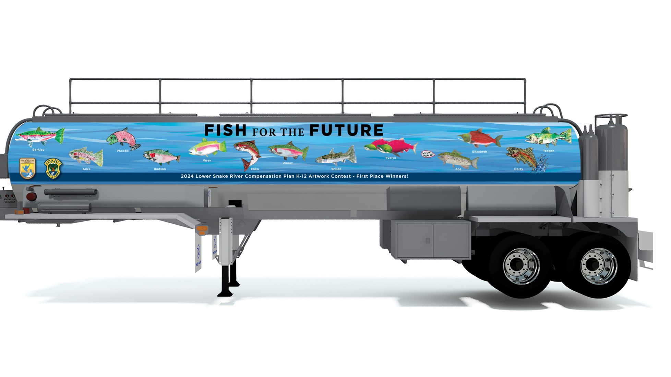
LSRCP K-12 ART CONTEST 2024

