Slide 1
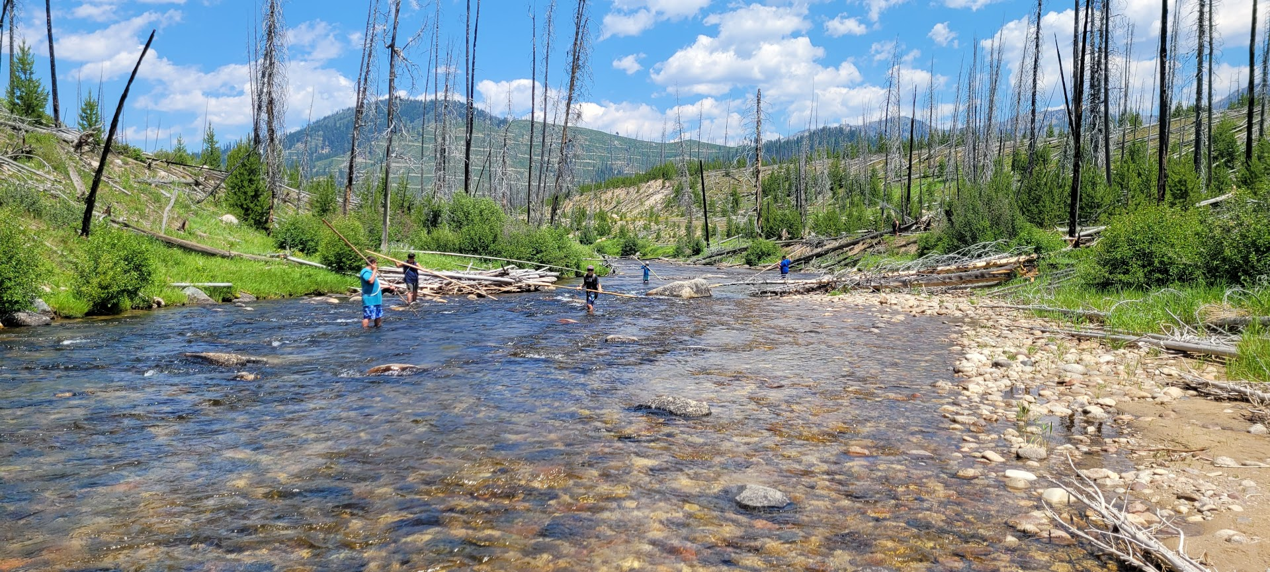
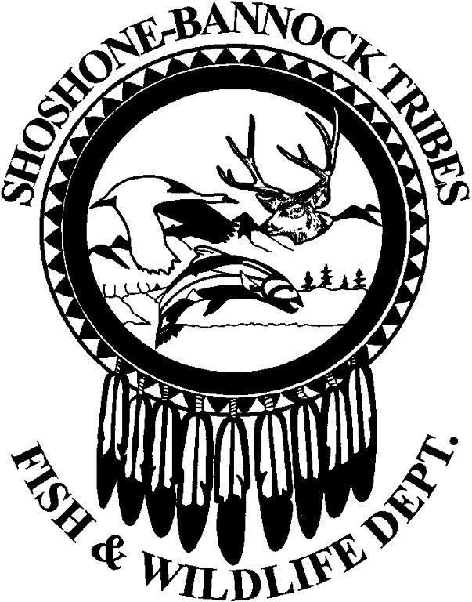
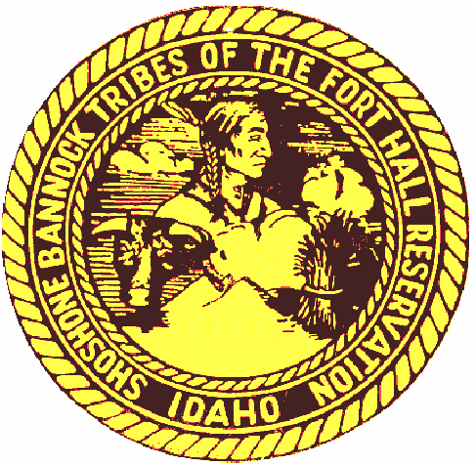
Crystal Springs Update and
Plans for Yankee Fork and Panther Creek
Lytle Denny, Danny Stone, Sammy Matsaw, Joseph Snapp, & Aaron Colter
Shoshone-Bannock Tribes
2023 LSRCP Annual Meeting
April 26, 2023

Slide 2
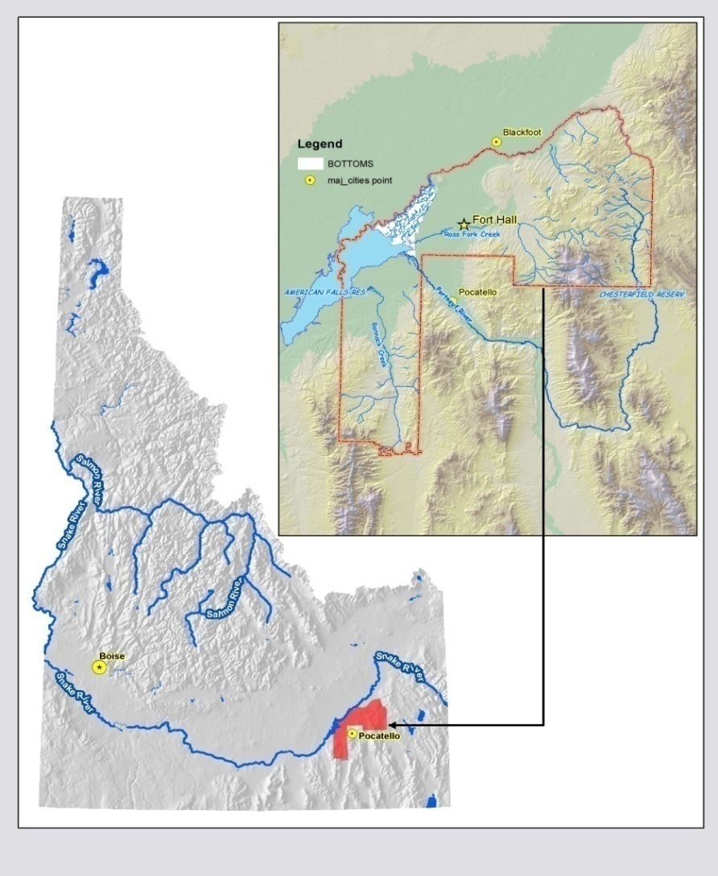
Shoshone-Bannock Tribes
Background
Fort Hall Indian Reservation is the permanent home
Located in southeastern Idaho
Approximately 5,600 Tribal members
We maintain a subsistence lifestyle which is protected by Article IV of the Fort Bridger Treaty of 1868
We are an active co-manager of natural resources off the reservation

Slide 3
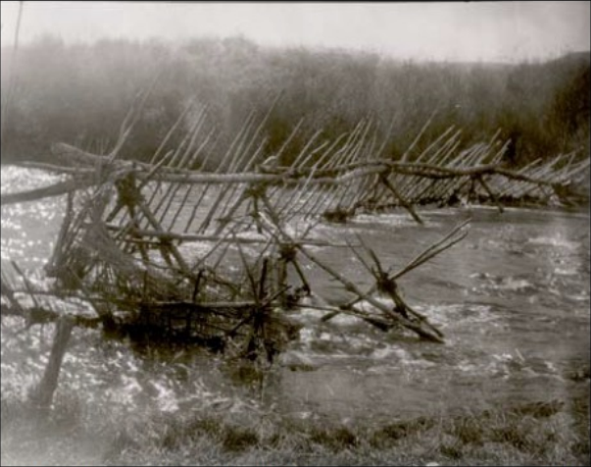
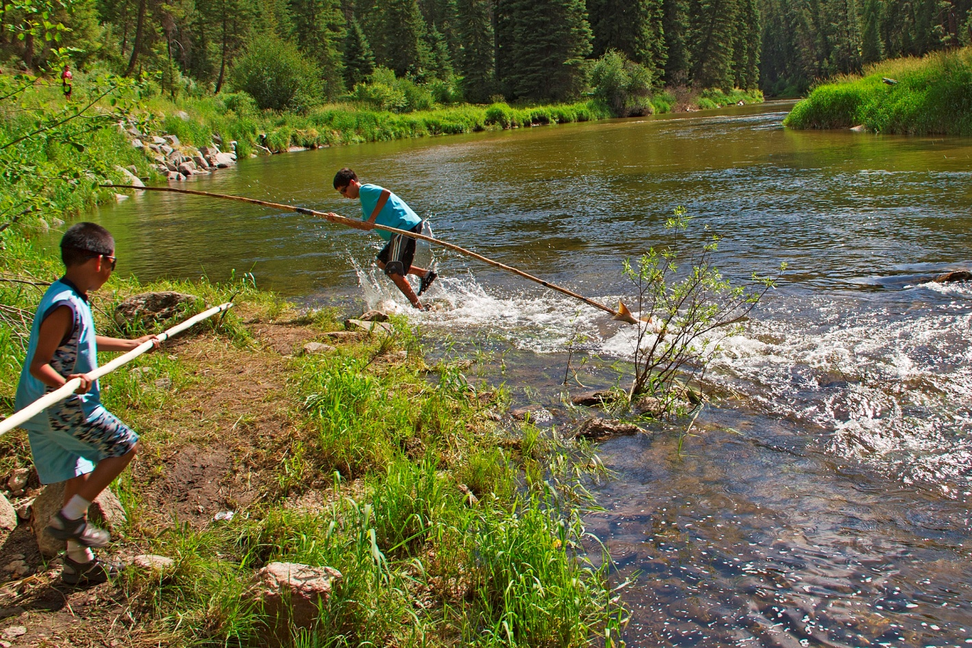
Shoshone-Bannock Tribes
Salmon and Subsistence
average annual fish harvest pre-colonization for the Salmon River
233,555 fish
700 lbs/person/year
average annual fish harvest from 1992-2006 for the Salmon River
~200 salmon
0.6 lbs/person/year
In 2008, the Tribes signed a Fish Accord with BPA to fund an Anadromous Fish Hatchery

Slide 4


Slide 5
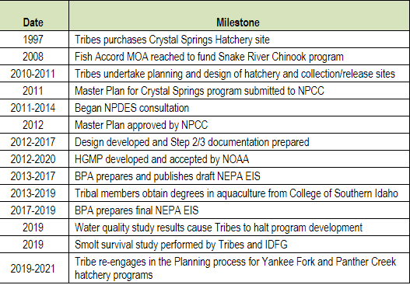

Slide 6
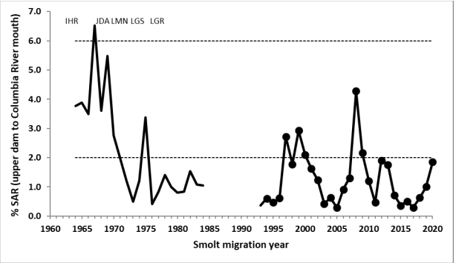
Changing Gears
Shifting baselines
Natural and hatchery fish survival declined during the planning phases of Crystal Springs
Lack of adult returns further limited Tribal harvest, raising concerns about the utility of hatchery smolt programs
Will a smolt program actually provide more harvest?

Slide 7
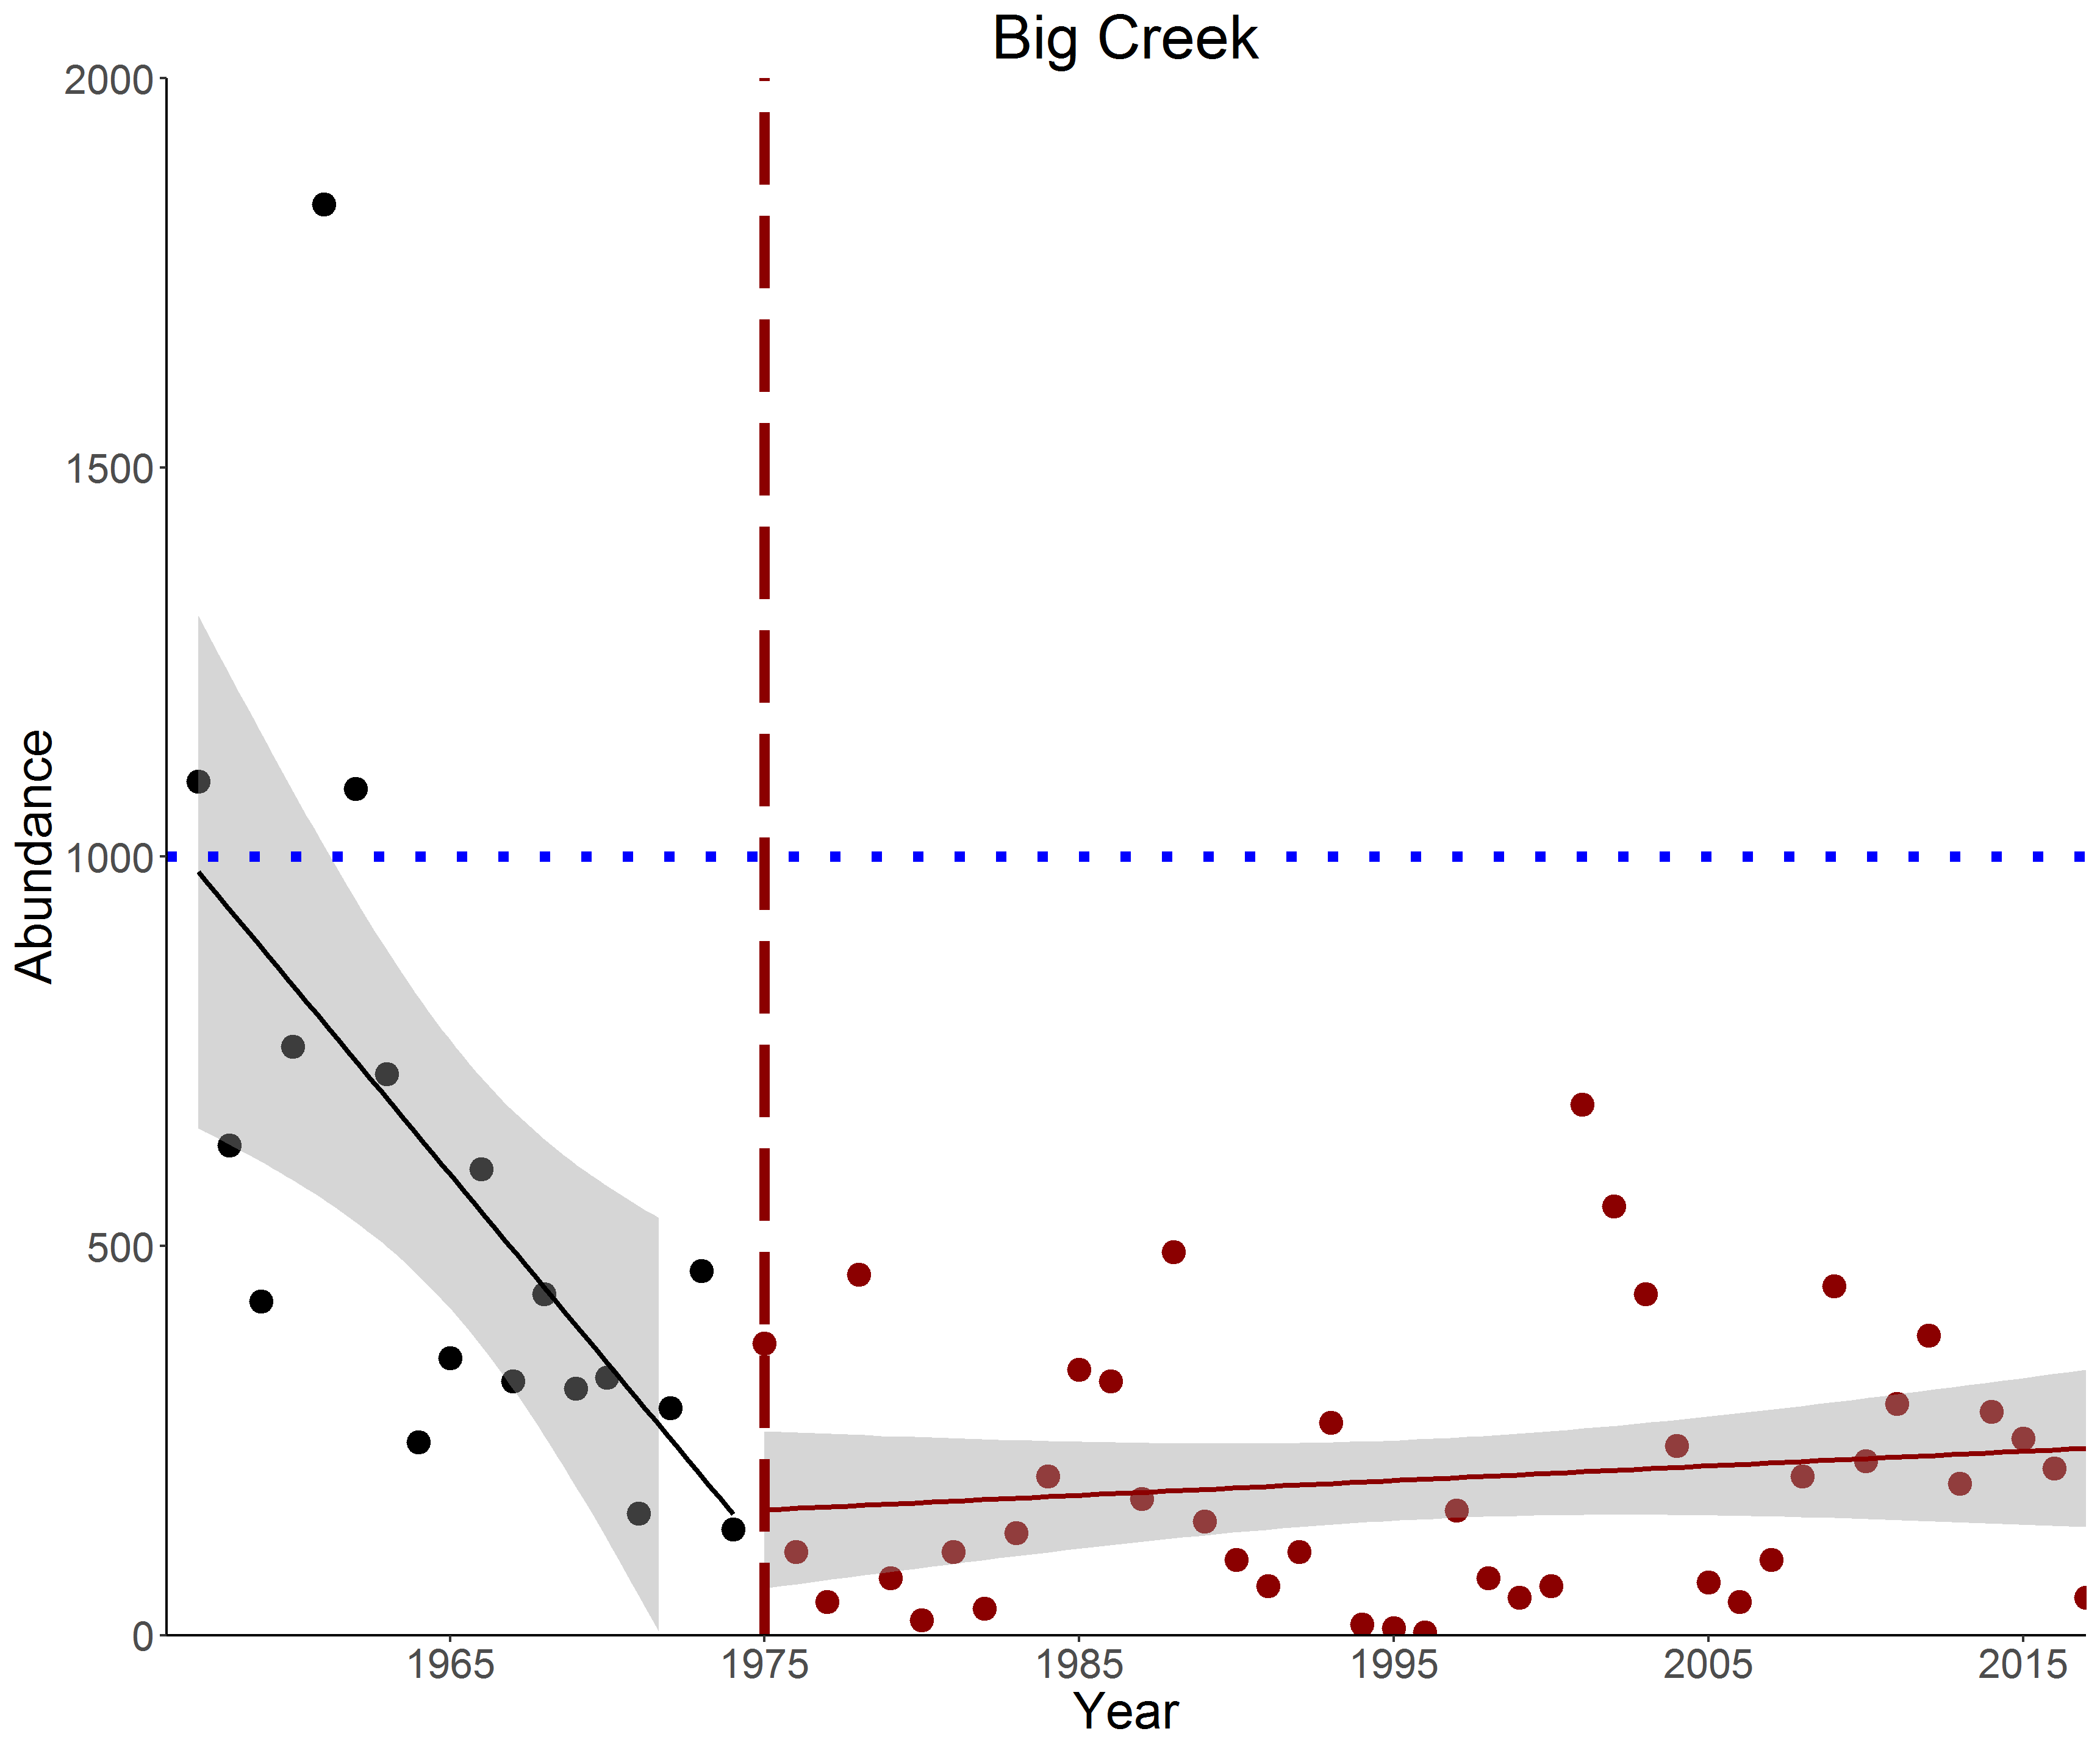
Chinook Abundance
Middle Fork Salmon River

Slide 8
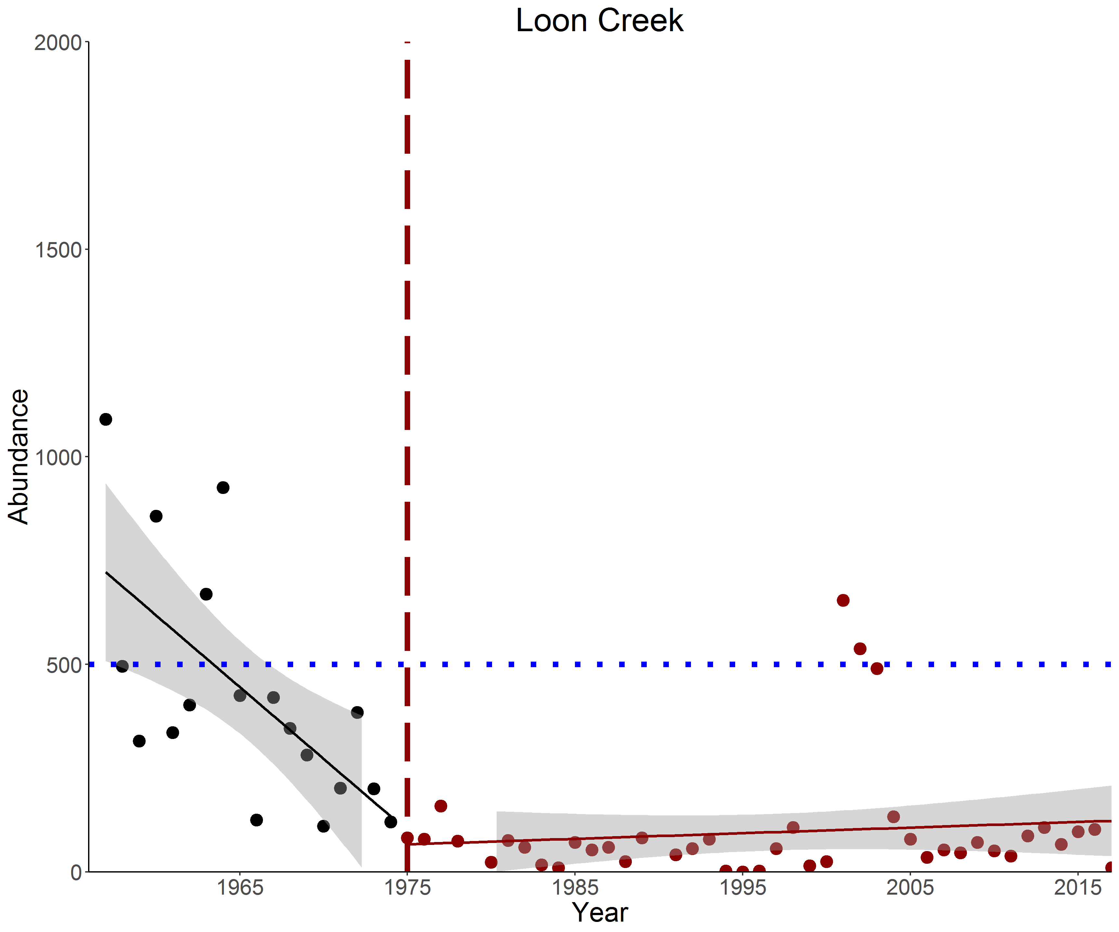
Chinook Abundance
Middle Fork Salmon River

Slide 9
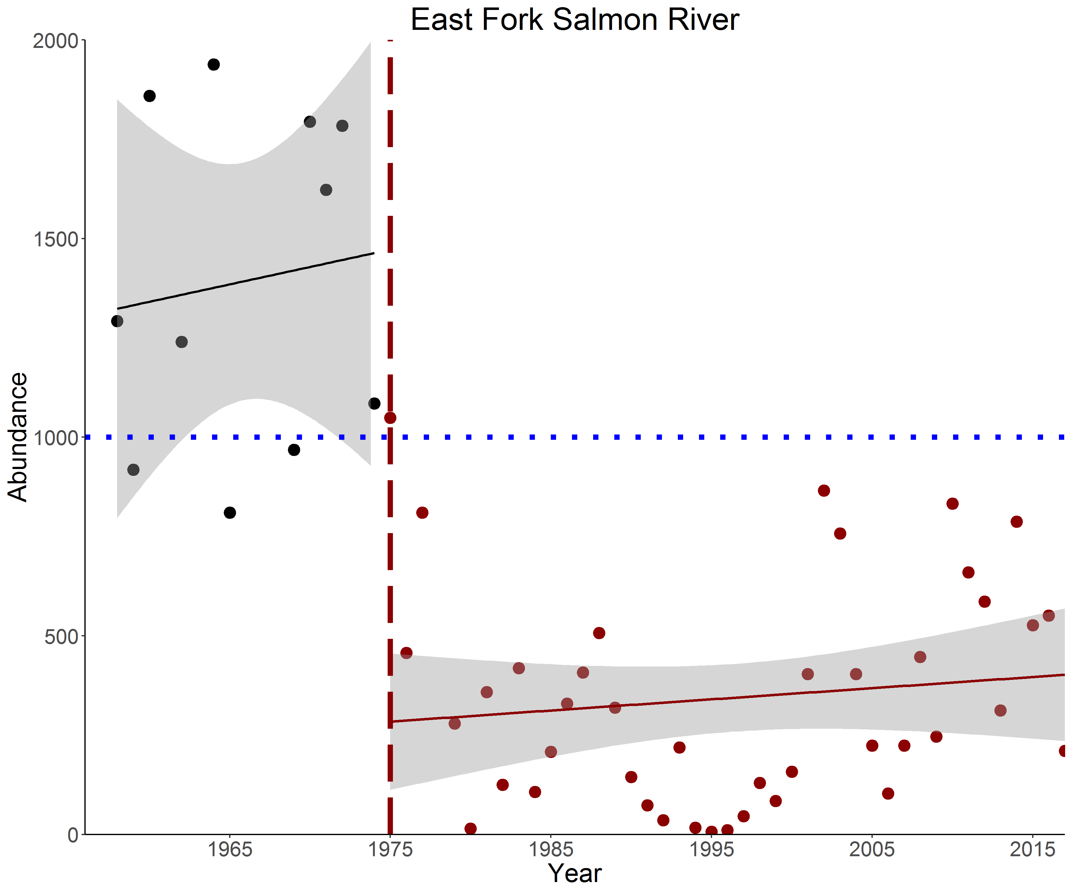
Chinook Abundance
Upper Salmon River

Slide 10
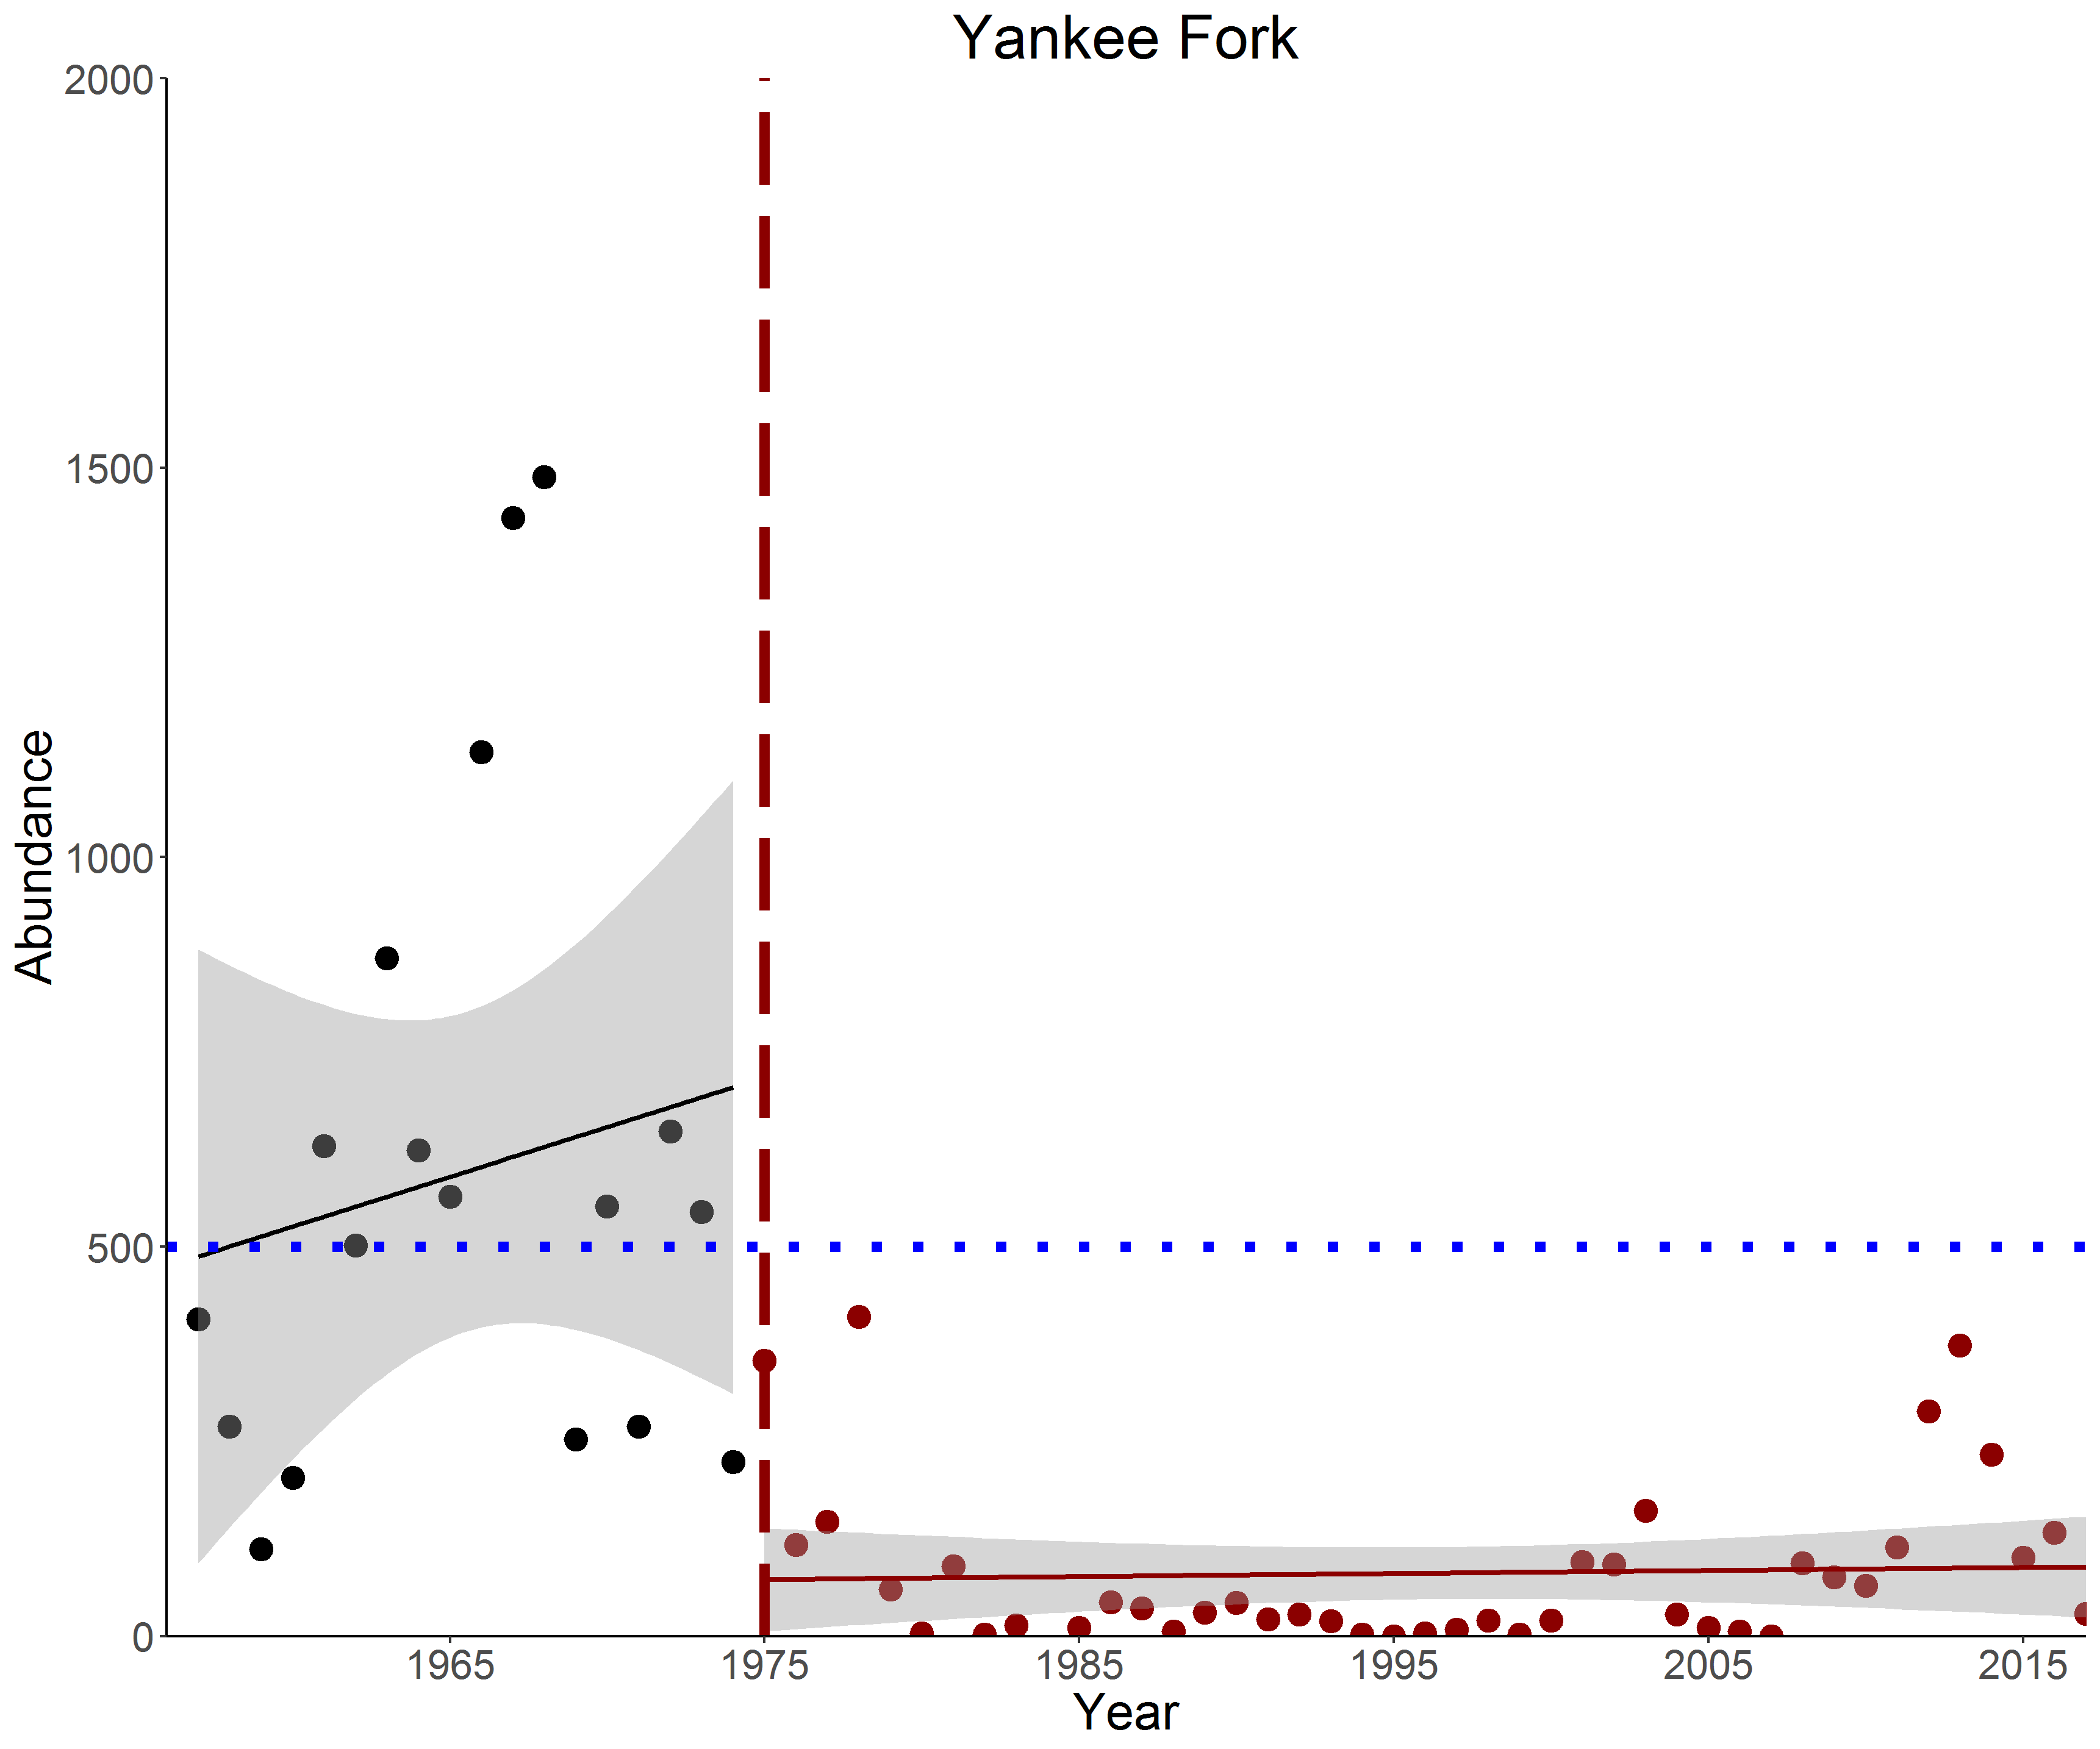
Chinook Abundance
Upper Salmon River

Slide 11
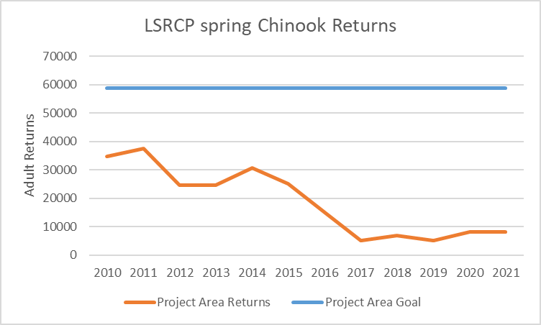
Chinook Abundance
Hatchery Fish

Slide 12
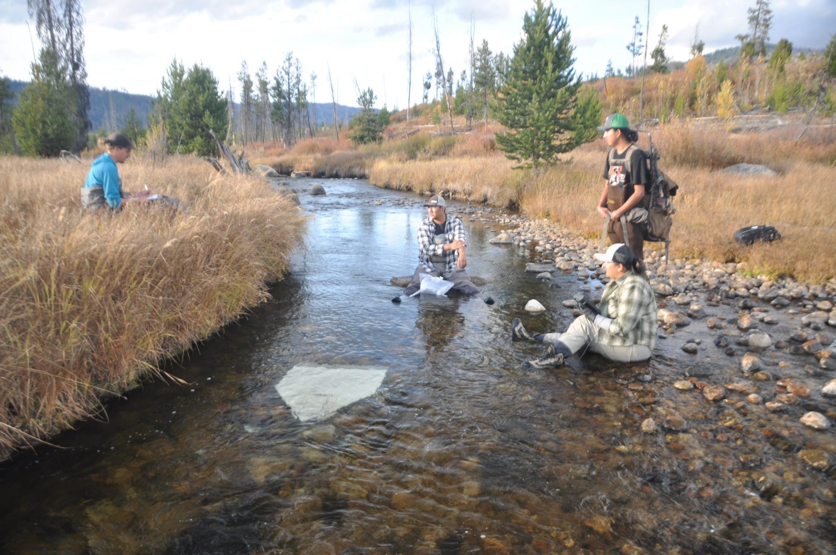
Changing Gears
Research On Egg
Supplementation Advances

