Slide 1
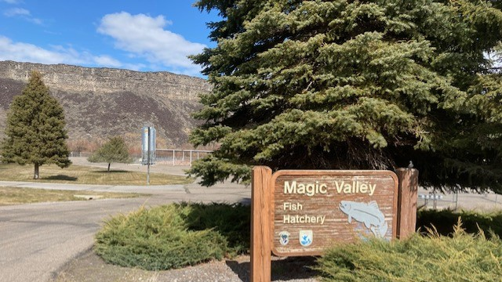
Magic Valley Steelhed Hatchery Rebuild

Slide 2
History
Hatchery built in 1985.
32 – 200ft long concrete raceways.
Traveling bridge on top of raceways.
Walls began to deteriorate in the late 90’s at each of the expansion joints. There are 720 expansion joints.
Spalling became bad enough that the hatchery began making repairs in the mid 2000’s.
Spent 25k each of the last two years to keep the raceways usable and the bridge operational.

Slide 3
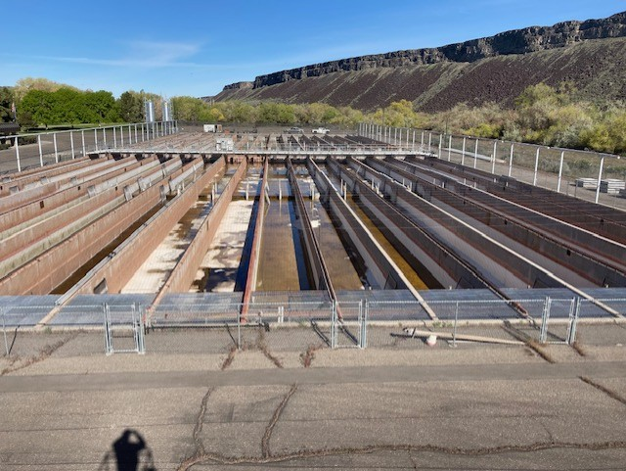

Slide 4
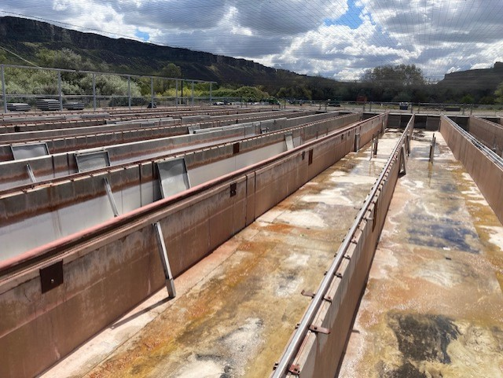

Slide 5
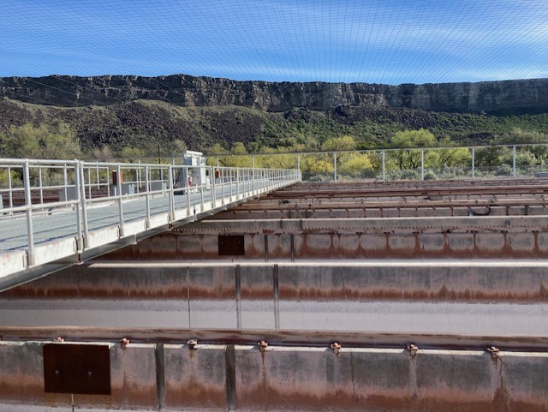
Traveling bridge

Slide 6
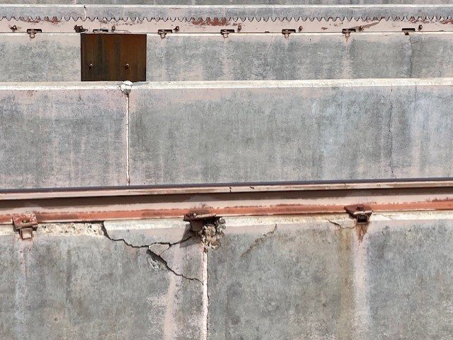
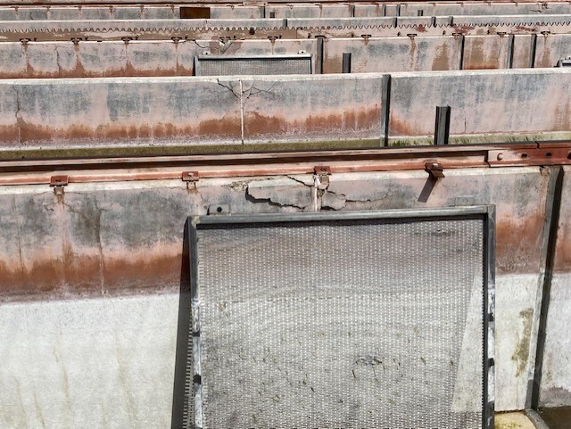
Spalling at expansion joints

Slide 7
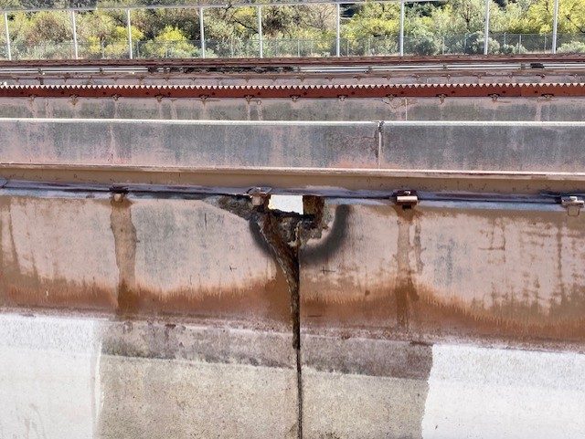
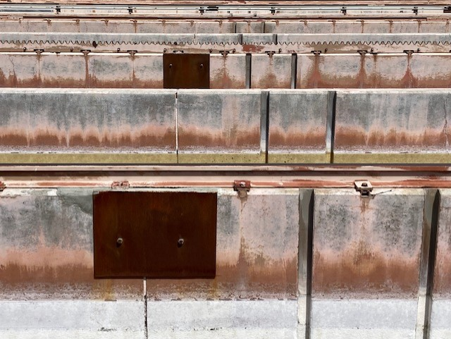
Spalling repairs

Slide 8
Big issues to consider with rebuild
Waste load allocations
  Total Phosphorus proposed to be reduced from 21.7 lbs/day to 10.3
Disease – IHN and Cold Water disease
Manpower
Marking and tag groups
Cost

Slide 9
Rearing container types
Concrete raceways
  Same as existing
  Paired
Circular tanks
Circular tanks with partial re-use
Large rearing ponds

