Slide 1
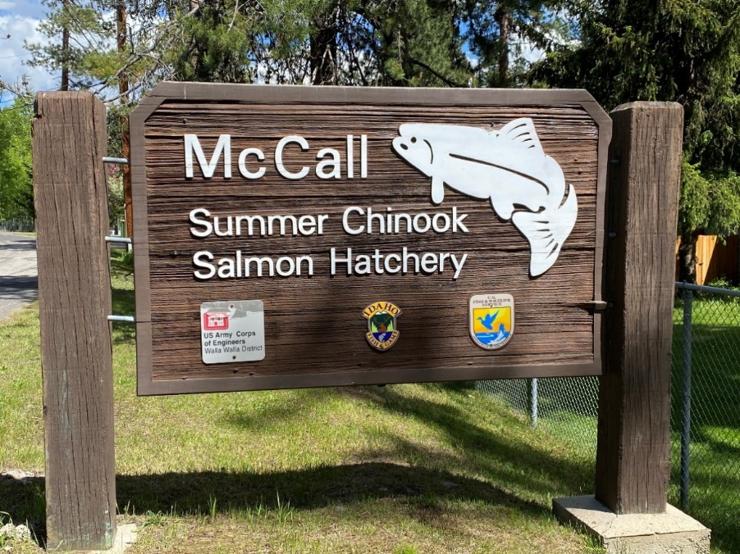



McCall Fish Hatchery
Overview
New Adult Holding Ponds
Phosphorus
Production Changes

Slide 2
McCall “National” Fish Hatchery
Anadromous – Since 1979
South Fork Salmon SUCH
11K Adults to LGD
850K Ad clipped SEG
150K CWT only INT
150K CWT only JCAPE
300K Eyed Eggs for SBT RSI
~18 months to release size
Support M&E projects
Resident – Since 1944
Coastal Rainbows, Westslope Cutthroat, Golden Trout, Arctic Grayling
R3M Catchable Redistribution
Western and Northern HML stocking - R1, R2, R3
Support other local res production and management projects

Slide 3
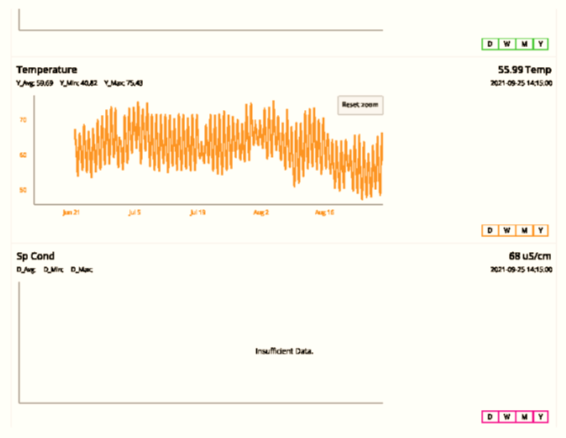
South Fork Salmon River
Trap, Held, and Spawn at the SFSR Adult Trap since Late ‘70’s
Habitat & Climate changes
Water temperature threshold

Slide 4
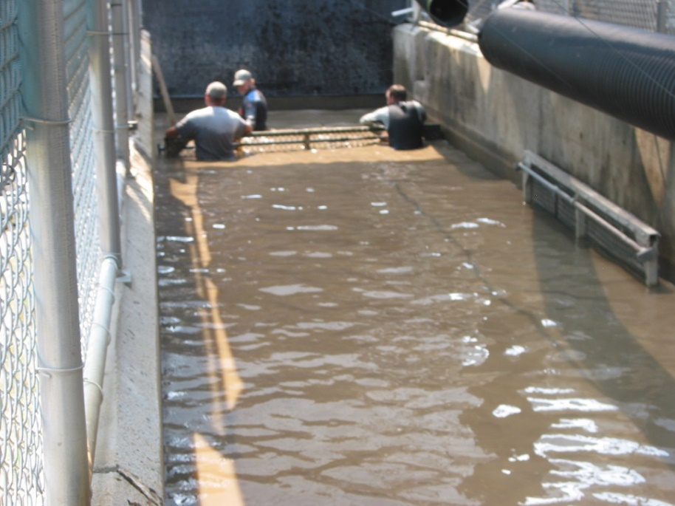
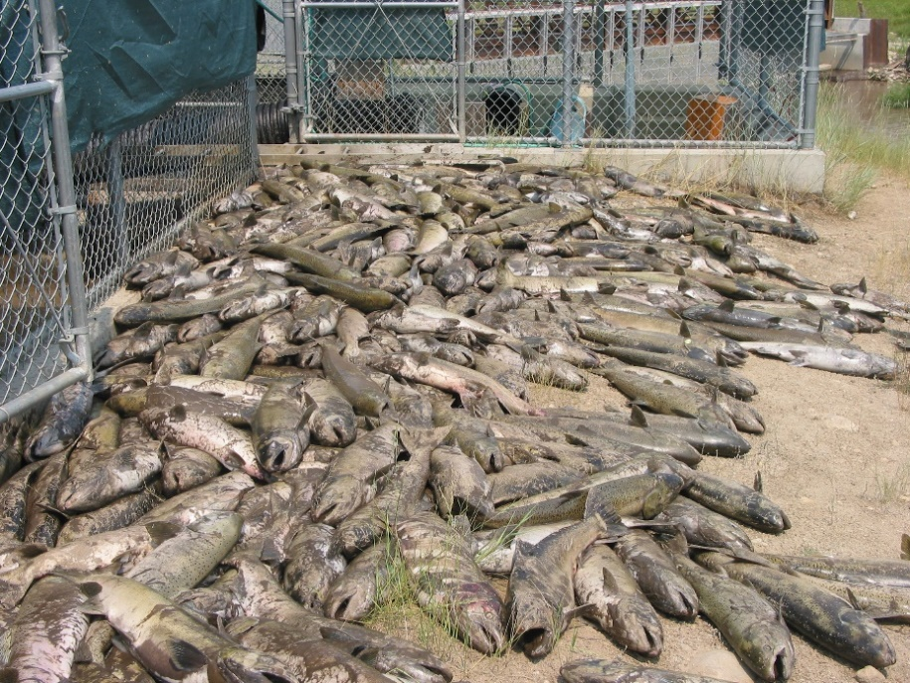
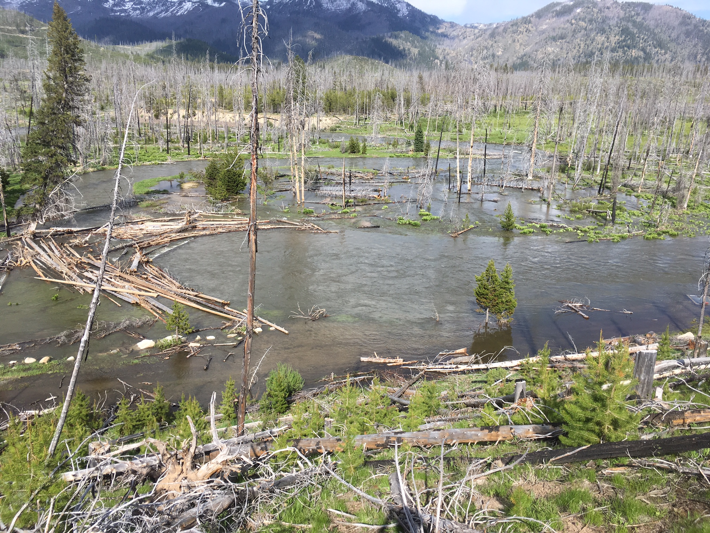
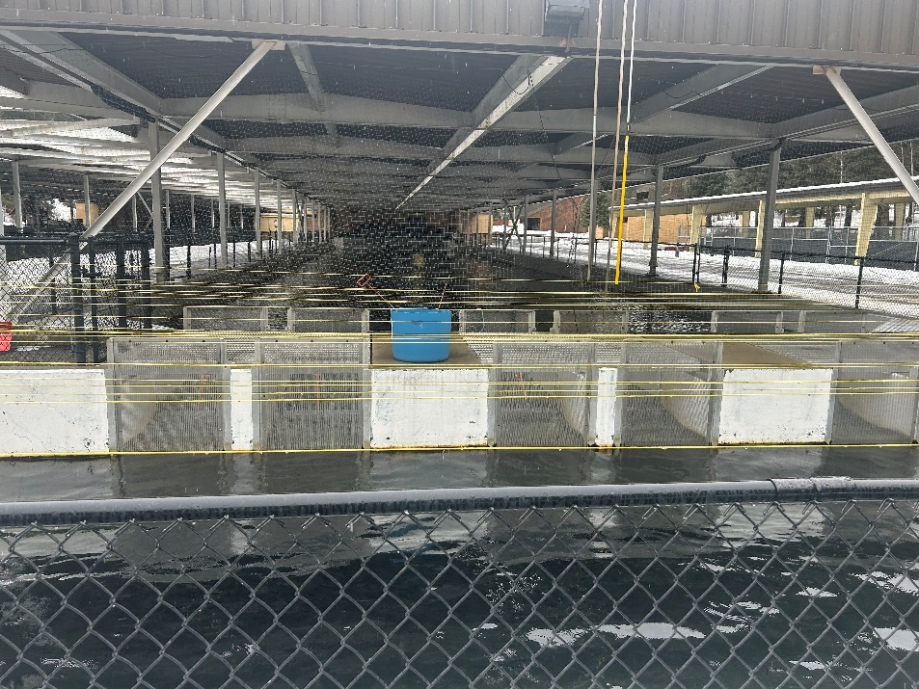

Slide 5
McCall Brood Pond Construction
Broke Ground - 10/17/22

Slide 6
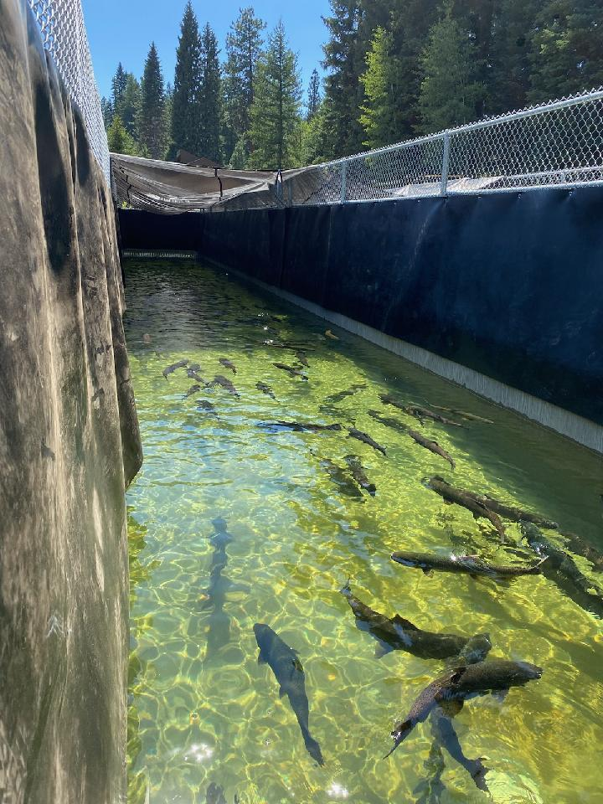
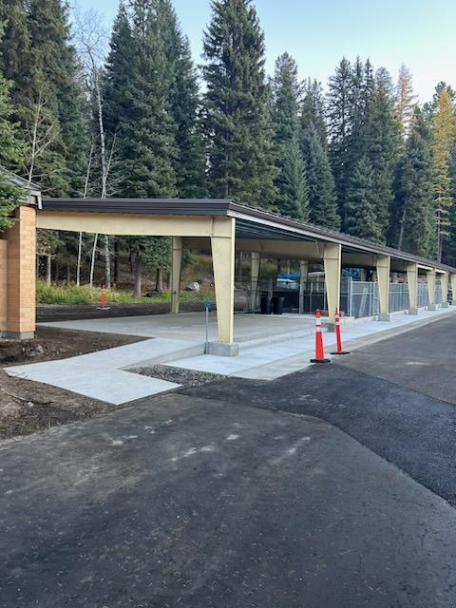
McCall Brood Pond Construction

Slide 7

7,680 cuft new concrete
33% production increase?
Get the JCAPE program on 1st use?
Isolate the Integrated?
Endless possibilities?

Slide 8
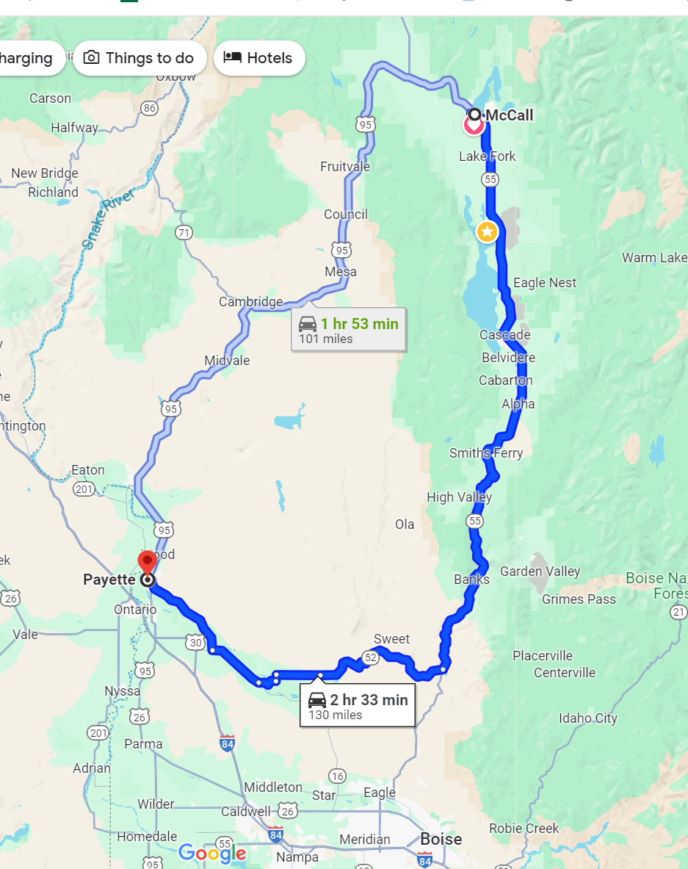
NFPR TMDL
Single Point source for Phosphorus above Cascade Reservoir
Cascade Reservoir – “Impaired”
“Friends of Lake Cascade”
Open the entire Payette River watershed’s TMDL?

Slide 9
Phosphorus
Sample monthly
Report quarterly
480.6 pounds/year

Slide 10
Phosphorus
Idaho Pollution Discharge Elimination System Permitting
1996 WLA = 2.3 lbs/day (839.5lbs/year)
2023 WLA = 1.32 lbs/day (480.6lbs/year)
Springfield Hatchery, (comparable production) - 8.9lbs/day
Dredged set pond in 2023
Moving Forward
Identified highest periods of P discharge
continue to sample monthly
Corelate annual phos load and total pounds of fish in production/pounds feed fed
Modify diet- Lowphos product available*
Goal is to Stay in Compliance and efficiently maintain healthy animals
Turning dials/increasing production will take time

Slide 11
Low Phosphorus Feed
Bio Oregon LP1000
Limitations
Help meet compliance
Time to evaluate

Slide 12
Questions

