Slide 1
Lookingglass Fish Hatchery
Intake, Traveling Screen, and Fish Ladder Replacement
Presented by:
Nathan Paulson (USFWS)
with the assistance of Diane Deal (ODFW) and Andrew Gibbs (ODFW)
Notes:
I am a civil engineer and project manager in USFWS IMD Project Execution Branch. What does that mean? I’m the PM for your projects. My goal at the end of this is for you to have a clear understanding of what “NOAA compliance” means and what that looks like for you and your facilities.

Slide 2
Background
Built in 1982 by USACE
Production goal 1.39m Spring Chinook are released annually
Intake facility provides water to the hatchery from Lookingglass Creek
  Water goes to incubation, 30 indoor rearing troughs, 18 raceways, 4 adult holding ponds, the lower ladder, 3 large and 3 small circulars in Endemic Building and into the settling pond.
  Intake water is screened by two traveling screens
Weirs
  There are two weirs, an upper weir and a lower weir that is no longer in use
  Upper weir has a picket structure to prevent adults from traveling upstream
Lower Fish Ladder
  Comprised of multiple ladder structures built at different times
This is primarily a NOAA Compliance project
Notes:
My next slide has a map so it’ll make a little more sense in a minute
AHPS =
That’s a lot of water! Water rights come into play here. Something to keep in mind is that We can not and will design anything that can provide you more water than your water right allows for!

Slide 3
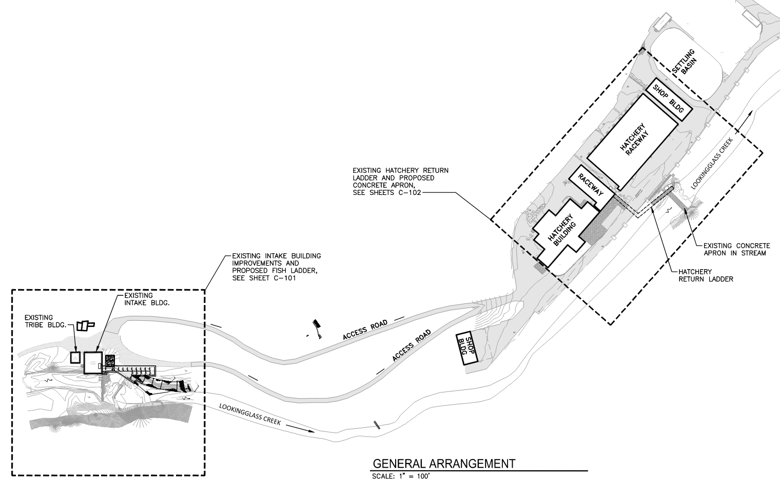
Overview
Notes:
We all love engineer’s drawings and don’t worry there will be more! Work is only occurring at the two highlighted areas.

Slide 4
Project Goals
NOAA-Compliance Project Goals
Address deficient intake screens
Address deficient fish screen juvenile bypass
Modify barrier to adult downstream fish passage (picket structure)
Improve upstream passage at lower hatchery ladder apron
Address fish ladder deficiencies
Operational Project Goals
Improve hatchery adult return trapping & handling
Improve facilities to hydraulically isolate fish screen for maintenance
Provide improved access to the forebay for management of ice
Notes:
Goals identified in the scoping phase of the project. We typically have a scoping phase where an engineering firm does a deep dive into the compliance issues and works with the hatchery to identify these goals. This study was done in 2016, so think far into the future.

Slide 5
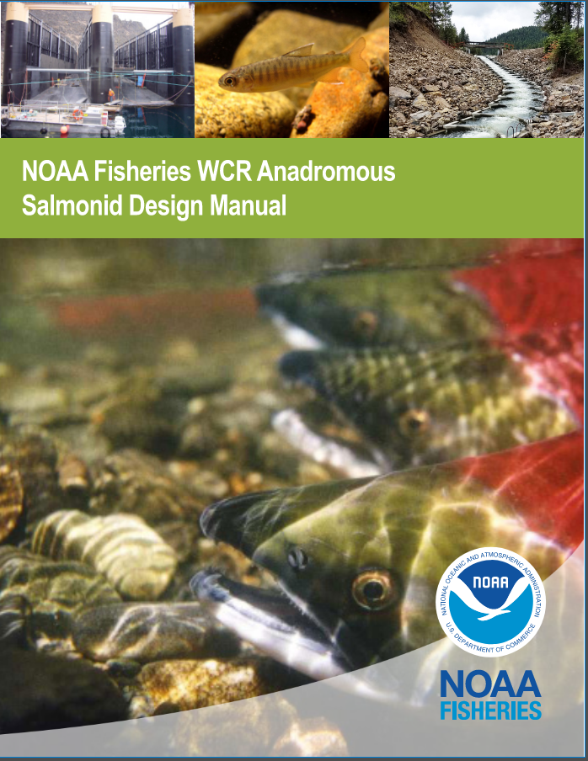
What is NOAA Compliance?
NMFS’s primary goal is the safe passage of fish. See the design manual
Many different fish have been getting past the traveling screens, including wild salmon smolt and fry, lamprey, trout, and more.
These fall into several categories
Current version released February 22, 2023
Notes:
If you ever have trouble falling asleep at night, give this a read. Fortunately, I have you for the next 3 hours, so you should leave here with a good understanding of what NOAA NMFS looks at for fish passage….
NMFS says that’s their motto and they really do mean it.

Slide 6
What is NOAA Compliance?
Broken into five categories
  Upstream Adult Fish Passage Systems
    Fish way entrance, auxiliary water systems, transport channels, fish ladder design, counting stations, fishway exit control, sediment and debris management, roughened/baffled chute fishways, nature-like fishways
  Exclusion Barriers
    Picket and weir barriers, drop structure barriers, behavioral barriers
  Adult Fish Trapping Systems
    Types of traps, fish handling criteria, trap design criteria, lifting devices, single holding pool taps, upstream transportation criteria
  Fish Screen and Bypass Facilities
    Existing fish screens, new fish screens, screen design specifications, bypass systems, water drafting, horizontal and conical screens
  Operations and Maintenance
Notes:
This is how the anadromous salmonid design manual is organized. I won’t go into too much detail here, but this is kind of an outline for what you’re about to see. (SKIP SUB POINTS)

Slide 7
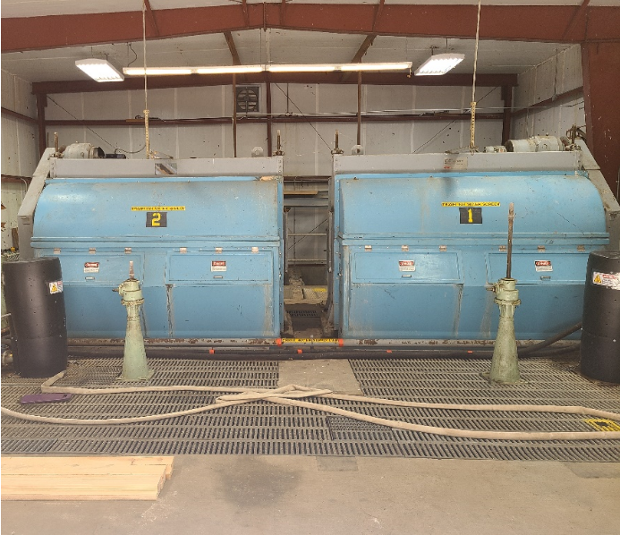
1. Intake Screen Replacement
Existing screens are showing signs of wear – misalignment, gaps, worn seals, etc.
  Causing other species to get into the hatchery (3 ft lamprey)
New screens will be installed to remedy these issues and improve maintenance and operability
Notes:
Original screens to the facility and are in dire need of repair.

Slide 8
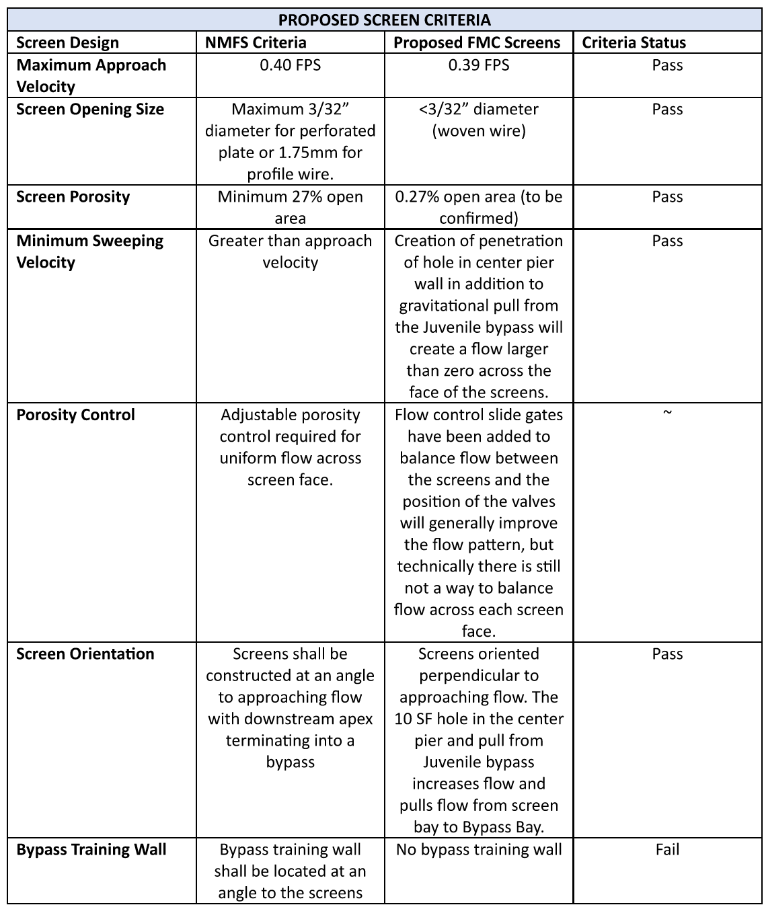
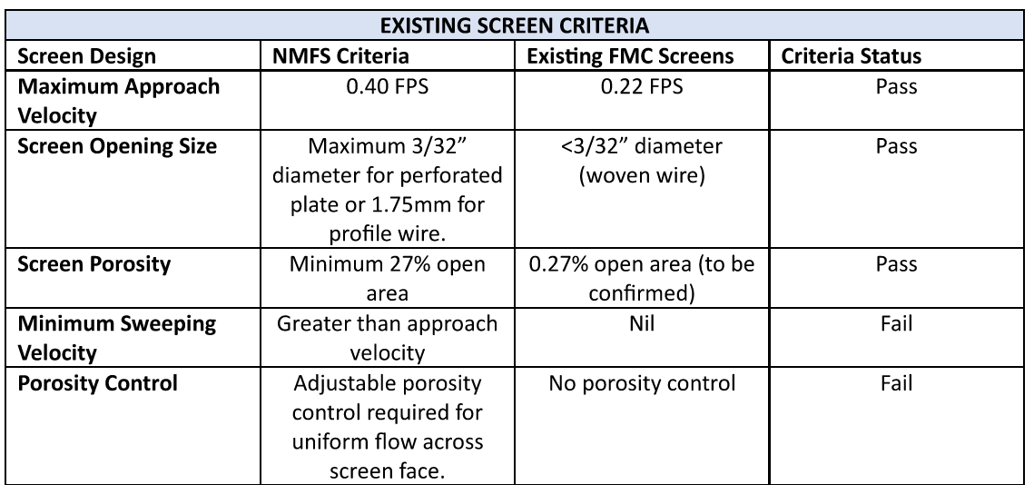
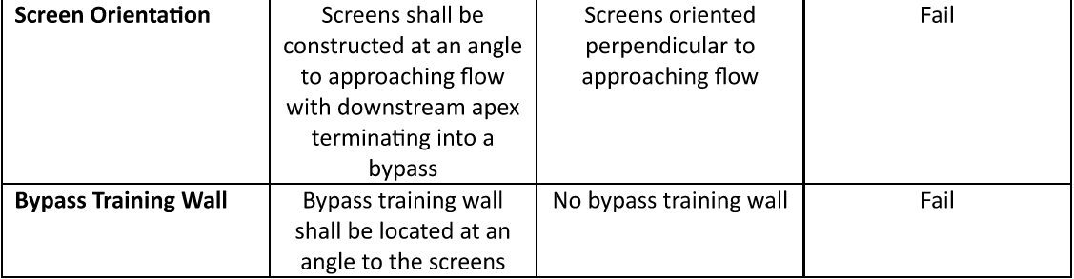
Notes:
Just pay attention to the red on the left and what it looks like on the right. I know, we’re not fixing all of it, but this is the nature of retrofit projects. Those are the words that NOAA used when we met with them

Slide 9
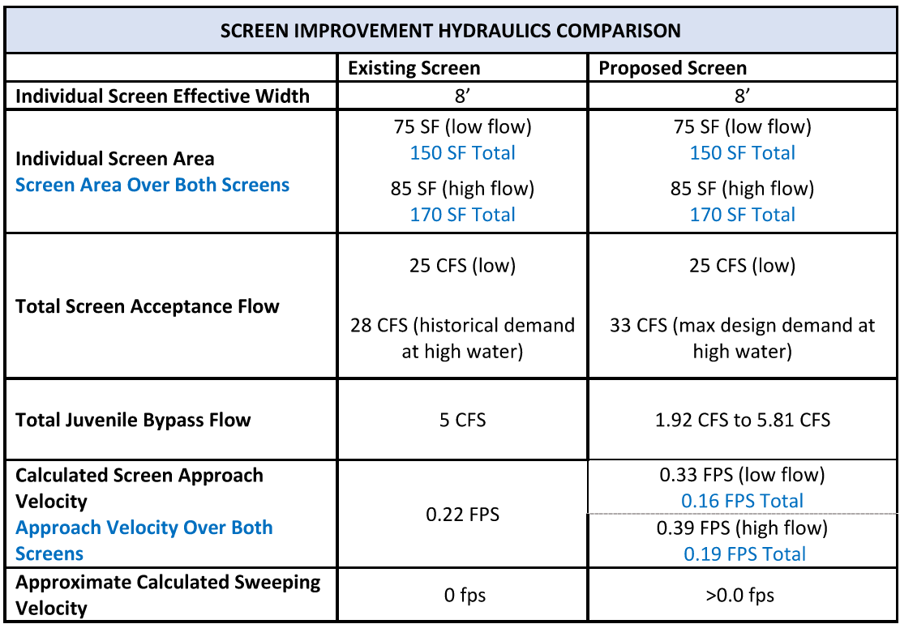
8.17 CFS to 9.92 CFS
Notes:
Approach velocity is already compliant
Sweeping velocity is improving, but not in a measurable way and depends on operation of the screens. NMFS was ok with this when we met
We’re about to get to the juvenile bypass

Slide 10
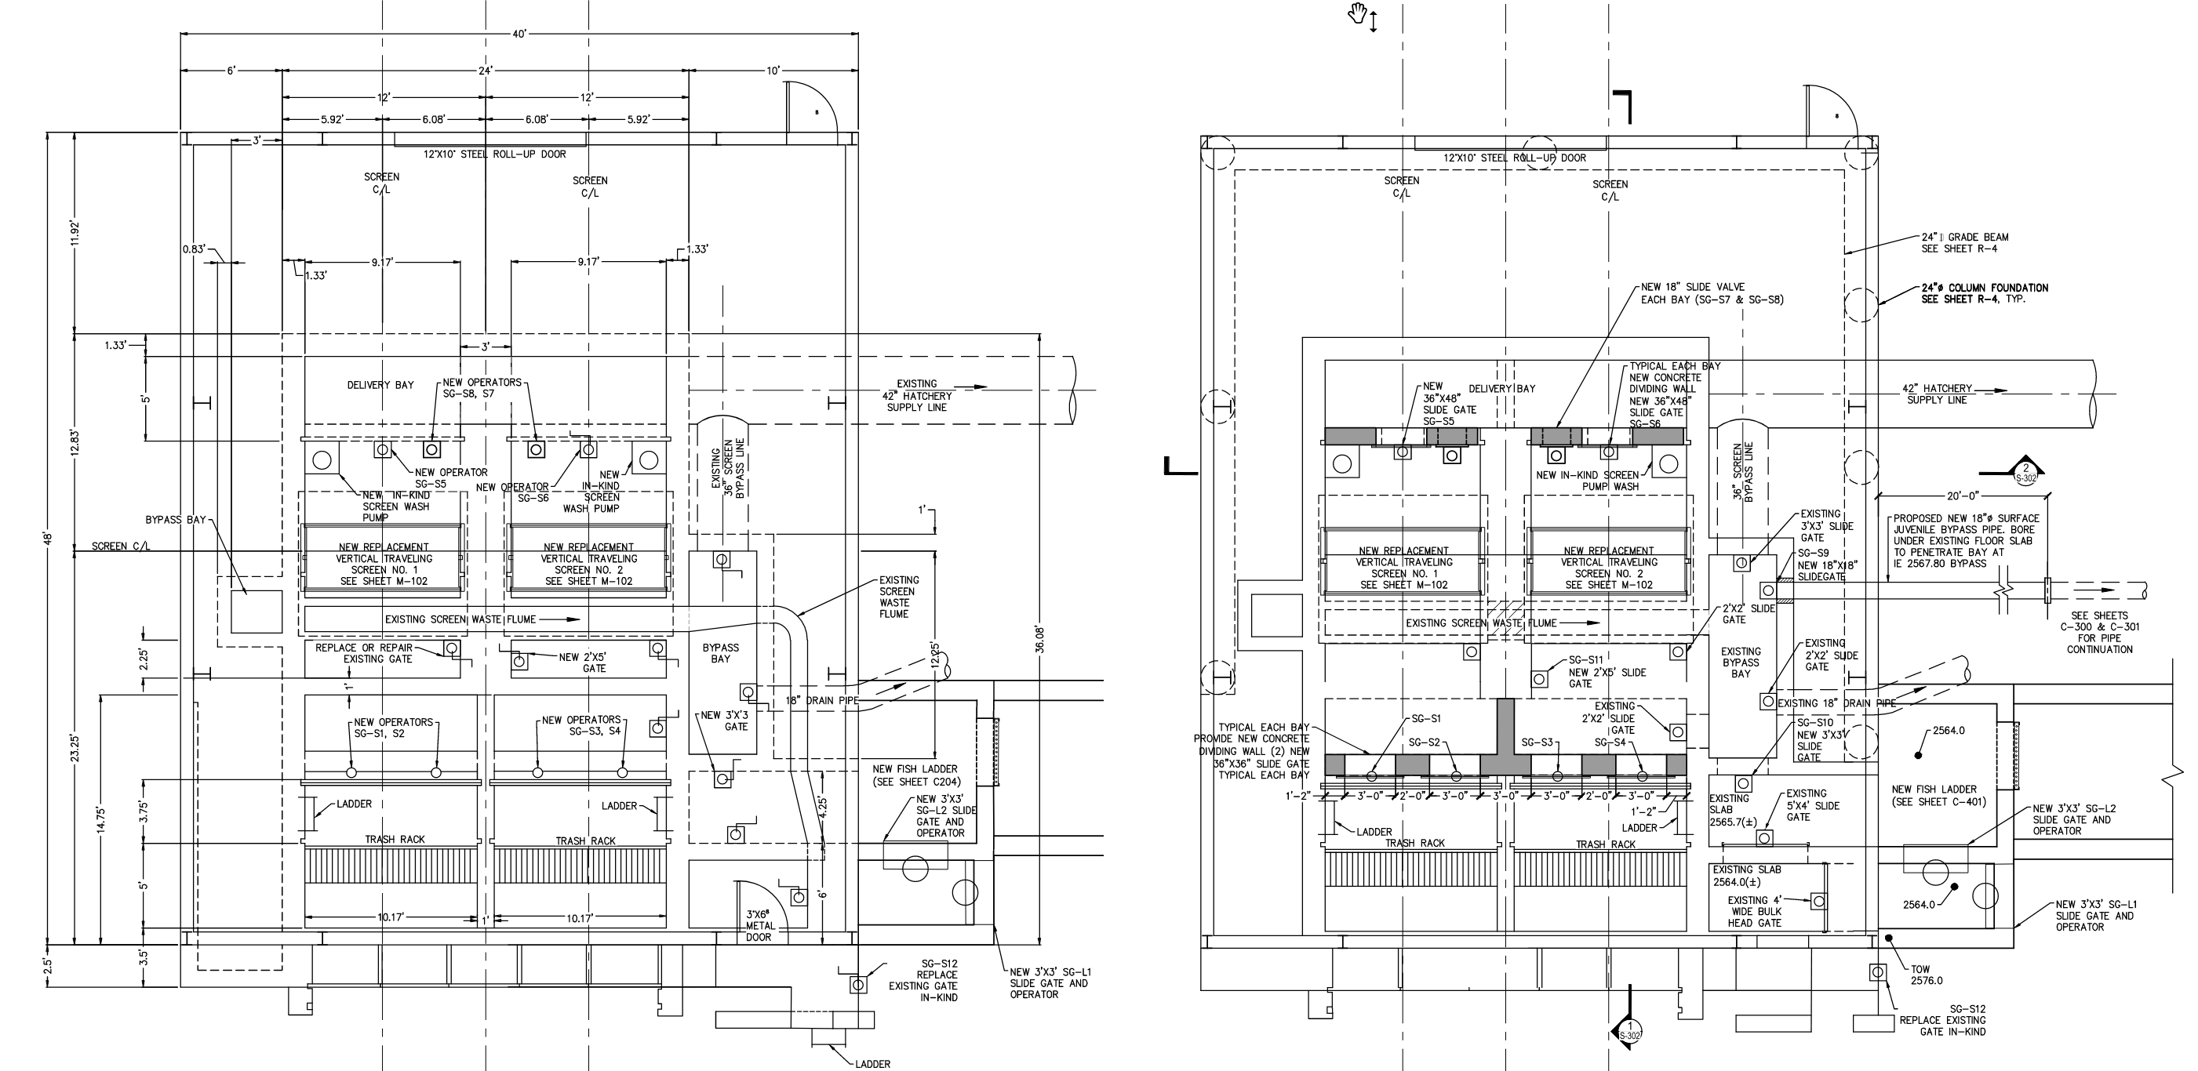
1a. Intake Structure Modifications
UPPER LEVEL
LOWER LEVEL
Notes:
I know this is hard to read, but bear with me. Just look at these highlighted areas.
Blue is the screens
yellow are structure modifications to allow for screen isolation
red is where a new penetration will be installed to allow for sweeping velocities
green is juvenile bypass
And orange is temp intake bypass

Slide 11
1a. Intake Structure Modifications
Ability to isolate each screen – concrete work and new gates needed
Sweeping velocities – cutting hole between bays
New juvenile bypass
New intake bypass
Notes:
-Increased safety and maintainability for ODFW personnel
-Sweeping velocities will be encouraged based on how the facility operates the newly installed gates to push some fish toward the bypass
-Juvenile Bypass is next slide
-New intake bypass – almost like it was designed to be there, but never installed

Slide 12
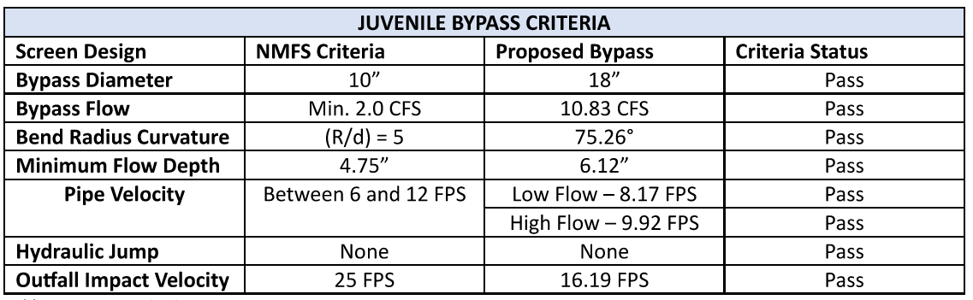
2. Fish Screen Juvenile Bypass
Current bypass is not used and is located on the floor of the intake, which is not compliant with NMFS criteria
New bypass will add sweeping velocity and the entrance will be raised from the bottom of the intake structure to the water line
Notes:
The designer wanted to use a 12” pipe was compliant, but NMFS requested they consider the 18” pipe again to reduce velocity because it was very close to 12 FPS. Remember, NMFS has to sign off on this and some battles aren’t worth fighting.

Slide 13
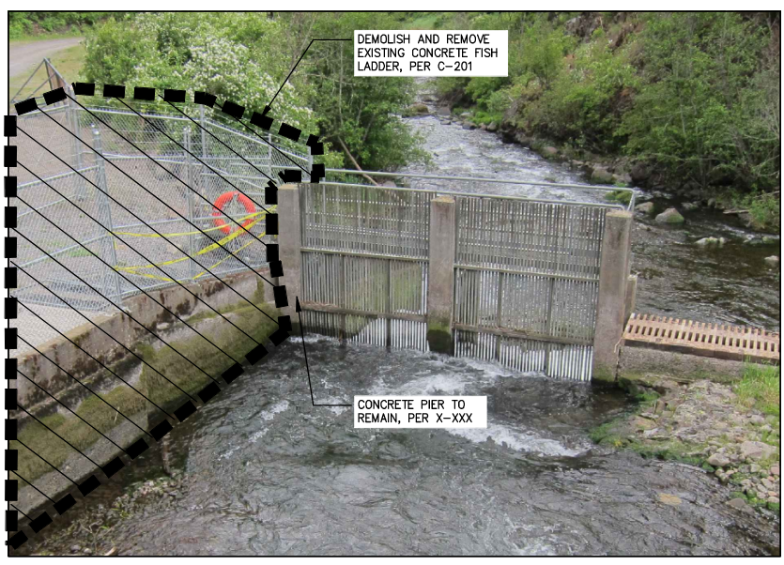
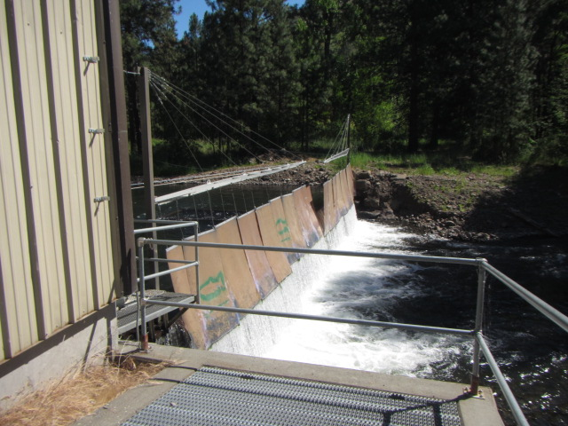
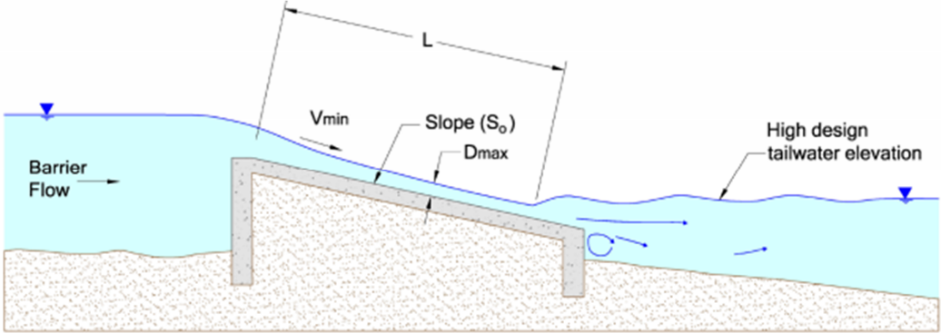
3. Picket Structure Barrier
This picket structure blocks adult downstream passage
Fish that go over the upper weir are stuck between the pickets and the diversion dam.
Picket structure will be removed and replaced with something similar to Tucannon that allows downstream passage, but blocks upstream passage
We could have installed a velocity barrier for ~$2m more
Notes:
Velocity would reduce velocity to encourage fish to go up the ladder

Slide 14
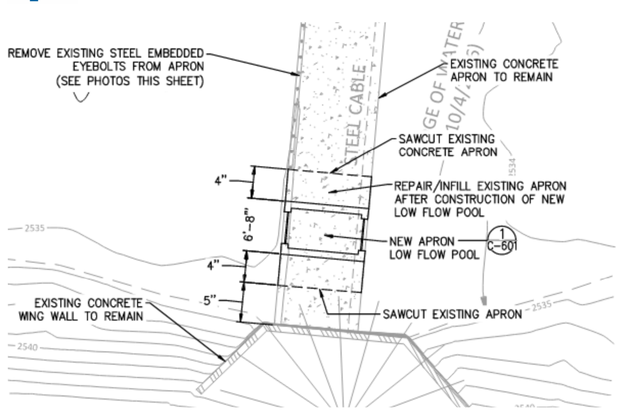
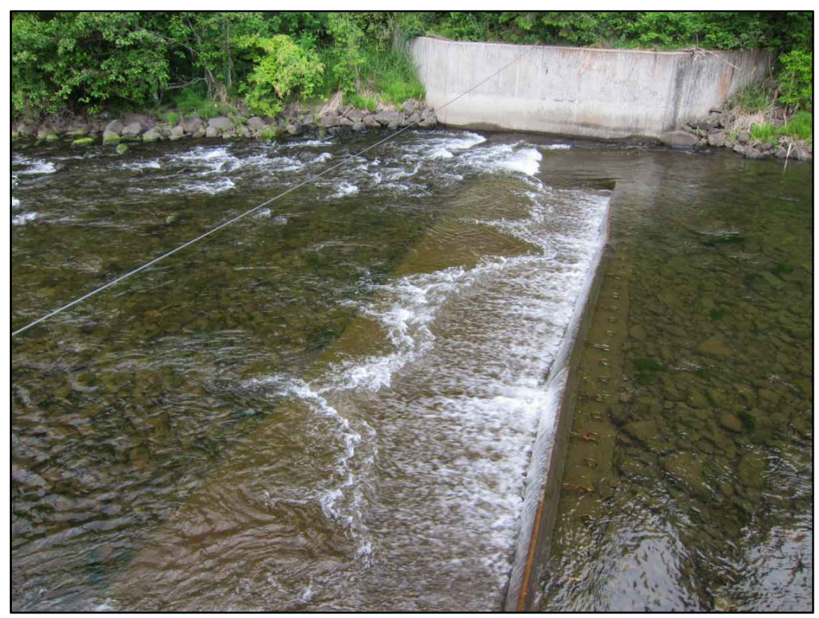
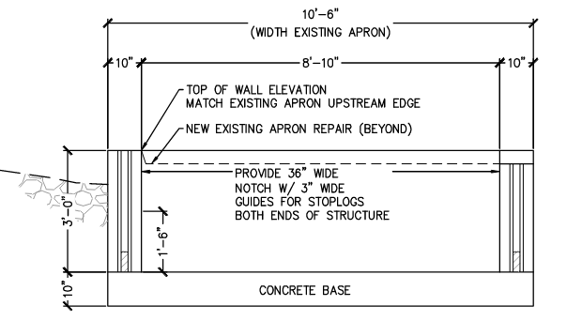
4. Lower Weir Modifications
In low flow conditions, passage cannot be achieved with the existing sill in place.
A ‘low flow pool’ will be installed to fix this and direct attraction water to lower ladder.
Notes:
Yes, this will fill in with sediment, but it can be cleaned out by pulling the stop logs and allowing the river to clear it out. This is a permitting requirement and was non-negotiable.

Slide 15
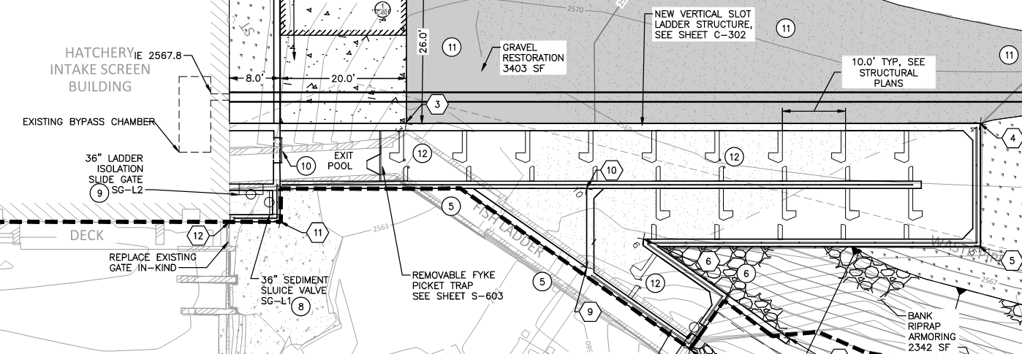
5. New Fish Ladder
Existing ladder made of multiple ladders built at different times
Denil style ladders do not conform to NMFS criteria (ODFW has special criteria for Denil style ladders that are also not met by the current ladder)
  Juvenile and some adult passage has been limited due to ladder height and gradient
New vertical slot ladder will remedy these issues
Notes:
Ladder is longer, so it required extra space to install. This can be a challenge when addressing ladder compliance issues.

Slide 16
Operational Goals
Improve hatchery adult return trapping & handling
  There will be significant efficiencies gained with the new ladder and adult trap
  The new ladder will also facilitate year-round volitional passage outside of adult trapping season
Improve facilities to hydraulically isolate fish screen for maintenance
  This will be achieved by adding gates to isolate the screens
  Now one screen can still run while the other undergoes maintenance
Provide improved access to the forebay for management of ice
  This is being addressed by replacing existing de-icing equipment with new and replacing existing defunct radiant heaters
Notes:
Ice management has been a real problem here historically. They can get really big ice flows coming down the creek, so the addition of radiant heaters replacing the existing de-icing equipment will be huge.

Slide 17
Timeline
FWS Procurement
  February 07, 2024 – September 30, 2024 (at the latest)
  Realistically, project will be awarded in June
Construction
  Traveling screen lead time is 6+ months
  A temporary intake will be installed to allow hatchery operations to continue during construction
  IWWW May 8 – August 7
  All work to be completed by September 30, 2025 with the month of October for punch list and close out items
Notes:
This is going to be a big push for the contractor to get it done within the work window. It will require a lot of cross-coordination between trades and a lot of oversight/involvement from the hatchery staff and myself.

Slide 18
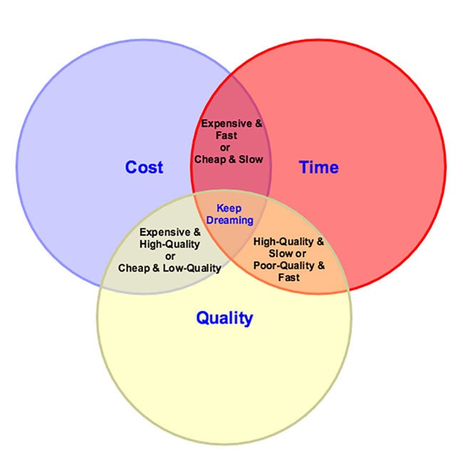
So….
So what does all of this cost?
Can’t share IGE value because we’re awaiting bids, but it’s between $1m and $5m (dictated by the FAR)
We are not completely addressing the NMFS criteria for safe fish passage, but this is normal for retrofit projects and we will have NMFS buy in through their approval of the BO
To fully address the NMFS criteria, it would have been a significantly larger effort that would have resulted in little additional value being added
NMFS is understanding of this at this time
Notes:
FAR = Federal Acquisition Regulation

Slide 19
Conclusion
What does this mean for you?
It is our shared responsibility to fix these deficiencies
We have additional compliance projects coming soon
  Each project is a three+ year effort
Future challenges:
  NMFS timing on the approval of the BO
  Funding/schedule
  Scope and scale of projects require a lot of time and oversight
Notes:
1 scoping, 2 design, 3 construction
HATCHERY MANAGERS BE ENGAGED. You only get out of this what you put into it. Without invested partners and cooperators, the projects will not be successful. I encounter this at refuges all the time, they say, “I’m too busy to help with your project” and then they complain when it doesn’t address their needs that they didn’t disclose.

Slide 20
Thank you!
Questions?
Notes:
HATCHERY MANAGERS BE ENGAGED. You only get out of this what you put into it. Without invested partners and cooperators, the projects will not be successful. I encounter this at refuges all the time, they say, “I’m too busy to help with your project” and then they complain when it doesn’t address their needs that they didn’t disclose.

