Slide 1

To B1 or not to B1
Fish Health and Welfare in a Thiamine-Depleted Ecosystem
Christine Parker-Graham, DVM, MA, Dipl. ACZM
Pacific Region Fish Health Program
LSRCP Meeting- April 26, 2023
The veterinary perspective

Slide 2
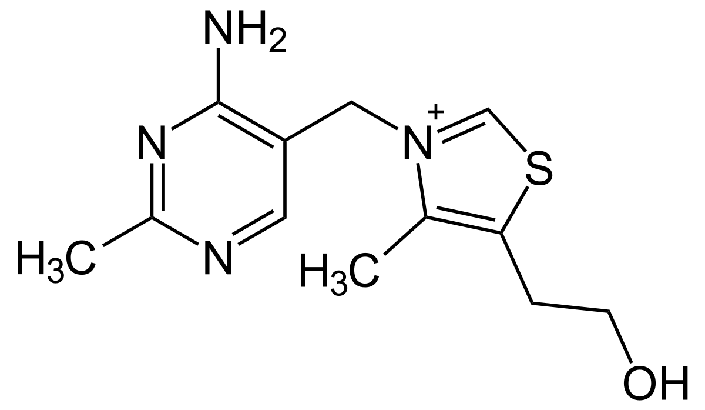
What is Thiamine?

Slide 3
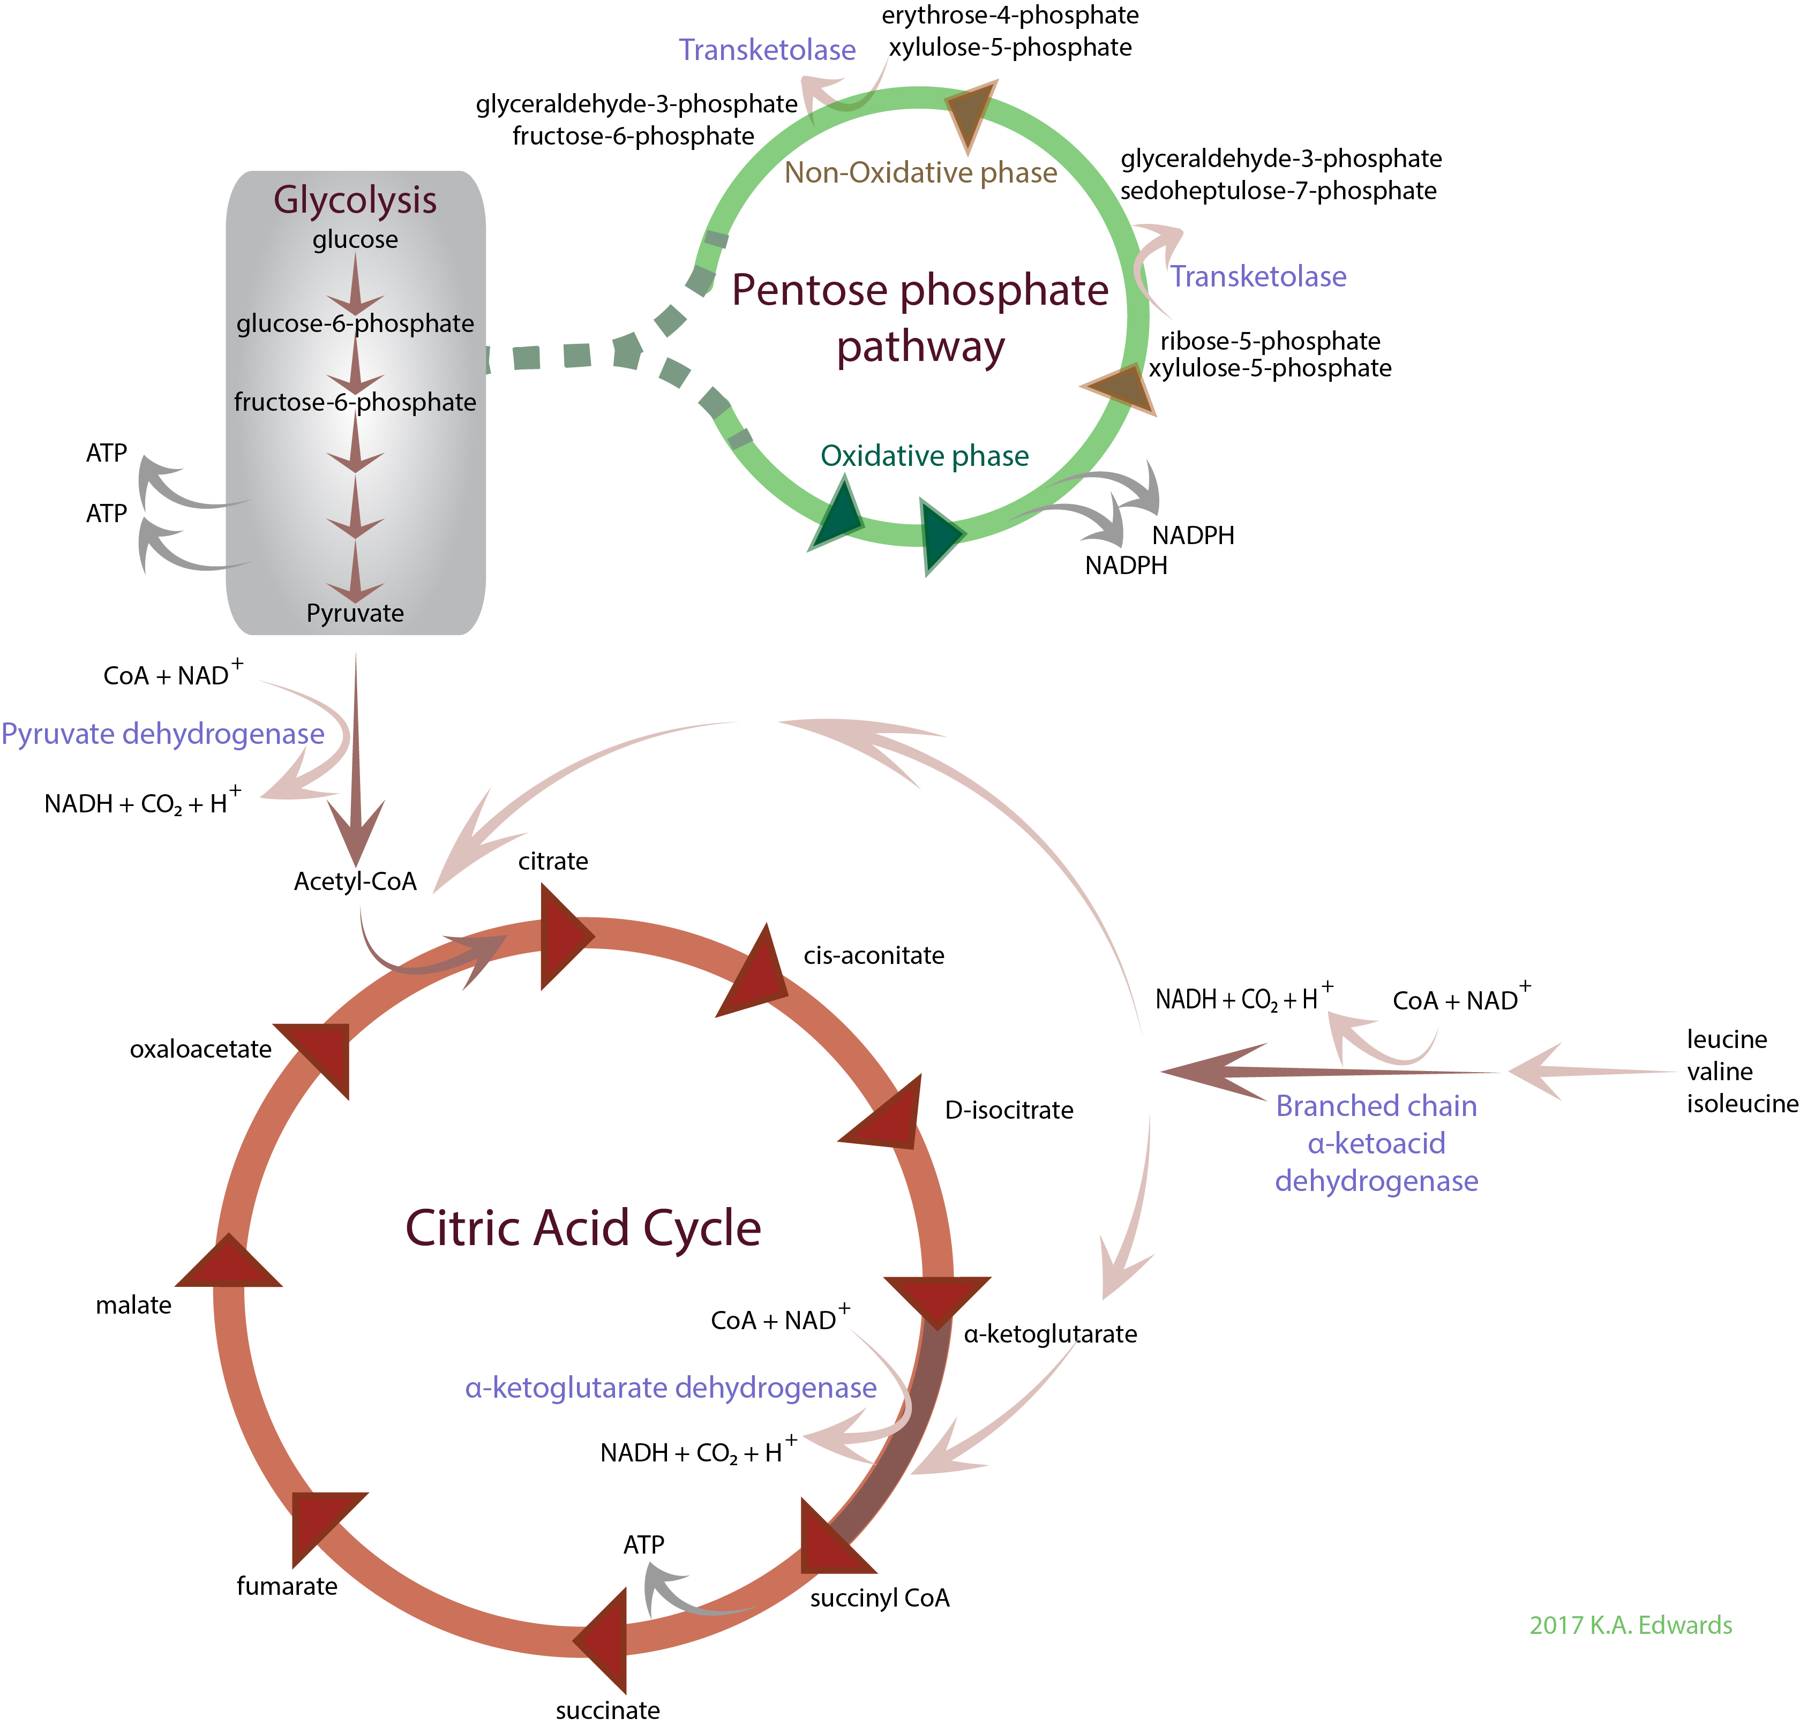

Why is Thiamine Important?

Slide 4
Where do Salmon Get Thiamine?
Bacteria
Zooplankton
Phytoplankton
Salmon
Bait fish

Slide 5
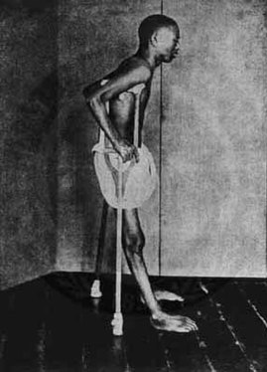
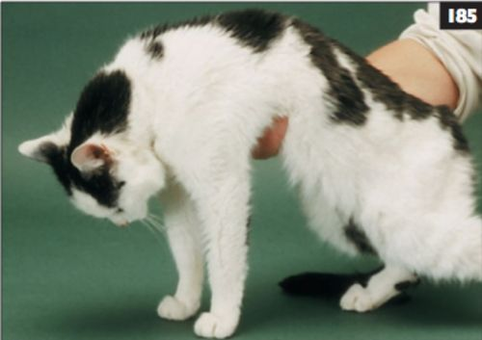
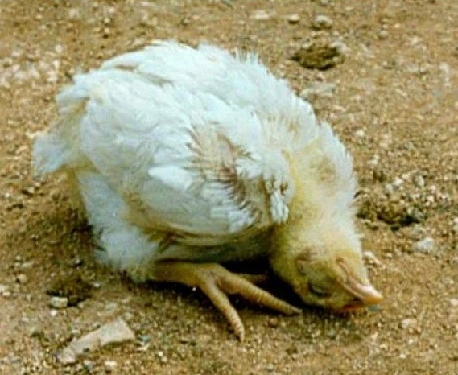
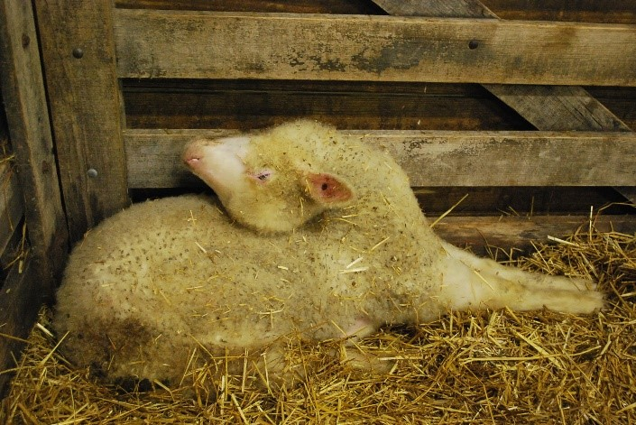
Thiamine Deficiency is Well- documented

Slide 6
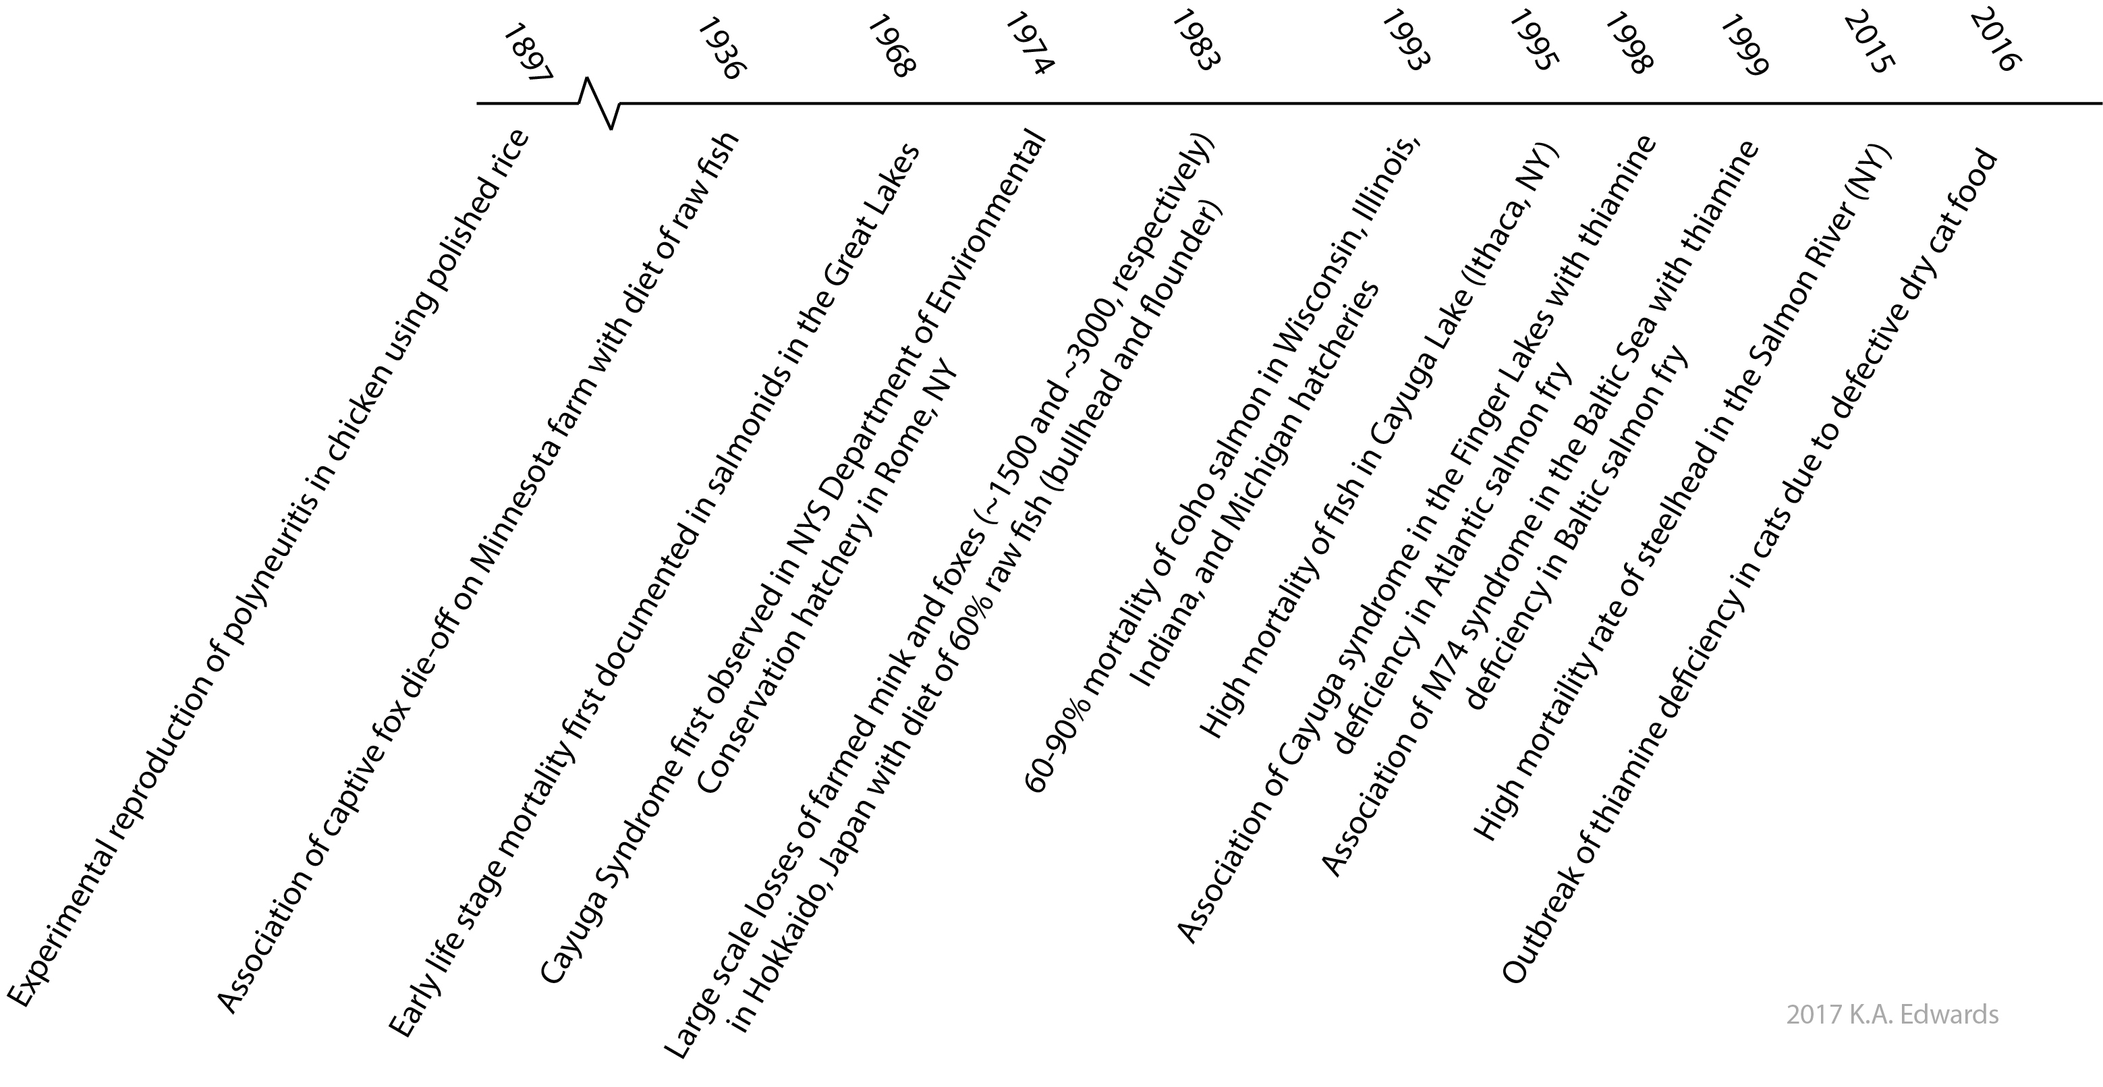

History of TDC on the west coast

Slide 7
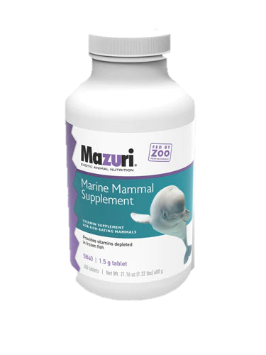
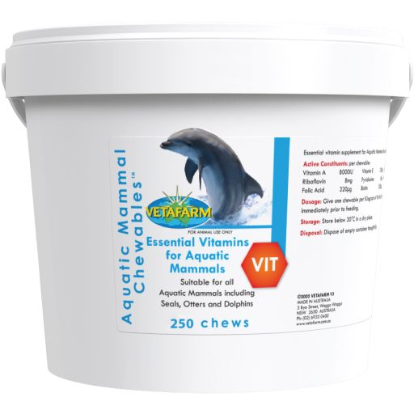
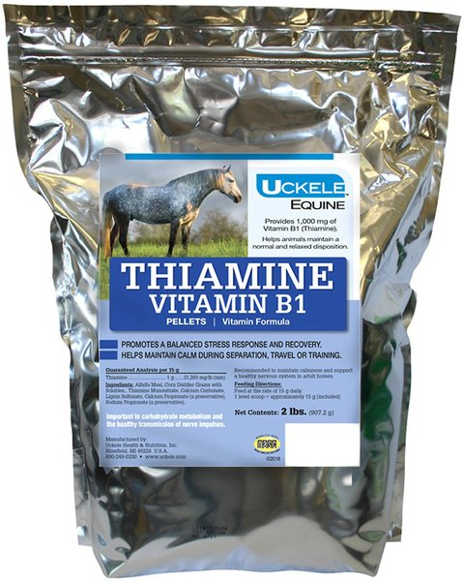
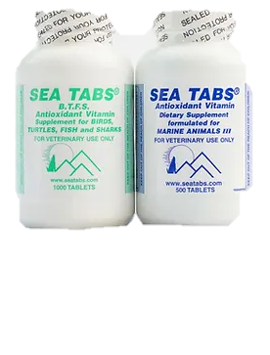
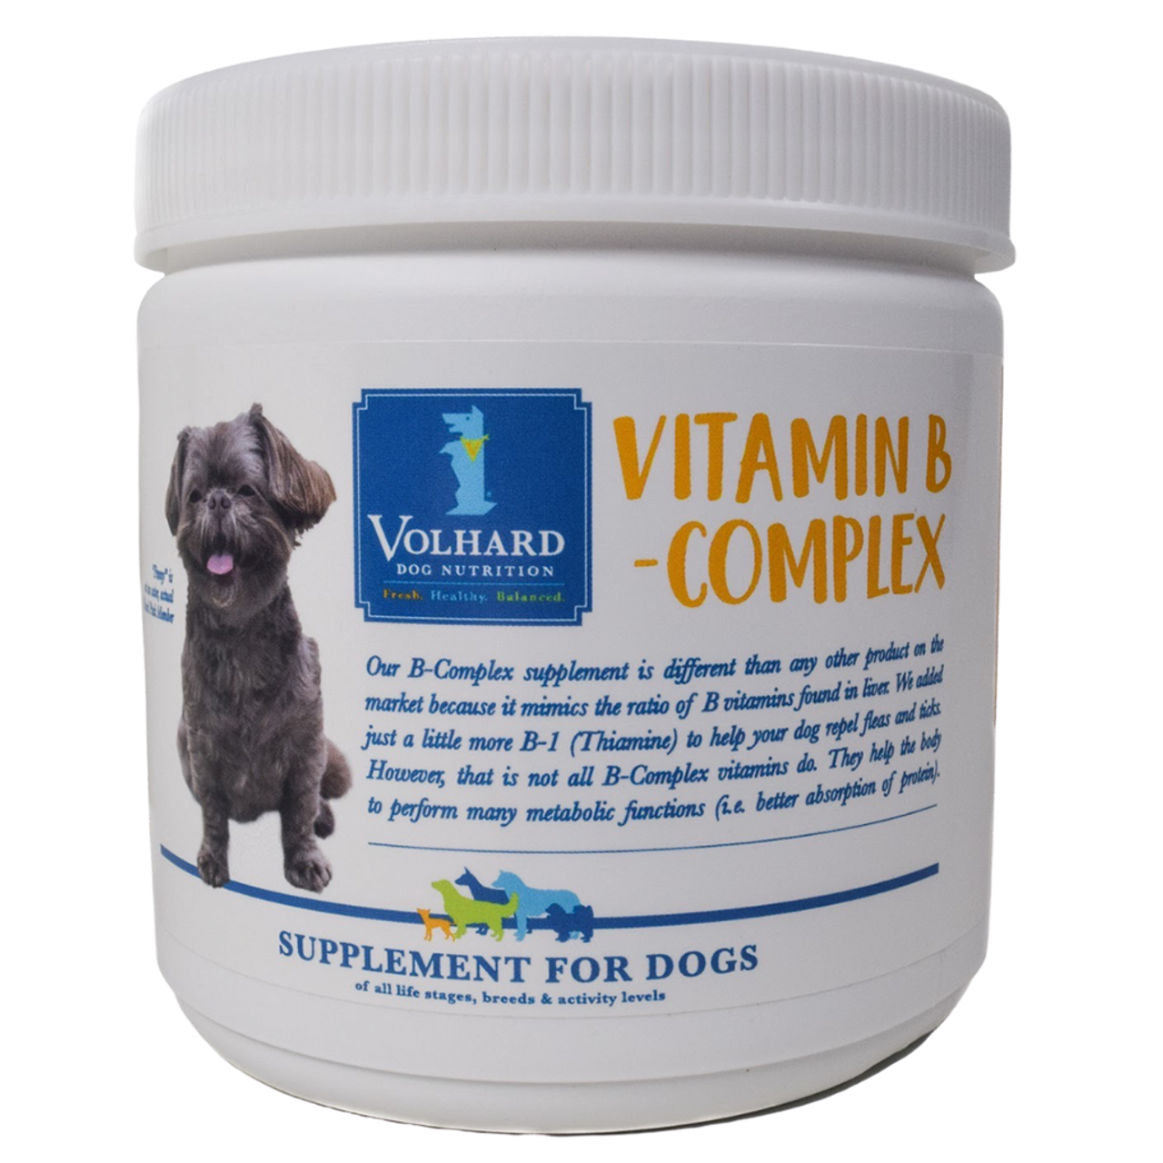
Thiamine Supplementation is Common

Slide 8
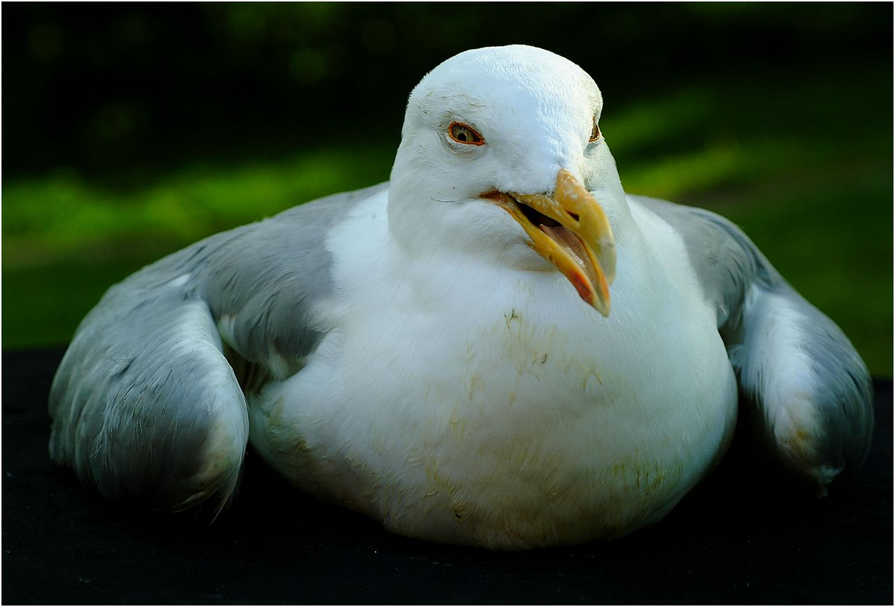
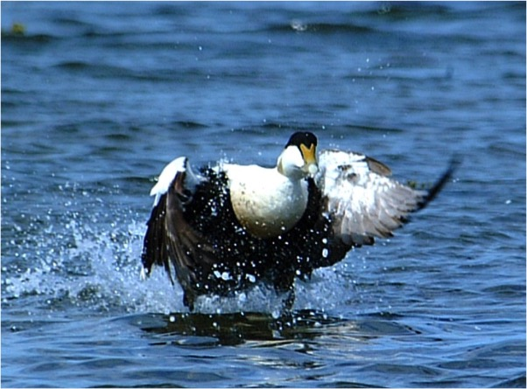
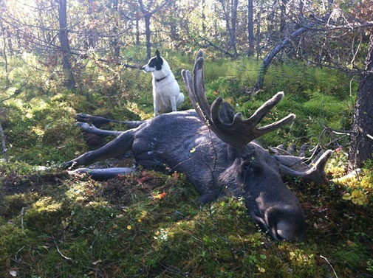
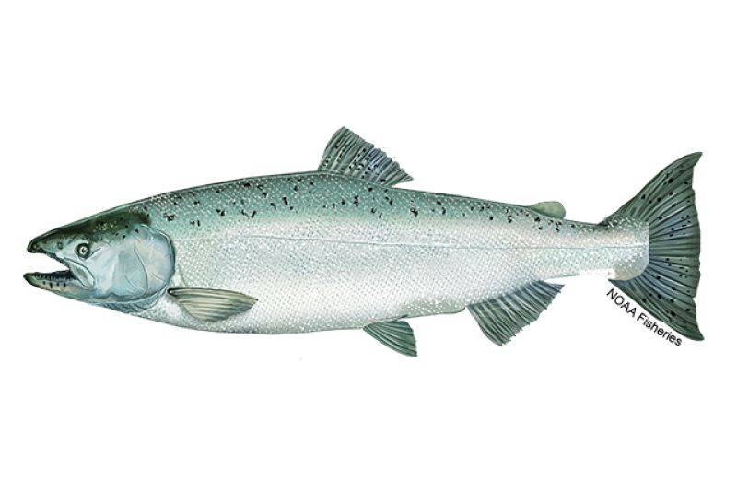
Thiamine Deficiency in Wildlife

Slide 9
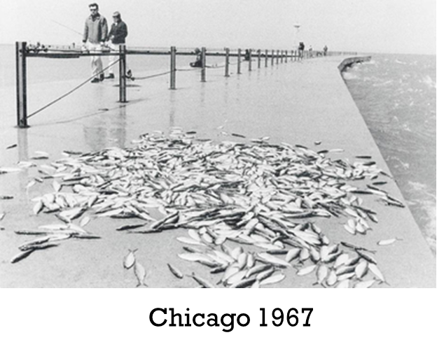
Thiamine Deficiency in Salmonids
Thiamine deficiency complex
Cayuga Syndrome
Early Mortality Syndrome
“Wigglers”
M74

Slide 10
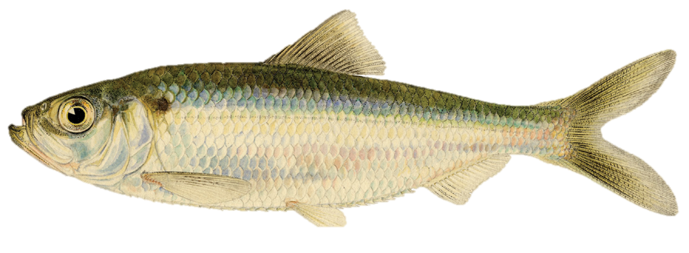
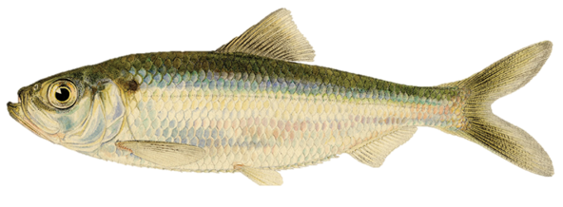
1960s
Great Lakes
Juvenile lake trout (hatchery and wild)
  Decreased hatch rate
  Abnormal behavior
  Widespread early mortality
  No pathogens isolated
Alewives spread throughout Great Lakes in 1930s
  Widespread in basin by 1960s…
  Alewives are high in thiaminase

Slide 11
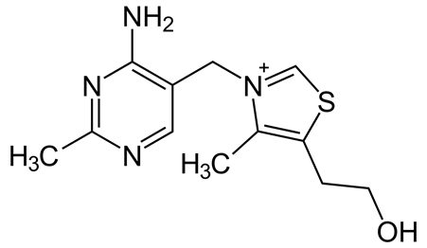

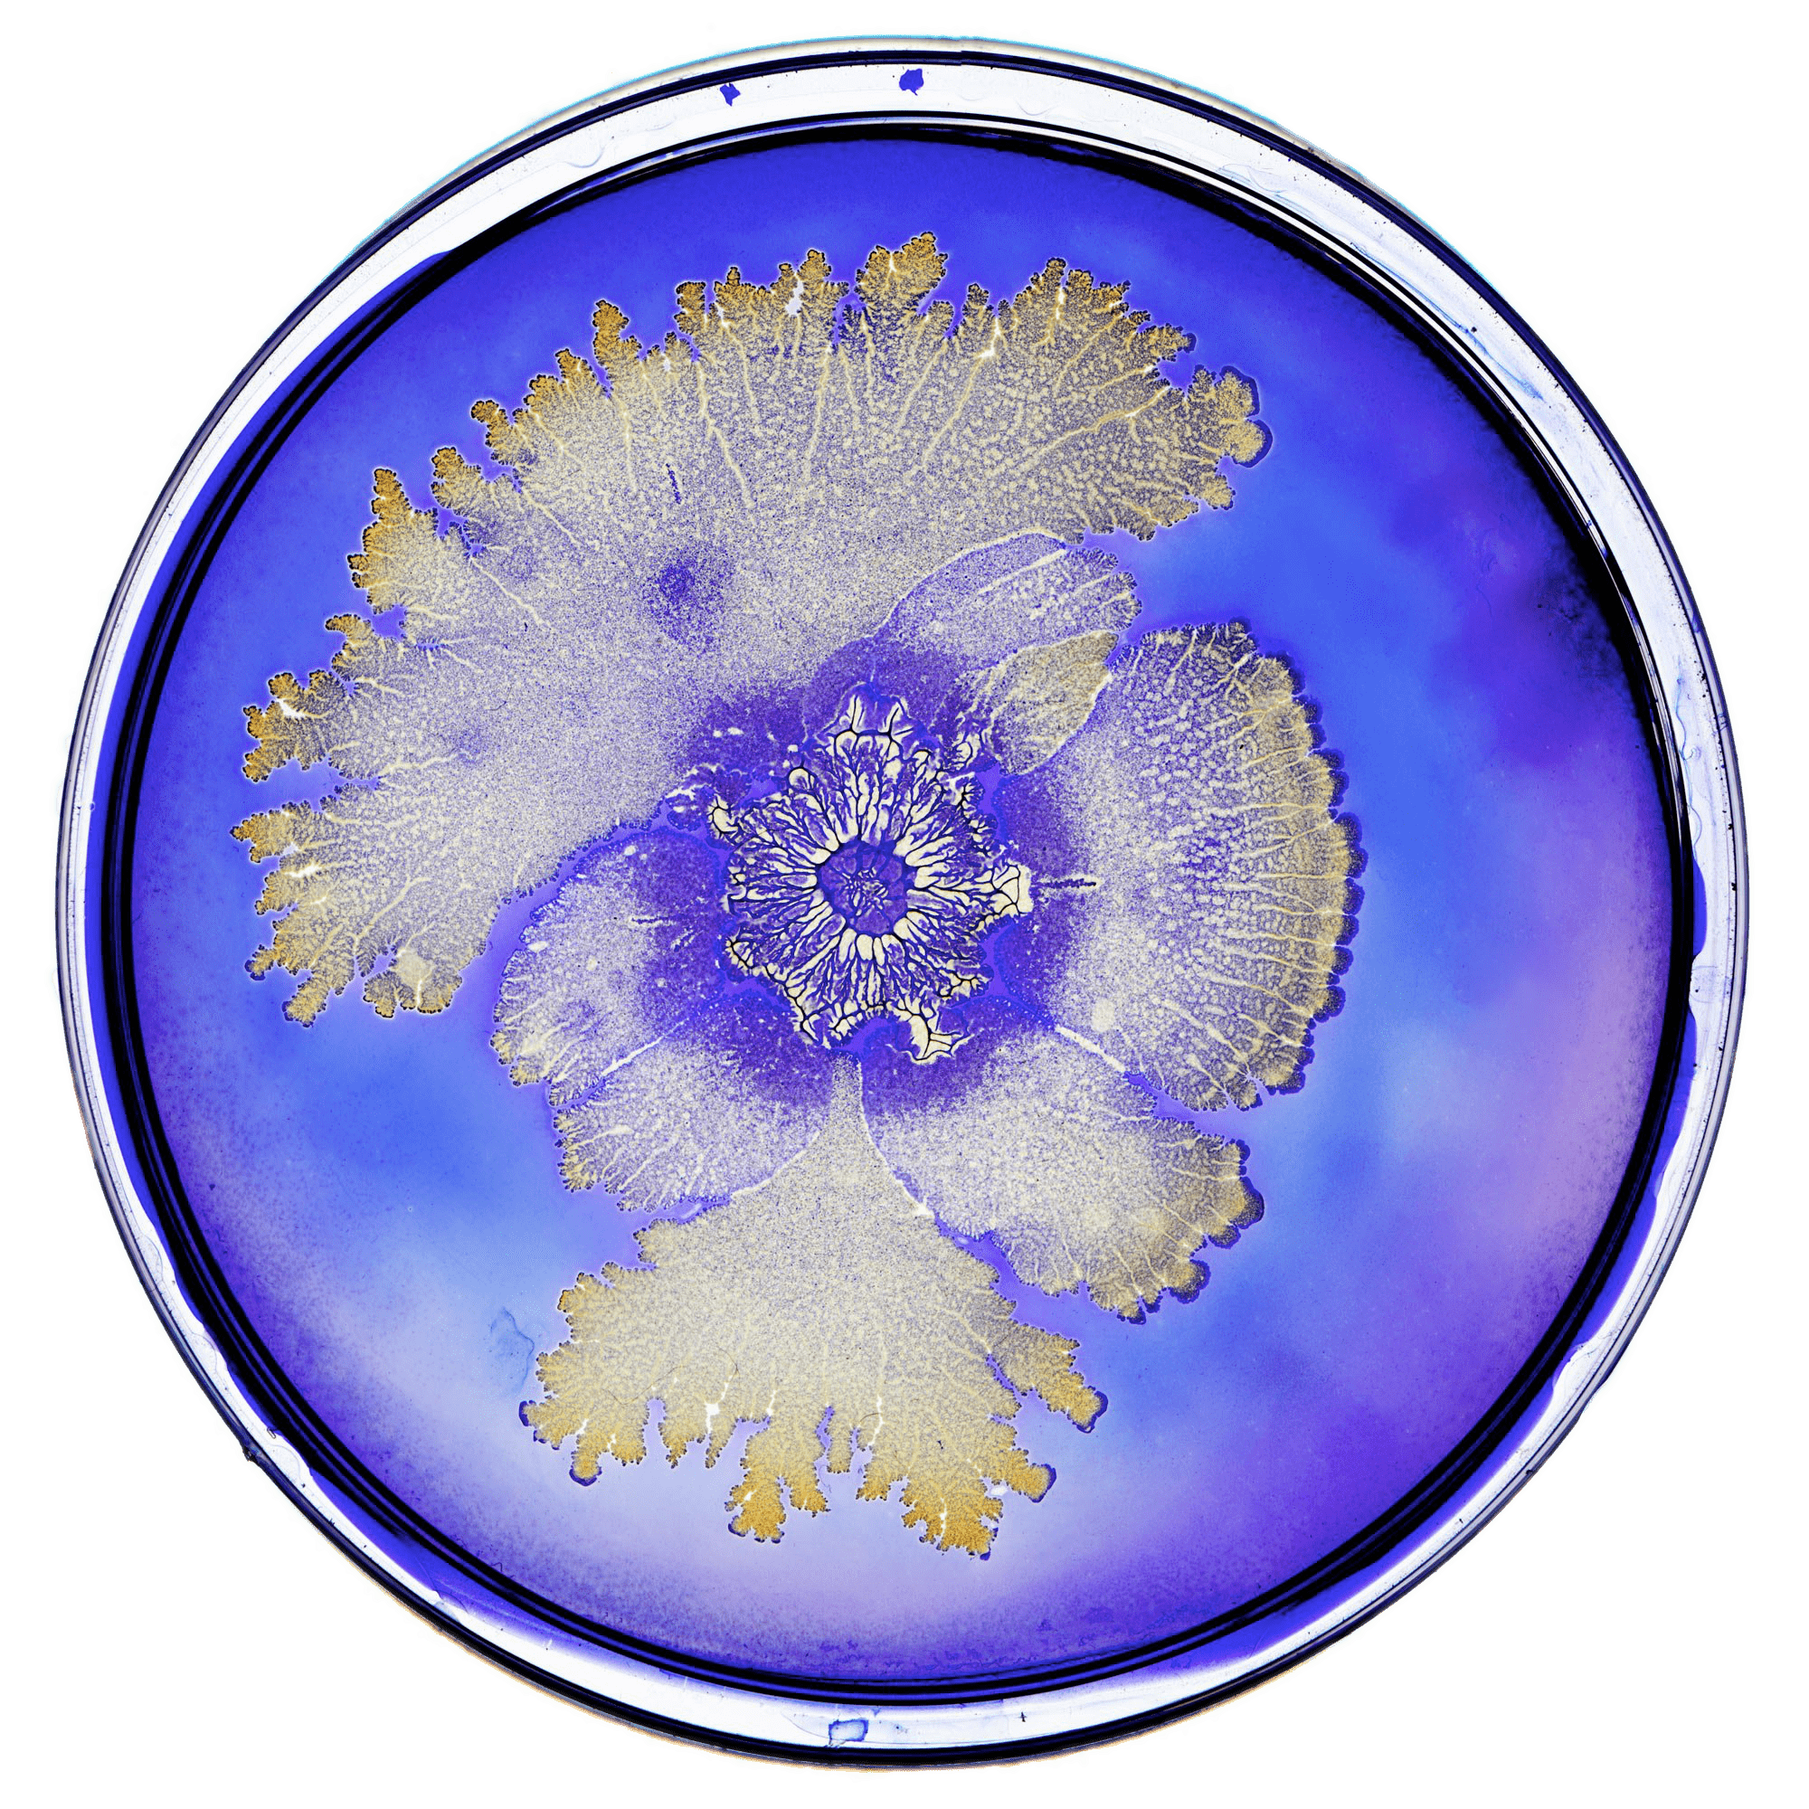

Thiaminase I

Slide 12
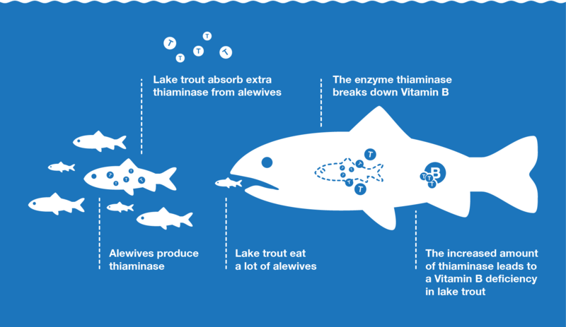

Slide 13
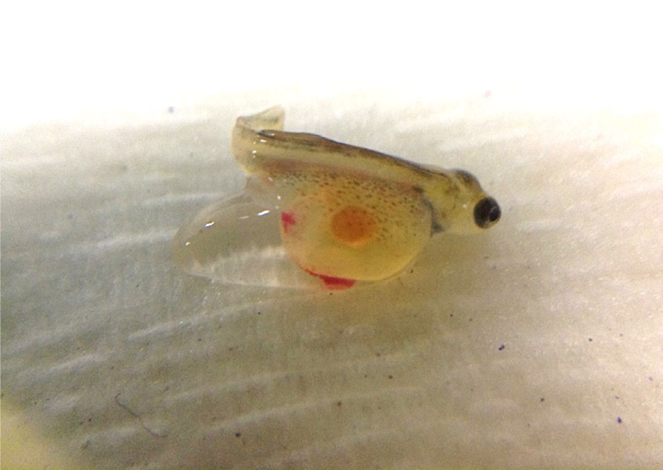
1990s
Great Lakes
Thiamine Deficiency Complex (TDC)
Poor egg survival and hatch
Elevated early mortality
Abnormal behavior
Lethargy
Immune compromise
“Poor doers”
…?
Behavioral changes and/or mortality are the only sign(s)
A Great Lakes Atlantic salmon fry with thiamin deficiency

Slide 14
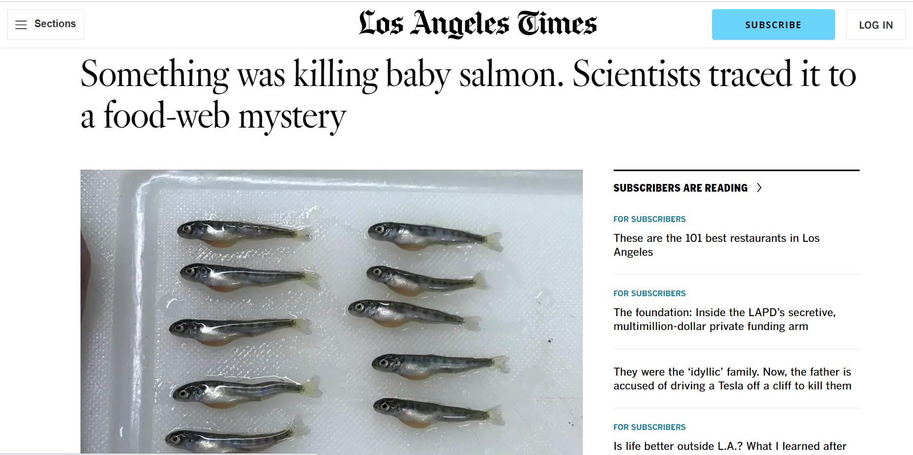

Slide 15
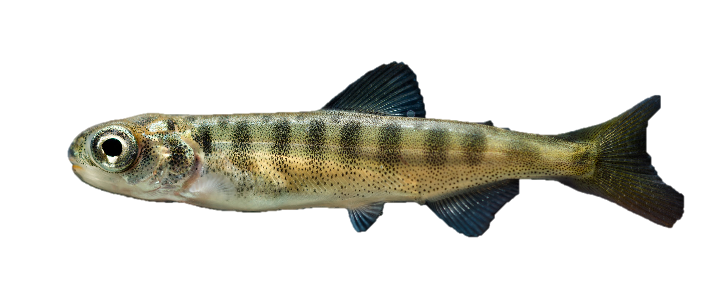

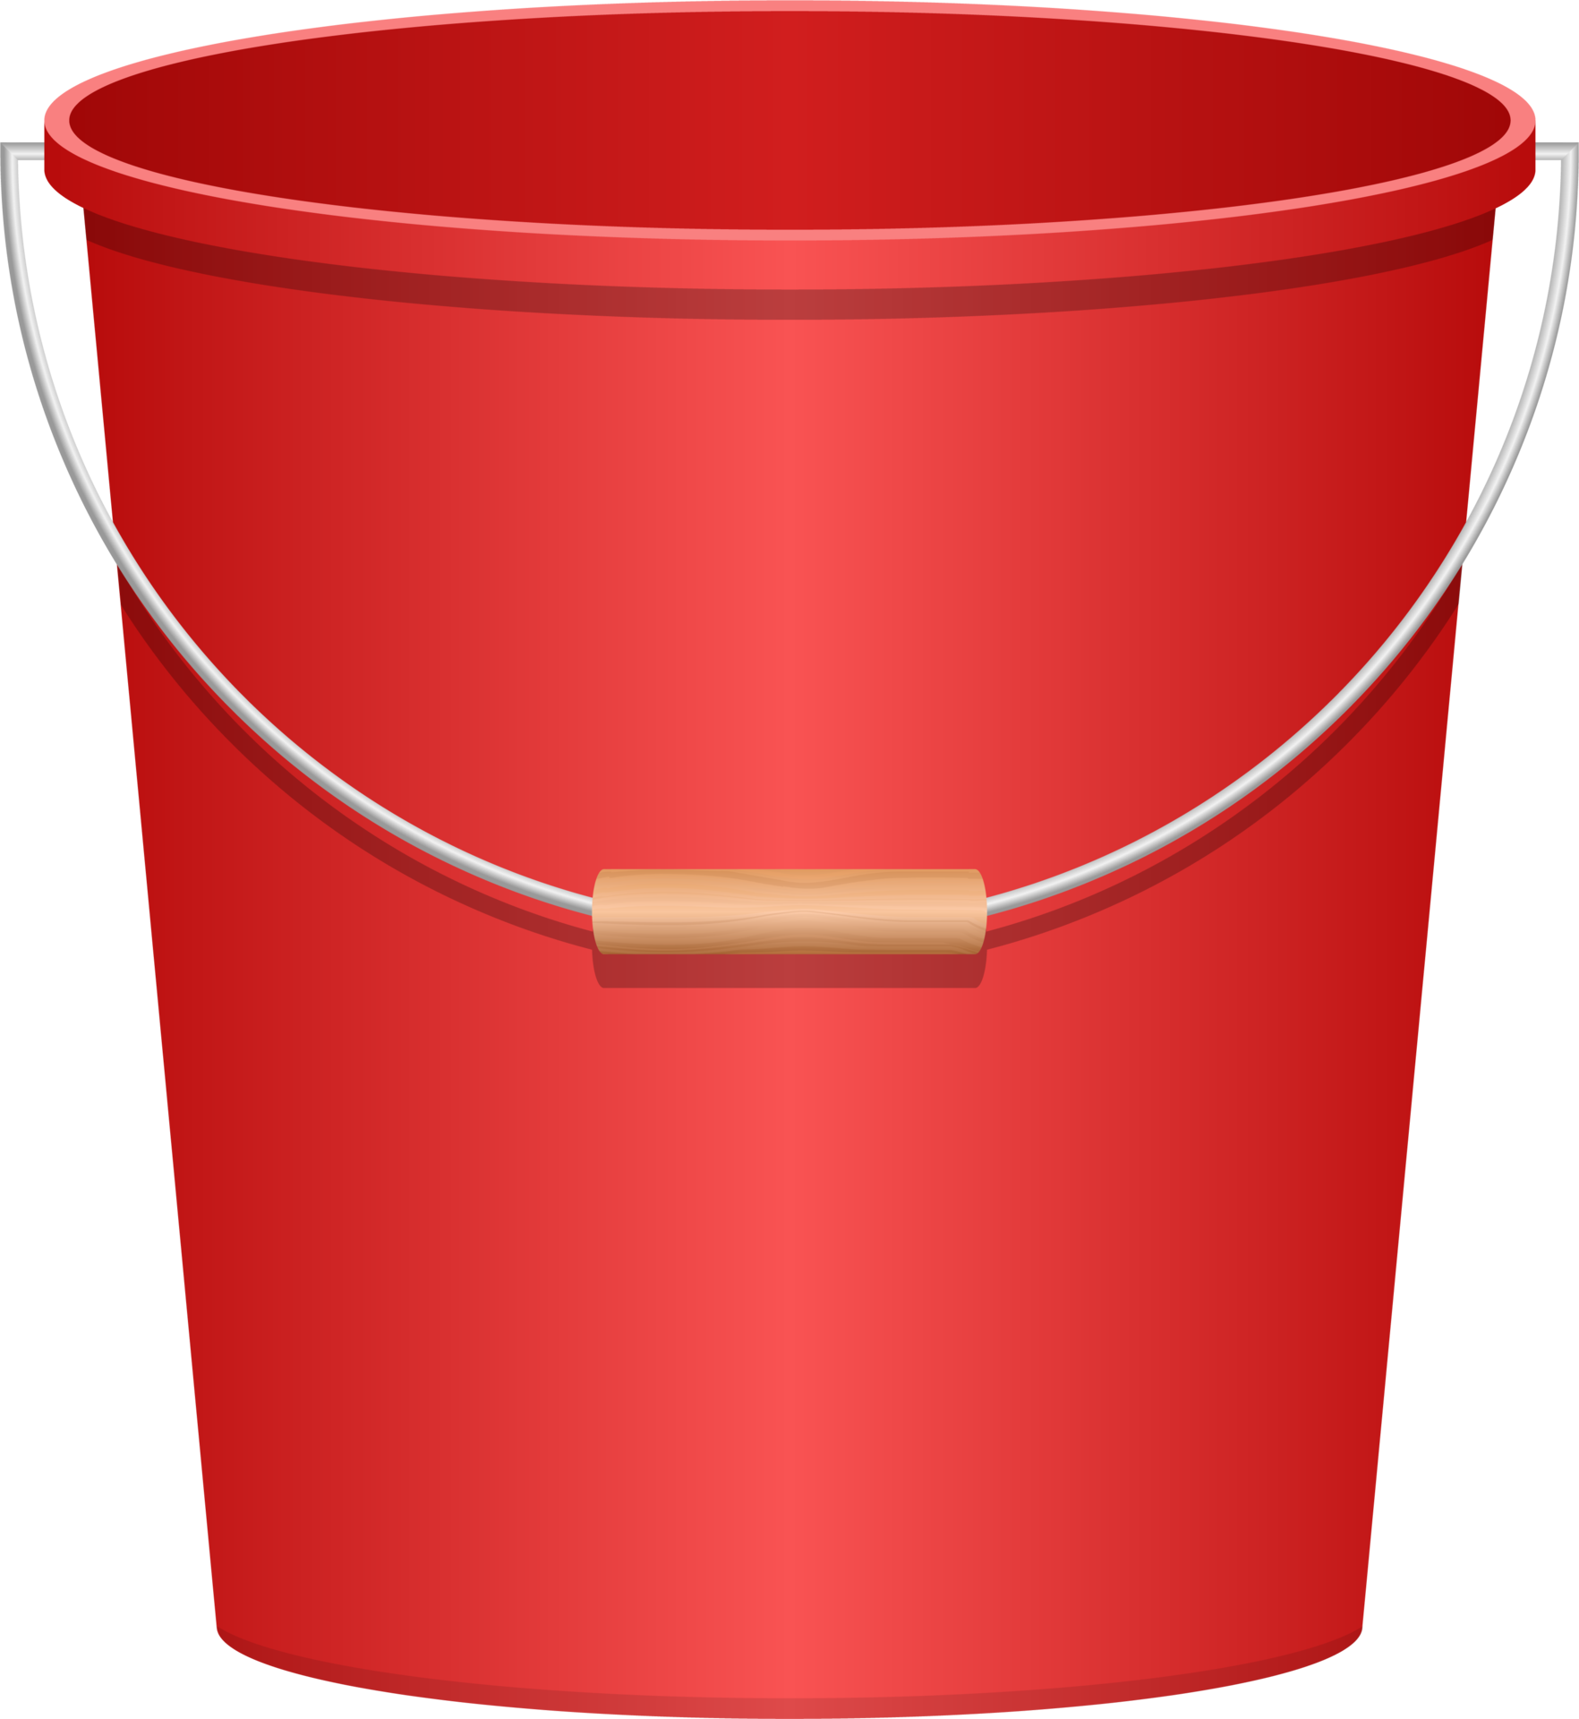


2019
California
THIAMINE
NO THIAMINE

Slide 16
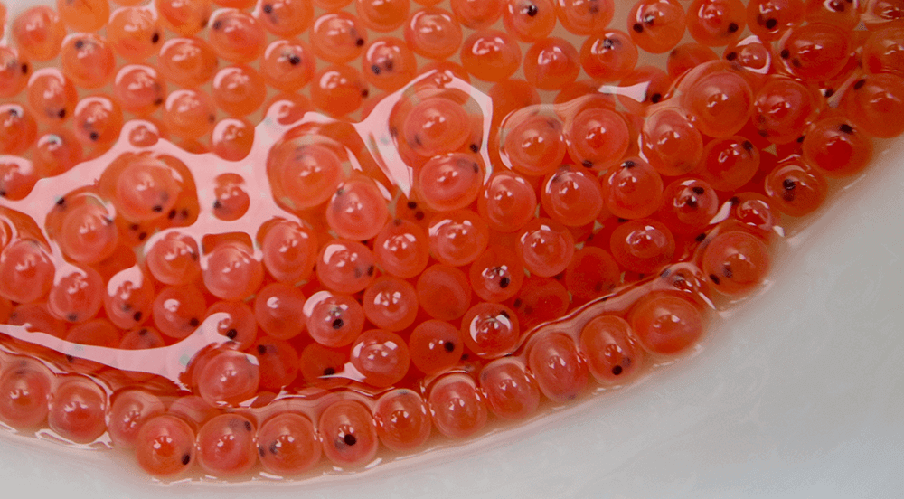
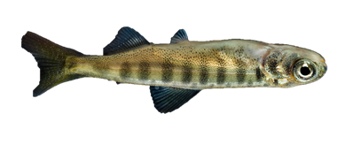
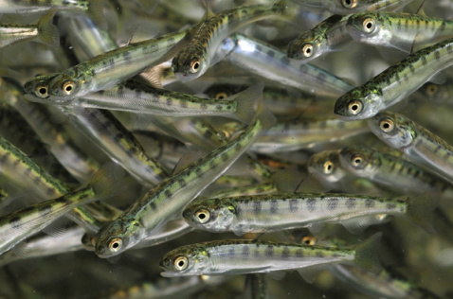
2019
California
Thiamine deficient females
Thiamine deficient eggs
Thiamine Deficiency Complex
Thiamine deficient fry

Slide 17
2022
Region 1
PRFHP monitoring situation in R1 since 2019
Winthrop NFH→ BY22 steelhead adults
6/10 females screened were low in thiamine (eggs)
  1/10 borderline low
  3/10 adequate
Low thiamine detected in COS and WST in 2023

Slide 18
How Much Thiamine Do We Need?
* Concentrations refer to egg thiamine concentration
PUTATIVELY DEFICIENT
Early mortality
Up to 100% mortality
THIAMINE REPLETE
Unlikely to experience clinical syndromes under normal circumstances
<6.5 nmol/g
6.5-10 nmol/g
>10 nmol/g
SUBCLINICAL
Increased likelihood of clinical syndrome(s)
Unknown long-term effects

Slide 19
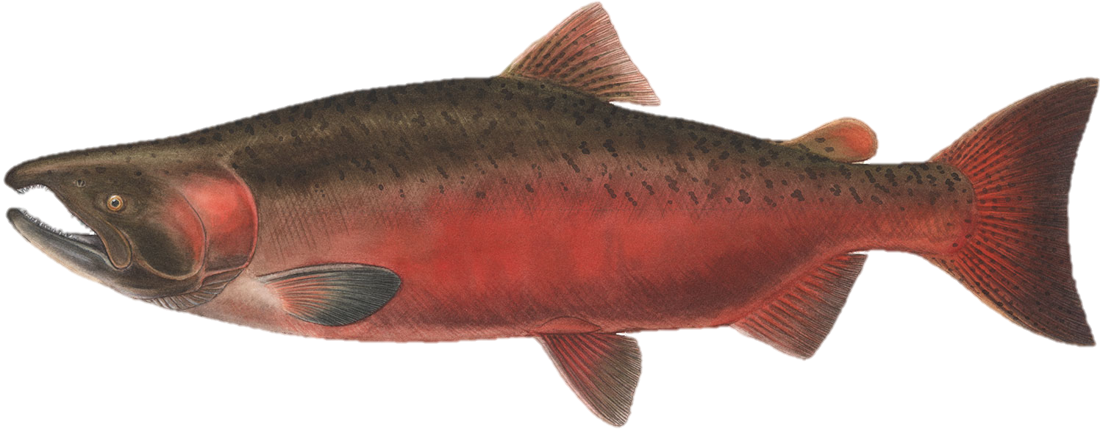
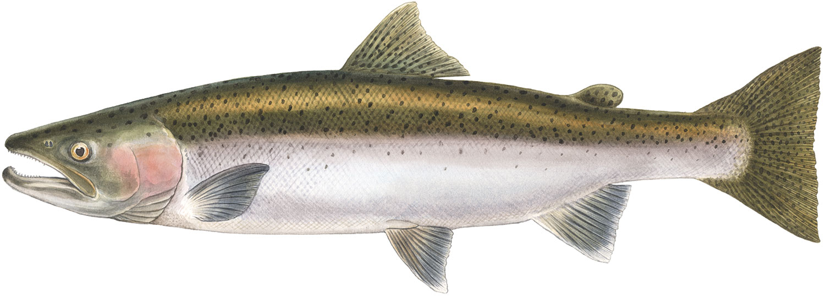
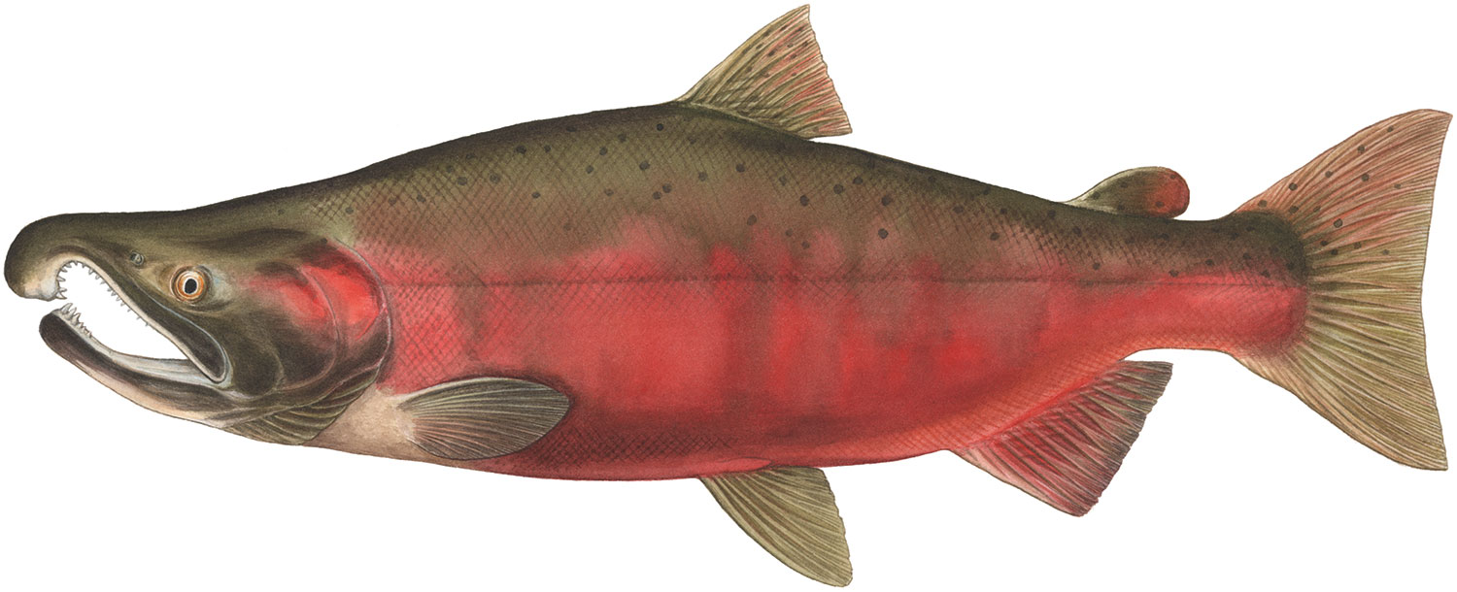
Species Differences

Slide 20
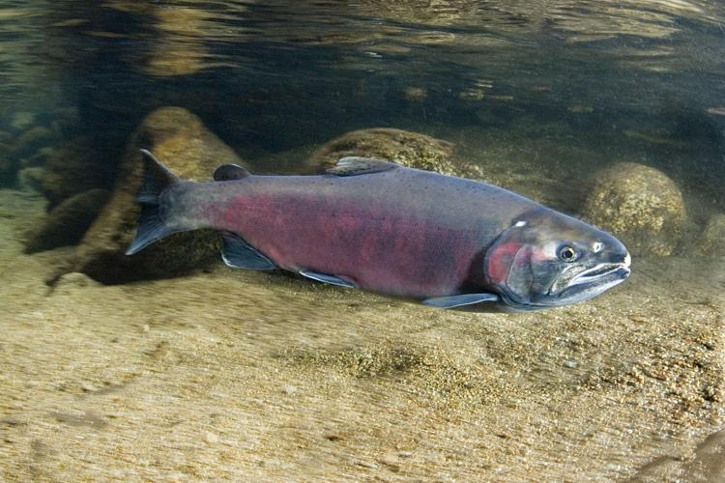
Thiamine Testing for Adults and Fry?
Not yet

Slide 21
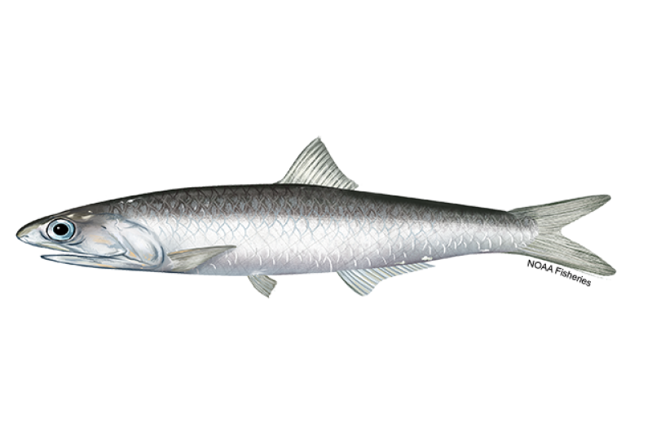
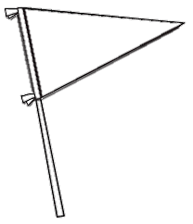
Why Now?
Increased anchovy predation
  Ocean temperature changes
  Plankton availability shift
Climate change
Ecosystem-wide deficiency
THIAMINASE

Slide 22
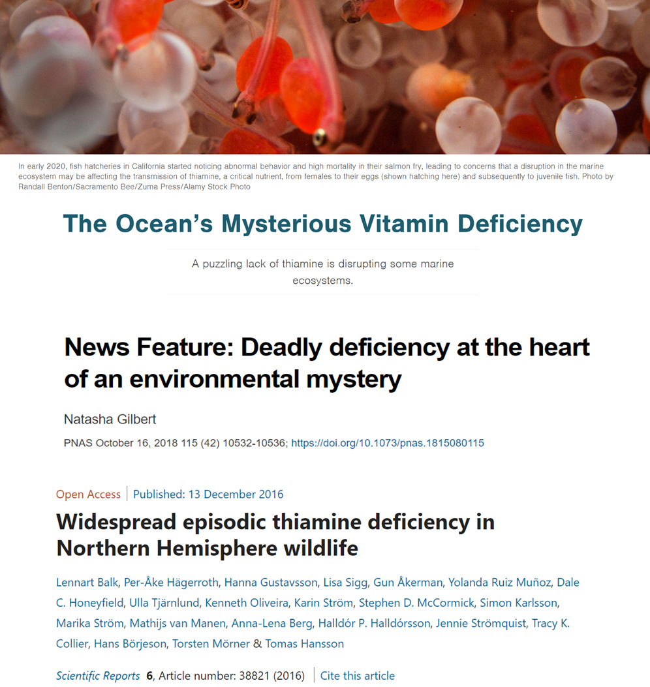
Why Now?

Slide 23
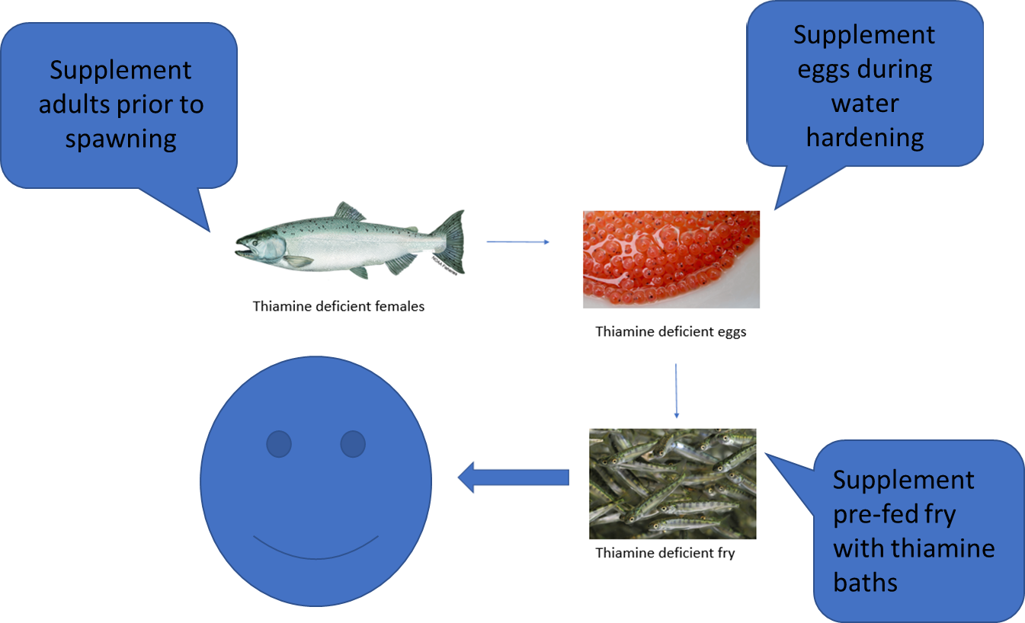
Management: Hatchery

Slide 24
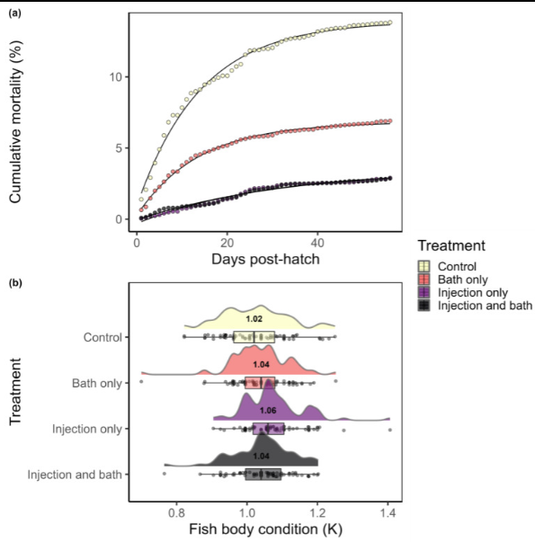
Which treatment is best?
Supplementation of adults
  Added benefit of improving brood stock welfare!
Reed AN, Rowland FE, Krajcik JA, Tillitt DE. 2023. Thiamine supplementation improves survival and body condition of hatchery-reared steelhead (Oncorhynchus mykiss) in Oregon. Vet Sci;10(2):156. DOI: 10.3390/vetsci10020156

Slide 25
Pros
Highly effective
Low-risk of adverse effects
Cost effective
Welfare improvement for broodstock
Treatment is easily obtained and widely available

Slide 26
Cons
Labor-intensive
Stress of handling for injection (adults)
May influence development of thiamine deficiency tolerance in some populations

Slide 27
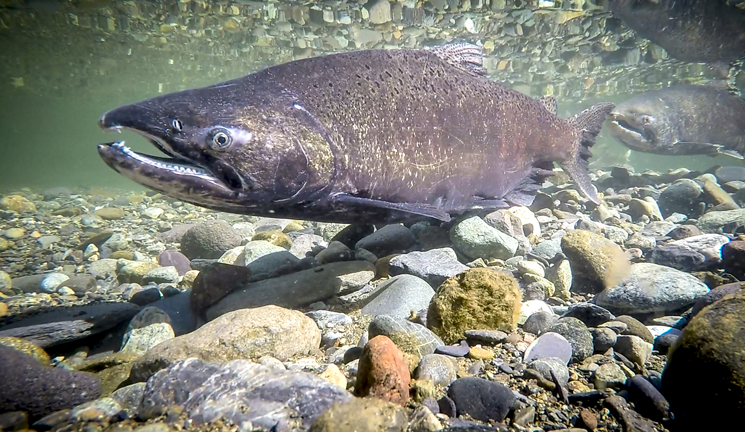
Management:
Wild
???

Slide 28
Outlook
Thiamine Deficiency Work Group (NOAA, USFWS, CDFW, others)
Prop. 1 Restoration Grant (CDFW)
Increased surveillance and treatment recommendations

