Slide 1

Chinook Planning
The Next Chapter
Nathan Wiese LSRCP

Slide 2
Why??
“The scarcity of salmon is a cultural genocide…..”

Slide 3
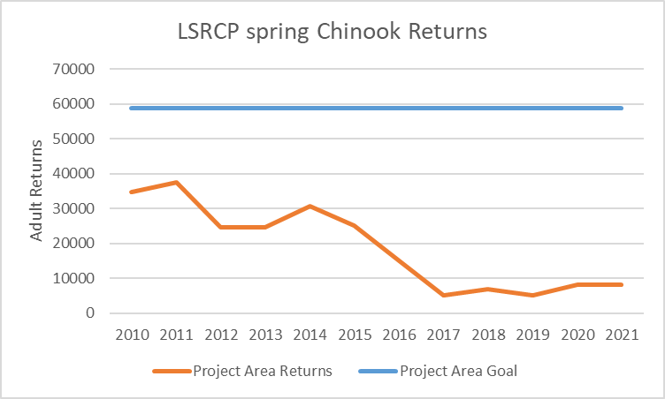
Why??

Slide 4
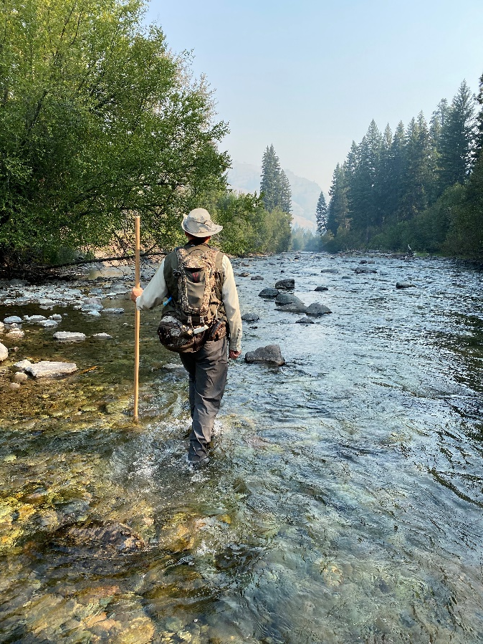
What is the Plan?
Infrastructure
Monitoring and Evaluation
Endangered Species Act
Management

Slide 5
What’s happened so far?
Survived ISRP
Added 165K smolts at Sawtooth for Panther Creek (PAH Stock) – Brood Year 2022
McCall Holding Ponds in progress
Sawtooth well rehab and tank reconstruction in contracting process
Completed Infrastructure Audits
Notes:
We didn’t put enough infrastructure in originally

Slide 6
Average by Basin
Notes:
When you meet on average, you still fail 50% of the time to meet the Project Area Goals
The Salmon River fails 100% of the time
First year of returns to Southeast Washington was about 600 adults short of Project Area Goals – we’ve just started

Slide 7
Infrastructure Nuances
Adult deficit is in the Upper Salmon
Most infrastructure is in the Clearwater Region or beyond
FPP Size trade-offs are large, but not clear-cut (Dworshak/Clearwater Example)
Transportation
Options Paper

Slide 8
Infrastructure Nuances
1+ spring/summer Chinook programs are space costly
Most of the bottlenecks are occurring in the early rearing/final rearing overlap
Solutions
Acclimation
Additional Chilling (Dworshak Model)
Age 0+?

Slide 9
Infrastructure Opportunities
Basin | Facility | Smolts | Expected Adults
NE Oregon | Lookingglass | 100,000 | 485
Salmon | McCall | 340,000 | 1,020
Salmon | Sawtooth | 520,000 | 1,560
 | Total | 960,000 | 3,065

Slide 10
Additional Opportunities
Facility | Smolts
Dworshak | 500,000 -2,300,000
Clearwater | 0 – 1,600,000
Lyons Ferry | 500,000 – 1,500,000
Irrigon | 800,000 – 2,000,000
Lookingglass | 100,000 – 910,000
Total Smolts | 1,800,000 – 8,210,000
Expected Adults (0.3% SAR) | 5,400 – 24,630

Slide 11
Infrastructure Costs
Basin | Smolts | Annual | Infrastructure
McCall | 340,000 | $68,000 | $1,800,000
Sawtooth | 520,000 | $104,000 | $770,000
Clearwater | 1,600,000 | $320,000 | $31,000,000
Dworshak | 2,300,000 | $460,000 | $31,000,000
Lyons Ferry | 1,500,000 | $300,000 | $12,200,000
Lookingglass | 910,000 | $182,000 | $800,000
Irrigon | 800,000 | $182,000 | $1,270,000
 | Totals | $1,616,000 | $78,840,000

Slide 12
What’s Needed
5.6 M smolts and Broodstock
FPP
Age 0+
Acclimation
Transportation
Plan
Resources

Slide 13
How many smolts?
NE Oregon
100,000 smolts at 0.5 SAR = 500 Adults
Upper Salmon
5.5M smolts at 0.3 SAR = 16,500 Adults
Out of basin rearing
Why 0.3 SAR??

Slide 15
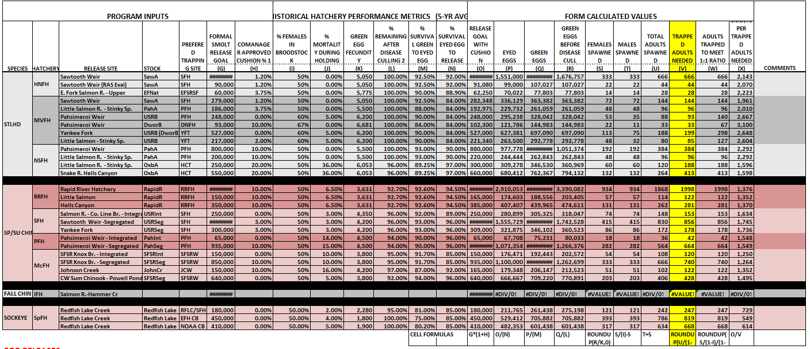
How Many Brood?
1,745 smolts per trapped adult

Slide 16
How Many Brood?
NE Oregon (0.5% SAR)
58 brood adults
500 average returns
Upper Salmon (0.3% SAR)
3,152 brood adults
16,500 average returns
Breakeven??
0.06% SAR for 1,745 smolts/adult

Slide 17
Fish Per Pound Difference
 | 25 FPP | 12 FPP
Length (Inches) | 5.1 | 6.5
Lbs/Million | 40,000 lbs | 84,000 lbs
Total Lbs (10.5 M Smolts) | 420,000 lbs | 825,000 lbs

Slide 23
Age 0+ spring/summer Chinook
Fall Parr – 3 to 4 inches in length
Age-0 in warm-water (52-59 F) could be 4-5.1 inches (25-50 fpp) by May
Opens space for 10-22M smolts if combined with acclimated steelhead strategy
Hagerman PRAS and Lyons Ferry reports

Slide 24
Acclimation
Remove overlap bottleneck
Out of basin rearing potential
Steelhead combination
Challenges high in the basin
Yankee Fork Acclimation work
Chilling instead of acclimation??
Dworshak example

Slide 26
Transportation
ODFW transport trailer = $300,000
Transport is about $4.00/mile
A load is about 80K (20 fpp at 4,000 lbs)
800 mi round-trip is $3200
Move 5.5M is about 70 trips or $224,000
Staff time, number of trailers, etc., etc.

Slide 27
Monitoring and Evaluation
Size at release
Age 0
Reciprocal type work
Acclimation strategies
Release timing (Ongoing Clearwater work)

Slide 28
ESA
Basin | Location | New Smolts | Brood Needed
Salmon | Yankee Fork* | 600,000 | 342
Salmon | Panther Creek* | 400,000 | 228
Total |  | 1,000,000 | 570
*Permitting already exists for Crystal Springs Hatchery project

Slide 29
ESA – Where else?
East Fork Salmon
Valley Creek
Additional Sawtooth
??????

Slide 30
Management
Broodstock Needs vs Fisheries?
Options Paper
Upper Salmon and NE Oregon deficit
Tool to plan internally and present to NOAA, BPA, etc.
More infrastructure? ($60M pipeline, $30M Walla-Walla, etc.)

Slide 31
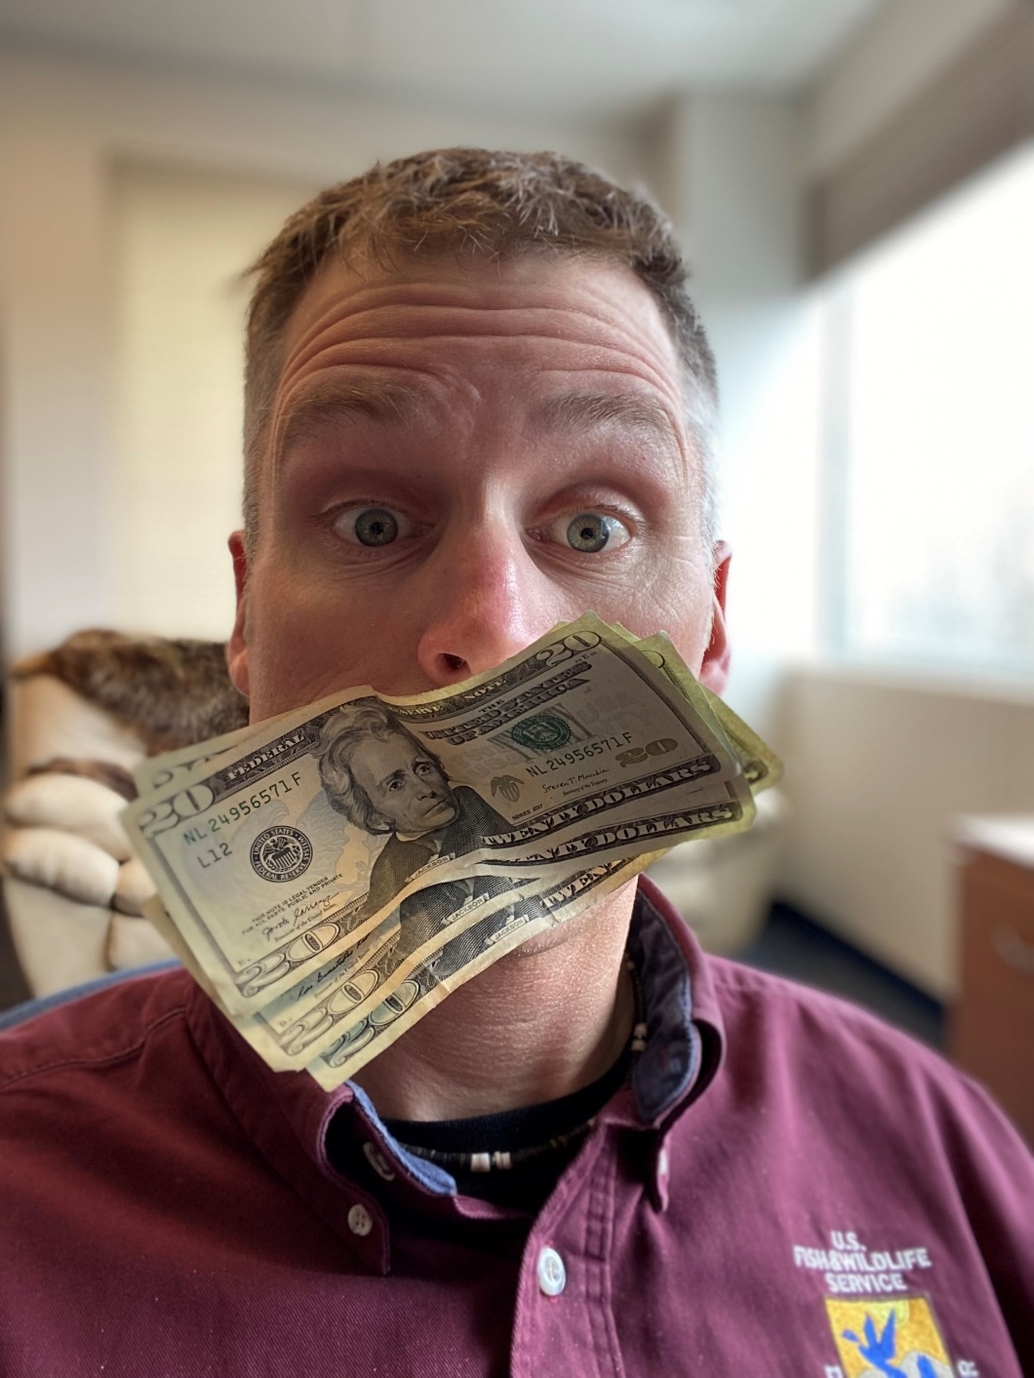
What did we learn?
The concrete has some additional capacity
We have a lot of options in front of us

Slide 32
What is the our biggest Challenge?
“Saving salmon is far more a social problem than a scientific problem.”
Courtland Smith, Cultural Anthropologist, 1998

Slide 33

You are
Fish for the Future

