Slide 1
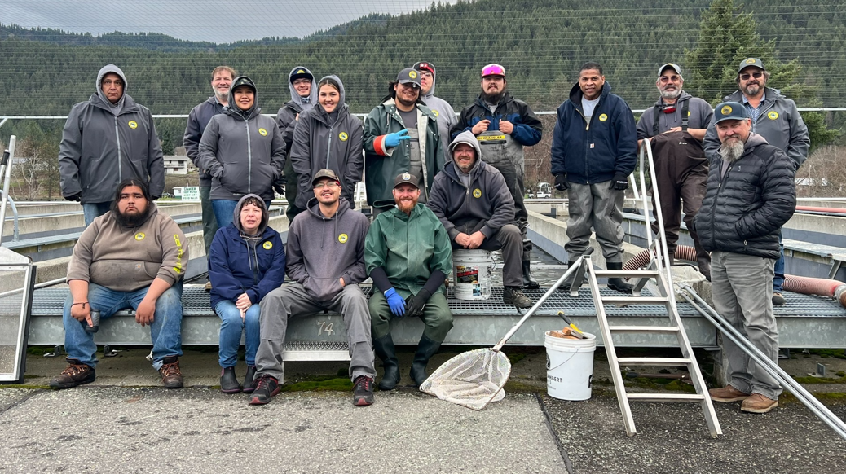
Welcome to LSRCP!
Dworshak Spring Chinook Releases 2024
Annual Meeting
May 7-8th, 2024

Slide 2
Housekeeping
Please mute phones and chat box for questions
We’ll use the integrated mics for questions from the audience or have the speaker repeat them
$20 Social/Breaktime snacks – please find Tanya Wiley or Anna Copeland
Social at Kristen Armstrong Pavilion (5-9 pm)
Bathrooms

Slide 3
Meeting Objectives
Reinspire our efforts towards Fish for the Future
Kick-off Steelhead ISRP review
Check out some LSRCP outreach
Update current on ongoing LSRCP and basin projects
Connect with each other

Slide 4
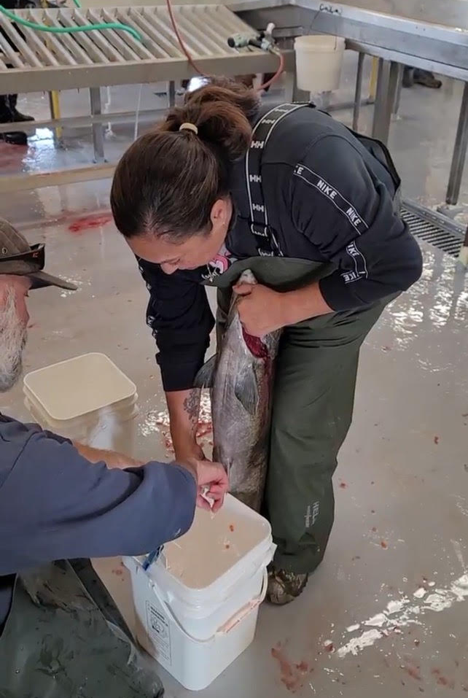
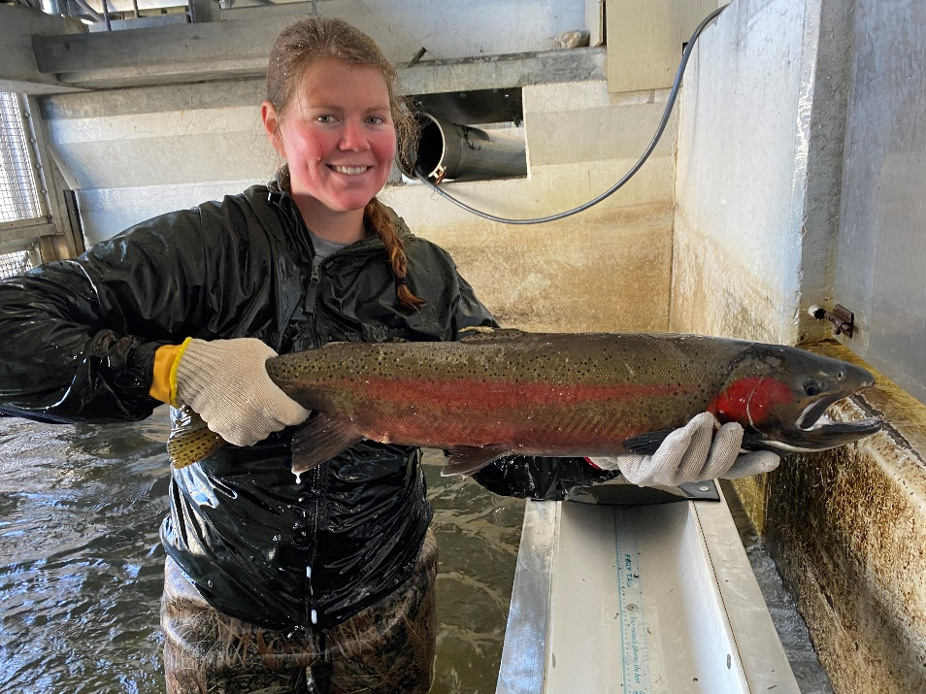
You are Fish for the Future!
Notes:
Introduce Director Schriever

Slide 5
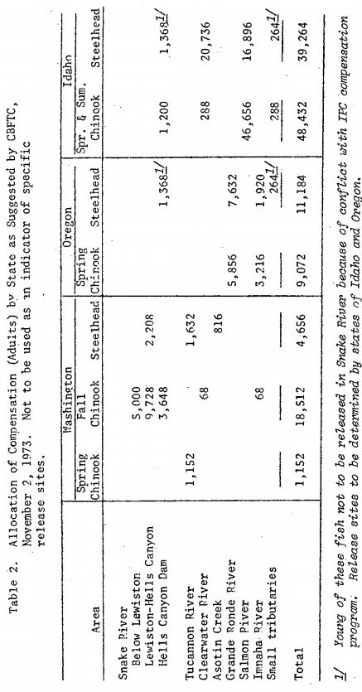
In Place/In-Kind
Notes:
Page 13 -

Slide 6
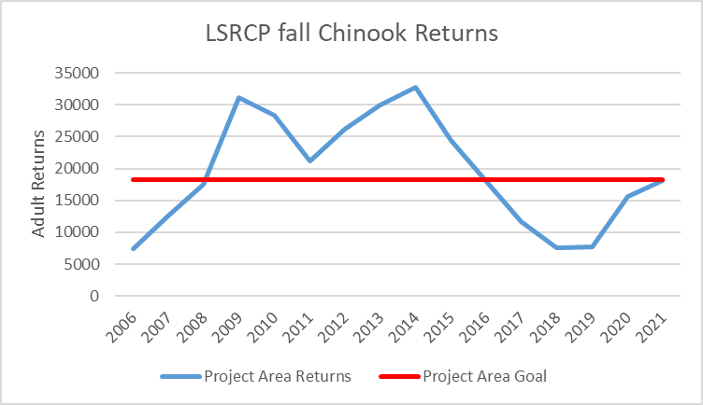
Performance
2019-2021 estimates
Notes:
Estimate

Slide 7
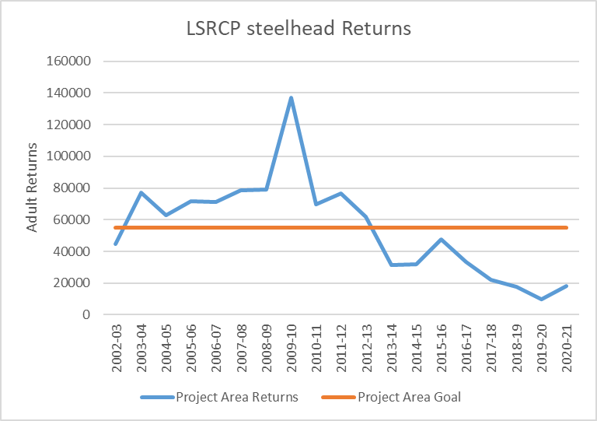
Performance
Notes:
Overall, number of spring Chinook salmon (HOR and NOR) returning over recent time period. Returns in last decade have just began to compete with estimates of the Snake Basin from 1950’s (little to no hatchery influence and prior to construction of Lower Snake River Dams).
Data from Fish Passage Center.

Slide 8
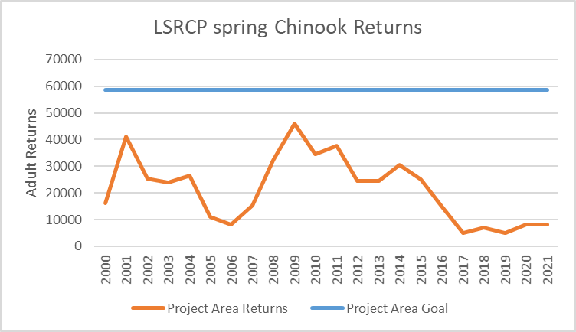
Performance
2019-2021 estimates
Notes:
Overall, number of spring Chinook salmon (HOR and NOR) returning over recent time period. Returns in last decade have just began to compete with estimates of the Snake Basin from 1950’s (little to no hatchery influence and prior to construction of Lower Snake River Dams).
Data from Fish Passage Center.

Slide 9
2025…..I’d be surprised to see them last that long
- 1998 LSRCP Chinook Symposium, Howard Burge
Notes:
Dire straights
How do WE address our goals?
Invest in top performance – reduce investment in lagging performance.
LSRCP = Meet Adult Project Area Goals

Slide 10

Budgets
FY24 = $32.75M
FY25 = $32.75M
FY26-28 is in the Integrated Program Review (IPR) process

Slide 11
Budgets – FY25 Guidance
Budget requests need to remain flat by Cooperator - not by Project
Draft FY25 budgets due by June 15th
Notes:
Look hard, tighten the belt, and bring your best projects that will move the needle.

Slide 12
Art of the Possible
Chart the future
Reimagine and reinvent
Keep making positive changes!
Notes:
We will not cut every budget by 6% - prioritize!

Slide 13
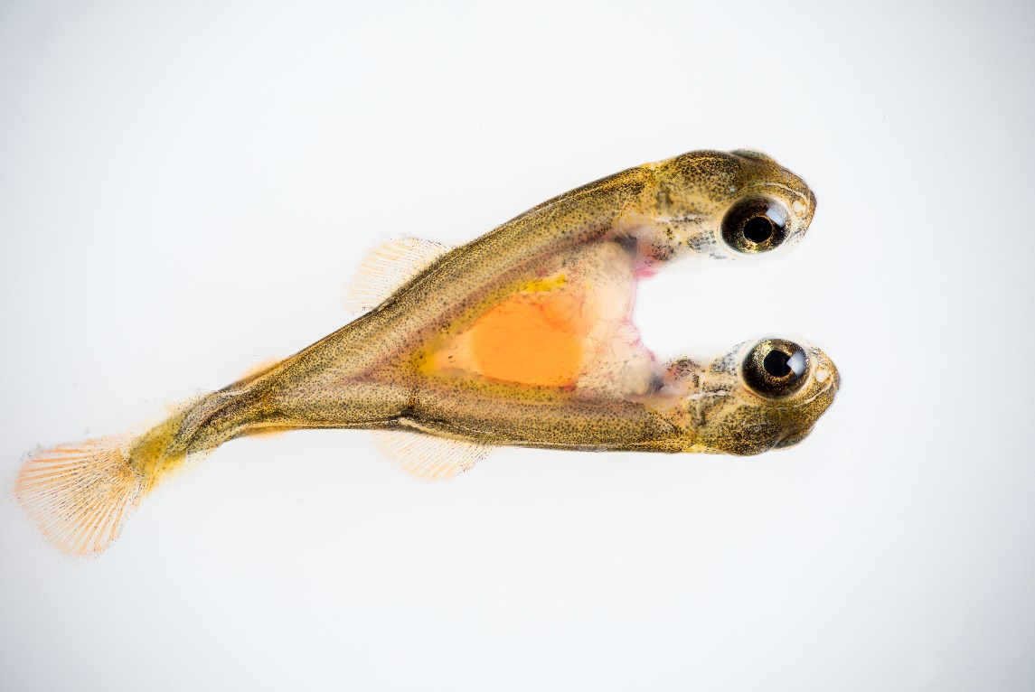
Thanks for Being Here!
Notes:
We’re all stuck in this together!

