Slide 1

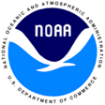
What is going on in the North Pacific?
Laurie Weitkamp
NOAA Fisheries
Northwest Fisheries Science Center
Newport, Oregon

Slide 2
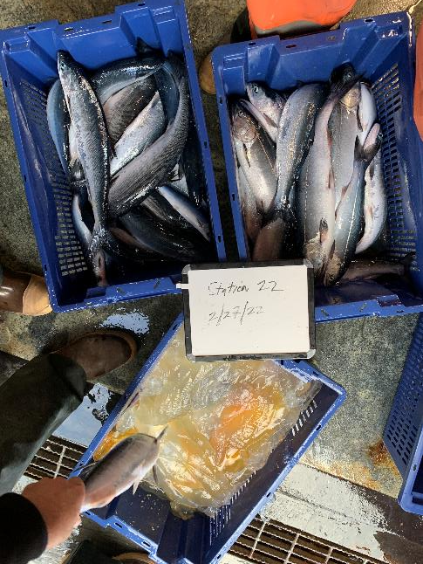
Today’s talk
Physical environment drivers
1. El Niño/La Niña
2. Marine heat waves
Biological response
3. Stoplight chart & Columbia salmon forecasts
4. Recent N Pacific salmon trends
Beyond the coastal realm
5. High seas research

Slide 3
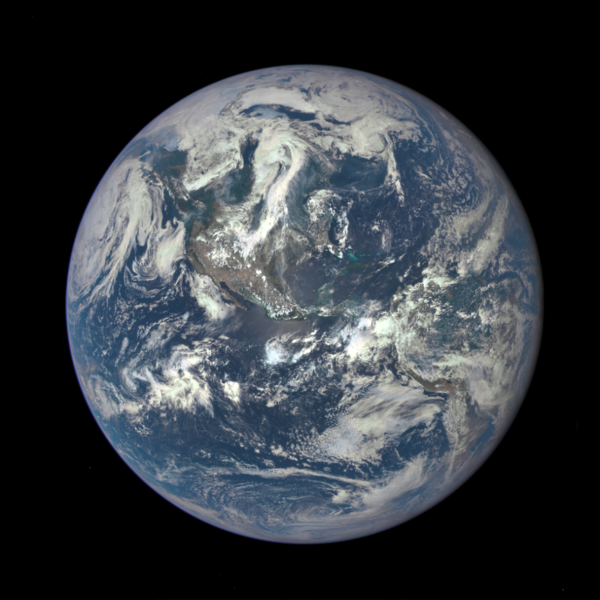
Physical environment drivers
1. El Niño/La Niña
2. Marine heat waves

Slide 4
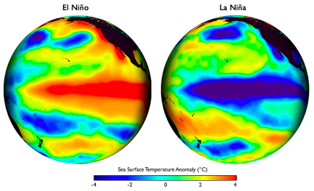
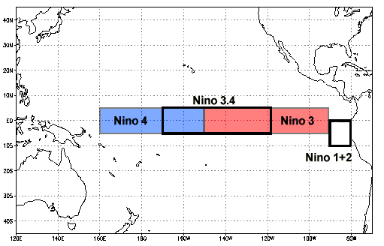
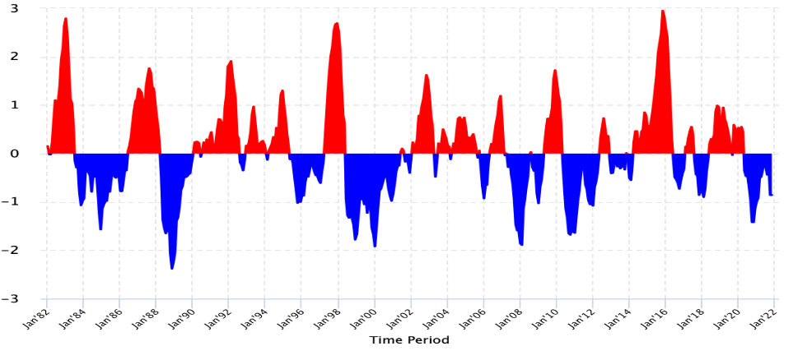
El Niños and La Niñas are tropical phenomena that impact global weather
1. El Niños/La Niñas
Measured in the Niño 3.4 area:
1982-83
1997-98
2015-16
El Niño
Since huge 2015/16 El Niño, had
2 La Niñas (weak)
1 El Niño (moderate)
2 La Niñas (1 mod, one weak)
Nino 3.4 SST anomaly (°C)
La Niña

Slide 5
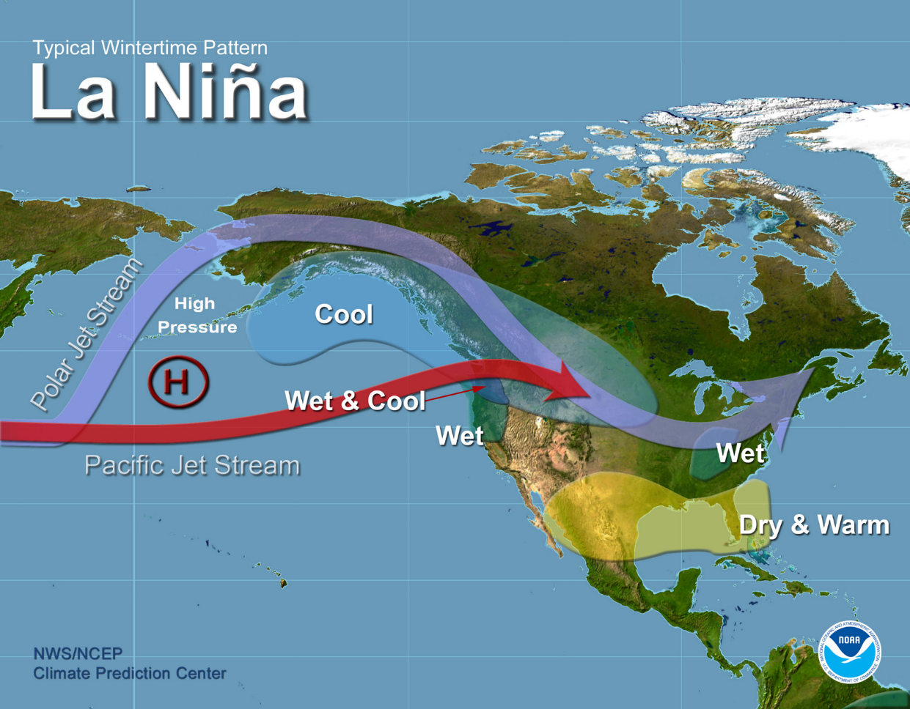
https://www.pmel.noaa.gov/elnino/sites/default/files/thumbnails/image/LaNina-Jet-Wintertime-Pattern.jpg

Slide 6
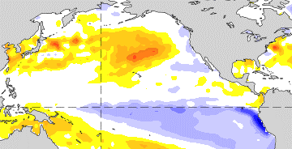
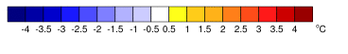
ENSO Summary 12 May 2022
ENSO Alert System Status: La Niña Advisory
La Niña is present.
Monthly SST anomaly, Apr 10-May 7, 2022
https://www.cpc.ncep.noaa.gov/products/precip/CWlink/MJO/enso.shtml

Slide 7
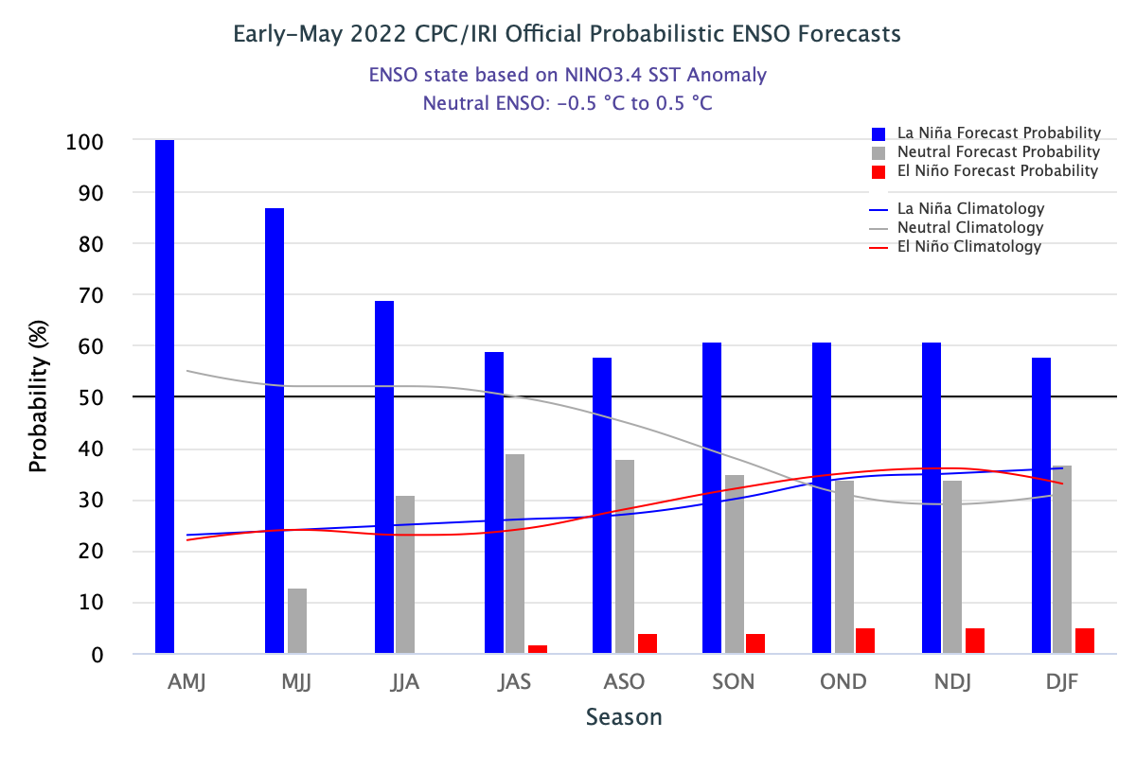
ENSO Summary 12 May 2022
ENSO Alert System Status: La Niña Advisory
La Niña is present.
La Niña is favored to continue through the Northern Hemisphere summer (59% chance during June-August 2022), with a 50-55% chance through the fall.
https://www.cpc.ncep.noaa.gov/products/precip/CWlink/MJO/enso.shtml

Slide 8
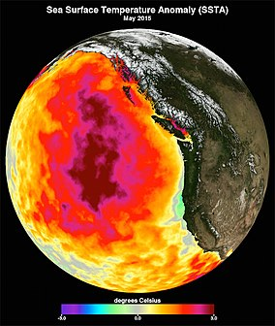
2. Marine heat waves

Slide 9
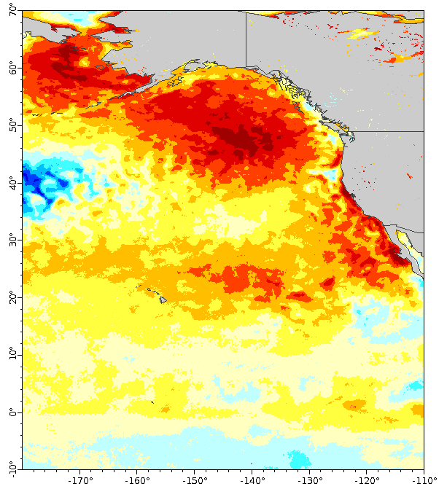
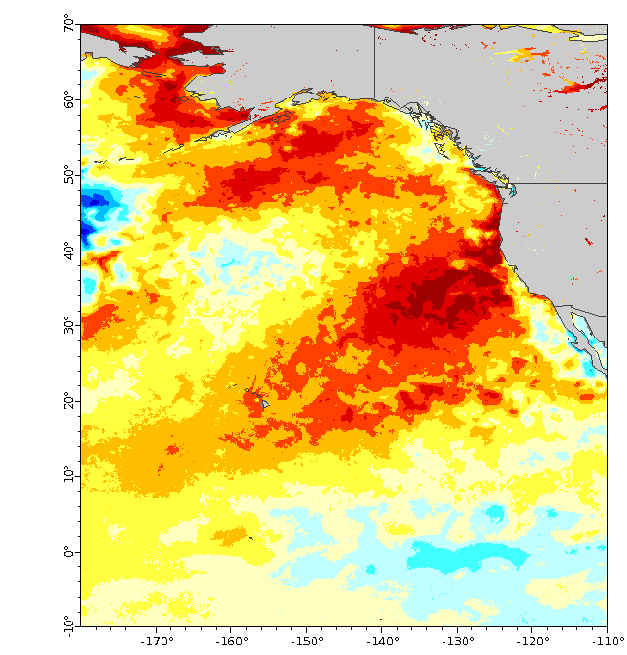
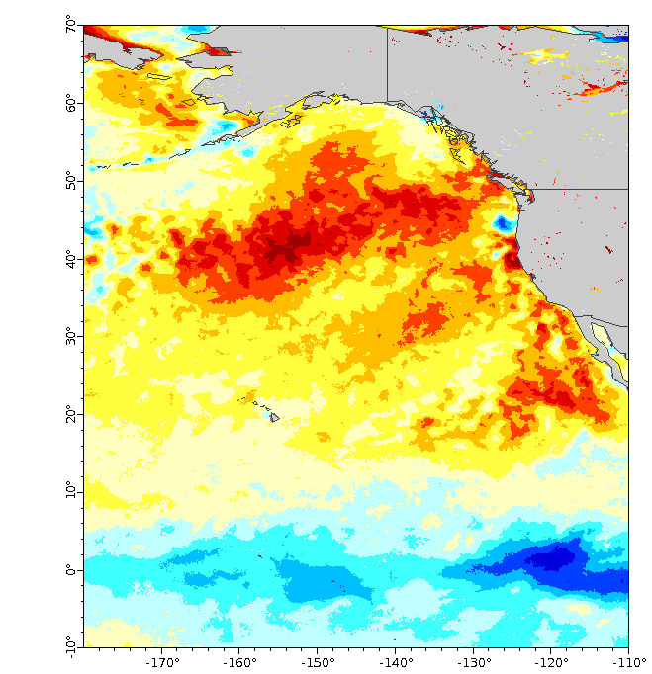
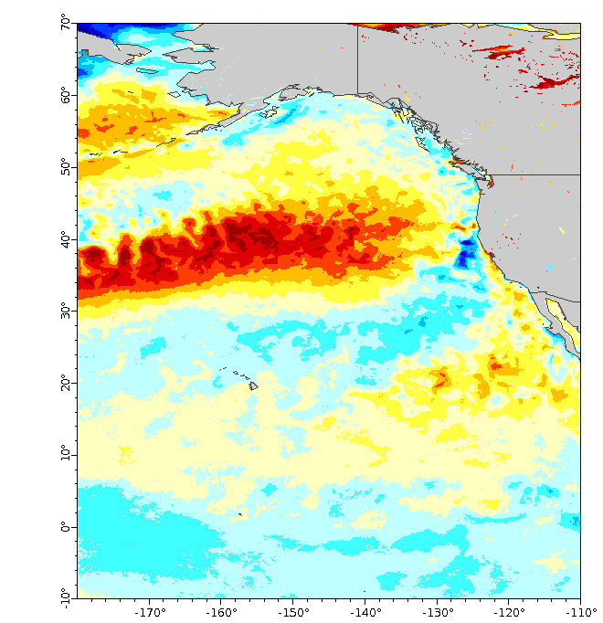
Recent NE Pacific marine heat waves
Sea surface temperature (SST) anomalies in September
2014-16 “The blob”
2019
2020
2021
Peak size
9.7 mill km²
8.5 mill km²
9.1 mill km²
4.1 mill km²
https://www.integratedecosystemassessment.noaa.gov/regions/california-current/cc-projects-blobtracker
https://coastwatch.pfeg.noaa.gov/erddap/index.html
Notes:
Series of marine heat waves caused exceptionally warm surface layer, also extremely low surface productivity.

Slide 10
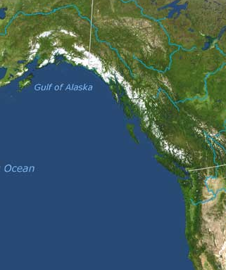
Ocean distributions
First summer in the ocean:
3 patterns for Columbia salmon
Pattern 1: Rapid north-wards movement on shelf to Gulf of Alaska
Which: Spring Chinook, chum, sockeye, some coho
Pattern 2: Remain in local waters
Which: Fall Chinook, some coho
Pattern 3: Move rapidly offshore
Which: Steelhead

Slide 11
Recent NE Pacific marine heat waves
Sea surface temperature (SST) anomalies in September
2014-16 “The blob”
2019
2020
2021
Peak size
9.7 mill km²
8.5 mill km²
9.1 mill km²
4.1 mill km²
https://www.integratedecosystemassessment.noaa.gov/regions/california-current/cc-projects-blobtracker
https://coastwatch.pfeg.noaa.gov/erddap/index.html
Notes:
Series of marine heat waves caused exceptionally warm surface layer, also extremely low surface productivity.

Slide 12
Recent NE Pacific marine heat waves
Sea surface temperature (SST) anomalies in September
2014-16 “The blob”
2019
2020
2021
Huge biological impacts to marine ecosystems at all trophic levels, including:
harmful algal blooms
extreme bird and whale mortality events
species ranges extensions
changes in species productivity (high and low)
explosions of unusual species (e.g., pyrosomes)
Peak size
9.7 mill km²
8.5 mill km²
9.1 mill km²
4.1 mill km²
https://www.integratedecosystemassessment.noaa.gov/regions/california-current/cc-projects-blobtracker
https://coastwatch.pfeg.noaa.gov/erddap/index.html
Notes:
Series of marine heat waves caused exceptionally warm surface layer, also extremely low surface productivity.

Slide 13
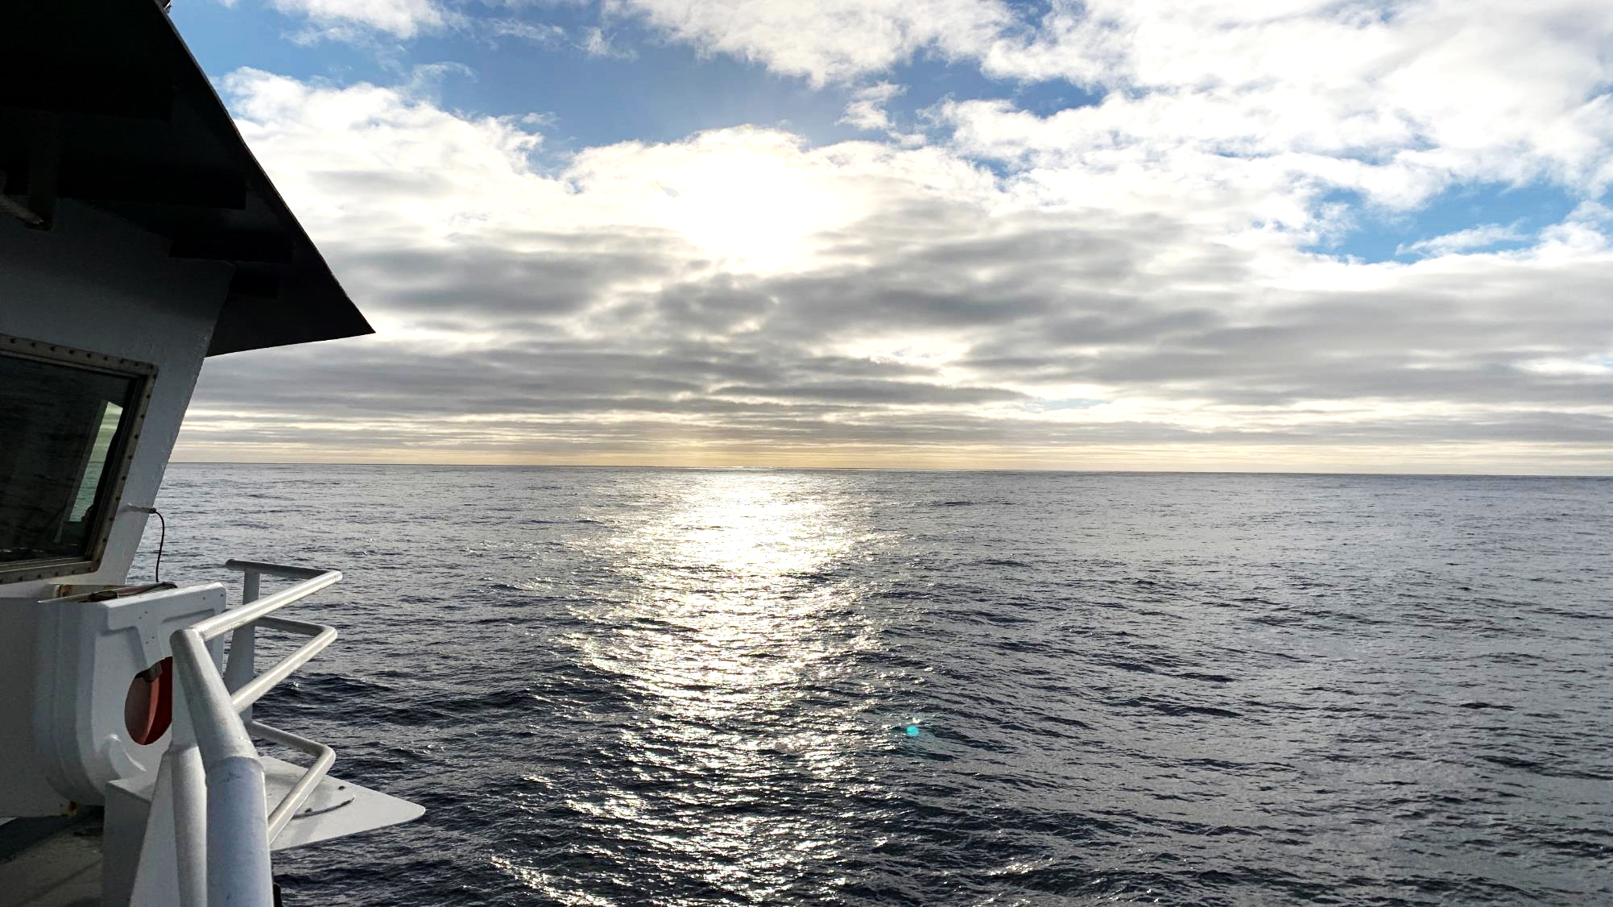
Biological response
3. Stoplight chart & Columbia salmon forecasts
4. Recent North Pacific salmon trends

Slide 14
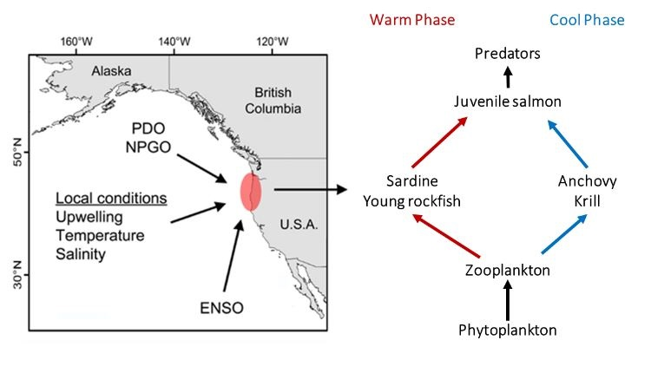
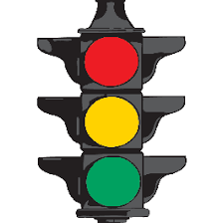
3. NWFSC’s stoplight chart
https://www.fisheries.noaa.gov/west-coast/science-data/ocean-ecosystem-indicators-pacific-salmon-marine-survival-northern

Slide 15
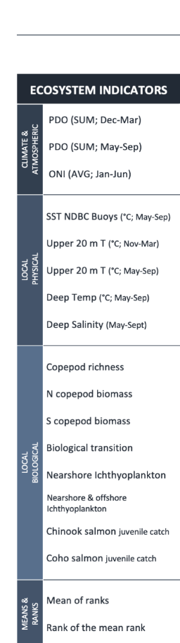
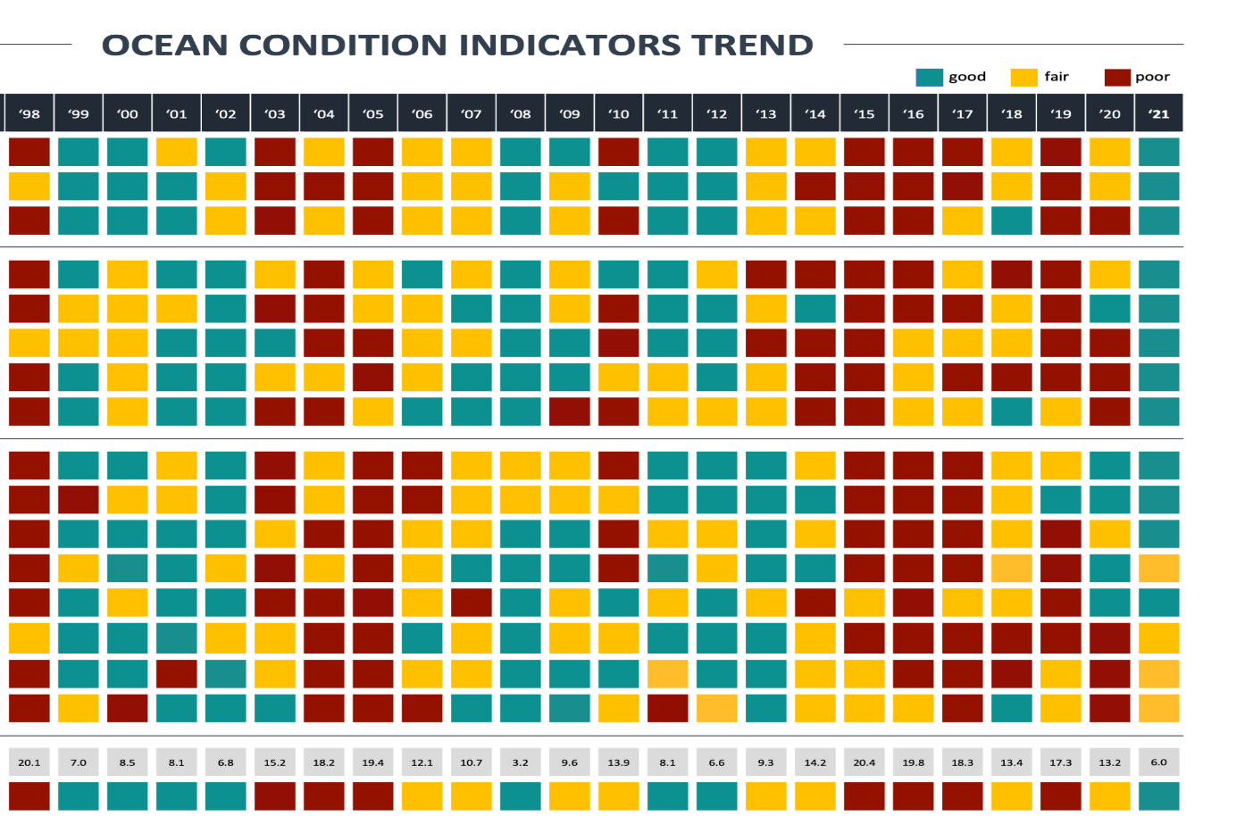
Ocean basin-scale
(PDO, ONI)
Local
physical
2nd best year after 2008
Why?
Local biological
Ranks
https://www.fisheries.noaa.gov/west-coast/science-data/ocean-ecosystem-indicators-pacific-salmon-marine-survival-northern

Slide 16
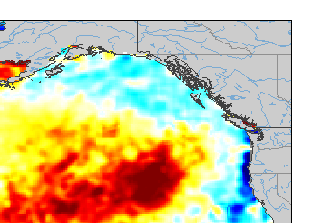

Ocean basin-scale
(PDO, ONI)
Neg
Negative PDO (=cold phase), back to back La Niñas
May 2021 SST anomaly
Local
physical
Cold water along coast
Lots of northern copepods
Local biological
Okay prey availability
Reasonable numbers of juvenile salmon in ocean survey
Ranks

Slide 17
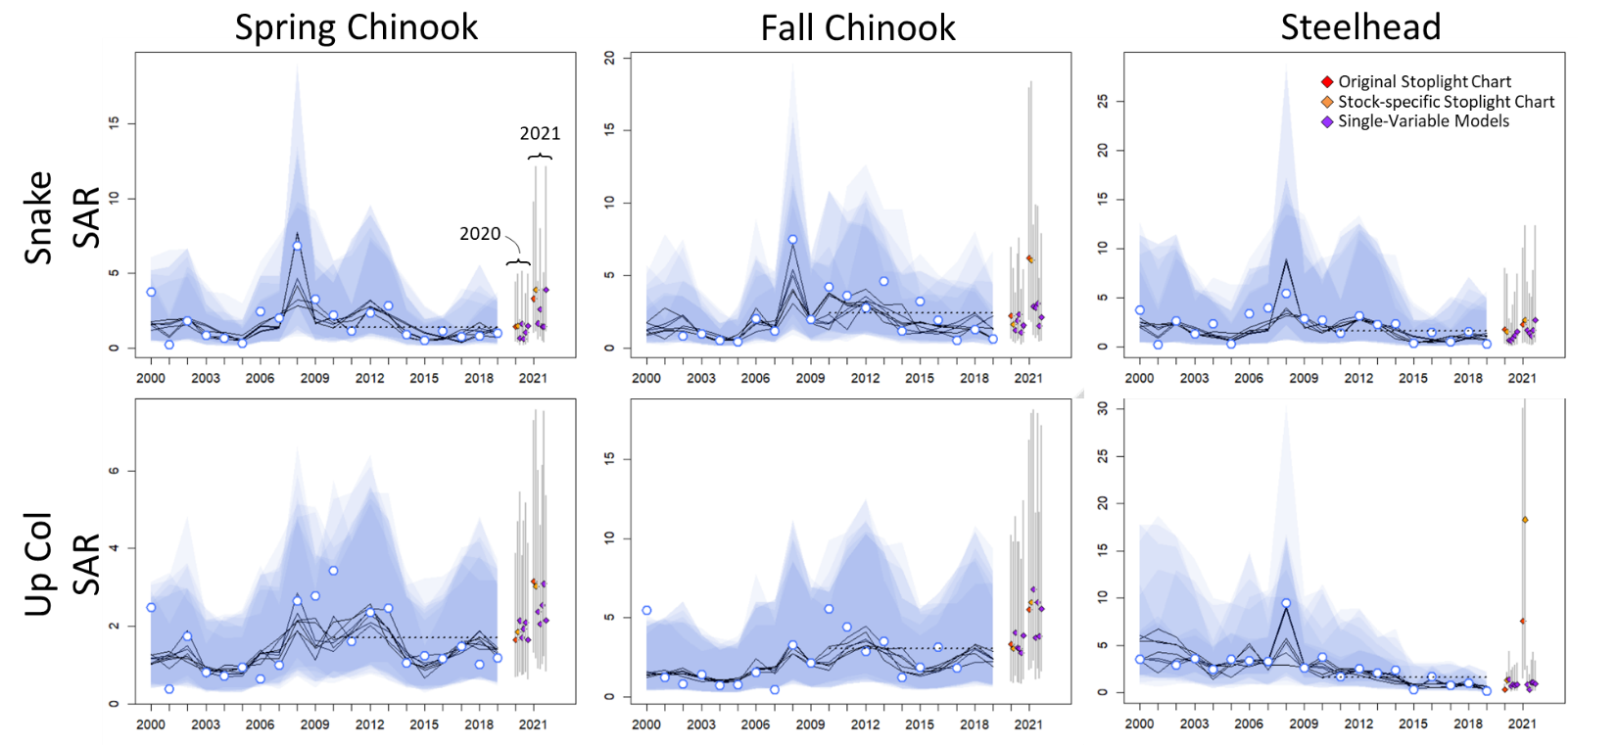
Smolt to adult forecasts for 2020 & 2021 out migrants
(From Brian Burke, NWFSC)

Slide 18
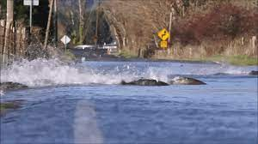
4. Recent Pacific salmon trends seeing impacts of marine heat waves around the Pacific Rim (high & low)

Slide 19
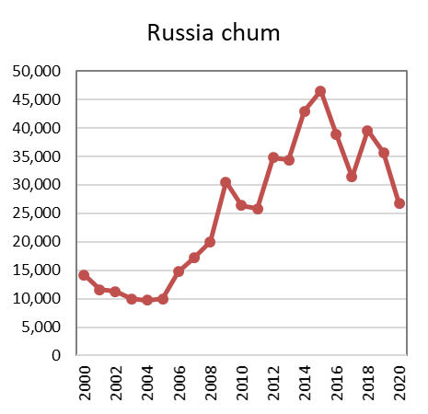
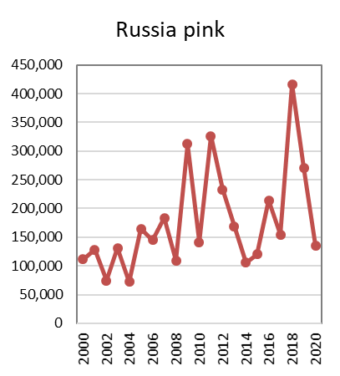
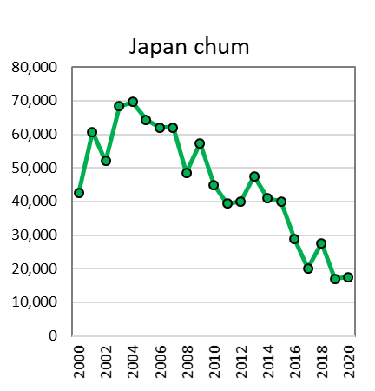
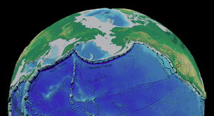
Catch by country/state shows diverse trends (numbers of fish in 1,000s)
Data from NPAFC.org
Notes:
Enormous pink salmon returns in Russia in 2018 (& 2019) then decline in 2020, generally stable in Alaska (mix of spp), declining in Japan (chum), Canada and WA-OR-CA.

Slide 20
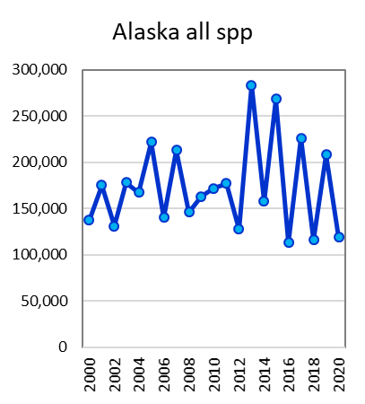
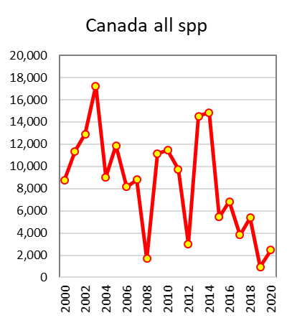
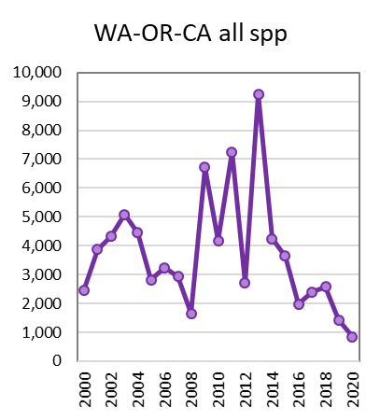
Catch by country/state shows diverse trends (numbers of fish in 1,000s)
Data from NPAFC.org
Notes:
Enormous pink salmon returns in Russia in 2018 (& 2019) then decline in 2020, generally stable in Alaska (mix of spp), declining in Japan (chum), Canada and WA-OR-CA.

Slide 21
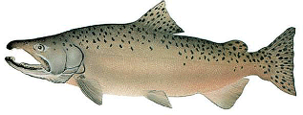
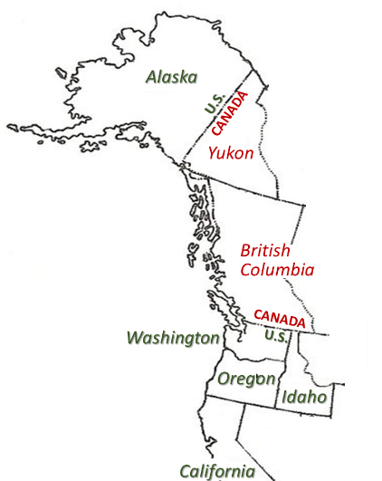
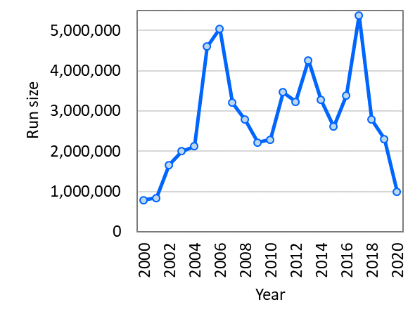
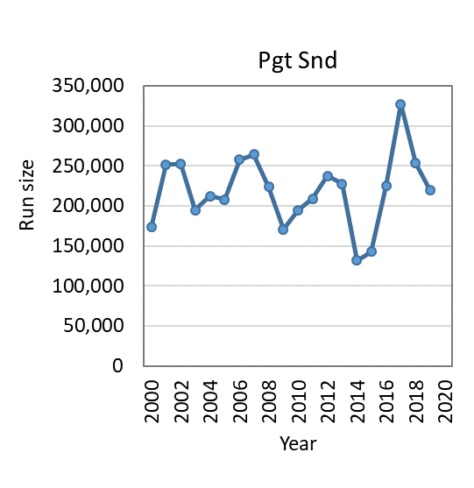
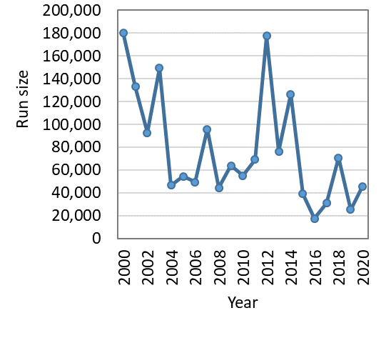
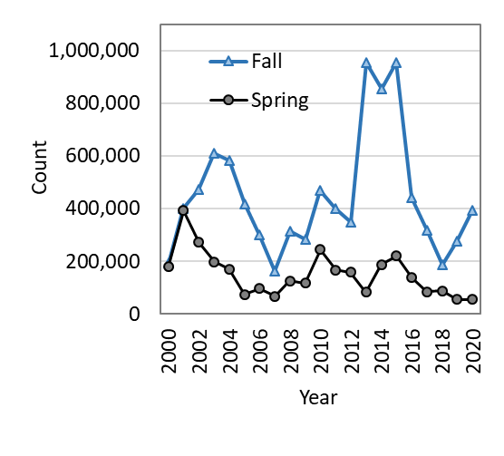
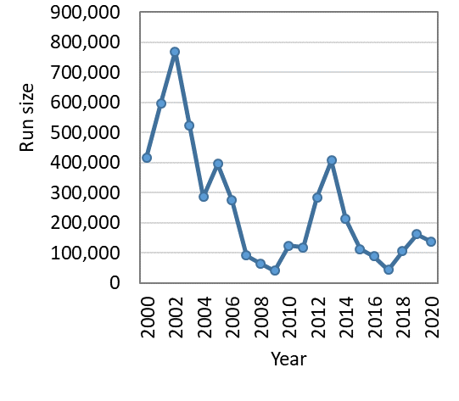
Chinook (O. tshawytscha)
CAN Yukon Run size
Puget Sound
Columbia (Dam counts)
Klamath
Sacramento
Notes:
Very mixed patterns for Chinook, some show hump (Yukon, PS, Skeena-Nass), others hit lows but year of low varied (Klamath-2016, Sacramento 2017, Columbia 2018). Columbia Springers going down.

Slide 22
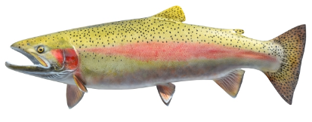
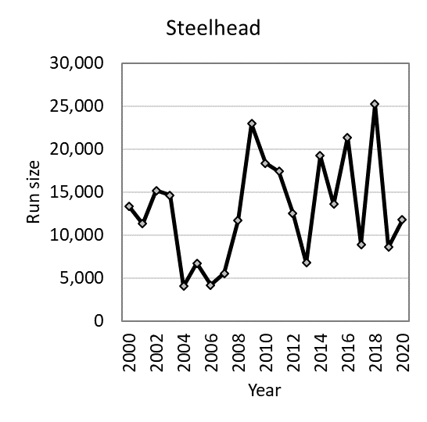
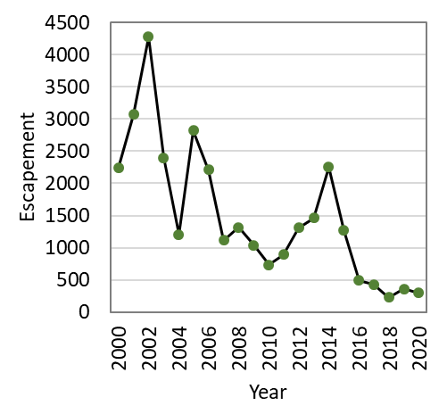
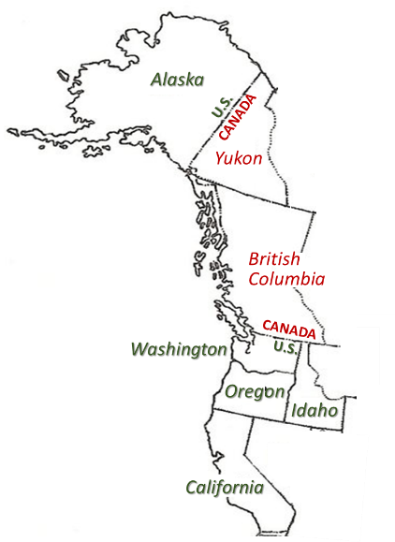
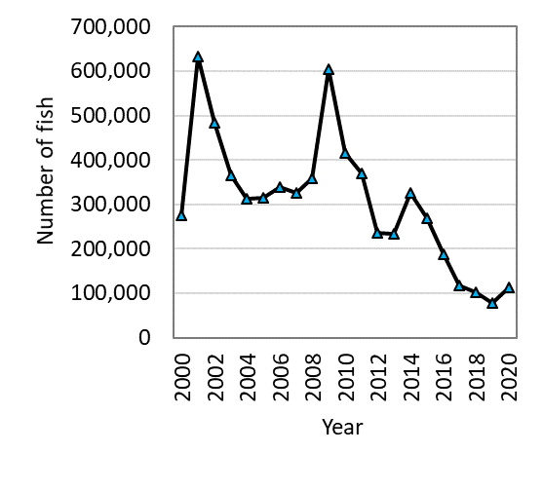
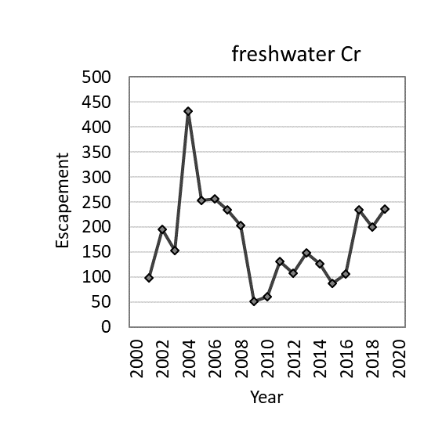
Steelhead (O. mykiss)
Nass test fishery
Fraser River
(Thompson-Chilcotin)
Columbia (dam counts)
Freshwater
Creek
Notes:
Mixed trends for steelhead. Both Fraser and Columbia on strong downward trend, with lowest ever returns to both systems in 2021. Only 19 steelhead returned to Chilcotin (and 203 to Thompson), an “extreme conservation concern”. Increase in CA pops likely aided by end of drought in 2017.

Slide 23
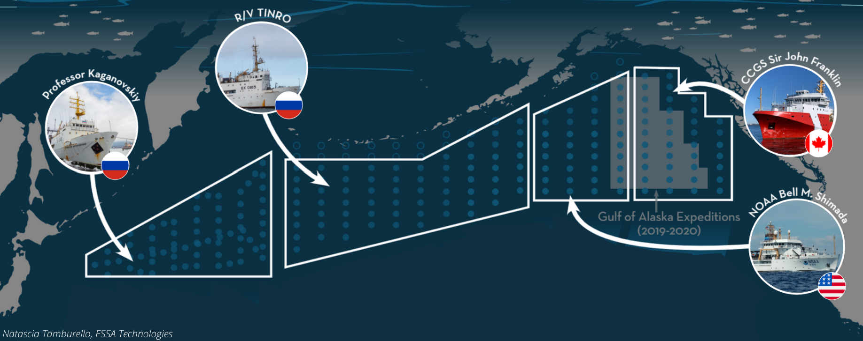
5. 2022 IYS High seas salmon survey

Slide 24
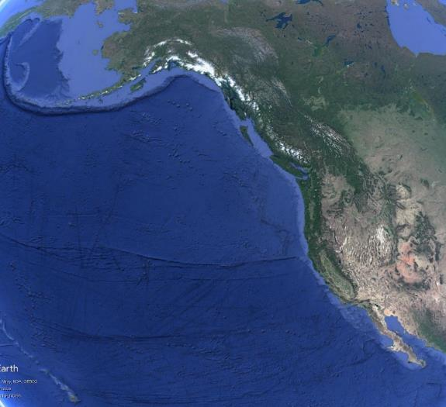

Why the survey?
We know very little about salmon once they leave coastal areas for high seas (=black box)
Low prey availability in winter hypothesized to create survival bottleneck
Recent unexpected salmon returns (both high and low) suggest changes in mortality schedules
  high seas to blame?
Builds on Gulf of Alaska expeditions in 2019 and 2020.
  Caught Columbia River Chinook, coho, and sockeye
https://yearofthesalmon.org/high-seas-expeditions/

Slide 25
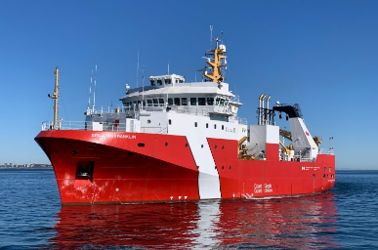
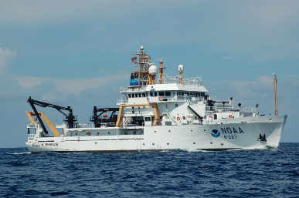
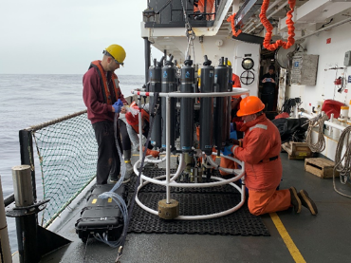
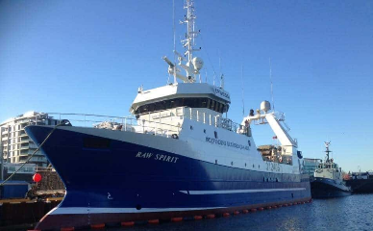




Using 5 ships concurrently with identical methodologies
Canada: Franklin
US: Shimada
Physical oceanography
Canada: Raw Spirit
US: NW Explorer
Biological oceanography
Russia: TINRO
Fishing
(surface trawl or gillnet)

Slide 26
Measurements & samples collected from salmon
Length, weight
Scales (age, growth)
External marks (possible predation attacks, disease)
Fin clips (Genetic Stock ID)
Gill tissue (pathogens, up/down regulation of genes)
Blood (IGF)
Muscle (bioenergetics, fatty acids, stable isotopes, thiamine)
Liver (bioenergetics, fatty acids, stable isotopes, thiamine)
Gonads (bioenergetics, maturation)
Stomach contents (food habits)
Otoliths (age, hatchery thermal marks)
CWTs (origins, age)
Eye lenses (elemental analyses)
Opercula & vertebrae (life-time hormone levels)

Slide 27







Slide 28

Catches by ship and species
Chum
Pink
Sockeye
Coho
Chinook
Steelhead
+58 caught by gill netter

Slide 29

Questions?

