Slide 1
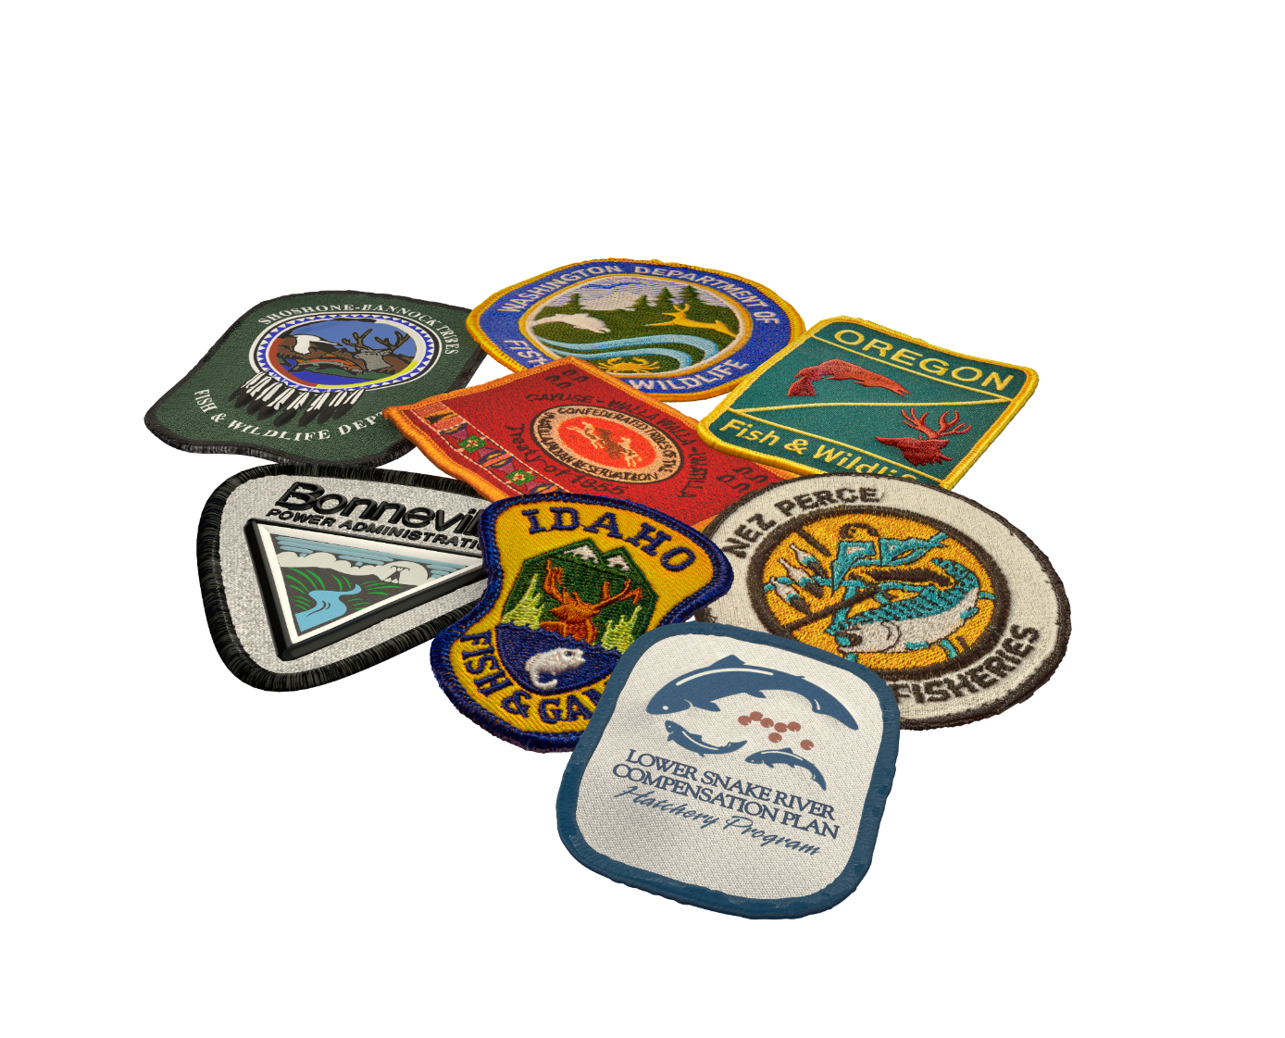
Fish for the Future
Station of the Year

Slide 2
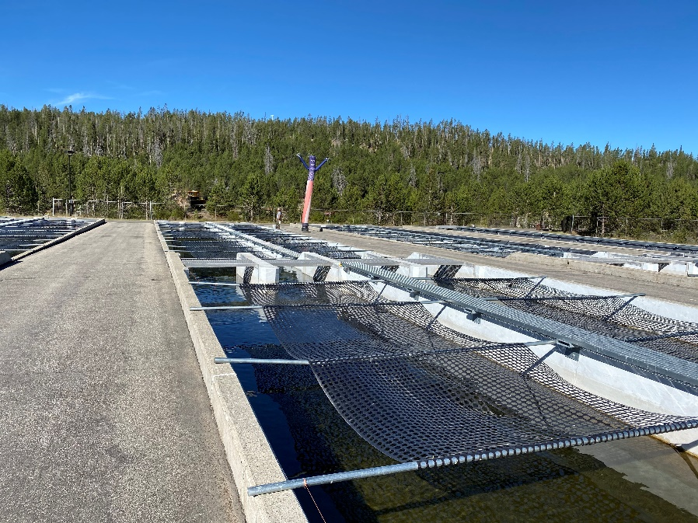
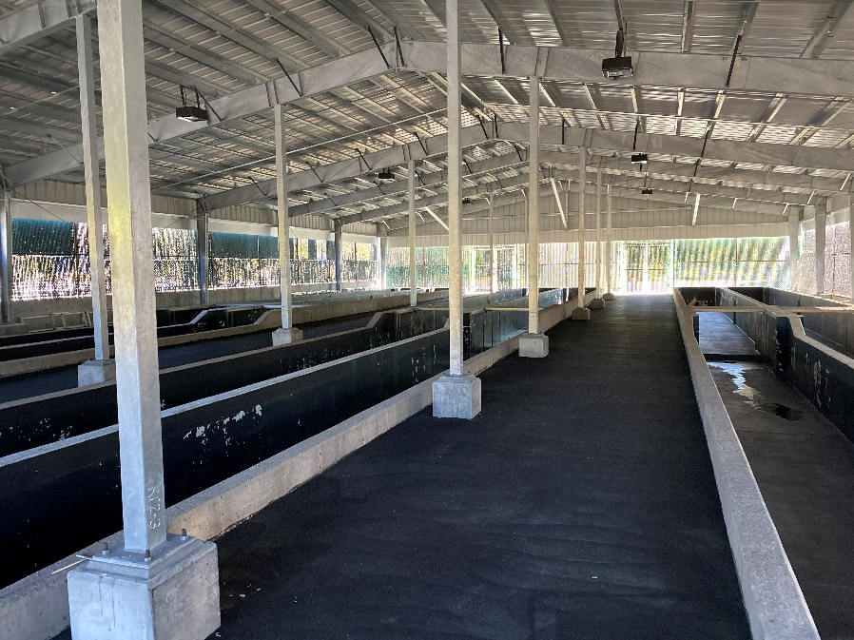
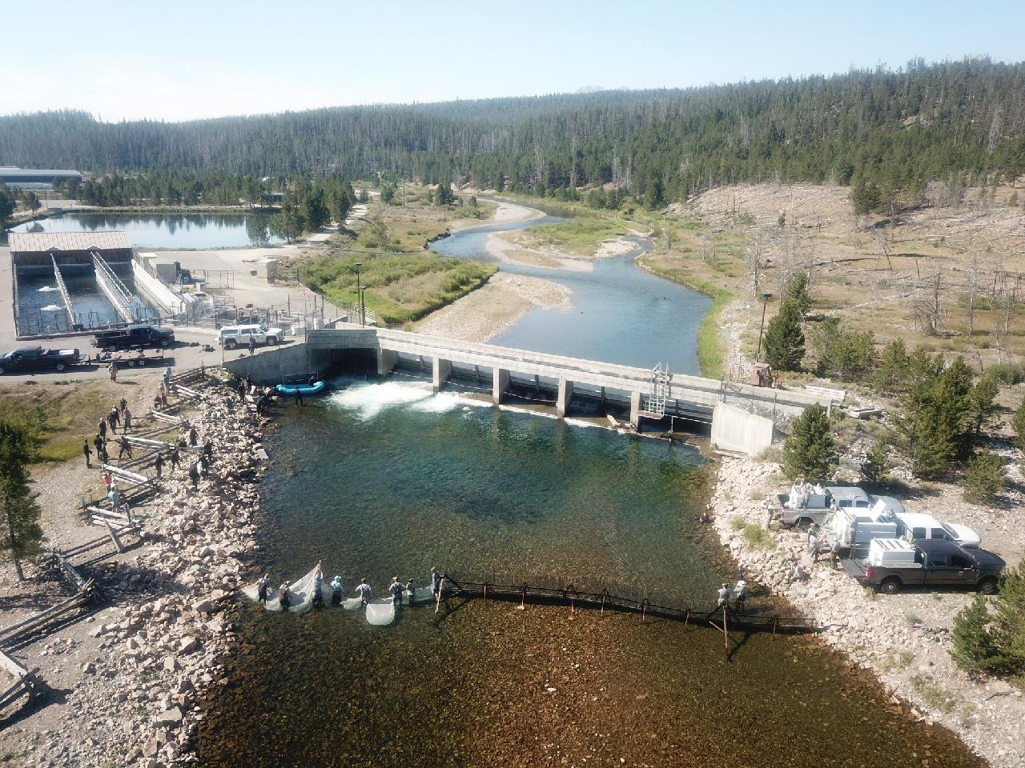
Sawtooth Hatchery

Slide 3
Sawtooth Hatchery
East Fork facility transition
Backfilling Pahsimeroi smolts
Work towards additional Yankee Fork acclimation periods
Outreach and new visitor signs around the facility
Troubleshooting getting fish into the trap and rounding up the rest

Slide 4
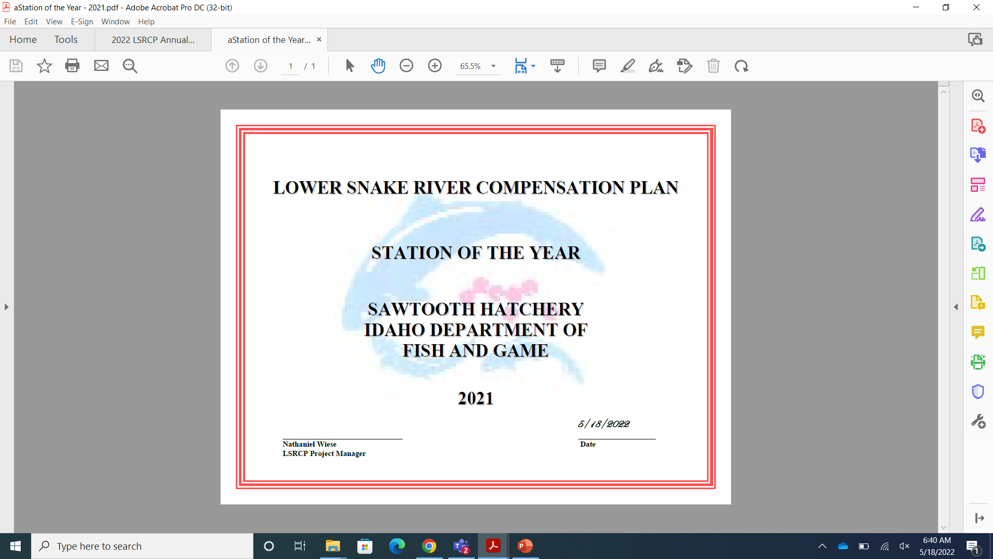

Slide 5
Thanks for Attending!

