Slide 1
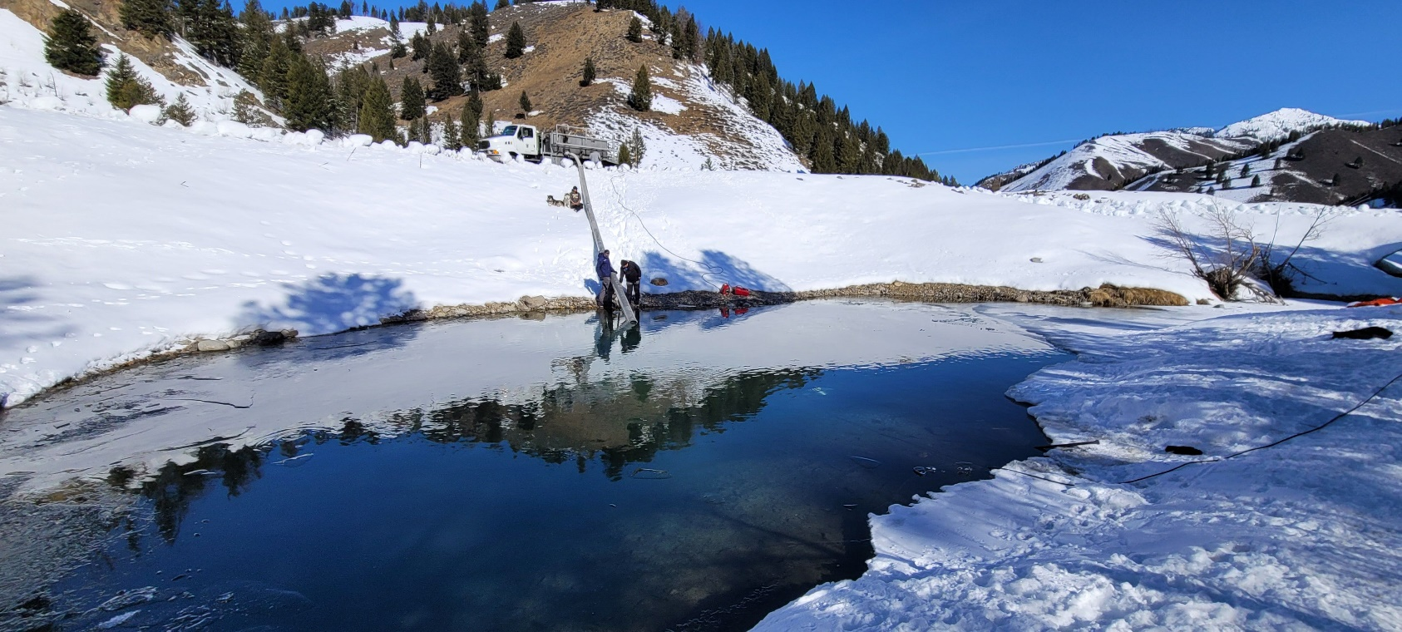
Aligning with Success
Annual Meeting
May 17-18th, 2022

Slide 2
Aligning with Success
HELP!
“My fish have fallen and they can’t get up.”
Notes:
30 minutes for this exercise
Directions on next slide
Matthew (Course Leader) will lead the exercise

Slide 3
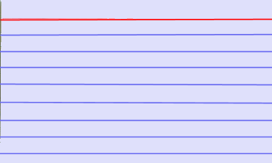
Aligning with Success
HELP!
1) Grab an index card
2) Write a short description of a problem you would fix as the LSRCP Coordinator.
3) Await further instructions.
You have 5 minutes
Notes:
Give the students 5 minutes to describe their situation when they did not get what they expect.
Then take them out in the hallway or outside and have them stand in a circle.
Have them chuck their note cards into the center of the room (provide a hat to aim for and prizes for landing in the hat).
Have students pick up someone else’s card. On the back identify some variables that may have affected the outcome and possible solutions to the problem, in case it ever happens again.
After the first round, exchange cards again so students can get another set of possible variables and solutions.
Come back in the room and ask students for volunteers to read their issue, variables and suggested solutions.

Slide 4

Fish for the Future

Slide 5
What is Low Hanging?
Release locations?
Size at release?
Release timing?
Multi-crop Steelhead and Age 0 Chinook?
Program facility assets to species strengths?
Broodstock availability in 2022?

