Slide 1
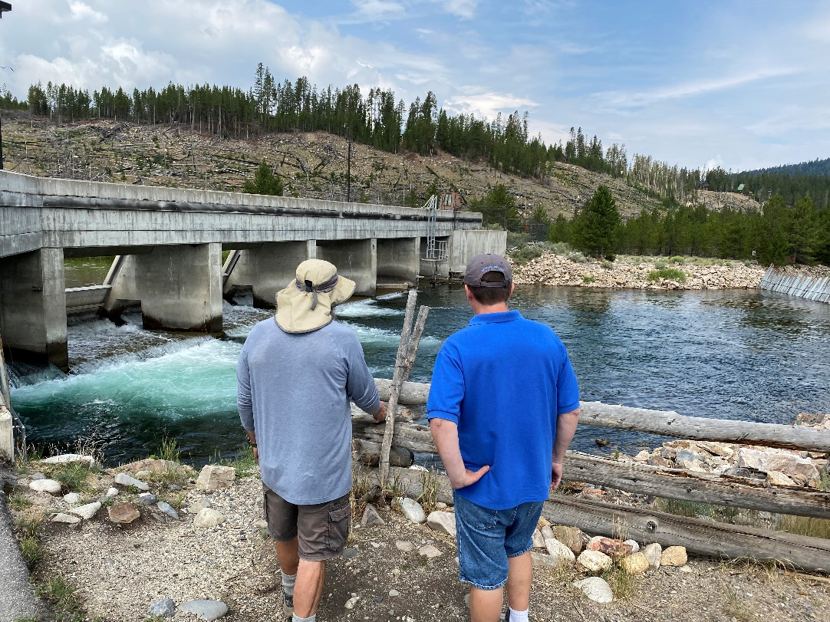
Welcome to LSRCP!
Annual Meeting
May 17-18th, 2022

Slide 2
Housekeeping
Please mute phones and chat box for questions
We’ll use the integrated mics for questions from the audience or have the speaker repeat them
$20 Social/Breaktime snacks – please find Margaret Anderson and Anna Copeland
Social at Kristen Armstrong Pavilion (5-9 pm)
Bathrooms

Slide 3
Meeting Objectives
Reconnect after a 3-year COVID hiatus
Reinspire our efforts towards Fish for the Future
Update current Ocean conditions and contemplate future LSRCP strategies
Brainstorm for the future – budgets, efficiencies, fish and more

Slide 4
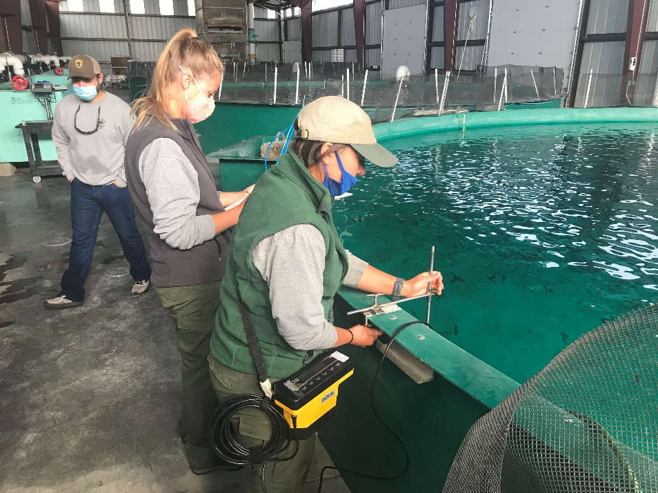
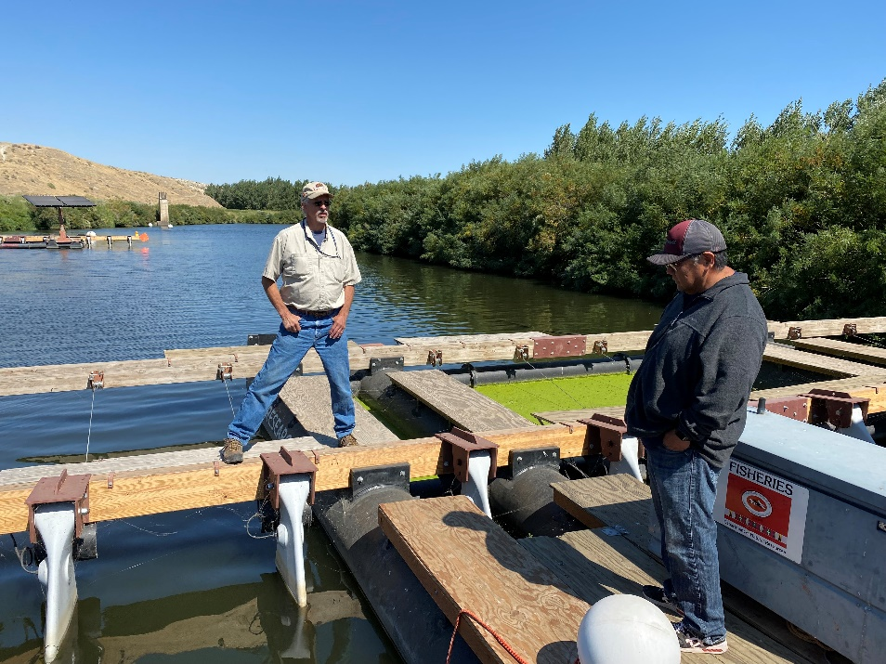
You are Fish for the Future!
Notes:
Introduce Director Schriever

Slide 5
Meeting Agenda
State of LSRCP
Ocean Conditions
FINS
New Tech – Walla Walla Hatchery
Business
  Budgets/BPA Update
  ISRP Review
  Maintenance
  Permitting

Slide 6
ISRP Spring Chinook Review
Summarize the past 10 years
Chart a future path
How to become more responsive to quick environmental changes?
Solicit feedback from the ISRP
Steelhead and Fall Chinook in upcoming years

Slide 7
LSRCP History
1945
  Congressional Approval
1975
  COE/Agency Special Report to Congress
  Goals Established
1976
  Environmental Impact Assessment
  Congressional Authorization
1983
  Implementation
Notes:
From Rod Engle’s Annual Report and presentations

Slide 8
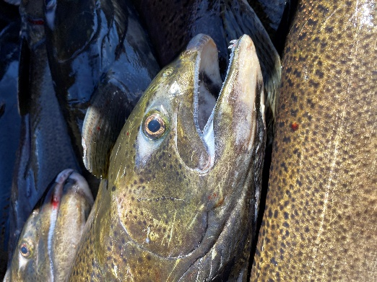
LSRCP Estimating Adults
Project Area Goals
  Pre-Dam Adults
  48% Loss from Dams
Harvest/Habitat Loss
  Loss of riverine habitat from reservoirs
  Harvest downstream (4:1) Chinook and 2:1 Steelhead
Notes:
From Rod Engle’s Annual Report and presentations

Slide 9
Project Area Goals
Species | Pre-Dam Adults | 48% Loss | Project Area Goal
Fall Chinook | 37,700 | 0.48 | 18,300
Spring/Summer Chinook | 122,000 | 0.48 | 58,700
Steelhead | 114,800 | 0.48 | 55,100
Notes:
Habitat loss from dam construction – flooding habitat – mitigate for that loss.
These are the goals for the three species (plus Rainbow trout). Other species were obviously impacted but through negotiations between COE and States, these species were the only ones identified for compensation in the documents.
Rainbow trout were predominantly a Washington request for loss of angler days due to the dams. Concern was expressed over loss of the river fishing environment in the areas of the dams and that lake/reservoir fishing wouldn’t be as beneficial. Another effort at mitigation through oss of fishing sites was attempted by the COE in the Washington area by purchasing riparian areas for fishing access. This was met with much local resistance from the 1983 report by the COE (county commissioner letters/testimony) as local landowners didn’t want to sell property to the federal government. An entire other piece of LSRCP exists outside of fish production actvities and is administered by the COE. A recent report can be provided that details those efforts.

Slide 10
History
Species | Project Area Goals | Harvest/Habitat | Total Production
Fall Chinook | 18,300 | 73,200 | 91,500
Spring/Summer Chinook | 58,700 | 234,800 | 293,500
Steelhead | 55,100 | 110,200 | 165,300
Rainbow Trout | 86,000 pounds stocked
Project Area goals are primary focus.
Rainbow trout are to compensate losses of riverine smallmouth bass, channel catfish, and white sturgeon opportunities
Notes:
Habitat loss from dam construction – flooding habitat – mitigate for that loss.
These are the goals for the three species (plus Rainbow trout). Other species were obviously impacted but through negotiations between COE and States, these species were the only ones identified for compensation in the documents.
Rainbow trout were predominantly a Washington request for loss of angler days due to the dams. Concern was expressed over loss of the river fishing environment in the areas of the dams and that lake/reservoir fishing wouldn’t be as beneficial. Another effort at mitigation through oss of fishing sites was attempted by the COE in the Washington area by purchasing riparian areas for fishing access. This was met with much local resistance from the 1983 report by the COE (county commissioner letters/testimony) as local landowners didn’t want to sell property to the federal government. An entire other piece of LSRCP exists outside of fish production actvities and is administered by the COE. A recent report can be provided that details those efforts.

Slide 11
Implementation
1975 Goals | Fall Chinook | Spring Chinook | Steelhead
Adults | 18,300 | 58,700 | 55,100
SAR | 0.20 | 0.87 | 0.50
Smolts | 9,160,000 | 6,750,000 | 11,000,000
Fish/lb | 90 | 15 | 8
2021 | Fall Chinook | Spring Chinook | Steelhead
Adults | 18,300 | 58,700 | 55,100
SAR (2004-16’) | 0.77 | 0.50 | 1.41
Performance | 20,622 | 29,115 | 70,283
Smolts | 3,050,000 | 10,500,000 | 5,500,000
Fish/lb | 25 | 19 | 4.6
Notes:
Decisions have been made over the past 40 years to try to achieve the Project Area Adult goals
Rod will update this further

Slide 12
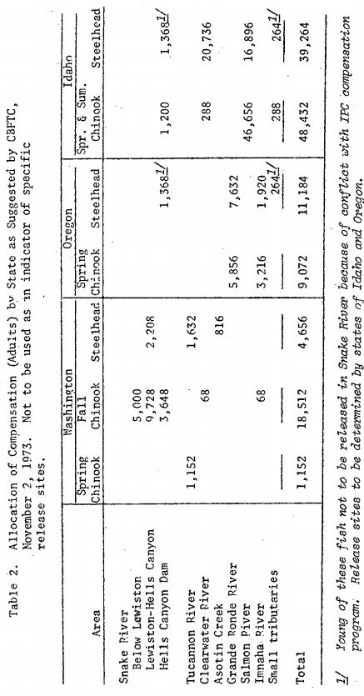
In Place/In-Kind
Notes:
Page 13 -

Slide 13
FCS Goals
Basin/Area | Fall Chinook Salmon | Project Area Goal
Lyons Ferry/FCAP (Snake River) | Snake River Fall | 18,300
Notes:
Page 13 -

Slide 14
SCS Goals
Basin/Area | Spring-Summer Chinook | Distribution of Project Area Goal
Salmon (Idaho, Sawtooth Hatchery) | Summer | 19,445
Salmon (Idaho, McCall Fish Hatchery) | Summer | 8,000
Clearwater (Idaho, Clearwater Hatchery) | Spring | 11,900
Lochsa River (Idaho, Clearwater Hatchery) | Summer | TBD
Clearwater (Idaho, Dworshak) | Spring | 9,135
SE Washington - Tucannon | Spring | 652
SW Washington - Touchet | Spring | 500
Imnaha River (Oregon) | Summer | 3,210
Grande Ronde (Oregon, upper basin) | Spring | 1,617
Catherine Creek (Oregon) | Spring | 970
Lookingglass (Oregon) | Spring | 1,617
Lostine (Oregon) | Spring | 1,654
Totals |  | 58,700
Notes:
Page 13 -

Slide 15
STT Goals
Basin/Area | Steelhead Type | Distribution of the Project Area Goal
Clearwater (Idaho) | B-Steelhead | 14,000
Salmon (Idaho, Hagerman NFH Production) | A-Steelhead | 13,600
Salmon (Idaho, Magic Valley Production) | A-Steelhead | 11,660
 | B-Steelhead | TBD
Grande Ronde (Oregon) | A-Steelhead | 9,184
Imnaha (Oregon) | A-Steelhead | 2,000
SE Washington | A-Steelhead | 4,656
Totals |  | 55,100
Notes:
Page 13 -

Slide 16
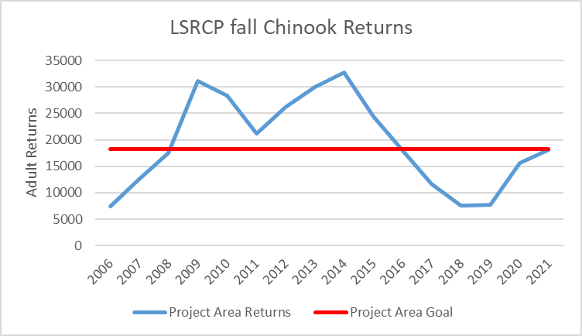
Performance
2019-2021 estimates
Notes:
Estimate

Slide 17
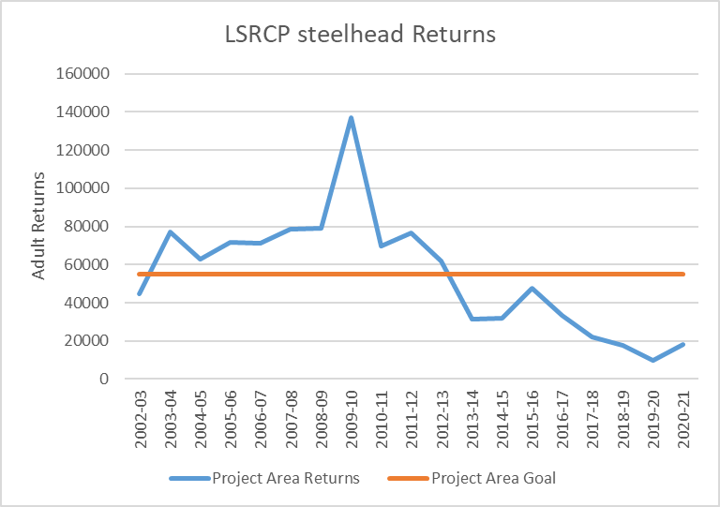
Performance
Notes:
Overall, number of spring Chinook salmon (HOR and NOR) returning over recent time period. Returns in last decade have just began to compete with estimates of the Snake Basin from 1950’s (little to no hatchery influence and prior to construction of Lower Snake River Dams).
Data from Fish Passage Center.

Slide 18
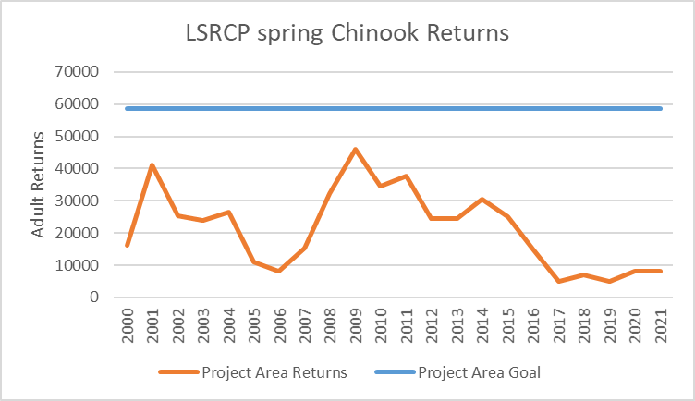
Performance
2019-2021 estimates
Notes:
Overall, number of spring Chinook salmon (HOR and NOR) returning over recent time period. Returns in last decade have just began to compete with estimates of the Snake Basin from 1950’s (little to no hatchery influence and prior to construction of Lower Snake River Dams).
Data from Fish Passage Center.

Slide 19
2025…..I’d be surprised to see them last that long
- 1998 LSRCP Chinook Symposium, Howard Burge
Notes:
Dire straights
How do WE address our goals?
Invest in top performance – reduce investment in lagging performance.
LSRCP = Meet Adult Project Area Goals

Slide 20

Budgets
FY22 = $27M + 6M
FY23 = $27M + 2M
Front-loaded the FY22/23 budget to tackle the Dworshak Shade Structure replacement

Slide 21
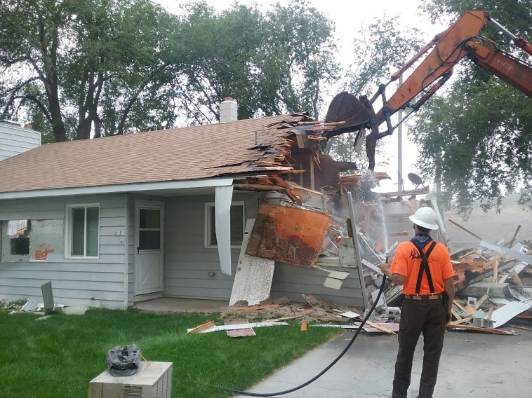
FY22 Maintenance
Hagerman NFH Houses
McCall Adult Holding Pond
Irrigon/Lyons Ferry Valves
Marmes Generator Building
Fleet Management - $400K investment
Notes:
Chris and Brian will discuss these in further detail

Slide 22
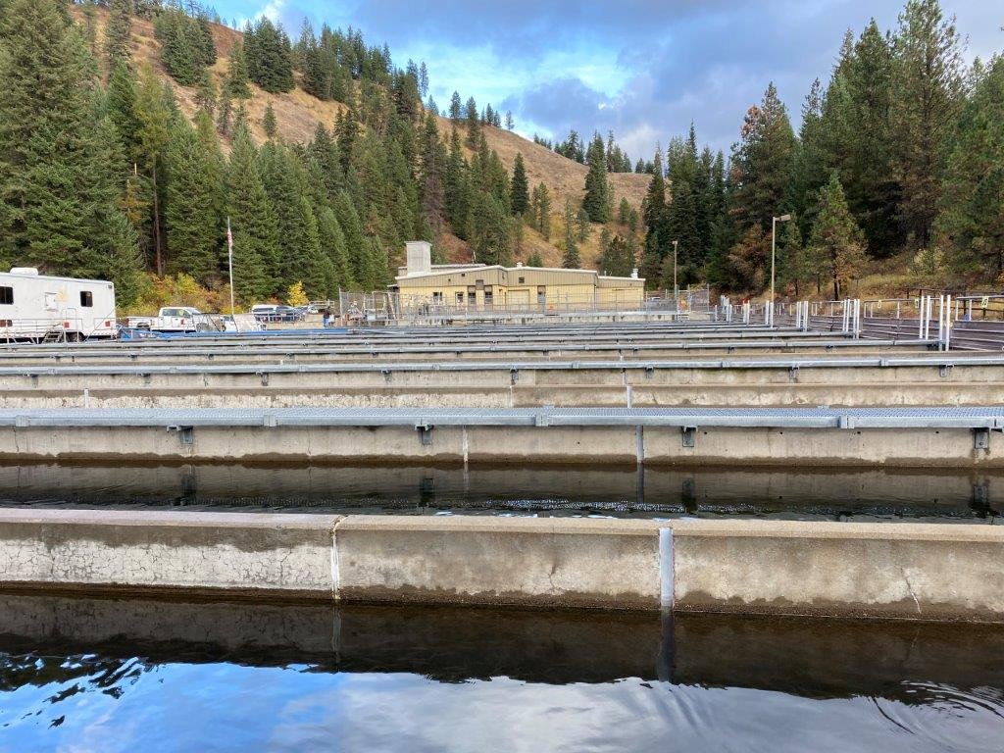
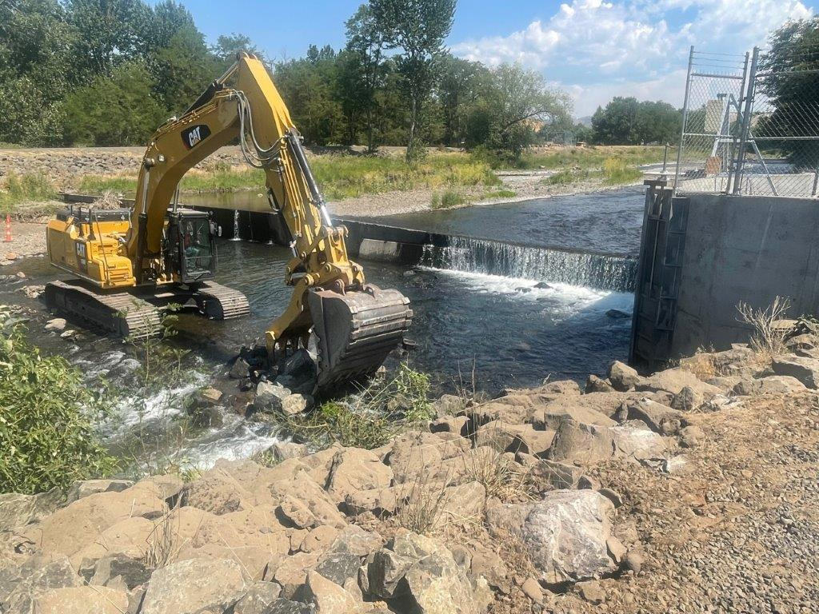
FY23 Maintenance
Dayton Dam - $1.7M
Other priority projects to $2.2M

Slide 23
Budgets – FY22 Actuals
Inflation
  Fish Food – 18%
  Labor – 3% to 10%
  Minimum Wage - $10.95 to $15.00/hr
  Transportation – 17%
Over $1.7M (6%) in inflationary costs anticipated in FY23
FY23 – Flat at $27M Operating Budget
Notes:
How are we going to deal with 2023??

Slide 24
Budgets – FY23 Guidance
Budget requests need to remain flat by Cooperator - not by Project
Prioritize your multiple programs that “move the needle” the furthest towards Project Area Goals
FY23 budgets due by July 13th
Notes:
Look hard, tighten the belt, and bring your best projects that will move the needle.

Slide 25
Art of the Possible
Chart the future
Reimagine and reinvent
Find efficiencies – how can we stay on flat budgets and do more??
Keep making positive changes!
Notes:
We will not cut every budget by 6% - prioritize!

Slide 26
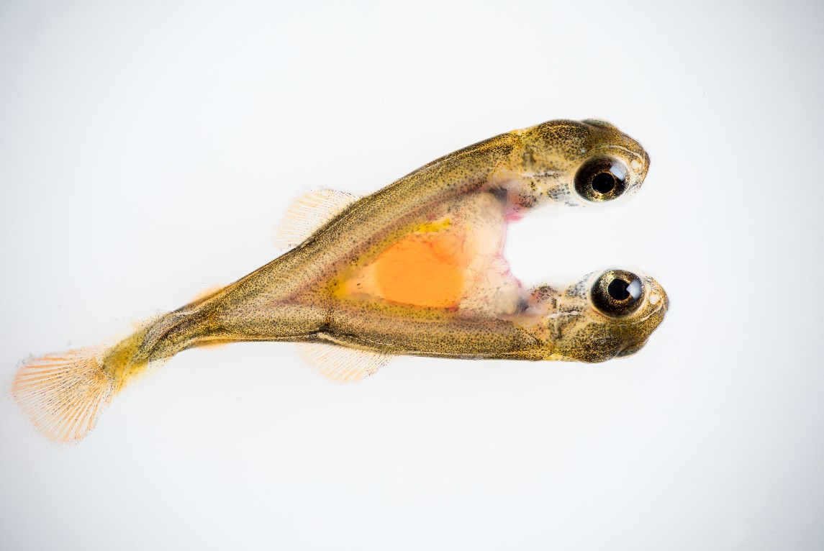
Thanks for Being Here!
Notes:
We’re all stuck in this together!

