Slide 1
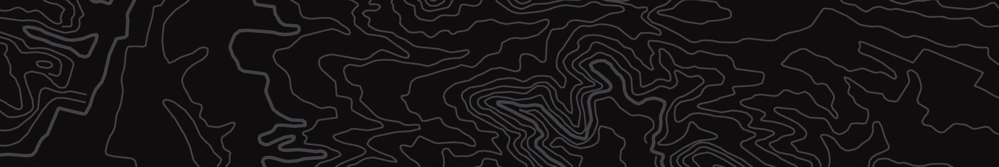

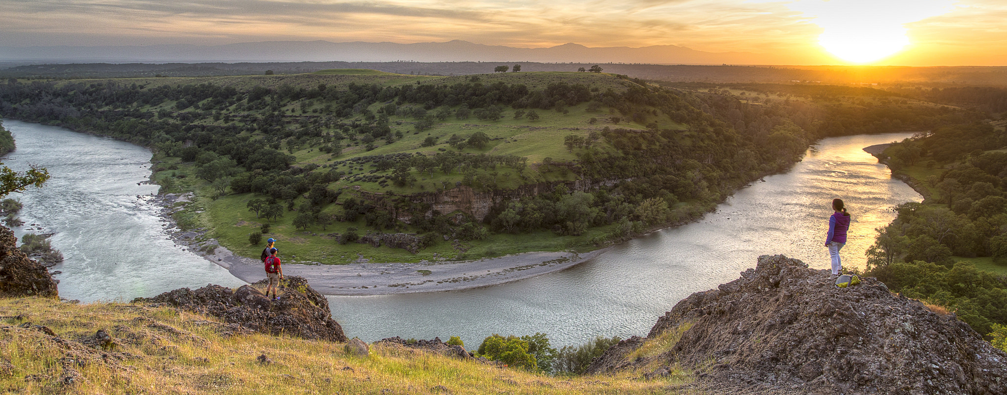
Dingell Act Section 4103 Updates
U.S. Department of the Interior
Bureau of Land Management
Reporting closures of public lands and waters permanently or temporarily to hunting, fishing or recreational shooting

Slide 2
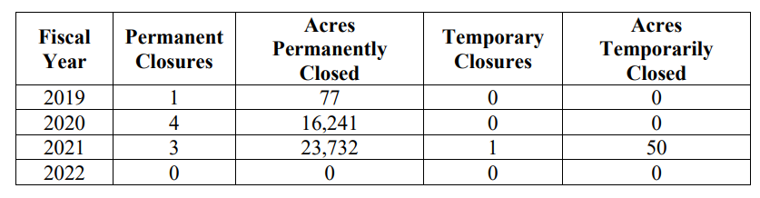
FY 2022 BLM Report to Congress

Slide 3
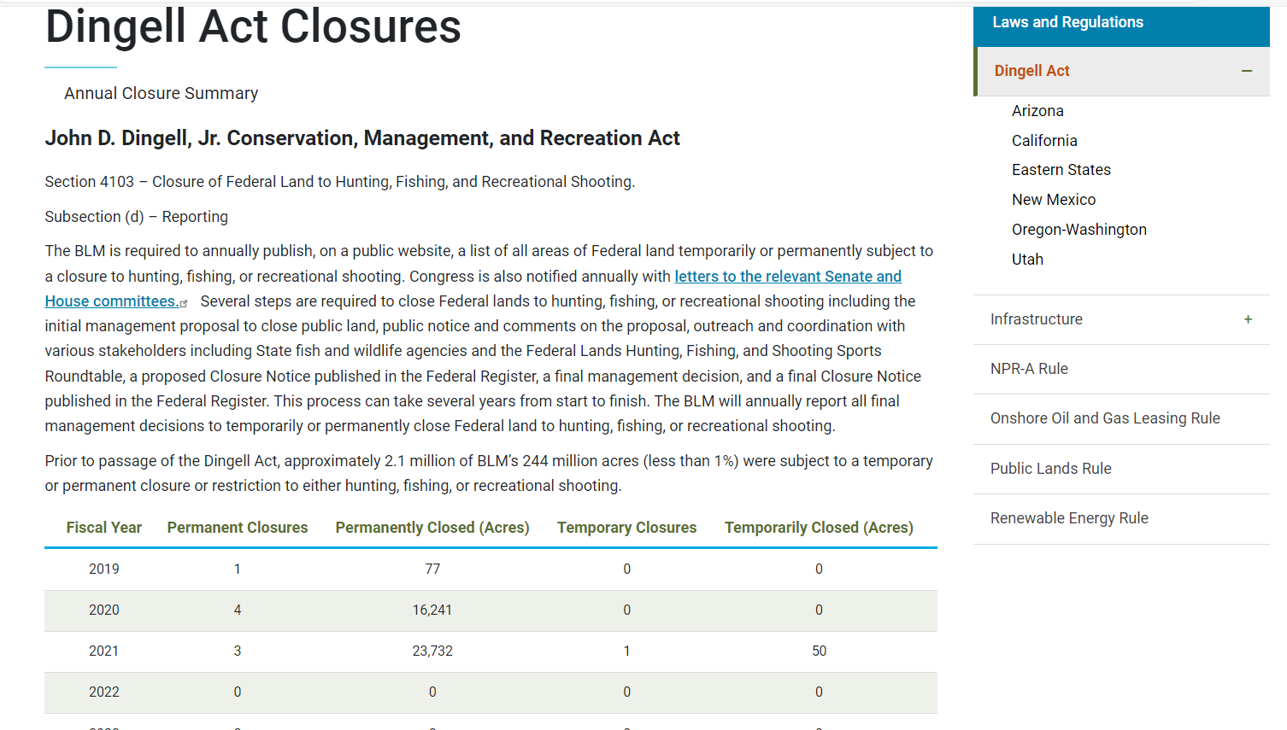
Bureau Website Devoted to Section 4103
Dingell Act Closures | Bureau of Land Management (blm.gov)

Slide 4
FY2023 Update & Status
In process, expected by end of calendar year 2023.
Currently tracking one closure, still checking with all BLM Units.
As new campgrounds and facilities are developed (e.g. BIL and IRA resilient recreation) new administrative closures will be implemented to provide for public and employee safety around those occupied sites.

