Slide 1



2022 National Survey of Fishing, Hunting, and Wildlife-Associated Recreation: Results and Follow-On Hunting and Shooting Research
Jerry Leonard
December 2023
Results are preliminary. Results are the authors alone and do not represent official positions of the U.S. Fish & Wildlife Service.

Slide 2



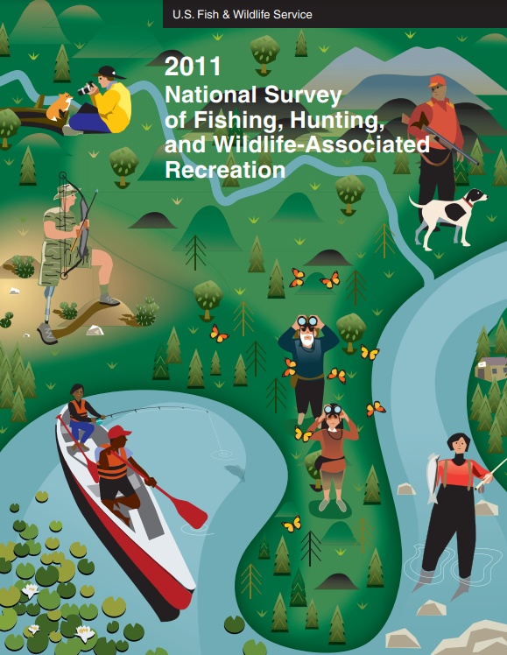
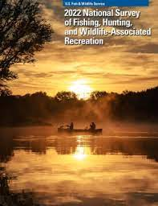
Background: History of the FHWAR
Collaboration between US Fish & Wildlife Service and Association of Fish and Wildlife Agencies
Seeks to measure participation and consumer expenditures for Fishing, Hunting, and Wildlife Watching
Since 1955, conducted approximately every five years
Methods and scope have evolved
  Changing activites
  Changing demographics
  Changing methods
1955
2022

Slide 3
Comprehensive Survey Redesign
CHALLENGES
SOLUTIONS
INNOVATIONS
Sustainability
Steep respondent burden
Coverage error in rural areas
Nonresponse bias
Reduce costs
Shorten the questionnaire
Address coverage error in rural areas
Web option
Offer State Opt-In
Blended sample design including NORC’s AmeriSpeak panel and non-probability sample
Enhanced weighting
pg 3

Slide 4
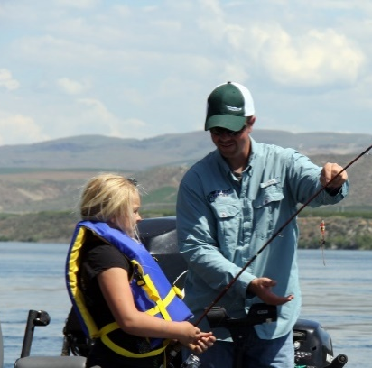
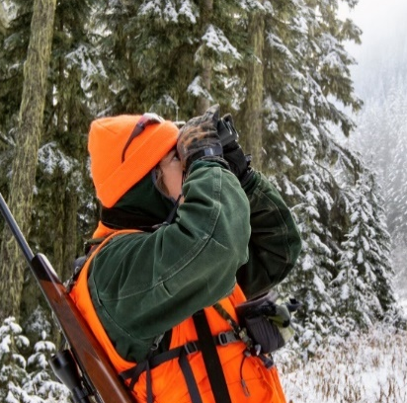
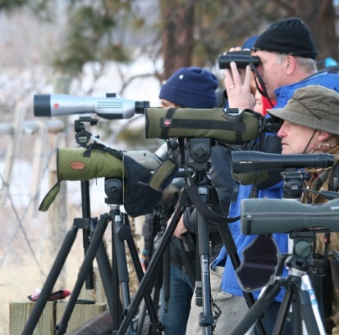
2022 Results: Headline National Results
How many people
Fish,
Hunt, or
Watch Wildlife
in the US?
Fishing
Hunting
Wildlife Watching
39.9 million participants
$99.4 billion in spending
14.4 million participants
$45.2 billion in spending
148 million participants
$250 billion in spending

Slide 5
Hunting Participants, Days, and Trips

Slide 6
Hunting Expenditures
Billions of hunting-related expenditures will contribute jobs and income to local economies, particularly in rural communities. See past economic reports: hunting and fishing.

Slide 7
Notes:
-Rural residents made up 20% of U.S. residents but 42% of all hunters

Slide 8
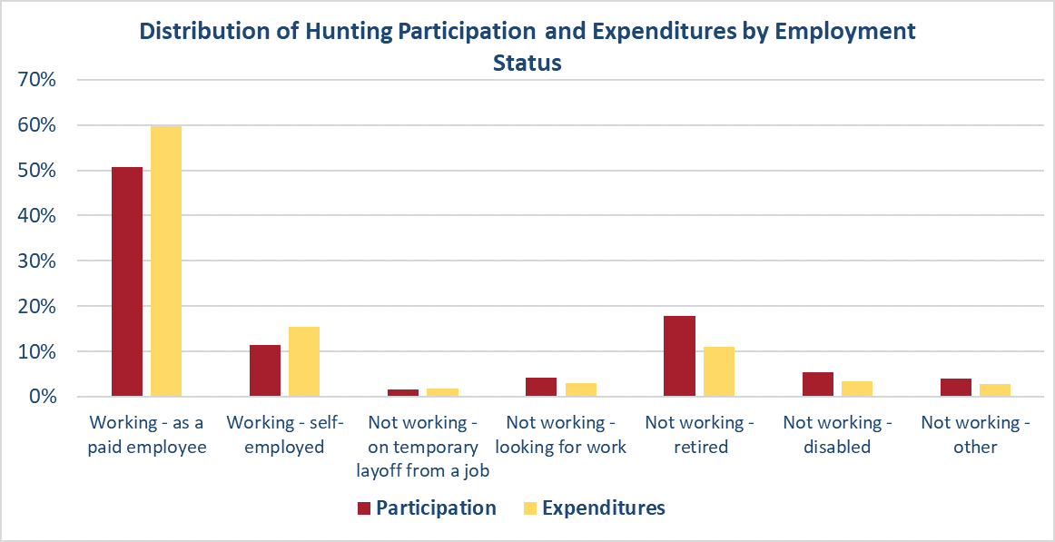
Additional 2022 Data – Not in Report Tables
62% of hunters work and represent 75% of expenditures
38% of hunters not-working and represent 25% of expenditures

Slide 9
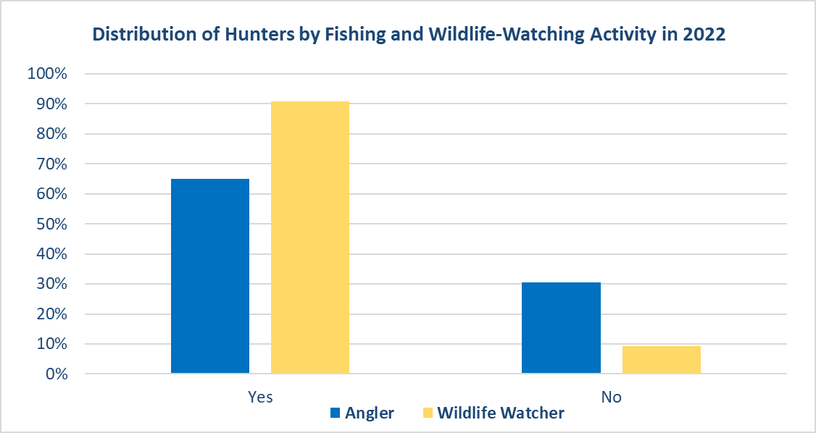
Additional 2022 Data – Not in Report Tables
65% of hunters are also anglers
91% of hunters are also wildlife watchers

Slide 10
Detailed and Screen Phase
Detailed Phase
Primary purpose: obtain participation, expenditure estimates in 2022
Target population: 16 and over U.S. residents
Respondents: self report on their own activities and expenditures
Uses:
  Guide management of fish and wildlife resources
  Promote participation in outdoor activities
  Understand the economic contributions of wildlife watching, hunting, and angling, and inform legislation
Screen Phase
Primary purpose: Identify those likely to participate in hunting, fishing, or wildlife-watching
Target population: 6 and over U.S. residents
Respondents: HH member reports on prior and likely future participation for all HH members
Uses other than primary:
  Recruitment and retention research
  Broad reach useful for gathering information on activities other than hunting and fishing

Slide 11
First-Time Hunter Demographics
Generally, characteristics of newcomers are similar to hunters active in 2022 with some notable exceptions
6-15 years is largest single cohort of newcomers, but the 18-44 group is also noteworthy at 38%
Females represent a higher share of newcomers than active hunters in 2022
Large MSAs represent a higher share of newcomers than active hunters in 2022. The opposite is true for Outside MSA

Slide 12
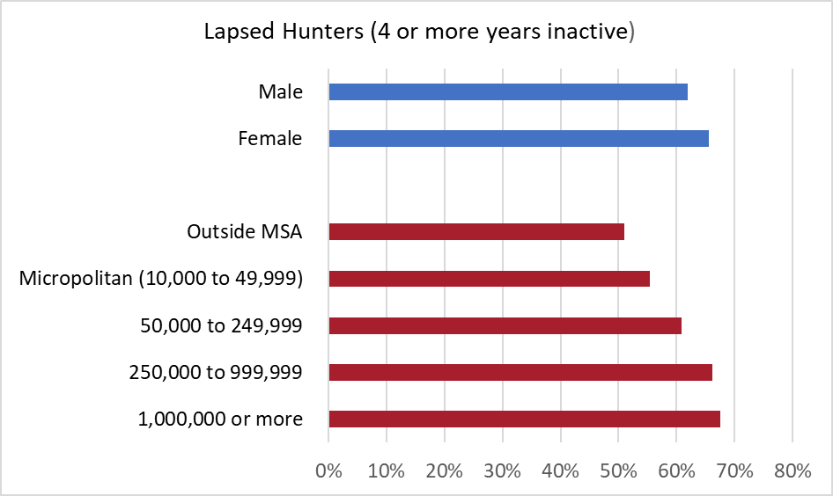
Share of Prior Hunters that Lapse
Females lapse at only slightly greater rate than males. The disparity between sexes is much higher for recruitment compared to retention
The larger the metropolitan area of residence the greater lapse share

Slide 13
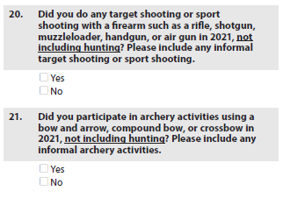
Changes to Screen → Research Opportunities!
Previously asked for likely hunters and anglers only
Now asked for all U.S. 6+ population

Slide 14
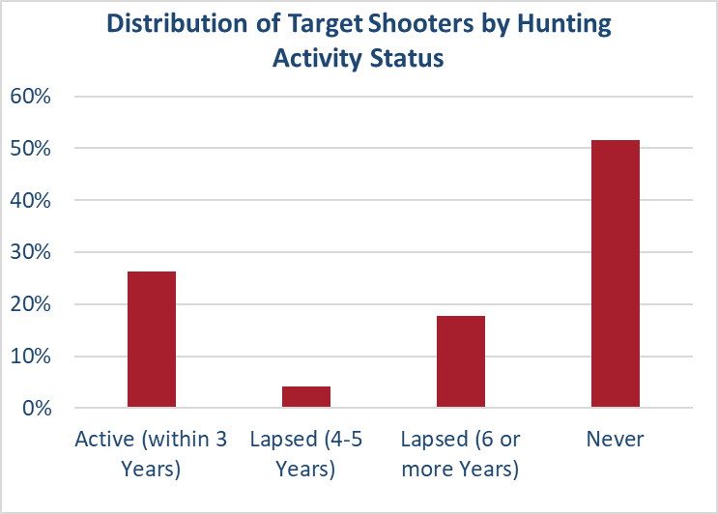
Further Exploration of Target Shooters

Slide 15
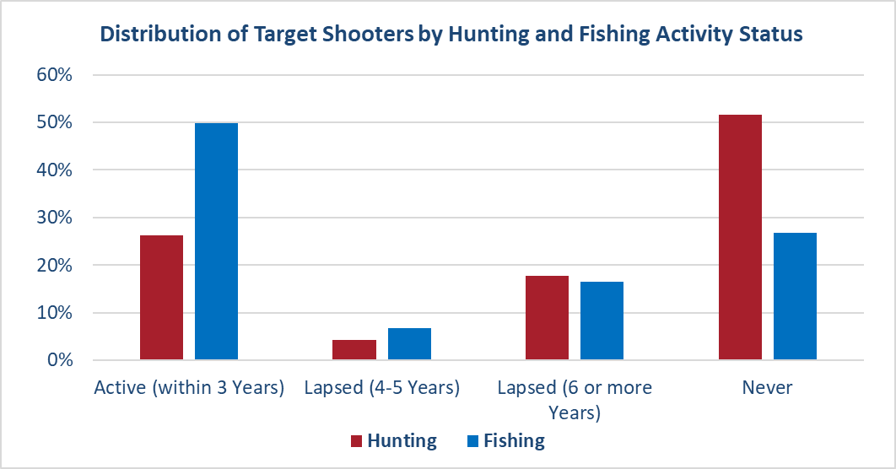
Further Exploration of Target Shooters
Half of Target Shooters are active anglers
Half of Target Shooters have never been hunting

Slide 16
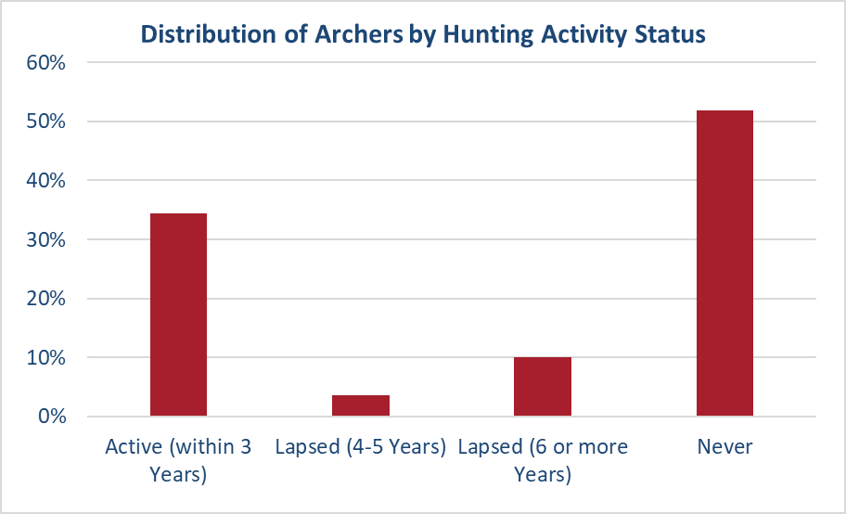
Further Exploration of Recreational Archers

Slide 17
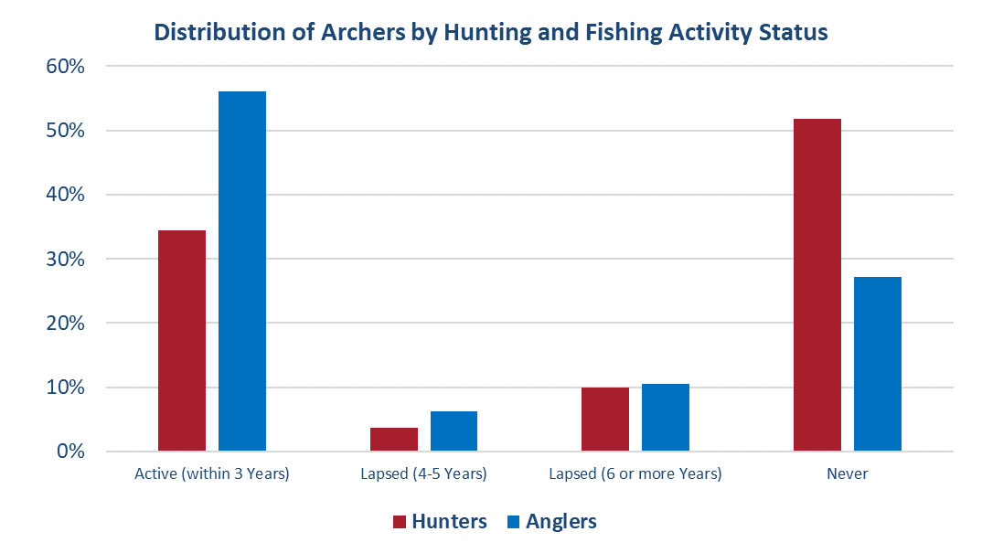
Further Exploration of Recreational Archers
Over half of all archers are active anglers
Half of all archers have never been hunting

Slide 18
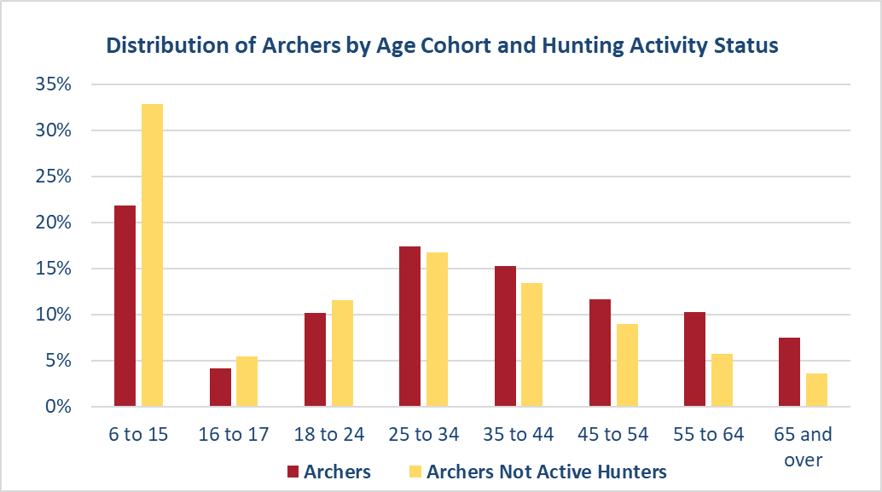
Further Exploration of Recreational Archers
Those that are not active hunters are younger, particularly 6- to 15-year-olds

Slide 19
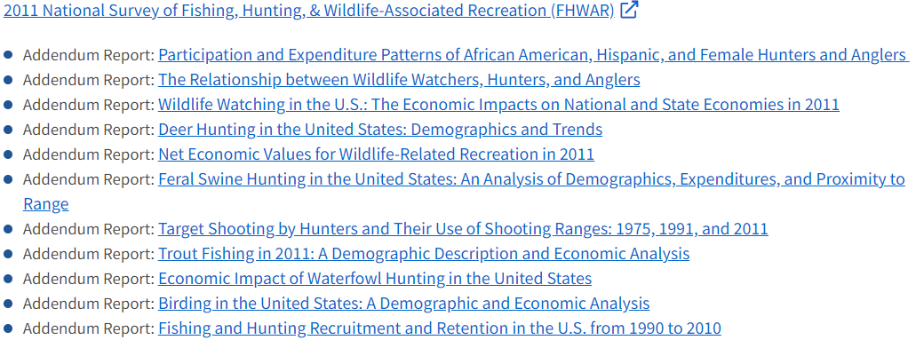
Research will Continue Through Addendum Reports in 2024
Reports are designed to delve deeper into questions of interest to wildlife and conservation related stakeholders
https://www.fws.gov/program/national-survey-fishing-hunting-and-wildlife-associated-recreation-fhwar/past-fhwar-surveys

Slide 20
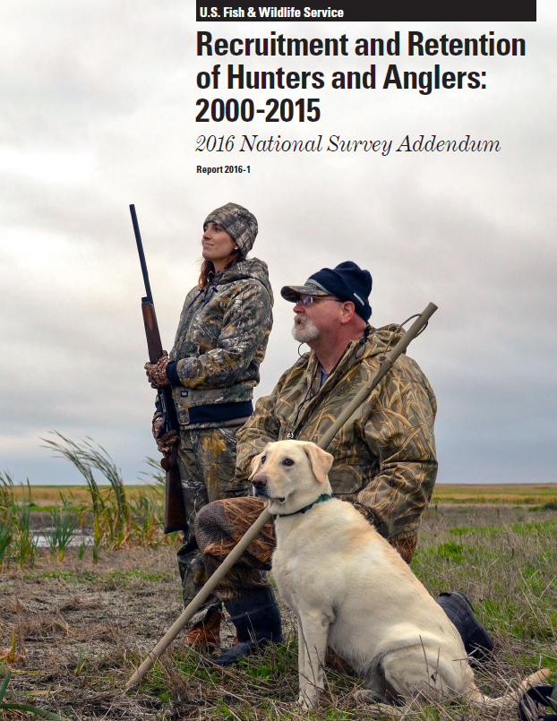
Research will Continue Through Addendum Reports in 2024
Topics for 2022 Survey
  Recruitment and Retention of Hunters and Anglers
  Birding in the United States: A Demographic and Economic Analysis
  Wildlife Watching in the U.S.: The Economic Contributions on the National Economy in 2022
  Participation and Expenditure Patterns of African-American, Hispanic, and Female Hunters and Anglers
  Recreational Boating in the U.S.
Notes:
-

Slide 21
R3 Related Addendum Report
Potential research questions to be addressed
  How does shooting sports/archery participation affect entrant behavior?
  How does hunting behavior of household members affect shooting sports participation of others in household?
  Do lapsed hunters continue to participate in shooting sports/archery? Does participation in shooting sports affect retention rate?
  How do entrants' expenditures differ?
  How many recreational boaters are not anglers?
  How does recreational boating participation change with age?
  How much more likely are recreational boaters to participate in fishing?
Definition: Newcomers or parents with participating children (collectively called “entrants”)

