Slide 1
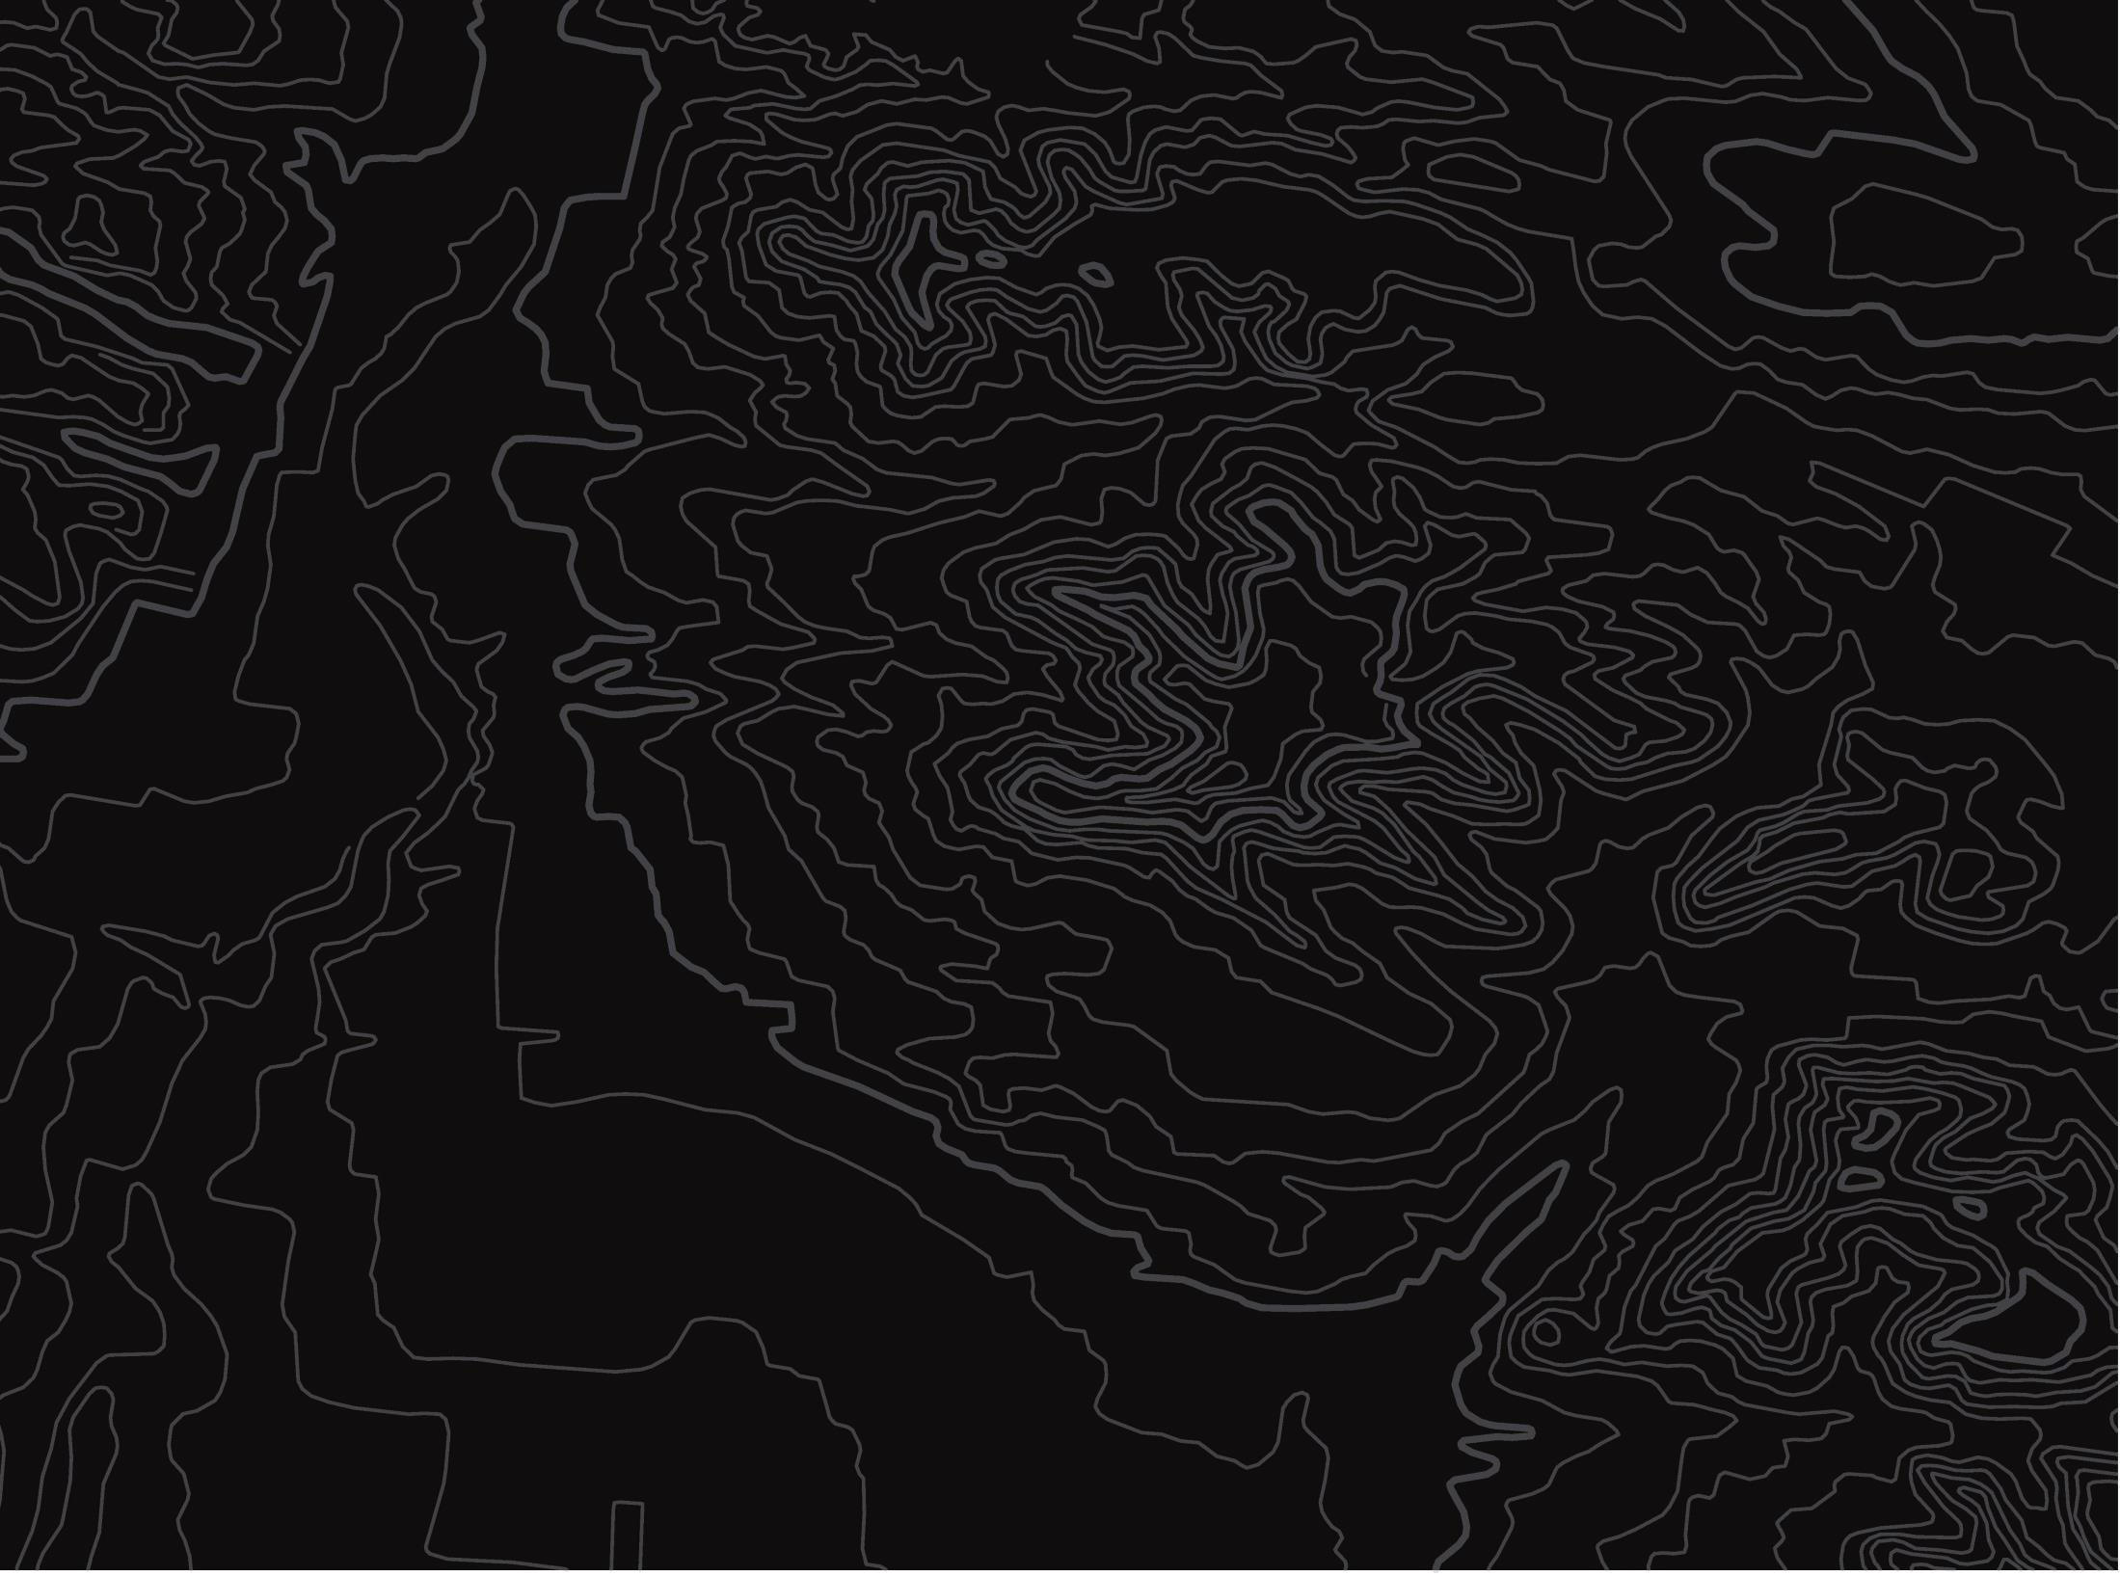

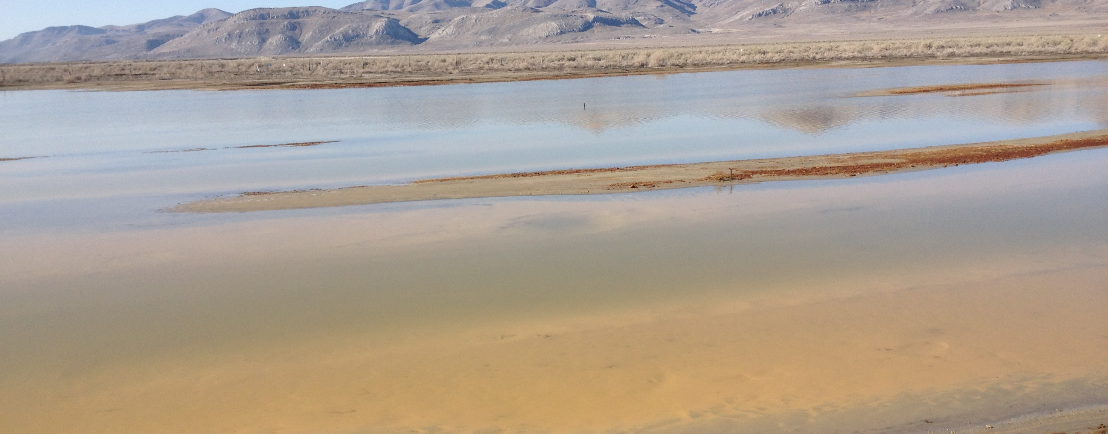
Proposed Rulemaking
U.S. Department of the Interior
Bureau of Land Management
Temporary Closure and Restriction Orders
(RIN 1004-AE89)
Acid Spill on BLM Lands, Rowley, UT (2014)

Slide 2
Background
Proposed Rule to improve the process of issuing
emergency closures and temporary restrictions on use of public lands.
Aspects of BLM’s current closure and restriction regulations (43 CFR 8364.1(c)) limit the agency’s ability to respond in a timely manner to emergencies and other unforeseen events.

Slide 3
Background (Continued)
BLM designs temporary closure and restriction orders to apply for the shortest duration and to cover the smallest area necessary to protect persons, property, and public lands and resources.
This proposed rule is intended to address short-term closures and restrictions. Long-term closures and restrictions generally must be accomplished through the land use planning process.

Slide 4
Challenges with Current Regulations
Aspects of BLM’s current closure and restriction regulations (43 CFR 8364.1(c)) limit the agency’s ability to respond in a timely manner to emergencies and other unforeseen events
  Federal Register Notice required
  Lacks immediate effectiveness provisions
  Inconsistent with adjacent agency regulations (NPS and USFS)
  County and local law enforcement relationships impacted

Slide 5
Case Study Examples
19 acres of BLM managed lands impacted by hydrochloric acid spill in Rowley, UT
  Immediate public health hazard on public lands (JAN 2014)
  Federal Register Notice published (MAY 2014)
  3+ months with no enforceable closure order
Recreation site near Challis, ID flooded by ice dams
  Hazard identified JAN 2022
  Federal Register Notice published April 2022
  3 months with no enforceable closure

Slide 6
Key Revisions to Current Regulations
Clarify uses for Temporary Closures and Restrictions (adding in “Temporary” to regulations
Require clarity for start and stop for closure
Eliminate delay of Federal Register Notice, require on site local area and web posting for closures
Provide full force and effect authority where appropriate

Slide 7
Timeline
Notice of Proposed Rulemaking published 21 NOV 2023
Public comment period closes 22 JAN 2024
Federal Register :: Temporary Closure and Restriction Orders

Slide 8
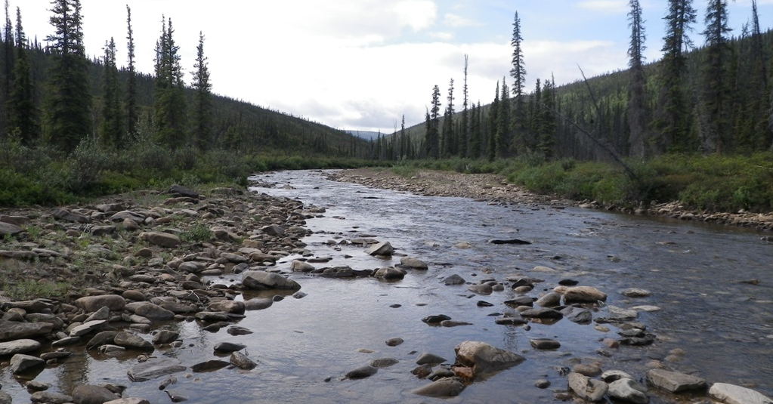
U.S. Department of the Interior
Bureau of Land Management
Questions & Discussion

