Slide 1


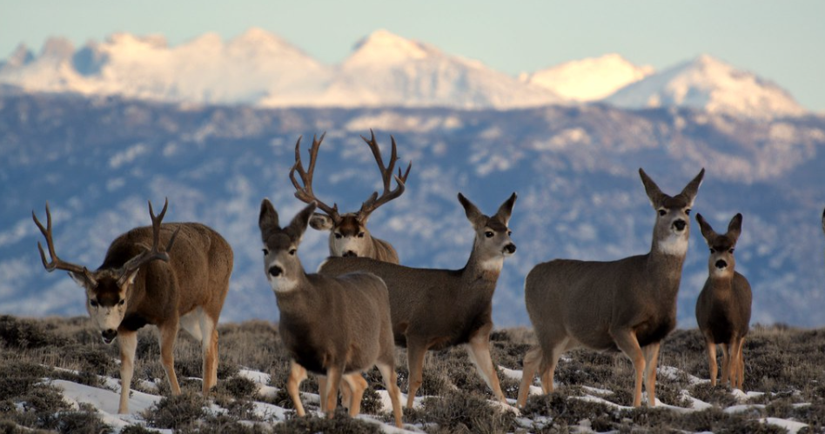
U.S. Bureau of Land Management Big Game Migration Corridor Conservation
2023 Briefing to the Hunting and Wildlife Conservation Council

Slide 2

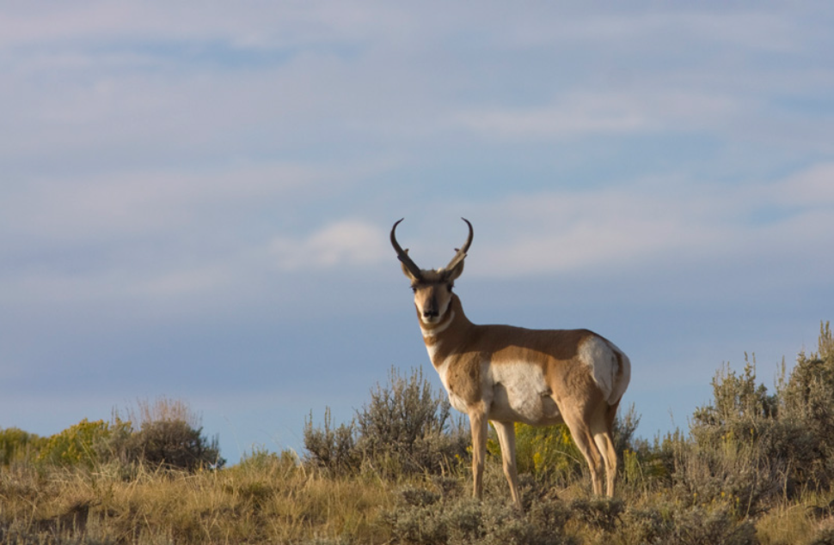
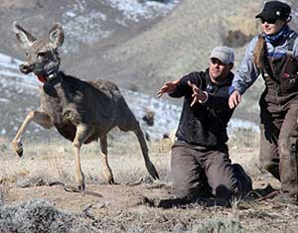
Research Projects and Expenditures
Initially funded three large research projects under direction of DOI with Arizona, Utah, & Oregon state wildlife agencies
Supported an additional 50 research projects on elk (14), mule deer (45), and pronghorn (24) with partners across ten states

Slide 3
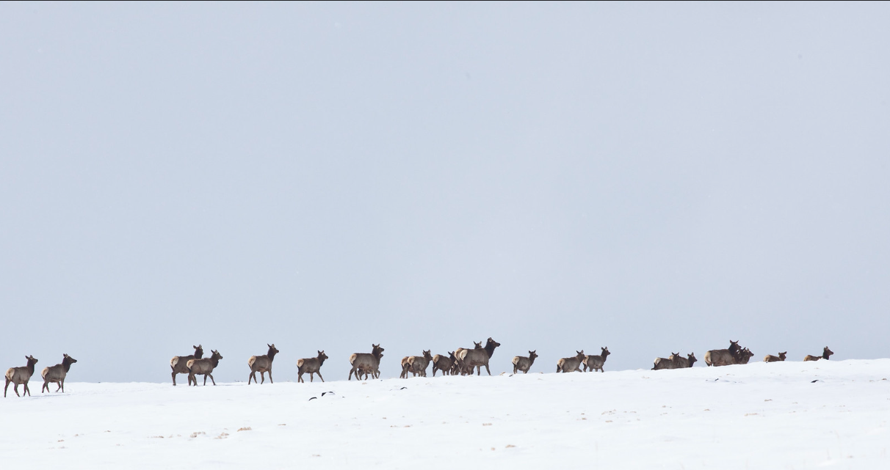

National Fish & Wildlife Foundation Partnership
240 Wildlife Biologists (0486 Series)
1 per 1.0 million acres
60 Fisheries Biologists (0482 Series)
1 per 4.2 million acres
60 Hydrologists (1315 Series)
1 per 4.2 million acres
50 Botanists (0430 Series)
1 per 5.0 million acres
40 Ecologists (0408 Series)
1 per 6.2 million acres
Additional Gen. Natural Res. & Biological Sci.(0401 Series)
2019-2022 Accomplishments:
BLM contributed $8M, other agencies $3.7M, and additional private sector match
52 Projects completed or underway
Protected 111,000 acres through easements
Improved 695,000 acres
Restored 68,000 acres
Removed/improved 670 miles of fencing
Reconnected 307 miles of corridors

Slide 4
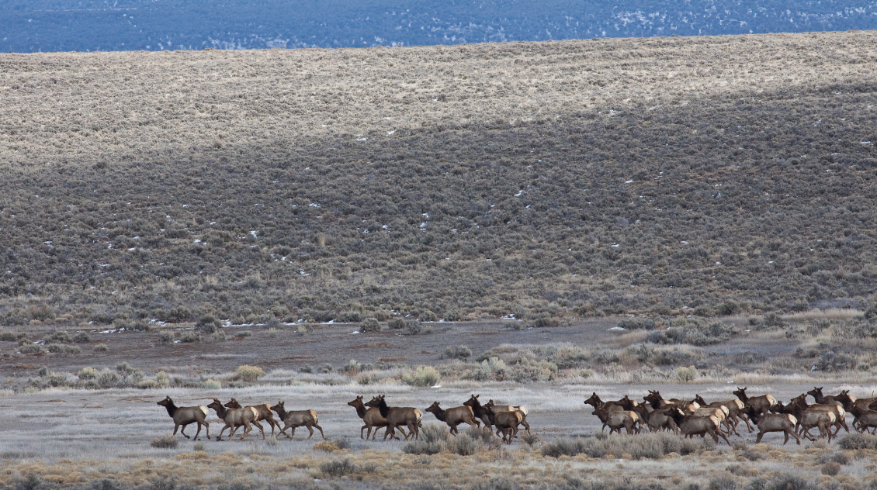
Additional BLM Accomplishments (Within State-identified Action Plan Areas; 2019-2022)
540,000+ acres of habitat treatments (mechanical, chemical, prescriptive fires)
650+ miles of fencing removed, modified, or wildlife-friendly fencing installed
480+ water developments installed or maintained

Slide 5
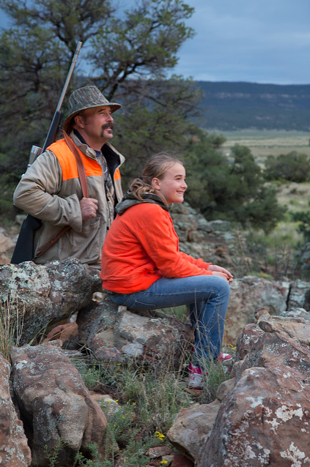
























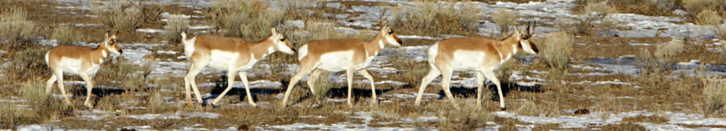
Thank you, partners and co-stewards!

