Slide 1
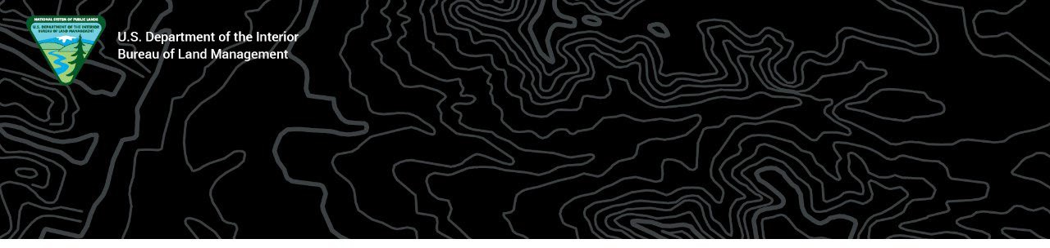
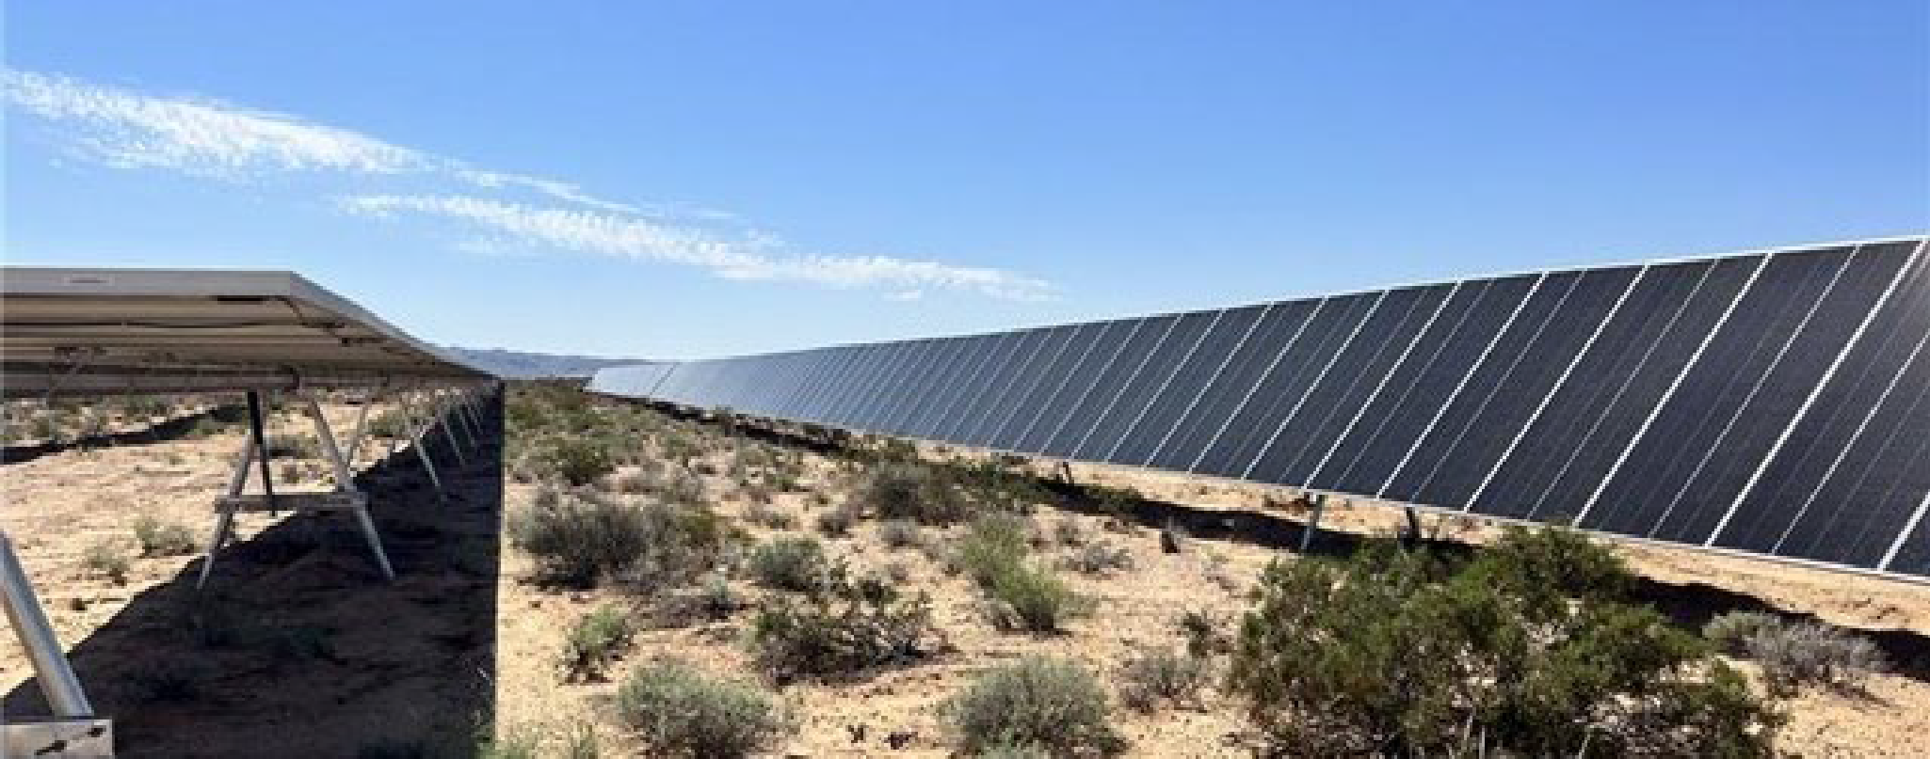
Western Solar Plan – Utility-Scale Solar Programmatic
Environmental Impact Statement
Hunting and Wildlife Conservation Council
Update
May 17, 2024
For Official Use Only - Predecisional Draft - Not for External Distribution

Slide 2

Summary of Public Comments Received
Despite a large volume of public comments, only a small percentage (~3.5%) contain unique content
41,333 submissions were campaigns/form letters; <2% unique comments
 | Total Received
ePlanning | 33,883
Email | 15,656
Handwritten | 7
TOTAL | 49,546

Slide 3
Summary of Public Comment Categories
Major Comment Category [based on volume]
Resource-Based Exclusion Criteria
Design Features and Mitigation
Alternatives - Preferred Alternative
Wildlife
General Resource Impacts
General Opposition
Alternatives – Considered but Not Analyzed in Detail
Alternatives - Previously Disturbed Lands Criterion
NEPA Process – Issues to be addressed in project-specific NEPA reviews
General Support
Purpose and Need
Special Status Species
Alternatives - Action
All substantive comments will be addressed regardless of whether part of a major comment category

Slide 4
Primary Issues
Range of Alternatives
Resources-Based Exclusions
Design Features
Transmission Proximity
Disturbed Lands Criteria
Slope % Criteria
Wildlife [primarily big game migration corridors and winter range]
Special Status Species

Slide 5
Targeted Schedule
Task | Target Dates
Response to Public Comments | May – July
Develop Final PEIS | May - August
Publish Final PEIS | End of August
Protest Period | September
Develop Record of Decision | September - December
Sign Record of Decision | December

Slide 6
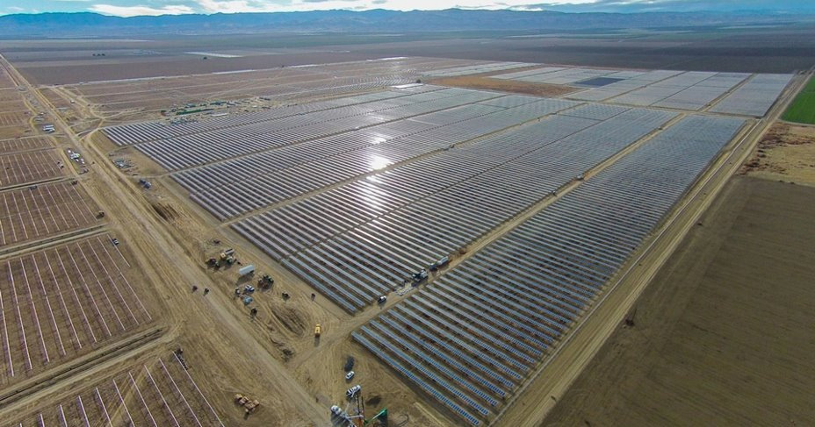
Questions

