Slide 1










Modernizing Access to Our Public Land Act (MAPLand Act)
Public Law 117-114
Hunting and Wildlife Conservation Council
September 12, 2023

Slide 2
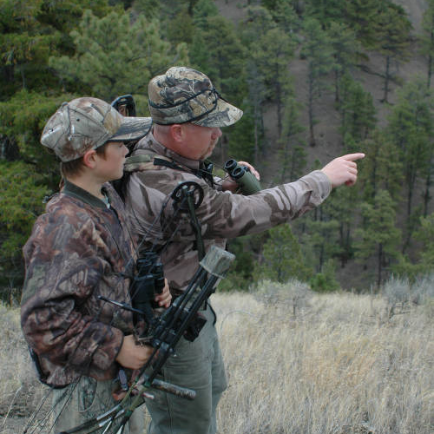
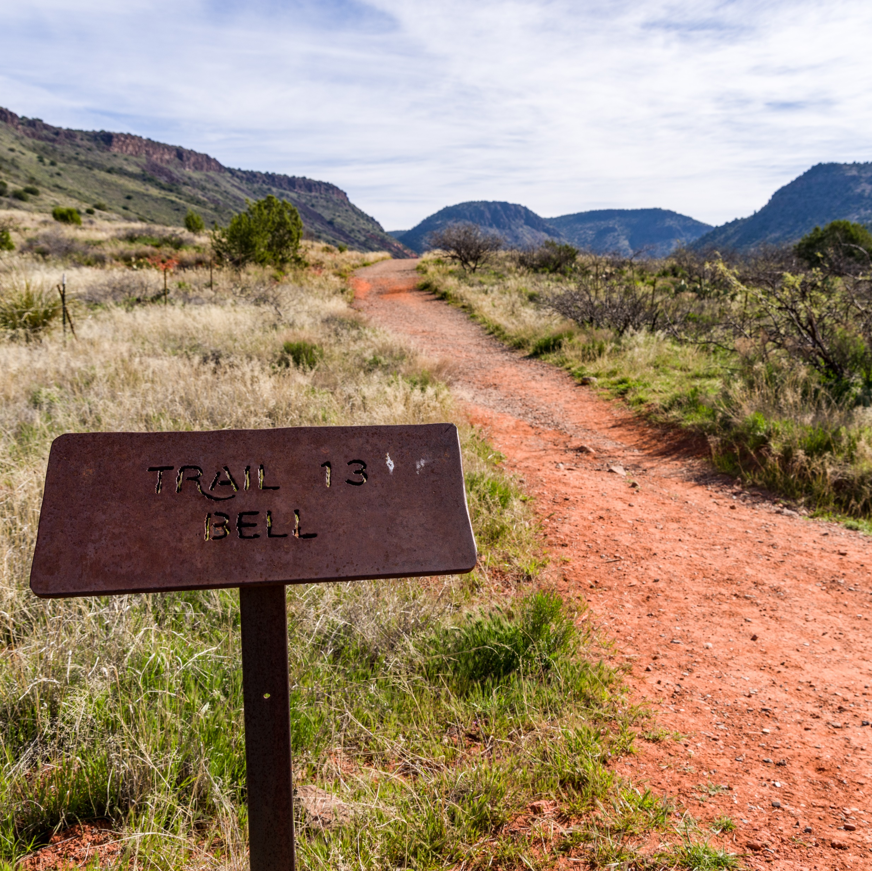
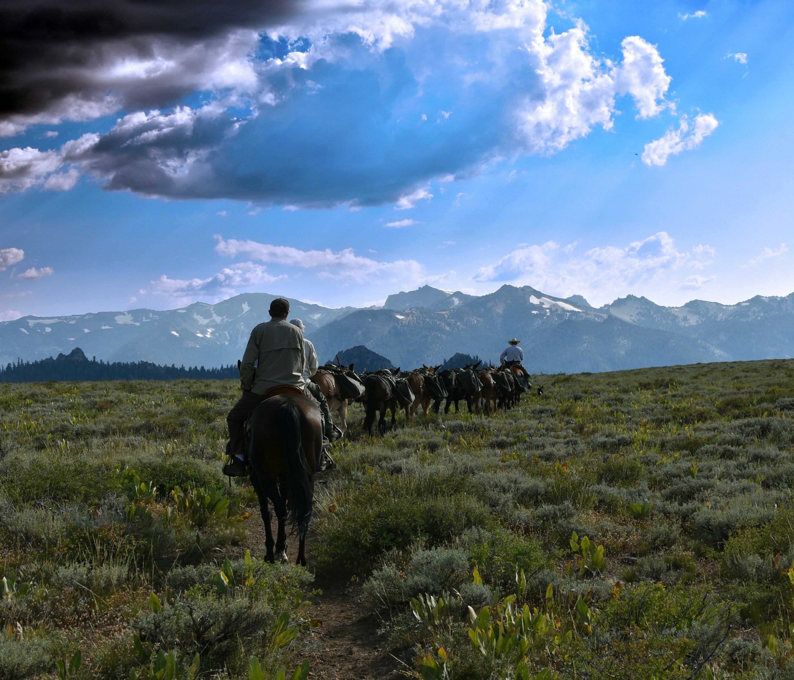


The MAPLand Act
Requires the Department of the Interior (DOI), the Forest Service, and the U.S. Army Corps of Engineers to jointly develop and adopt interagency standards to ensure compatibility and interoperability among Federal databases for the collection and dissemination of outdoor recreation data related to Federal lands.

Slide 3
MAPLand Act Governance
Standard schemas (October 2024)
Interagency Core Team & Interagency Subgroups
Charter
Action Plan & Milestones
Digitize and Publish data
Easements (April 2026)
Roads, Trails, Recreational shooting and hunting closure areas, Recreation sites (April 2027)
Develop a public feedback mechanism to maintain and update the data
Report Annually through 2031 on status.

Slide 4

Interagency Focus
Goal: geospatial data relating to outdoor recreation in standard schemas/geospatial data dictionaries.
Integrate
Translate without interpretation
Translation not changing how agencies do business
Standards across themes
Schema
Metadata
Quality

Slide 5
Interagency Focus
Goal: geospatial data relating to outdoor recreation in standard schemas/geospatial data dictionaries.
Integrate & Translate without interpretation
Potentially aggregate
Translation not necessarily changing how agencies do business
Standards across themes
Schema
Metadata
Quality

Slide 6
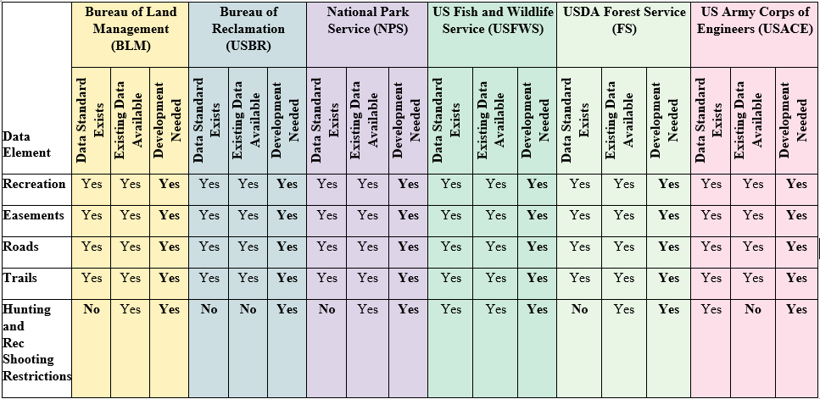
High-level Data Matrix

Slide 7
Challenges
Executive Orders, CFRs, Policy
Missions
Data and Content Management
Appropriations and capacity
Meeting Act’s timelines
Broad enough for county, state use

Slide 8
Successes
Bringing agencies together
Gaining awareness and understanding
Determining applicability of current national standards
Creating schemas for each data theme

Slide 9
MAPLand Timeline
Easement Data Available
Interagency Core Group
Standard Development
Hunting, Roads, Trails,
Recreation Sites
Data Available
MAPLand Act Signed
Thematic Sub Teams
Secretaries Approval
Review 1
Revision
Review 2
Ongoing
Data
Updates
Apr
2022
Sept
2022
Dec
2022
Aug
2023
Sept
2023
Oct
2023
Dec
2023
Oct
2024
Apr
2026
Apr
2027

Slide 10

What questions/comments do you have for us?

