Slide 1
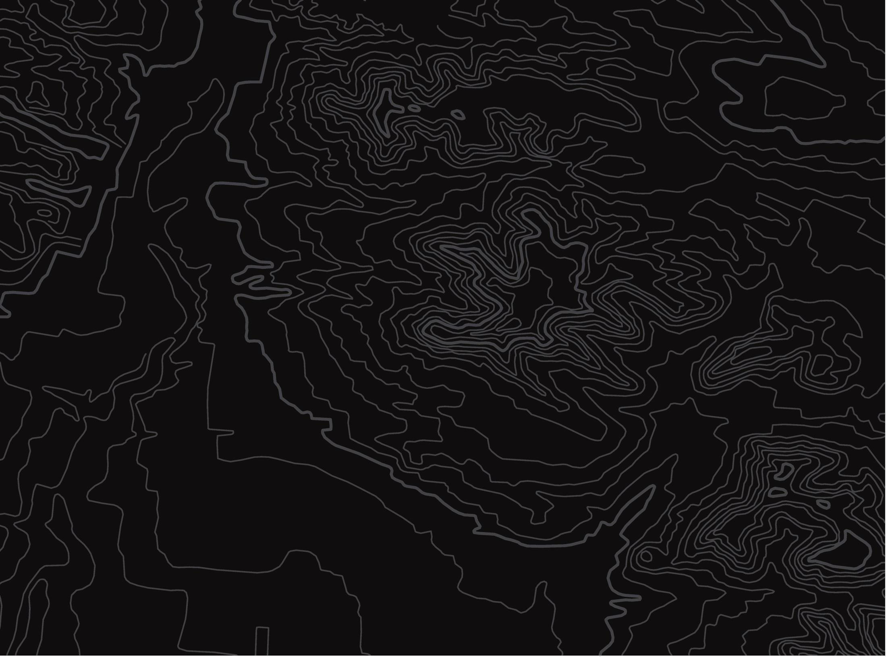

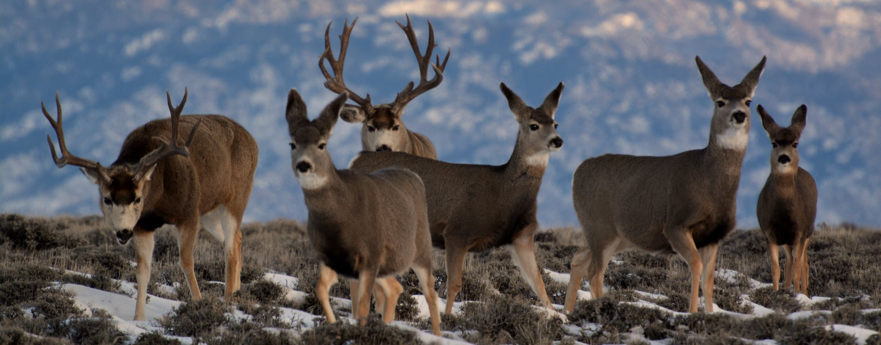
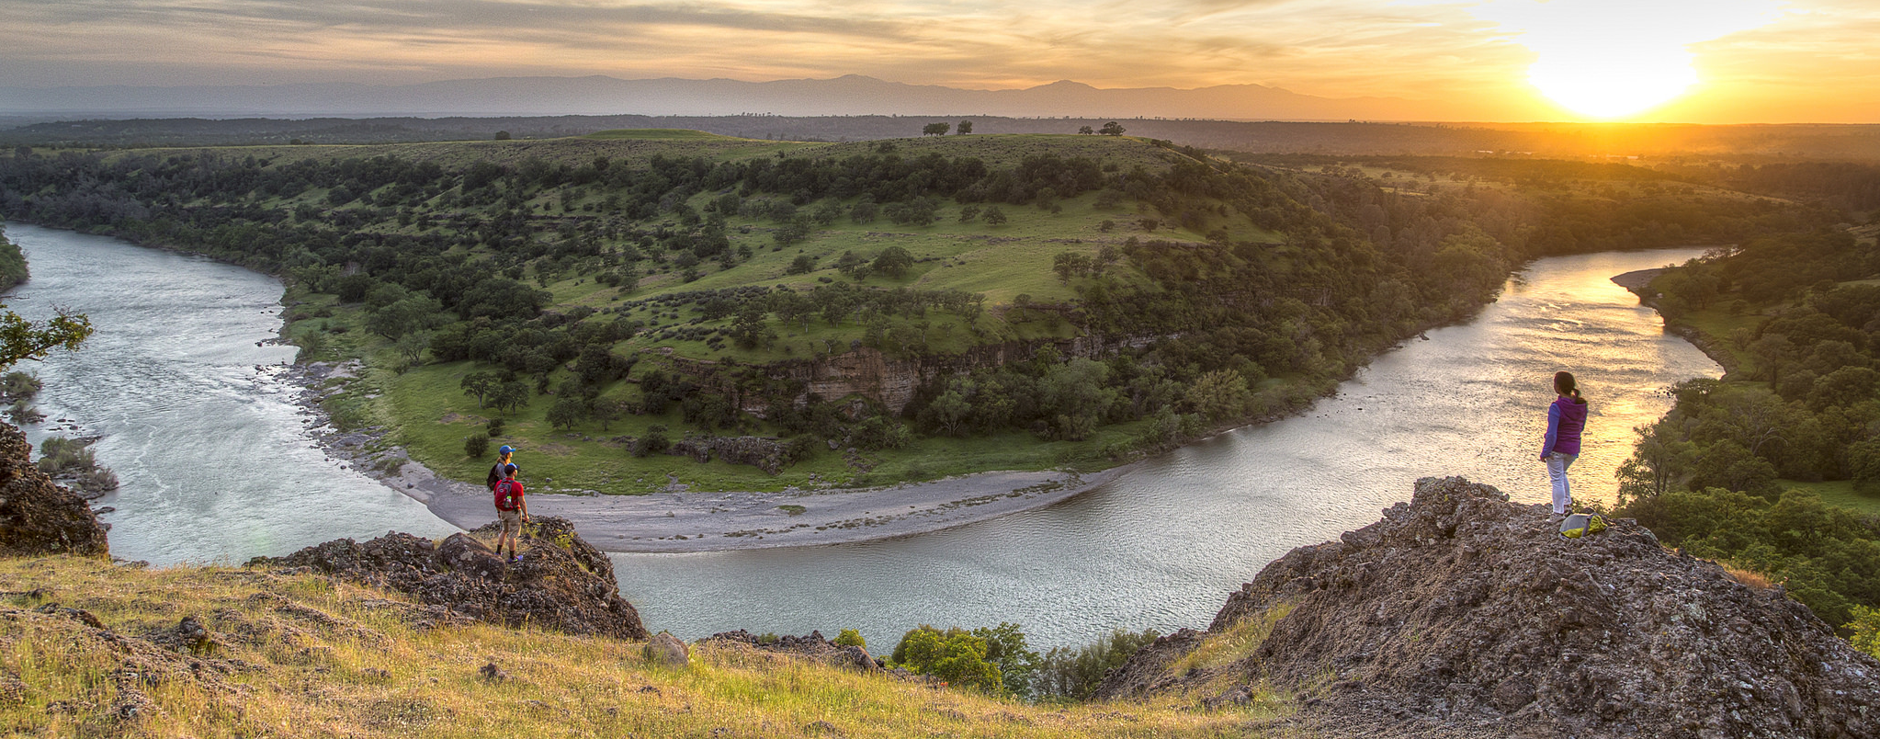
BLM Use of the Mule Deer and Sage-Grouse CX
U.S. Department of the Interior
Bureau of Land Management
Report to the September 2023 Hunting and Wildlife Conservation (HWCC) Meeting

Slide 2
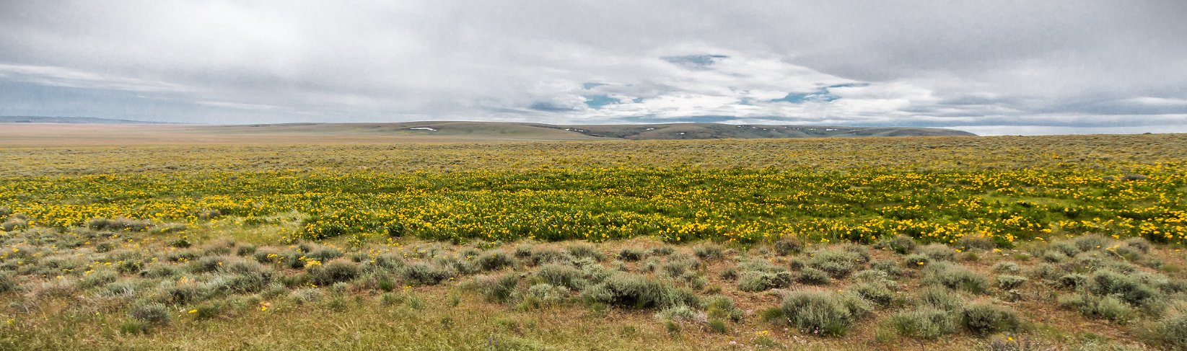
NEPA and Categorical Exclusions
Categorical Exclusions (CEs or CXs): are a category of actions the BLM has identified that do not individually or cumulatively have a significant effect on the environment.

Slide 3

BLM Administrative Pinyon-Juniper CX
In 2020, BLM adopted a Pinyon-Juniper Management Administrative CX covering actions for up to 10,000 acres (15.6 square miles) within sagebrush and sagebrush-steppe plant communities to manage pinyon pine and juniper trees for the benefit of mule deer or sage-grouse habitats
Defenders of Wildlife and Southern Utah Wilderness Alliance challenged the CX arguing that the acreage was too large and large-scale P-J treatments could pose a risk to pinyon jays and other species
BLM reached a court-approved settlement agreement with the litigants and discontinued use of this CX in 2022

Slide 4

BLM adopts Legislative CX
In 2020, BLM adopted the Mule Deer and Sage Grouse CX directed by the Agriculture Improvement Act of 2018 for specified covered vegetation management activities carried out to protect, restore, or improve habitat for greater sage-grouse or mule deer (HFRA, Section 606(b)(1))
  Up to 4500 acres
  Activities include manual or mechanical removal of conifers,
  or invasive vegetation, riparian restoration, seeding of natives, targeted grazing, temporary removal of wild horses and burros

Slide 5
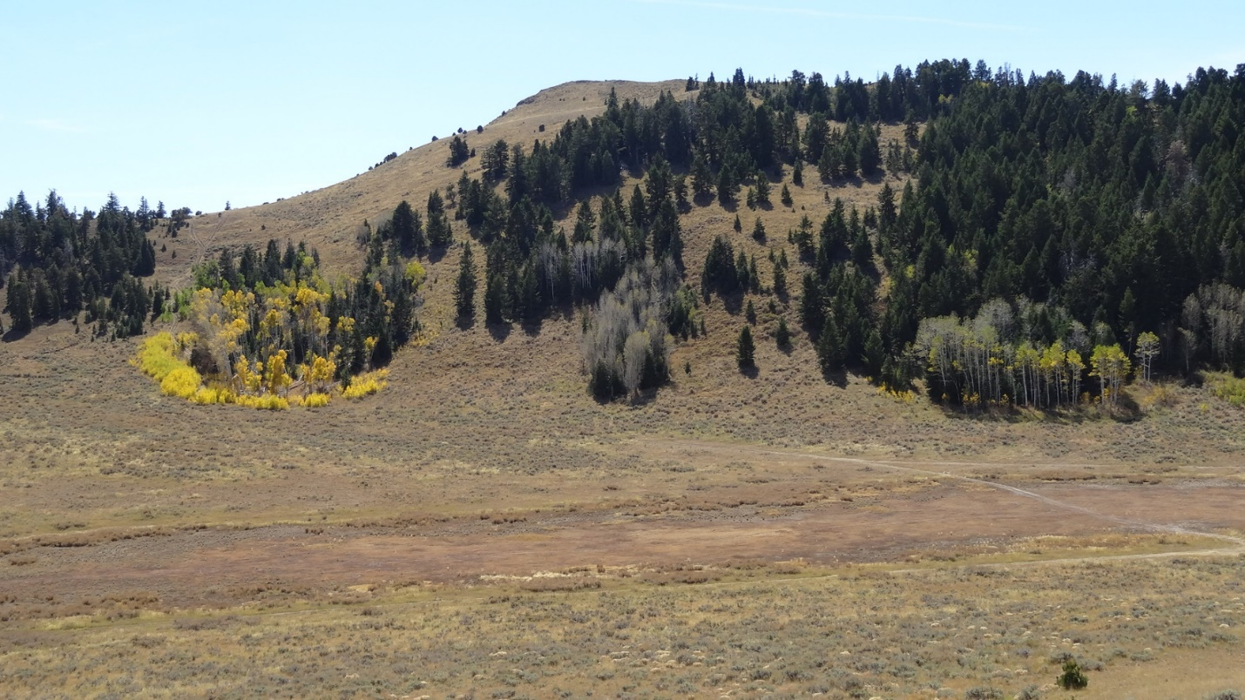
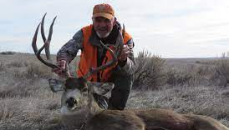
2021 Projects
SO/Field Office | Acres | Project | Benefitting Species
OR/Klamath Falls | 1286 | Juniper/Aspen Restoration | Mule Deer
ID/Challis | 4.5 | Riparian restoration | Sage-grouse/Mule Deer
ID/Salmon | 3406 | Sagebrush/Curlleaf mahogany restoration | Sage-grouse/Mule Deer
WY/Worland | 2400 | Juniper reduction (10-year project) | Sage-grouse/Mule Deer
NV/Humboldt | 4.2 | Riparian | Sage-grouse/Mule Deer
WY/Casper | 500 | Juniper reduction in sagebrush | Sage-grouse/Mule Deer

Slide 6
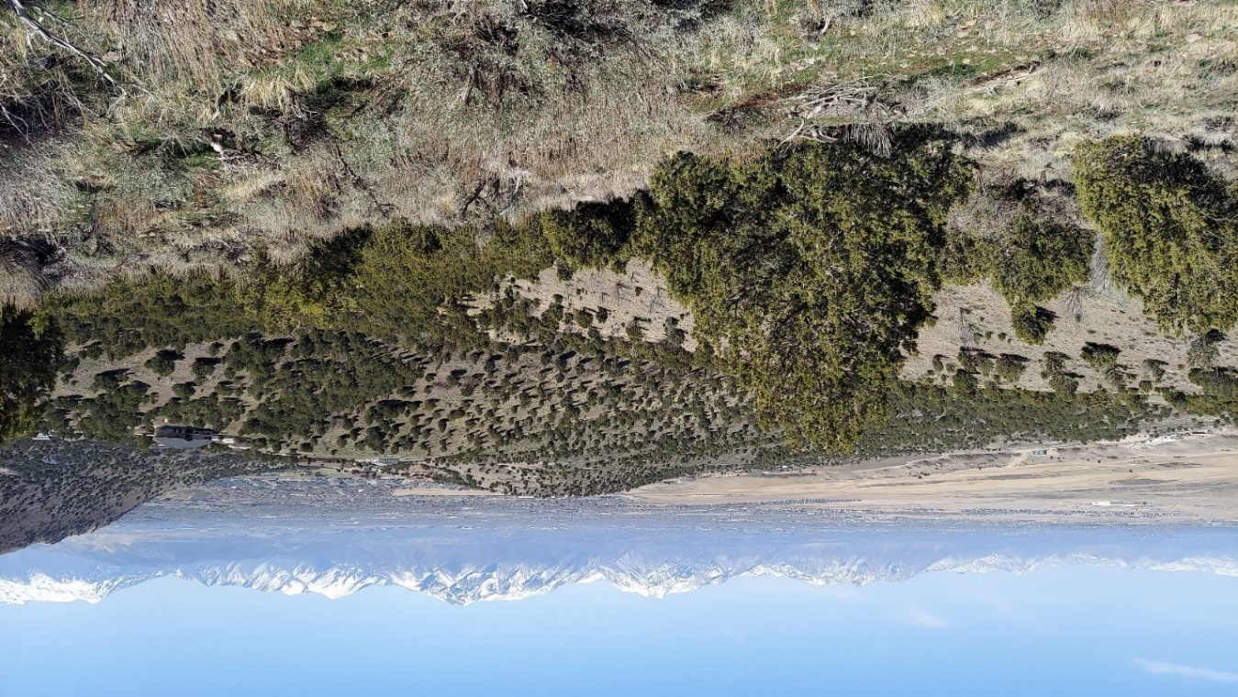
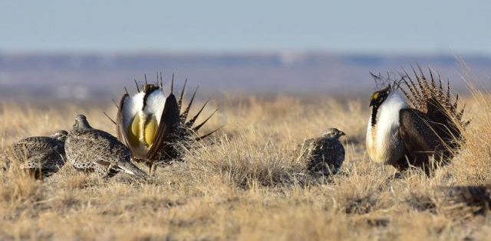
2022 Projects
SO/Field Office | Acres | Project | Benefitting Species
UT/Salt Lake | 165 | Aspen/sagebrush restoration | Mule Deer
WY/Casper | 575 | Restoration of riparian area and increase understory in ponderosa | Sage-grouse/Mule Deer
OR/Lakeview | 750 | Remove juniper from sagebrush, aspen stands (ph1/ph2 juniper) | Mule Deer
ID/Challis | 185 | Fencing, piping, trough to protect 2 riparian areas to recover veg | Sage-grouse/ Mule Deer

Slide 7
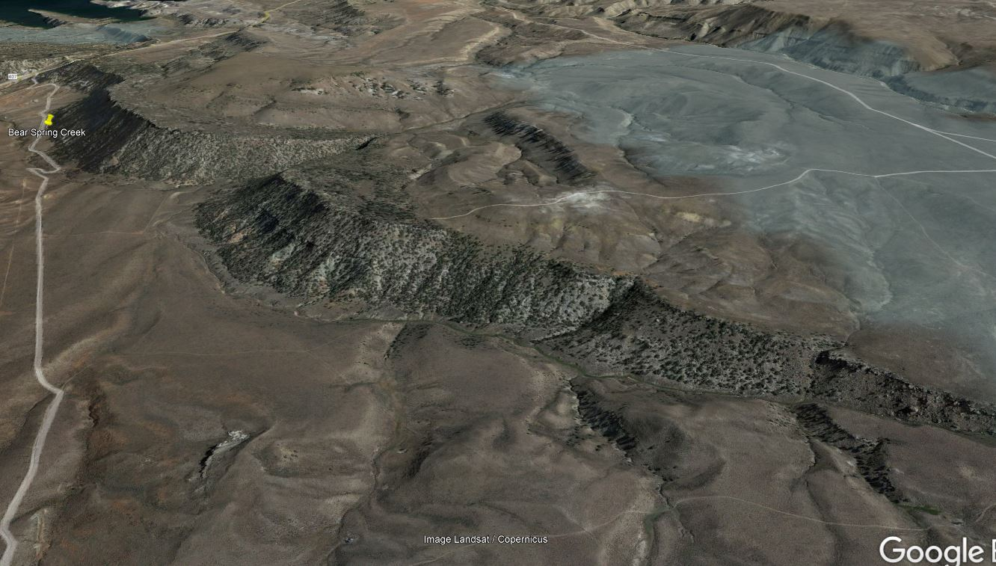
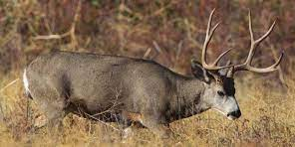
2023 Projects
SO/FO | Acres | Project | Benefitting Species
UT/Salt Lake | 75 | Trial Shrub restoration with seeding | Mule Deer
UT/Monticello | 1849 | PJ removal treatment (multiple methods) | Gunnison Sage-grouse Mule Deer
CO/Uncompahgre | 390 | PJ Lop and scatter and mastication to improve understory with seeding | Mule Deer
UT/Salt Lake | 956 | PJ removal | Mule Deer
UT/Richfield | 4464 | PJ removal | Mule Deer
OR/Klamath | 4438 | PJ removal with shrub plantings and grass/forb seeding | Mule Deer

Slide 8
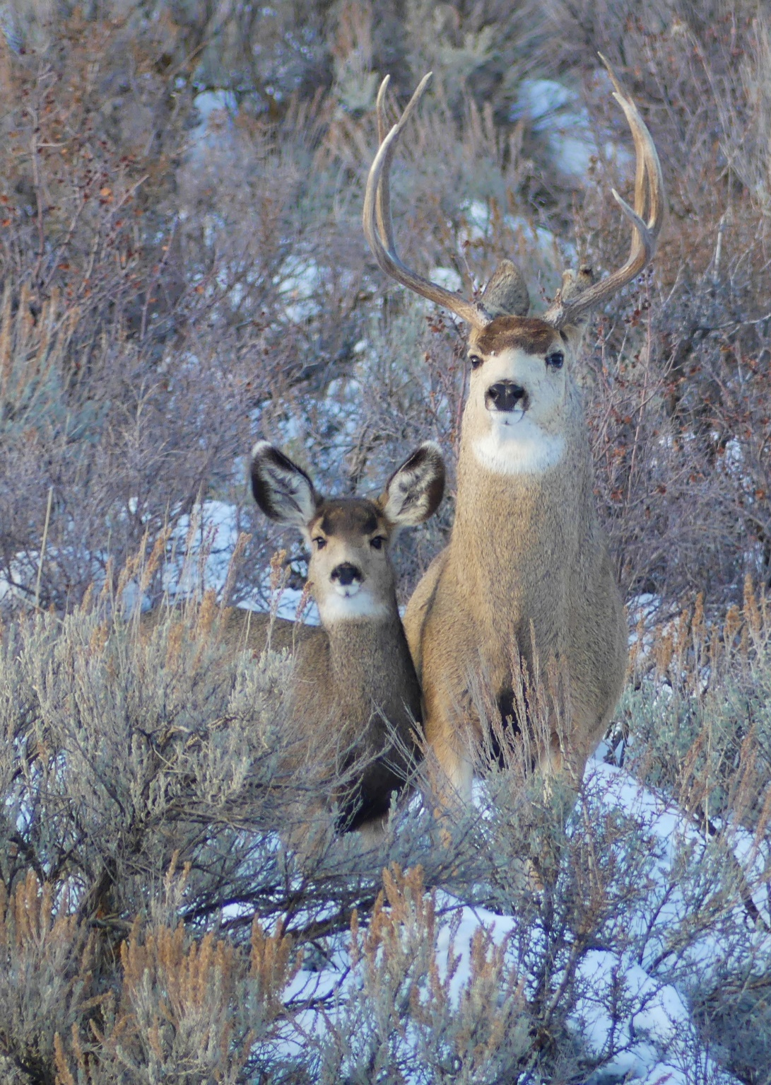
Totals & Takeaways
Sixteen projects reviewed
Over 21,000 acres of habitat projects across 15 locations
One project used the PJ CX
Projects in development
  Colorado
  Utah
Notes:
As it pertains to pinyon jay –if any partners are working with BLM on PJ woodland work, they need to consider migratory birds, including PIJA

Slide 9
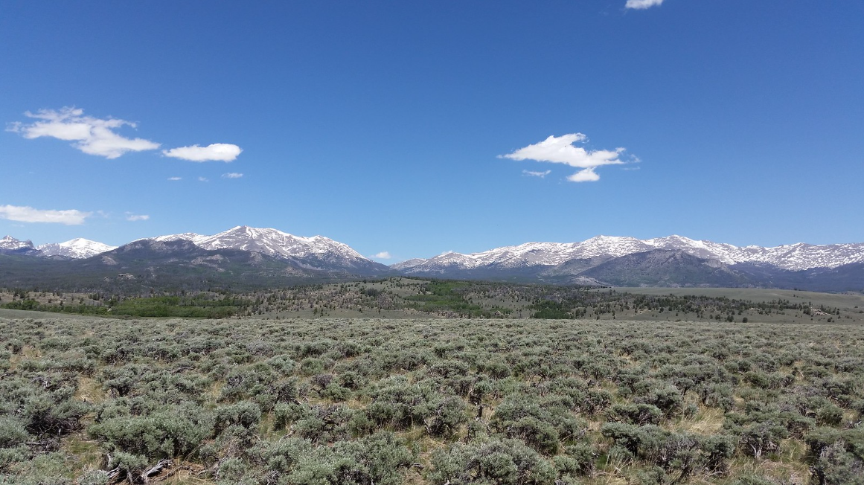
Thank you!!
Questions?
Renee Chi rchi@blm.gov
Elroy Masters emasters@blm.gov
Frank Quamen fquamen@blm.gov
U.S. Department of the Interior
Bureau of Land Management

