Slide 1
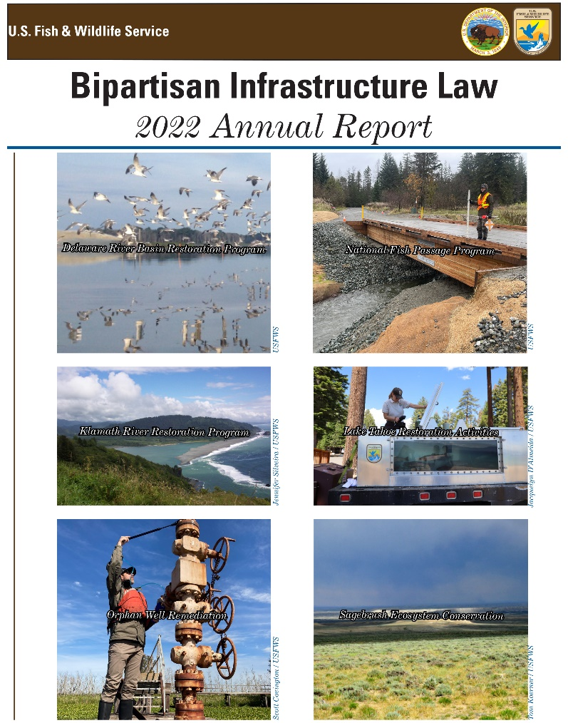
The U.S. Fish and Wildlife Service, BIL, IRA & GAOA
Steve Guertin
Deputy Director, USFWS
Notes:
Thank you for the opportunity to speak with you today about projects that the Service has funded under the Bipartisan Infrastructure Law, Inflation Reduction Act, and Great American Outdoors Act, and how we are working to ensure that these projects address threats caused by climate change, and opportunities to improve that connection.

Slide 2
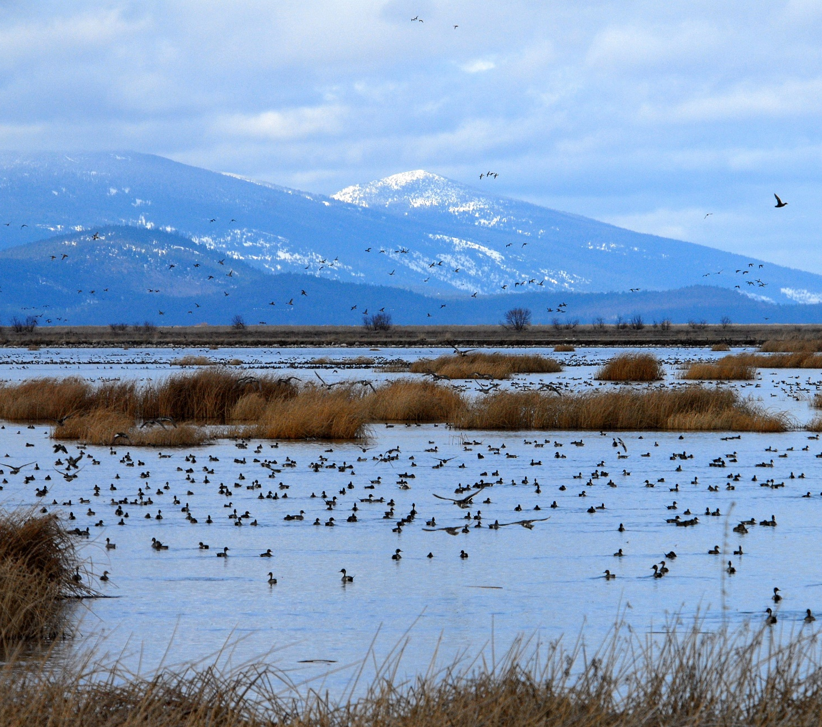
Bipartisan Infrastructure Law
$455M over 5 years
Klamath Basin Restoration Program
Sagebrush Ecosystem
Delaware River Basin Restoration
Lake Tahoe Restoration
National Fish Passage Program
Other Elements
Legacy Pollution
Ecosystem Restoration
Wildfire Mitigation
Notes:
The Bipartisan Infrastructure Law is a once-in-a-generation investment in the nation’s infrastructure and economic competitiveness. It provided the Service with a direct appropriation of $455 million, over five years, providing resources to restore ecosystems. The Service is allocating those funds to five priorities addressing at-risk species, recreational opportunities, and other needs. The Service also received additional funding for orphan well management, and the Department of the Interior received $905M over the next five years that will be divided among the DOI bureaus for Ecosystem Restoration.
While the Service was deliberative in its process, we weren’t able to discuss projects before they were announced. However, the Service values its close relationship with AFWA and other Network partners, seen for example in our recent work to develop shared landscape conservation priorities with each of the four regional fish and wildlife associations through the Landscape Conservation Joint Task Force.
I’m discussing the first projects that have been announced so far. We are working on reviews for others and will be happy to share details as they are announced.

Slide 3
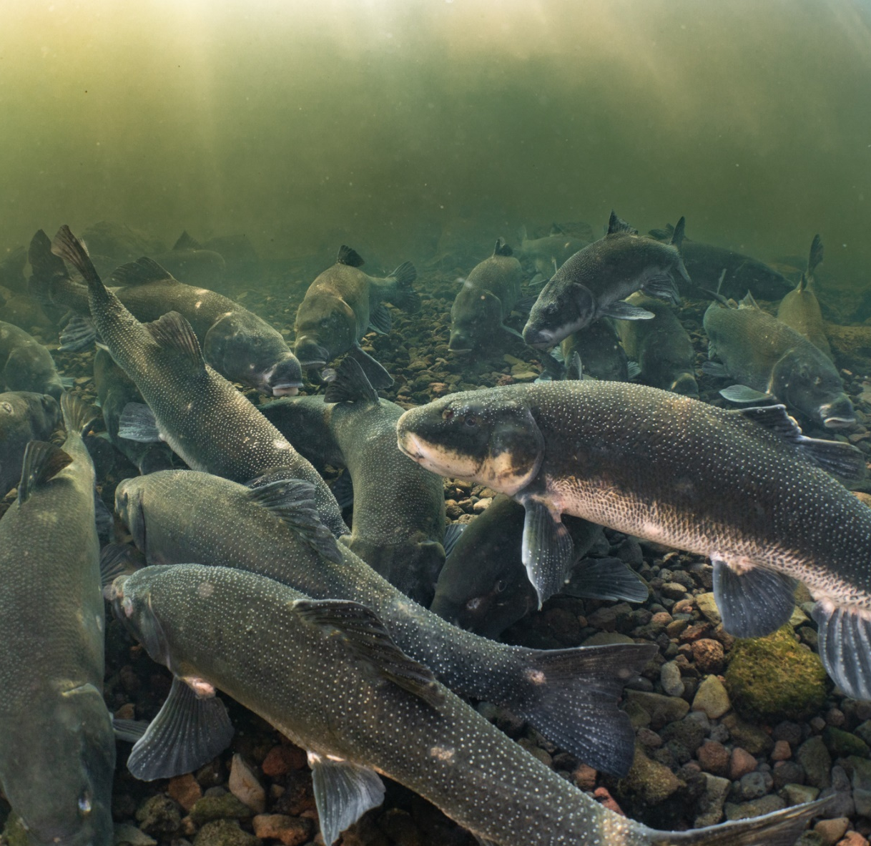
Klamath Basin Restoration
$162 million over five years
Enhancing captive rearing of Lost River and shortnose sucker species
Addressing water quality and water quantity issues
Supporting improvements for waterfowl and salmon and other native fish species
Notes:
Funding will support habitat restoration and water right acquisition to help restore the Klamath ecosystem, as well as for enhanced hatchery production of listed Klamath species
The work will support the unprecedented challenges due to ongoing drought conditions, limited water supply and diverse needs in the Klamath Basin, and support restored and resilient ecosystems in the face of climate change.

Slide 4
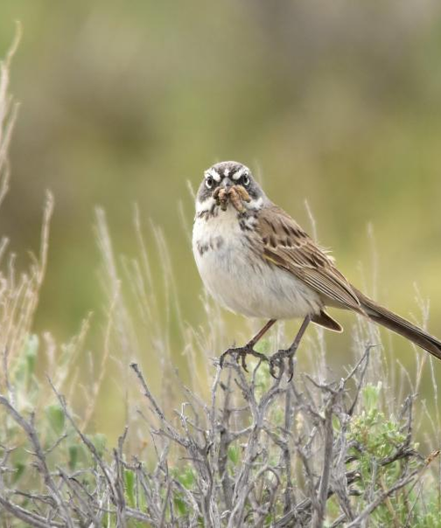
Sagebrush
$50M over five years
Focus on invasives, water, community and economic sustainability
Notes:
Projects for sagebrush habitat conservation will combat invasive grasses and wildfire, reduce encroaching conifers, safeguard precious water resources for neighboring communities and wildlife, and promote community and economic sustainability.

Slide 5
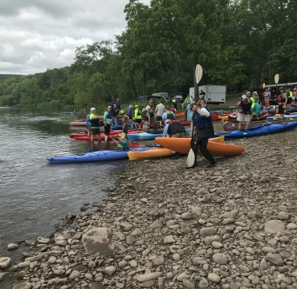
Delaware Basin
$26M over five years
Focus on green infrastructure
Notes:
The Service is providing competitive matching grants for habitat conservation in the Delaware Basin through the National Fish and Wildlife Foundation. The program will set priorities for advancing green infrastructure in the Delaware River watershed, with a focus on climate-change mitigation, resilience, and environmental justice.

Slide 6
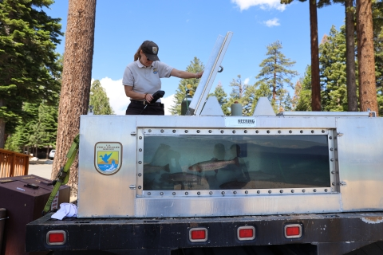
Lake Tahoe
$17M over five years
Focus on invasive species
Notes:
Lake Tahoe holds significant cultural importance for the Washoe Tribe and is part of the historic range of Lahontan cutthroat trout. Funding will help control aquatic invasive species for the benefit of Lahontan cutthroat trout and other native species. The trout is a threatened species under the ESA and is a recovery priority for the Service, Tribal partners, and others in the Lake Tahoe basin.

Slide 7
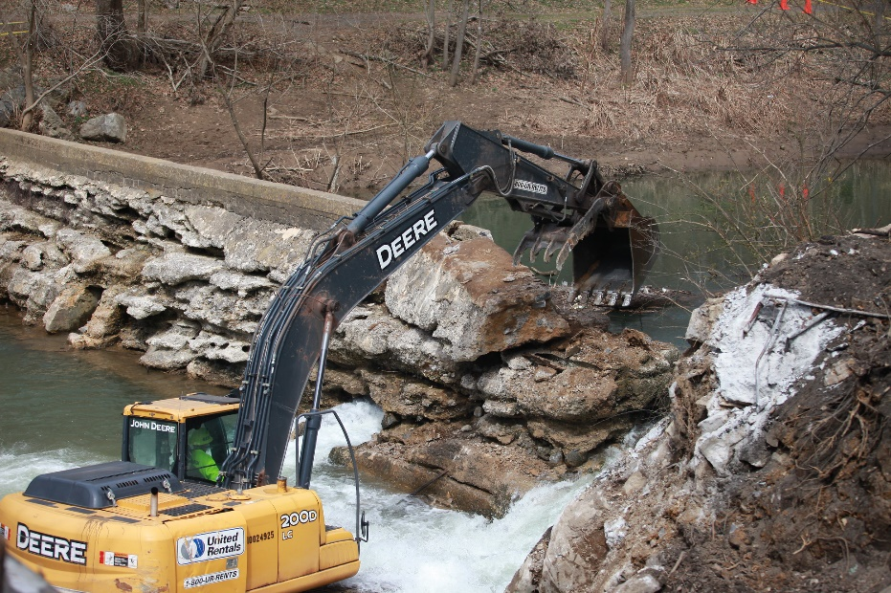
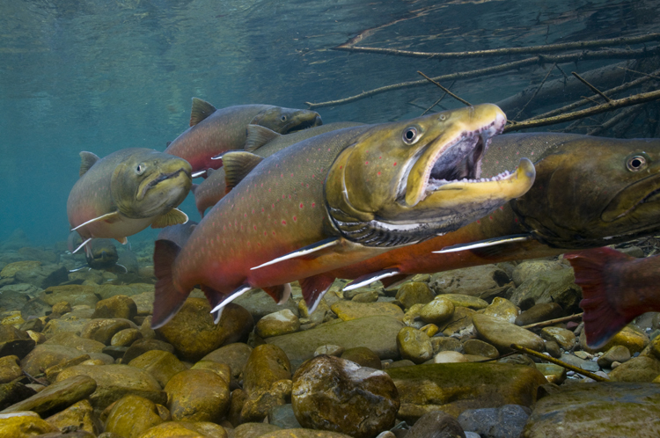
Fish Passage
$200M over five years for aquatic ecosystem restoration through instream barrier removal
Notes:
Fish passage helps provide and restore habitat connectivity, ensuring that fish can be more resilient in the face of climate change. It also helps to restore Tribal treaty rights, boost recreational opportunities, and improve access to subsistence fisheries.
The Law includes $200 million for removing in-stream barriers and technical assistance under the National Fish Passage Program. In 2022 alone, the funding is delivering $38 million to 40 projects in 23 states and Puerto Rico.
Service resilience criteria for making decisions included the ability to recover from or persist through changes due to climate change. The Service is also consulting with NOAA to ensure that actions promote climate resilient fish stocks.

Slide 8
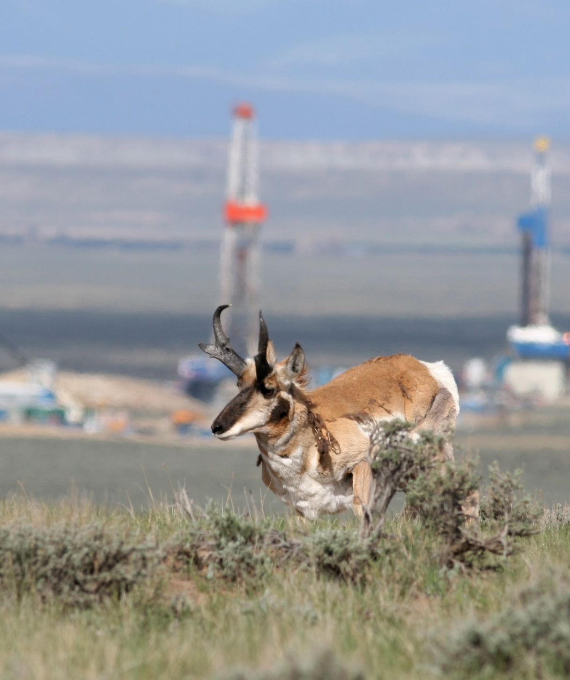
Legacy Pollution
Initial investment of $13.9M to plug 175 orphaned oil and gas wells at 6 Refuges in 2 States
Notes:
The Law provides funding for orphan wells through 2030. Many of the sites are actively leaking hydrocarbons, methane, and contaminated water, and they pose a threat to wildlife, their habitats, and communities.

Slide 9
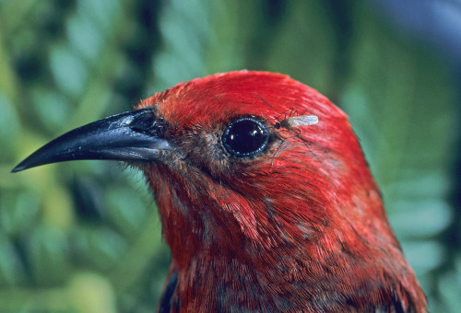
Ecosystem Restoration
$96.6M in Year 1
Healthy forests
Invasives
National Seed Strategy
Hazard mitigation
Photo © Jack Jeffrey Photography
Notes:
$15.3 million was allocated for Ecosystem Restoration activities that will benefit several significant ecosystems and will lead to better outdoor spaces and habitats for people and wildlife for generations to come.
An additional $81.5 million was distributed through a cooperative agreement to the National Fish and Wildlife Foundation for the America the Beautiful Challenge.
A new initiative has been announced recently. Gravel to Gravel will work in Alaska to combine Indigenous Knowledge and western science to inform plans for collective action to support resilient ecosystems and communities in Alaska that depend on salmon.
Projects will advance healthy forests, detect and eradicate invasive species, invest in National Seed Strategy collection and production, restore recreation sites and national parks, and mitigate hazards on mined lands. For example, funding will help address avian malaria spread by invasive mosquitoes in Hawai’i, which causes widespread mortality of endemic honeycreepers and other forest birds.

Slide 10
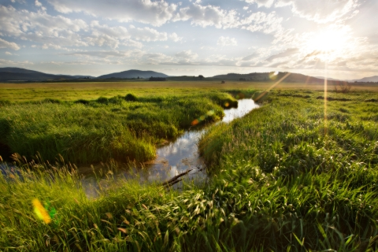
Wildfire Mitigation
$24 million to support voluntary risk reduction on private lands
Notes:
The Department is dedicating $24 million for a pilot program to support risk reduction work on private lands adjacent to federal lands. The work will support 24 fuels reduction projects in 13 states. The projects will also reduce unwanted vegetation along critical energy infrastructure, while supporting fish and wildlife habitat.

Slide 11
Albemarle-Pamlico Sound restoration, North Carolina ($27.25M)
Landscape conservation approach for a climate resilient Northern Forest, Maine, Massachusetts, Michigan, Minnesota, New Hampshire, New Jersey, New York, Pennsylvania, Vermont, Wisconsin ($25M)
Prairie Pothole Region - landscape conservation and restoration, Iowa, Minnesota, Montana, North Dakota, South Dakota ($23M)
Lower Mississippi River Valley nature-based resiliency, Arkansas, Louisiana, Mississippi, Tennessee ($20M)
Upper Mississippi and Illinois River nature-based resiliency and restoration, Illinois, Iowa, Missouri, Minnesota, Wisconsin ($10M)
Bison management and grasslands habitat improvements across several Service refuges ($7.5M)
Nature-based solutions to support the endangered Yaqui fish species on San Bernardino National Wildlife Refuge, Arizona ($7M)
Acquisition of LiDAR Data over National Wildlife Refuge System lands in partnership with the 3D Elevation Program (3DEP), Nationwide ($1M)
Charles M. Russell NWR and UL Bend NWR Grasslands and Nature-based Resiliency, Montana (.5 M)
Inflation Reduction Act
$250M total for significant climate and conservation projects
$125M to restore National Wildlife Refuges and State wildlife management areas
Focus on coastal resilience and climate adaptation via nature based solutions
Notes:
The Service received $250 million in new funding under the Inflation Reduction Act of 2022 for significant climate and conservation projects.
The investment of $120.75M for Refuges and partnering State Wildlife Management Areas will increase the resiliency of habitats and infrastructure to withstand severe weather events. Nature-based solutions are being incorporated as a primary means to achieve climate adaptation and resiliency.
The Service will fund projects for bison management, healthy forests and prairie potholes, Yaqui fish conservation, and conservation efforts in the Mississippi and Illinois Rivers. We want to leverage our funding with you under projects to enhance outcomes beyond our boundaries at the watershed and landscape scale. We welcome opportunities to work with you!
The remaining $125M will support development of recovery plans for threatened and endangered species.

Slide 12
Endangered Species Recovery
Congress provided the Service with $125 million in the Inflation Reduction Act (IRA) for recovery planning and implementation for threatened and endangered species.
- Recovery Planning - $62.5 million
- Recovery Implementation - $62.5 million

Slide 13
Permitting
The Service received $43 million for:
- ESA Section 7 consultation on DOI IRA projects.
- Modernizing and adding significant functional improvements to the FWS IPaC system to allow for expanded consultation streamlining.
- MBTA technical assistance and program development for renewable energy projects (offshore and onshore)

Slide 14
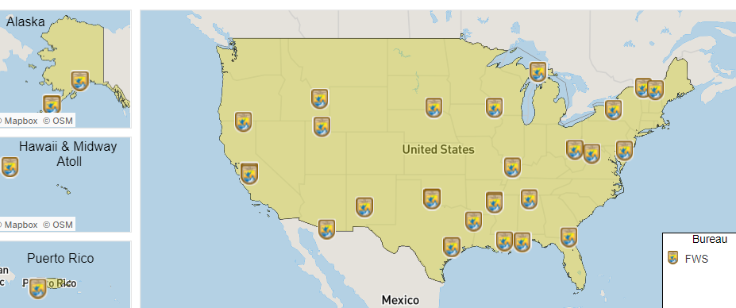
Great American Outdoors Act (GAOA)
FWS Currently Funded GAOA Projects
National Parks and Public Lands Legacy Restoration Act funded five years of projects at $95 million per year - 2021 though 2025
$63.7 million though 2025 to fund Maintenance Action Teams
Notes:
GAOA Funding split into two major areas- Contracted Projects & Maintenance Action Teams (MAT). The contracted projects are traditional contractor sourced while the MAT projects are FWS employee training based.

Slide 15
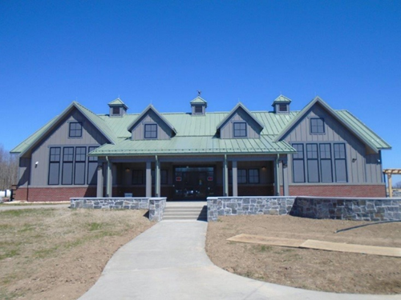
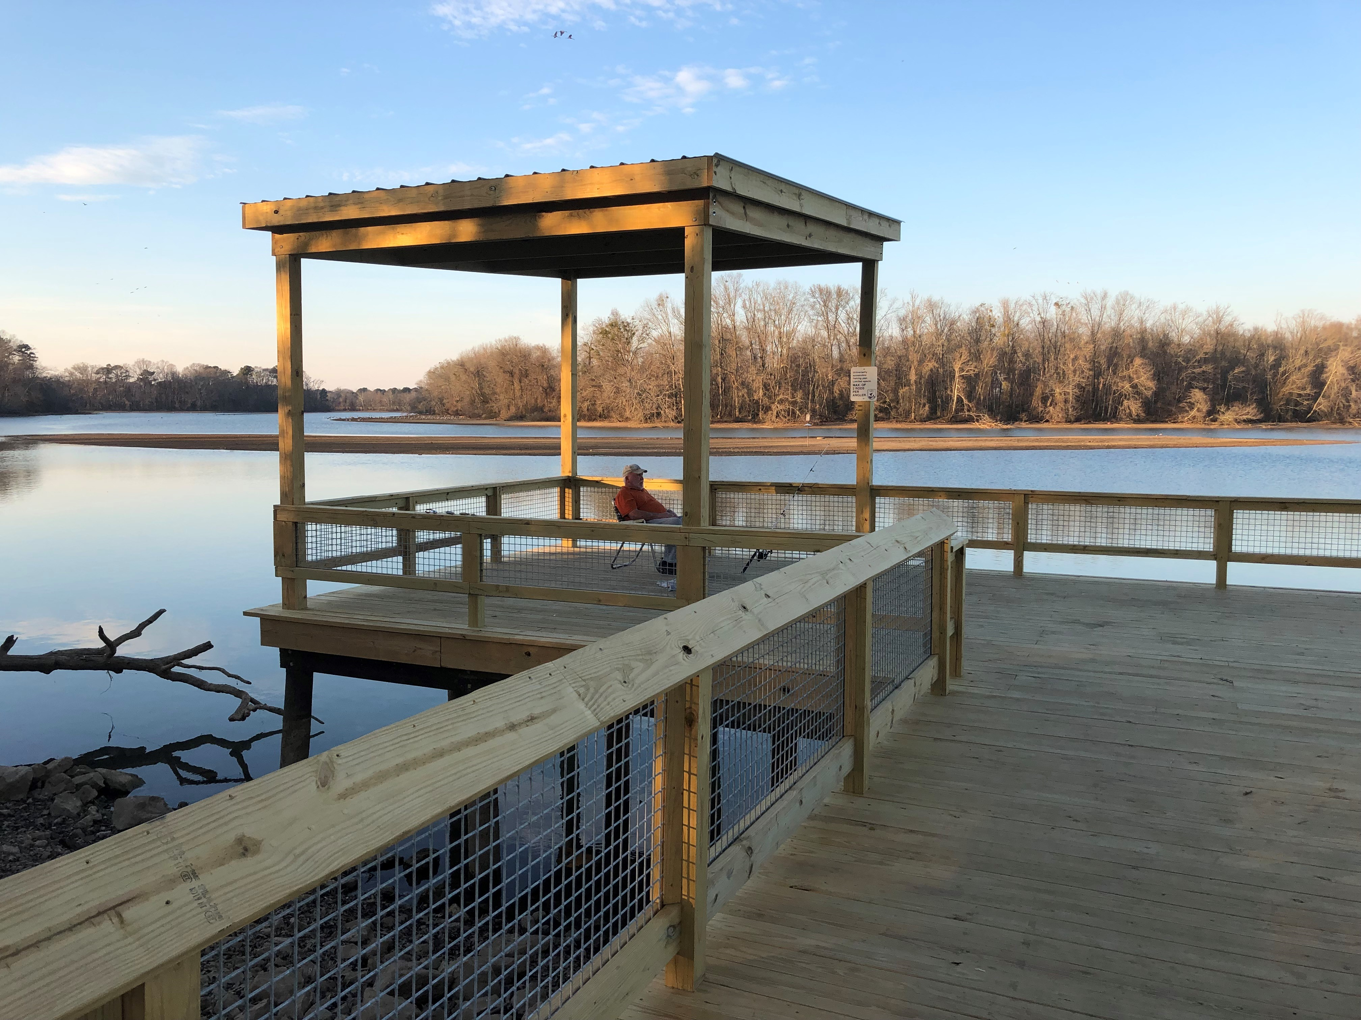
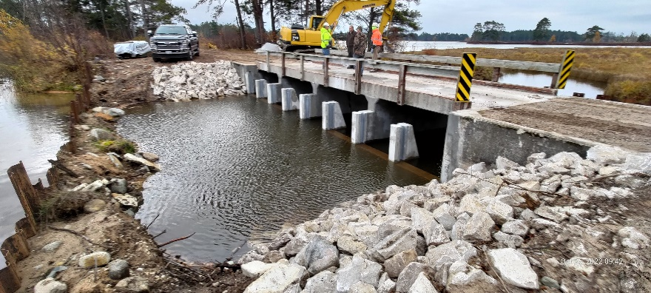
Great American Outdoors Act (GAOA)
GAOA Projects Selection Criteria:
Combination ranking criteria based on:
Highest DM backlog
Highest public visitation
(10) Other criteria specific to the mission of the NWRS
Consistent with NWRS Strategic Investment Strategy
Consistent with Legislative Intent
Replacing Key Aged Facilities
Rehabilitating Deteriorated
Public Use Assets
Addressing Critical Water Management Needs
Notes:
The contracted projects are traditional contractor sourced while the MAT projects are FWS employee training based.

Slide 16
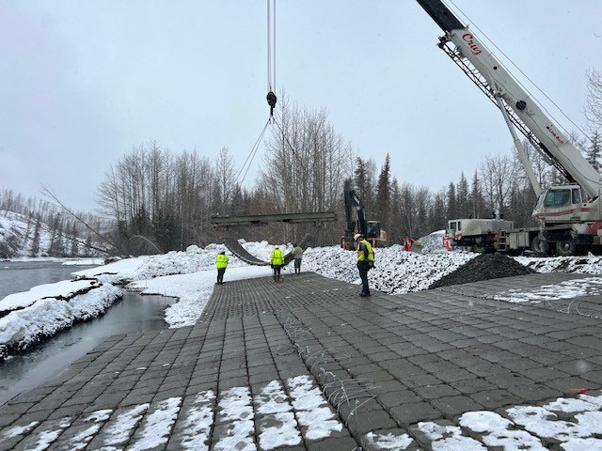
GAOA Projects
Emphasis: Infrastructure - focused projects to reduce our deferred maintenance backlog
Contractors lower concrete blocks on Jim’s Landing Boat Launch at Kenai NWR, AK. Opened to the public on April 8, 2023.
Notes:
GAOA Funding split into two major areas- Contracted Projects & Maintenance Action Teams (MAT). The contracted projects are traditional contractor sourced while the MAT projects are FWS employee training based.

Slide 17
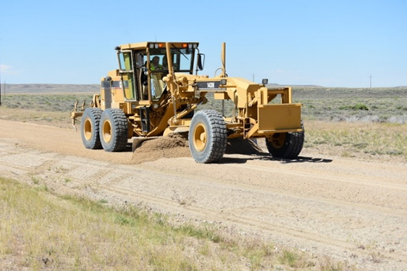
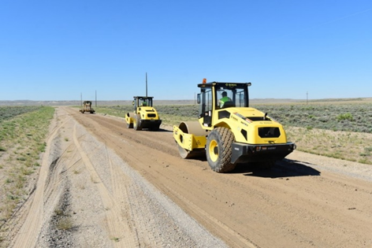
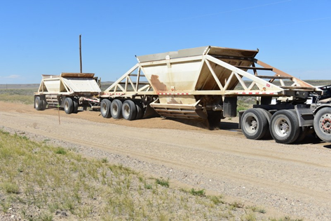
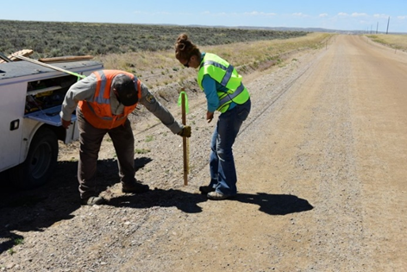
GAOA MAT
Maintenance Action Teams (MAT)
Provides essential skilled trades training
Completes deferred maintenance projects at a substantial cost savings to maximize return on investment
Significant Focus on public access, outdoor recreational access and habitat management infrastructure.
MAT team working on the road rehabilitation project at Seedskadee NWR, WY.
Notes:
FWS has hired over 80 maintenance professionals around the country with this funding.
These workforce supplements our maintenance professional workforce and allows us to provide essential skills training throughout the Service.

Slide 18
Questions?
Notes:
Thank you again for the opportunity to speak with you today.

